Slide 1
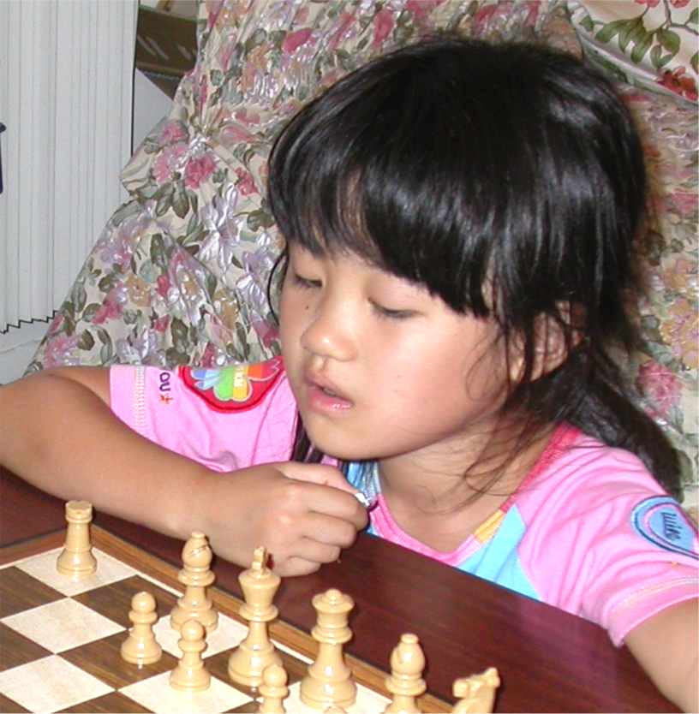
Scaffolding for Executive Control
Skilled teacher
Executive Control
Training on reasoning skills
Scaffolding for Acquisition
Metacognition
Situated Cognition
Acquisition
Scaffolding for Retrieval
Perception
Memory
Problem Solving
Retrieval
Apprenticeship
Hinting
Individual difference
Giftedness
Qualitative Analysis
Probability
Misconception
Transfer
Activation
Restructuring
Organization
Documentation
Indexing
Simple recall
Less coherent text
Inference generation
Intuitive Knowledge
Plasticity
Consolidation
Prior Knowledge
Reification
Feeling-of-Knowing
Priming
Skill Learning
Categorization
Anchored Instruction
Generalization
Proceduralization
Situated Learning
Forgetting
Collaborative Learning
Scaffolding for Organization
Feedback
Self-explanation
Inquiry for text read

