Slide 1
Decision Theoretic Instructional Planner for Intelligent Tutoring Systems
Noboru Matsuda & Kurt VanLehn
University of Pittsburgh
Learning Research and Development Center
Supported by NFS grant to CIRCLE:
Center for Interdisciplinary Research on Constructive Learning Environment

Slide 2
Instructional Planning
Determine a sequence of tutoring actions that maximize student learning.
Difficulties:
  Inaccuracy of the student model
    Due to a narrow bandwidth of communication, ITS has limited accuracy of student models.
  Failure in instructions
    Student might misunderstand or not understand what the tutor said at all.
  Unexpected responses
    Students might show unexpected behaviors such as asking a question.

Slide 3
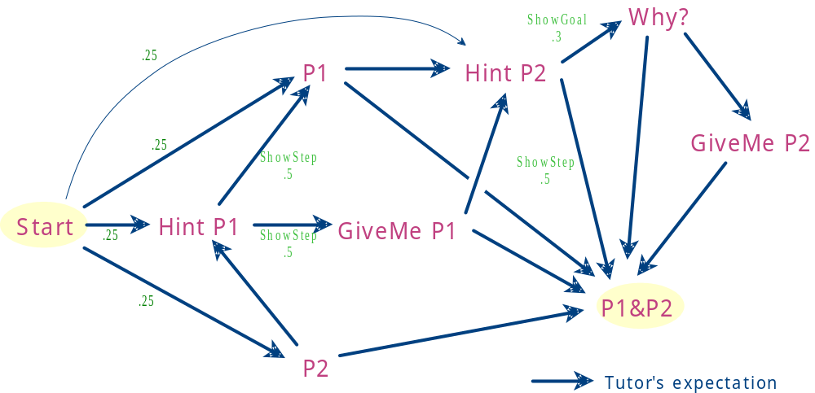
Tutoring as State Transition
Student’s response
Student’s unexpected response

Slide 4
A Closer Look
Finite states
  Tutoring session proceeds along with the states.
Effect of instruction and the student’s response
  Probability distribution over the states.
Instructions associated with the state
  Need to determine which instruction is the best to take.
Markov Decision Process

Slide 5
Mapping btw ITS and MDP
State
  Tutor’s belief about a tutoring situation; SM, expected answer, expected reaction…
Action
  An instructional interaction provided by the tutor; the effect can be represented as a probability distribution. Transition Matrix
Observation
  Tutor’s perception of the student’s response.
Value function
  Tutor’s assessment of the tutoring; Reward function
Optimality criterion
  Tutor’s criterion for evaluating success of instruction; Expected utility

Slide 6
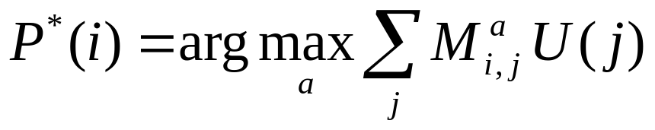
DMP planner might help
Given the transition matrix M and the utilities U, optimal action at state i, P*(i):
Sensory weakness
  An inaccuracy in student model
Uncertain outcome
  A failure of instruction
Exogenous event
  An unexpected response

Slide 7


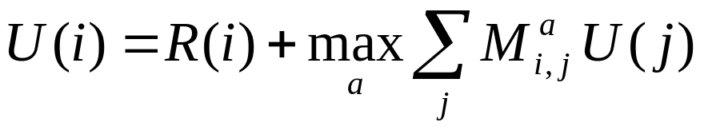
What we need?
Description of all the possible states
Transition Matrices
Reward function
Expected utilities
  Derived from the first three components.
compile
coded as tutoring rules
coded as a separate rule

Slide 8
Tutoring rules
If conditions are held in state Si
Then taking action
Results in states {S1,…,Sn}
With probabilities {P1,…, Pn}
(:TEACH-P-LINKs
(:STATE :sm <sm> :response :HINT)
(:WHEN (= <sm> #b00111111))
(:ACTION "Make all positive links")
(:EFFECT ((single-state :sm #b01111111 :response :NIL) .5)
((single-state :sm <sm> :response :DONE) .3)
((single-state :sm <sm> :response :HINT) .2) ) )

Slide 9
Reward Function
Numerical function representing a preference to reach a state.
  An instructional step: -0.1
  Student learning a concept: 0.125
  Student responding correct justification: 2.0
  Student responding incorrect justification: -1.0
  Reaching a final state: 20
  Student requesting for a hint: -1
Tutor’s individual preference.
  Note: the tutoring rule is domain dependent.

Slide 10
The Domain:
Argumentation
Domain skills:
  Proposing hypotheses
  Searching for evidence
  Evaluating the reliability and significance of the evidence

Slide 11

The Problem:
Is Santa Real?
Ho ho ho,
He sure is!
Hypothesis
Evidence
Santa signed the tags on my presents
Santa is Real
I sent my Christmas list to Santa’s address
Santa can’t deliver presents to all the children all over the world in one night
Santa is Not Real
Santa is too fat to fit in the chimney
Reindeer can’t fly

Slide 12
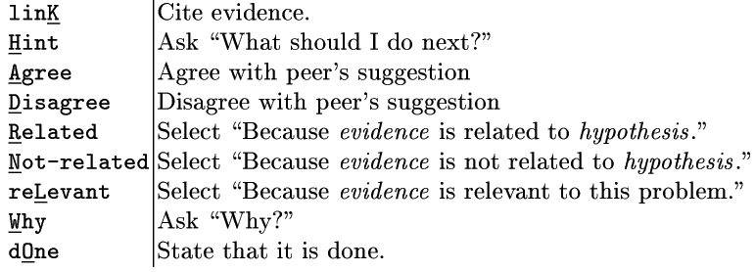
User Interface
Fully TUI (textual user interface)
Student’s response

Slide 13
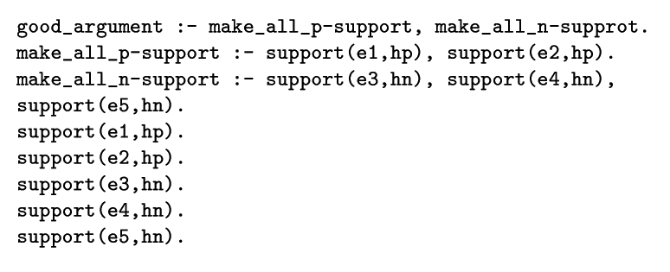
Student Model
Student knows he has to make both positive and negative links.
Student knows how to make positive (negative) support.
Student knows which evidence supports which hypothesis.

Slide 14
Example dialogue
Now, what do you think?
[linK Agree Disagree Related Not-related reLevant Hint Why dOne]
Your choice? [K,A,D,R,N,L,H,W,O] > k
Evidence? [(E1 E2 E3 E4 E5)] > e1
Correct. Tell me why you think so?
[linK Agree Disagree Related Not-related reLevant Hint Why dOne]
Your choice? [K,A,D,R,N,L,H,W,O] > k
Evidence? [(E2 E3 E4 E5)] > e2
Good, that's right. Why do you think so?
Unexpected event (reason)

Slide 15
Example dialogue (cont)
Good, that's right. Why do you think so?
[linK Agree Disagree Related Not-related reLevant Hint Why dOne]
Your choice? [K,A,D,R,N,L,H,W,O] > o
I do not think so.
[linK Agree Disagree Related Not-related reLevant Hint Why dOne]
Your choice? [K,A,D,R,N,L,H,W,O] > h
Consider the link [e5-hn]
[linK Agree Disagree Related Not-related reLevant Hint Why dOne]
Your choice? [K,A,D,R,N,L,H,W,O] > w
Unexpected event (reason)
Unexpected event (reason)

Slide 16
Example dialogue (cont)
Because you do not make all n-links
[linK Agree Disagree Related Not-related reLevant Hint Why dOne]
Your choice? [K,A,D,R,N,L,H,W,O] > k
Evidence? [(E3 E4)] > e4
Good, that's right. Why do you think so?
[linK Agree Disagree Related Not-related reLevant Hint Why dOne]
Your choice? [K,A,D,R,N,L,H,W,O] > k
Evidence? [(E3)] > e3
Why do you think so?
Optimal response: no feedback on correctness
All the links are made already.
To reach the final state quickly is preferred.

Slide 17
Lessons Learned
If you enumerate all the state, then …
  it is easy to maintain the tutoring rules,
  separation of domain pedagogy (tutoring rules) and tutor’s preference (reward) works fine.
The number of states might blow up.
It is difficult to predict actual behavior of the tutor.

Slide 18
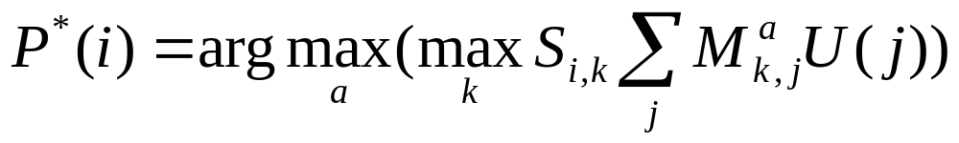
Future Work
Probability over the accuracy of student model
  Si,k : a probability that the student’s actual knowledge state is at k, given the student model indicates that it is i
  An optimal policy at state i:

Slide 19
MDP
The uncertainties can be represented as probabilities distributed over the states.
Each action (either student’s and teacher’s) can be associated with a numerical value representing cost of taking it.
Each state can be associated with a numerical value to represent pedagogical desirability of being in such situation.

Slide 20
What the tutoring rule represents
Probability distribution of state transition for taking an action in a state.
Student’s response is implicitly represented in a state.
It also represents a probabilities of expected events.

Slide 21
Difficulties in Instructional Planning
Inaccuracy of the student model
  Due to a narrow bandwidth of communication, ITS has limited accuracy of student models.
Failure in instructions
  Student might misunderstand or not understand what the tutor said at all.
Unexpected responses
  Students might show unexpected behaviors such as asking a question.

