Slide 1

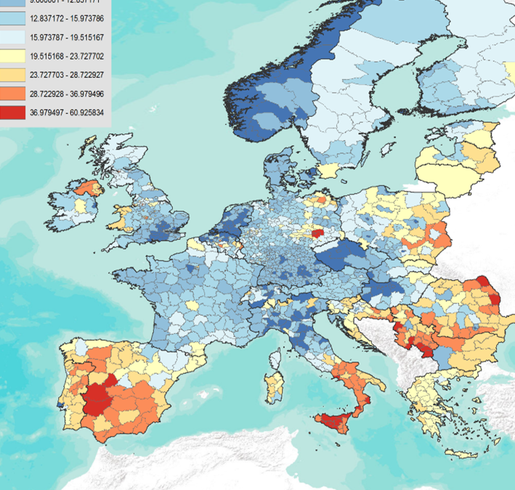



EU SAE WIZARD & DASHBOARD · 2026
A Practical Guide
to EU_SAE_application_package
Small Area Estimation of poverty and welfare indicators - from setup to outputs.
Use the 5.2.0-rc.6 clean package
Open Start_Here to choose a launcher
Set up Claude & ChatGPT
Prepared by Nobuo Yoshida · World Bank Group

Slide 2



OVERVIEW
What you'll learn
Three parts, a clear path from zero to running analyses.
01
02
03
Download and set up
Use the wizard or the dashboard
Add an AI Assistant (optional)
Install R and obtain the history-free 5.2.0-rc.6 clean archive from the authorized release manager. One-time work.
Load data, map variables, benchmark if needed, and run the UFH / MFH / Comparison pipeline.
Use an approved provider or gateway only after acknowledging the external transfer; then enter a key.
EU SAE Wizard & Dashboard · User Guide
2 / 37

Slide 3



OVERVIEW
What is the EU SAE application?
Two interfaces over one analysis engine, both guiding you through Small Area Estimation of poverty rates.
Two entry points
Data readiness
Readiness diagnostics
You will load survey, auxiliary, and geometry data, fit Fay–Herriot models (UFH and MFH), compare results side-by-side with maps and tables, and optionally generate AI-assisted interpretation.
Step 1 — UFH
Univariate Fay–Herriot
Step 2 — MFH
Multivariate Fay–Herriot
Step 3 — Compare
Windows launchers: open Start_Here
UFH vs MFH diagnostics
EU SAE Wizard & Dashboard · User Guide
3 / 37

Slide 4
OVERVIEW
What you can estimate
Three indicator families, all from the same survey-plus-auxiliary inputs.
INDICATOR 1
INDICATOR 2
INDICATOR 3
Poverty rate
Gap & severity
Mean welfare
FGT(0) · headcount
FGT(1) and FGT(2)
Income or consumption
Share of the population below the poverty line — the standard poverty rate.
Depth of poverty (average shortfall) and severity (more weight on the poorest).
Population-weighted mean welfare, with an optional log scale and bias-corrected back-transform.
EU SAE Wizard & Dashboard · User Guide
4 / 37

Slide 5
OVERVIEW
The three-step pipeline
Select which steps to run - wizard Step 4 (Models), or the dashboard sidebar.
STEP 1
STEP 2
STEP 3
UFH
MFH
Compare
Univariate Fay–Herriot
Multivariate Fay–Herriot
UFH vs MFH
Fits one model per year, independently. A solid baseline.
Jointly models years, borrowing strength across time.
Maps, scatter plots, and precision metrics to pick a model.
EU SAE Wizard & Dashboard · User Guide
5 / 37

Slide 6
FAST PATH2
Three datasets to prepare
Use Browse to select the three input files from any folder on your computer.
DATASET 1
DATASET 2
DATASET 3
Survey
Auxiliary
Shapefile
Household microdata
Subnational aggregates
Geographic boundaries
Household microdata with year, domain, PSU, weight, household size, welfare, poverty line, and optional strata or benchmark-level columns. Accepted formats: RDS/RData, CSV/TSV/TXT/DAT, Stata, SPSS, SAS, Parquet/Feather, and Excel.
Domain-level covariates for the same areas and years used in the analysis. Accepted formats: RDS/RData, CSV/TSV/TXT/DAT, Stata, SPSS, SAS, Parquet/Feather, and Excel.
Polygon boundaries for the target domains. Use ESRI .zip with valid .shp/.shx/.dbf, .rds, .gpkg, or GeoJSON. Domain IDs must match the survey and auxiliary files.
EU SAE Wizard & Dashboard · User Guide
6 / 37

Slide 7
DATA INPUTS
Data formats are very flexible
Each input accepts many common formats — the app reads them automatically.
SURVEY
AUXILIARY
GEOMETRY
Household data
Area covariates
Boundaries
Any table format
Any table format
Any GIS format
RDS/RData, CSV, TSV, TXT, DAT, Stata, SPSS, SAS, Parquet, Feather, and Excel — person or household microdata in whichever you already have.
The same table formats as the survey: RDS/RData, CSV/TSV/TXT/DAT, Stata, SPSS, SAS, Parquet/Feather, and Excel.
ESRI shapefile .zip (with valid .shp/.shx/.dbf), RDS/RData, GeoPackage (.gpkg), GeoJSON/JSON, KML, and GML.
EU SAE Wizard & Dashboard · User Guide
7 / 37

Slide 8

FAST PATH1
The shortcut
Set the essentials - the defaults handle the rest.
SET UP · ONE TIME
IN THE APP · EVERY RUN
Obtain the 5.2.0-rc.6 clean package and prepare approved local survey, auxiliary, and geometry files.
Choose the required settings; revisit advanced options only when diagnostics suggest it.
5
Pick analysis years and optional run label
1
Browse data files from any folder
e.g., 2012, 2013
→
6
Choose survey, auxiliary, and geometry files
survey + auxiliary + geometry
2
Obtain the history-free 5.2.0-rc.6 clean archive
7
Map key variables
year, domain, weight, hhsize, welfare
8
Confirm PSU consistency
3
select whether PSUs are consistent across years
Open Start_Here to choose a launcher
9
AI Assistant (optional)
paste a Claude or ChatGPT key for diagnostics
10
Click Check Data Readiness
readiness diagnostics only - wizard Step 6, or the dashboard sidebar
11
Click Run Analysis
UFH + MFH + Comparison run; outputs are archived by run label
That's it. Current outputs go to outputs/. A saved copy is archived under app_runs/<timestamp>_<run_label>/outputs.
EU SAE Wizard & Dashboard · User Guide
8 / 37

Slide 9
PART 01
Setting up
your computer
Install R and download the EU SAE Dashboard.
9 / 37

Slide 10



SETUP
Prerequisites at a glance
R 4.2+, one Pandoc provider, and the app; AI is optional.
R
EU SAE Dashboard
R 4.2+ - approved versions work
The app itself - from the authorized release manager
cran.r-project.org
Authorized release manager
AI keys
Report generation
Optional · Claude or ChatGPT
One of: RStudio, Quarto, or Pandoc
see Part 3 of this guide
one free option is enough
EU SAE Wizard & Dashboard · User Guide
10 / 37
Notes:
[Sources] - https://cran.r-project.org/ - https://posit.co/download/rstudio-desktop/ - https://quarto.org/docs/get-started/ - https://pandoc.org/installing.html [/Sources]

Slide 11

SETUP · STEP 1 OF 4
Install R
The statistical engine that powers everything else.
1
Go to cran.r-project.org
2
Click Download R for Windows, Mac, or Linux
Why R first?
3
Install R 4.2+ using your approved version
R 4.2+ powers the dashboard. Use the newest version your organization approves; the absolute latest R release is not required.
4
The absolute latest R release is not required
EU SAE Wizard & Dashboard · User Guide
11 / 37
Notes:
[Sources] - https://cran.r-project.org/ [/Sources]

Slide 12
SETUP · STEP 2 OF 4
Download the dashboard
Obtain the history-free 5.2.0-rc.6 clean archive.
1
Get the archive from the authorized release manager. Do not use an automatic GitHub source archive.
EU_SAE_wizard_5.2.0-rc.6-wizard.4-crossplatform/
├── app.R + Start_Here/
├── R/ + scripts/ + tests/
├── outputs/ (empty)
├── docs/ + Data/
├── LICENSE + NOTICE
└── release_manifest.csv
2
Windows: right-click the ZIP → Properties → check Unblock → OK, then Extract All.
3
Choose a convenient location. The extracted folder name may include the release tag.
4
Open EU_SAE_wizard_5.2.0-rc.6-wizard.4-crossplatform. Windows launchers are in Start_Here. The package includes apps, scripts, tests and docs. Examples: Data/simulated/ and Data/Spain/.
EU SAE Wizard & Dashboard · User Guide
12 / 37

Slide 13
SETUP · STEP 3 OF 4
Automatic package installation
On first launch, either launcher automatically installs all required packages.
Runs automatically on first launch
The script checks what is already installed and only downloads what is missing.
Shiny UI
SAE models
Data wrangling
shiny
emdi, sae, msae, survey
dplyr, tidyr, data.table, readxl, haven
Visualization
Documents
AI (optional)
ggplot2, sf, viridis, patchwork
rmarkdown, knitr, gt, xml2, zip
httr, jsonlite, base64enc
EU SAE Wizard & Dashboard · User Guide
13 / 37

Slide 14


SETUP · STEP 4 OF 4
Launch the wizard or dashboard
Windows: double-click a .bat launcher. macOS: double-click a .command launcher; if blocked on first launch, Control-click it and choose Open. Linux: run it with bash. Ports: 7788 wizard, 7777 dashboard.
Windows: *.bat · macOS: *.command · Linux: bash *.command (in Start_Here)
The app opens
Click Get Started
Resources
A browser window shows the cover page.
You land on the main workspace.
Use the DOCX guideline note, this slide deck, sidebar Resources, and tooltips.
EU SAE Wizard & Dashboard · User Guide
14 / 37
Notes:
[Sources] - Start_Here/README.md [/Sources]

Slide 15
PART 02
The wizard,
step by step
Six steps from data to run. The classic dashboard offers the same controls in one sidebar.
15 / 37

Slide 16

DASHBOARD
Start here — the cover page
The first screen in both interfaces. Click Get Started to reveal the workspace.
localhost:####
What you'll find
EU SAE Package
Wizard: six steps on a clickable breadcrumb · Dashboard: one sidebar
Small Area Estimation of poverty rates
Check Data Readiness, then Run Analysis
Preflight - input validation (wizard: inside Step 6)
Get Started →
Data Readiness - diagnostic checks (wizard: inside Step 6)
Click to reveal the main workspace.
Status - progress, run folder and output locations
EU SAE Wizard & Dashboard · User Guide
16 / 37

Slide 17
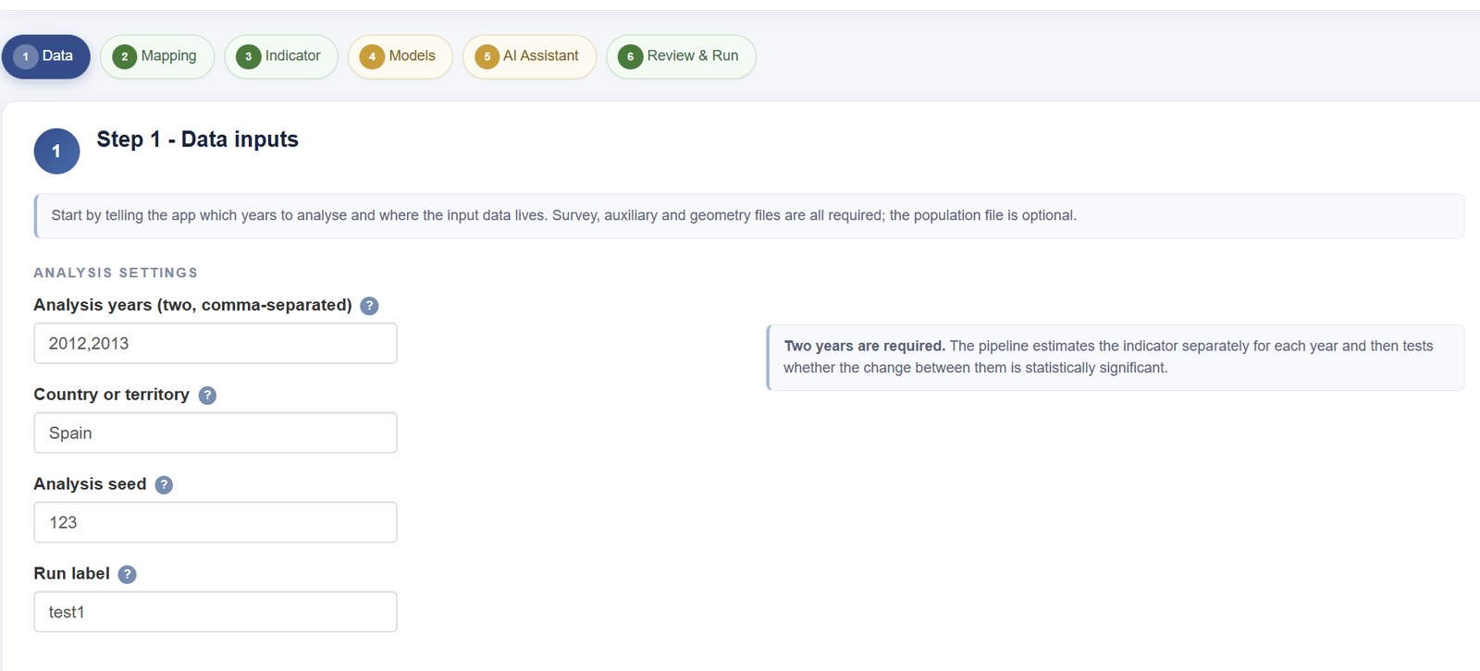
WIZARD
The wizard at a glance
Every one of the six steps shares this layout. Step 1 shown.
Breadcrumb
where you are, and what is still outstanding
Guidance banner
what this step is for, in one line
Form column
the inputs; help panels sit to the right
Back / Next
move freely - nothing is locked
EU SAE Wizard & Dashboard · User Guide
17 / 37

Slide 18
WIZARD
Three things to watch
The parts of the screen that tell you whether the run will work.
Breadcrumb - green is complete, amber has an outstanding item, blue is the current step. Clickable.
Validation - green confirms the step is satisfied; red lists what to check. Both can appear together.
Navigation - Next stays available on an incomplete step. Only the run control in Step 6 is gated.
EU SAE Wizard & Dashboard · User Guide
18 / 37

Slide 19
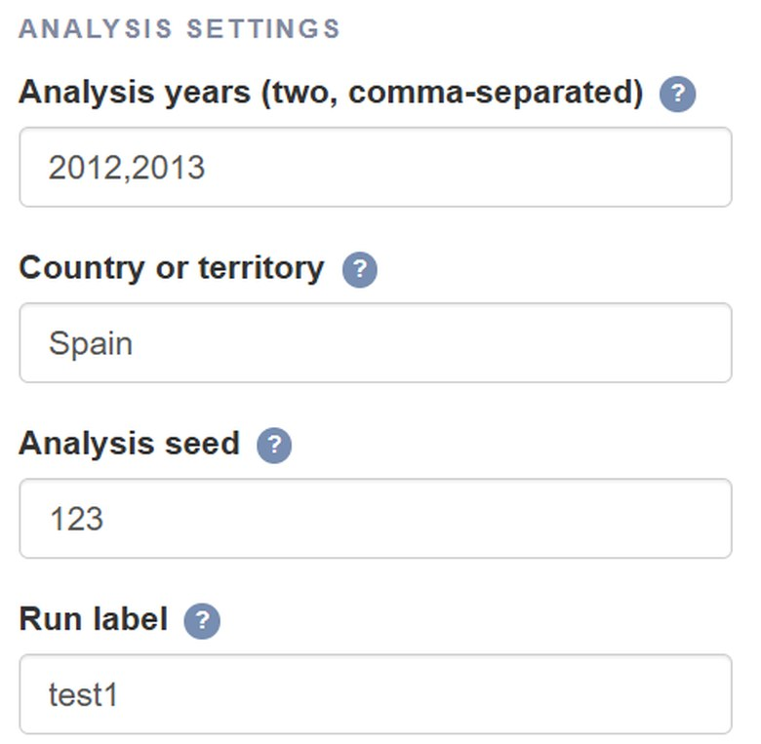
WIZARD · STEP 1 — DATA
Step 1 — Data
Analysis settings first, then the input files.
Analysis years
two, comma-separated — each year is estimated, then the change is tested
Country or territory
appears in the report and analysis-brief headers
Seed and run label
seed 123 reproduces the run; the label names the archive folder under app_runs/
Below the settings
Browse to the survey, auxiliary and geometry files; a population file is optional
EU SAE Wizard & Dashboard · User Guide
19 / 37

Slide 20
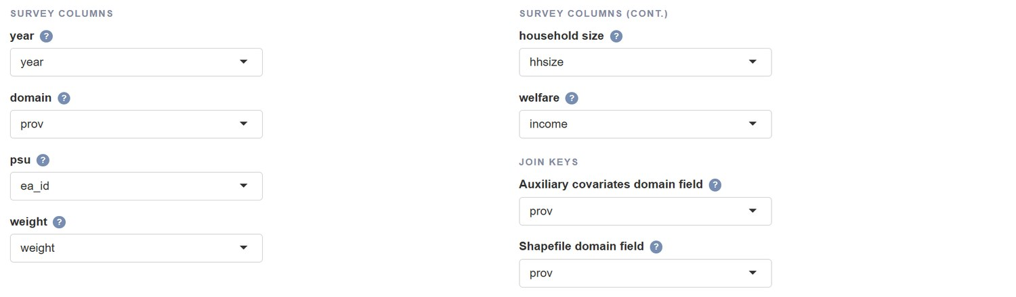
WIZARD · STEP 2 — MAPPING
Step 2 — Variable mapping
Tell the app which column holds which variable.
Left: survey columns. Right: the join keys — the auxiliary and shapefile domain fields must hold the same domain IDs as the survey. A red field means the typed name is not in the selected dataset.
EU SAE Wizard & Dashboard · User Guide
20 / 37

Slide 21
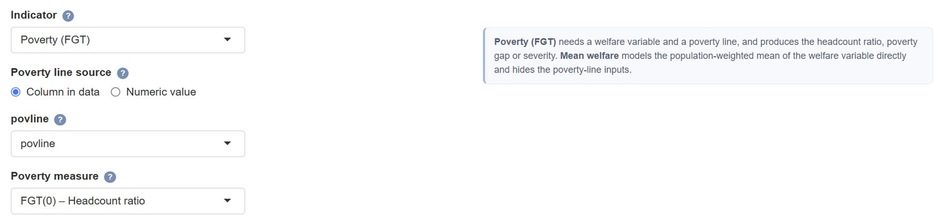
WIZARD · STEP 3 — INDICATOR
Step 3 — Indicator definition
Choose what is being modelled; the help panel updates with each choice.
Poverty (FGT) needs a welfare variable and a poverty line — a column in the data or a numeric value — and produces FGT(0) headcount, FGT(1) gap or FGT(2) severity. Mean welfare models the weighted mean directly and hides the poverty-line inputs.
EU SAE Wizard & Dashboard · User Guide
21 / 37

Slide 22
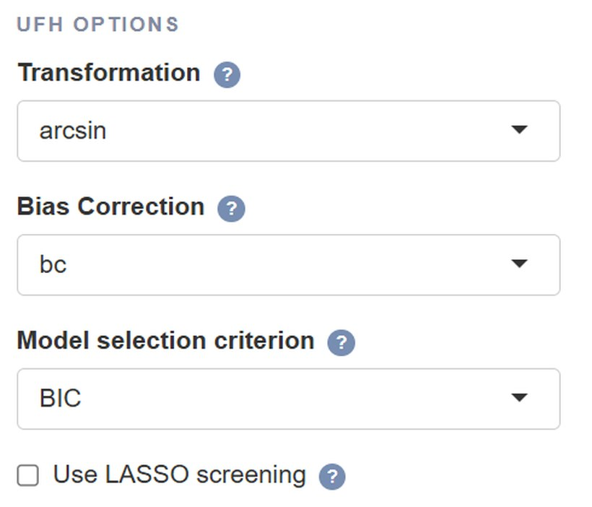
WIZARD · STEP 4 — MODELS
UFH options
UFH: with LASSO on, year-specific lists are candidate pools; with LASSO off, they are fixed specifications.
Option | Values | What it does
Transformation | arcsin (default) / no | Keeps estimates between 0 and 1; stabilizes variance.
Bias correction | bc (default) / none | Adjusts for non-linearity of the arcsin transform.
Model selection | BIC (default) / AIC | Criterion for stepwise covariate selection.
Variance option | sm_out / sm_all / direct | sm_out replaces missing/non-finite or < 0.001 values.
LASSO screening | off (default) / on | Optional screen before AIC/BIC stepwise selection.
Wizard Step 4 - Models
Rule of thumb Keep LASSO off for replication; turn it on only to screen large candidate sets.
EU SAE Wizard & Dashboard · User Guide
22 / 37

Slide 23
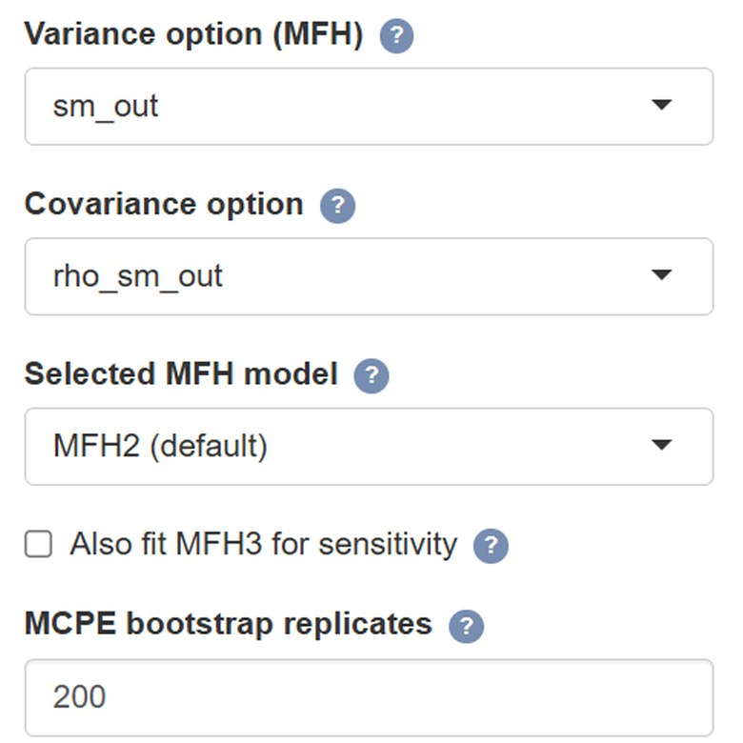

WIZARD · STEP 4 — MODELS
MFH options
MFH: with LASSO on, year-specific lists are candidate pools; with LASSO off, they are fixed specifications.
Option | Values | What it does
Model selection | AIC (default) / BIC | Criterion for covariate selection.
Variance option | sm_out / sm_all / direct | sm_out replaces missing/non-finite or < 0.001 values.
Covariance option | auto-matched to variance | How cross-year covariance is set.
Selected MFH model | MFH2 / MFH1 / MFH3 | Which MFH model is exported and reported.
Try MFH3 | checkbox | Heteroskedastic AR(1); slower but more flexible.
LASSO screening | off (default) / on | Optional screen before AIC/BIC stepwise selection.
Wizard Step 4 - Models (MFH-specific controls)
MFH2 is the default. MFH3 falls back to MFH2 on error or non-convergence, and is kept only if its variance test supports it. MFH1 is a manual sensitivity option.
EU SAE Wizard & Dashboard · User Guide
23 / 37

Slide 24
WIZARD · STEP 4 — MODELS
Benchmarking option
If a boundary fit cannot be benchmarked, the report states why and continues with unbenchmarked estimates.
OPTION 1
OPTION 2
OPTION 3
Apply benchmarking
Benchmark Target Database
Benchmark level
Check Apply benchmarking. The Benchmarking level control and optional target database then appear.
Optional targets by year and group. If selected by mistake, click Clear selected file. If omitted, targets come from survey direct estimates.
Choose National to match the population-weighted domain estimates to the direct national target. Choose Grouped, then map region, NUTS2, or another higher-level survey variable.
EU SAE Wizard & Dashboard · User Guide
24 / 37

Slide 25
WIZARD · STEP 5 — AI ASSISTANT
Step 5 — AI Assistant (optional)
Off by default. Nothing is sent anywhere unless you opt in here.
Two controls before any key
enable the assistant AND acknowledge the external transfer; only then paste an approved provider or gateway key
Language
AI text comes back in the language you pick — 25 options
Where it lands
labelled blocks in both HTML and Word reports; status is saved in outputs/data/ai_interpretations.rds
Keys and providers
see Part 03 of this guide; keys are never stored on disk
EU SAE Wizard & Dashboard · User Guide
25 / 37

Slide 26


WIZARD · STEP 6 — REVIEW & RUN
Two-stage launch — check, then run
Review your data before the pipeline starts. Catch typos, missing years, and mapping issues early.
Wizard Step 6 · Dashboard sidebar
1. Check Data Readiness
1. Check Data Readiness
Loads inputs, validates variables, checks requested years and mappings, and populates the Preflight and Data Readiness tabs - no modelling yet.
2. Run Analysis
→
Stage 1 — review
2. Run Analysis
Stage 2 — run the pipeline
Unlocks only after step 1. Runs the selected steps, writes current files to outputs/, and saves an archived copy in app_runs/<timestamp>_<run_label>/outputs.
Click 1, review, then click 2.
Why two stages? You see what the app sees before committing to a long run - catch typos, missing domains, missing household size, or unexpected years early.
EU SAE Wizard & Dashboard · User Guide
26 / 37

Slide 27


WIZARD · STEP 6 — REVIEW & RUN
Preflight tab — inputs at a glance
Shown after Check Data Readiness. Confirms the app understood your inputs.
Analysis years parsed
2012, 2013
What to look for
Variable mapping complete
Green parsed correctly
year, domain, psu, weight, hhsize, welfare
Amber a fallback is being used
Poverty line set
type = relative, value = 0.60
Red blocking error — fix and re-run
Survey file loaded
selected survey file (RDS/CSV/DAT/Stata/SPSS/SAS/Parquet/Excel)
Preflight is cheap — re-running it is a safe way to iterate on variable mappings.
Geometry file missing
choose ESRI .zip (valid .shp/.shx/.dbf), .rds, .gpkg, or GeoJSON
EU SAE Wizard & Dashboard · User Guide
27 / 37

Slide 28
WIZARD · STEP 6 — REVIEW & RUN
Data Readiness - diagnostics
Populated when you click Check Data Readiness. Review warnings and errors before Run Analysis.
01
02
03
Year variable present
Requested years available
Covariate summary
Both datasets include a year column.
Survey and auxiliary data include the two requested years.
Means, SEs, correlation for selected years.
04
05
06
Domain/key alignment
Missing poverty rates
National headcount
Checks domain/year keys and geometry domains across all files.
Flags empty domain-year cells.
Population-weighted national poverty for selected years.
EU SAE Wizard & Dashboard · User Guide
28 / 37

Slide 29

OUTPUTS
Where results live
Current outputs are in outputs/. Each run also has an archived copy under app_runs/.
outputs/final_report.html + .docx
outputs/figures/
Same results in both formats. Word text/tables are editable; figures are images. AI blocks retain review labels.
Maps and diagnostics, plus signed-change and CI-width comparison plots (.png).
outputs/data/pov_comparison_detailed.xlsx
outputs/data/
Detailed Direct, FH, and MFH estimates with domain names, population, poverty line, MSE, RMSE, CV, and benchmark columns when enabled.
Workbooks include EU_SAE_results.xlsx and change_estimate_comparison.xlsx; models and AI metadata are retained.
outputs/tables/
app_runs/<timestamp>_<run_label>/app_config.yml
CSV summaries - readiness checks, LASSO/stepwise diagnostics, model-fit statistics, Shapiro tests, and significance results.
Saved run configuration - years, mappings, benchmarking settings, and output archive location.
Note Save a separate Word copy before editing. Keep outputs/data/ for Excel links; later runs replace current outputs.
EU SAE Wizard & Dashboard · User Guide
29 / 37

Slide 30
PART 03 · OPTIONAL
AI Assistant —
Claude & ChatGPT
Acknowledge the external transfer first; use only an approved provider or gateway, then enter a key.
30 / 37

Slide 31


AI ASSISTANT
What the AI Assistant does
Plain-language interpretation in both HTML and Word reports, in your language.
Interpret diagnostics
Evaluate normality
Generate a brief
Summarizes convergence, normality, and precision.
Reads Shapiro–Wilk results; can view Q–Q plots.
A structured markdown analysis report.
Privacy No microdata is sent. Prompts carry aggregate estimates, uncertainty, diagnostics and counts; geographic identifiers are removed from the ranked and extreme-change tables. Every AI block requires documented human review.
EU SAE Wizard & Dashboard · User Guide
31 / 37

Slide 32
API KEY · ANTHROPIC CLAUDE
Get a Claude API key
Anthropic's API platform — keys start with sk-ant-
1
Open console.anthropic.com — sign up or log in.
2
Settings → API Keys — or go to console.anthropic.com/settings/keys directly.
3
Create a new key — give it a name and copy it.
Claude
4
Add credit in Billing — pay-as-you-go, no subscription.
Anthropic
5
After consent, enter an approved provider or gateway key in the AI panel.
sk-ant-…
Key format
EU SAE Wizard & Dashboard · User Guide
32 / 37

Slide 33
API KEY · OPENAI CHATGPT
Get a ChatGPT (OpenAI) API key
OpenAI's developer platform — keys start with sk-
1
Open platform.openai.com — sign up or log in.
2
Dashboard → API Keys — or go to platform.openai.com/api-keys directly.
3
Create a new key — give it a name and copy it.
ChatGPT
4
Add credit in Billing — pay-as-you-go, no subscription.
OpenAI
5
After consent, enter an approved provider or gateway key in the AI panel.
sk-…
Key format
EU SAE Wizard & Dashboard · User Guide
33 / 37

Slide 34
AI ASSISTANT
Enable the AI Assistant in the app
One checkbox, one key, one language — then you're ready.
AI Assistant (optional)
Enable AI and acknowledge the external transfer
1
AI interpretations appear in both HTML and Word reports. No microdata is sent; geographic IDs are removed from prompt tables.
Both controls are required before key entry.
Enable AI Assistant
2
Enter an approved provider or gateway key
✓
The app auto-detects Claude (sk-ant-…) or ChatGPT (sk-…).
API Key
sk-ant-••••••••••••••••
3
Pick your language
Language
25 options. Every AI response comes back in that language.
English
▾
The key is never stored on disk — re-enter it each time you relaunch the app.
EU SAE Wizard & Dashboard · User Guide
34 / 37

Slide 35
AI ASSISTANT
25 languages supported
Every AI response is returned in the language you pick.
Bulgarian
Croatian
Czech
Danish
Dutch
25
English
Estonian
Finnish
French
German
Greek
Hungarian
Irish
Italian
Latvian
Lithuanian
Maltese
Polish
Portuguese
Romanian
languages
24 EU official · + Arabic
Slovak
Slovenian
Spanish
Swedish
Arabic
EU SAE Wizard & Dashboard · User Guide
35 / 37

Slide 36

REFERENCE
Troubleshooting
Quick fixes for the most common stumbling blocks.
Package errors on launch
Data file not selected or not found
Re-run the launcher you used. It reinstalls missing packages automatically.
Use Browse for each file. Survey/auxiliary: RDS/RData, CSV/TSV/TXT/DAT, Stata/SPSS/SAS, Parquet/Feather, Excel. Geometry: ESRI .zip, RDS, GPKG, GeoJSON.
Report or Word file missing
AI says invalid key
Check the run log, Pandoc, xml2 and zip; fix and regenerate. Word failure leaves HTML intact.
Paste only the key — no quotes, no spaces. Check billing is active.
AI request times out
Geometry readiness error
Try again, or reduce the year range. Check the Status tab for the provider error summary.
Check geometry domain IDs match your data and the mapped geometry domain column. For ESRI shapefiles, use a .zip containing valid, non-empty .shp, .shx, and .dbf.
EU SAE Wizard & Dashboard · User Guide
36 / 37

Slide 37


YOU'RE READY
Download, launch, analyse.
Use the 5.2.0-rc.6 clean archive
Launch the wizard or dashboard
Consent before AI
From the authorized release manager
Open Start_Here to choose a launcher
Then enter an approved key or gateway
Questions? Nobuo Yoshida · nyoshida@worldbank.org

