Slide 1
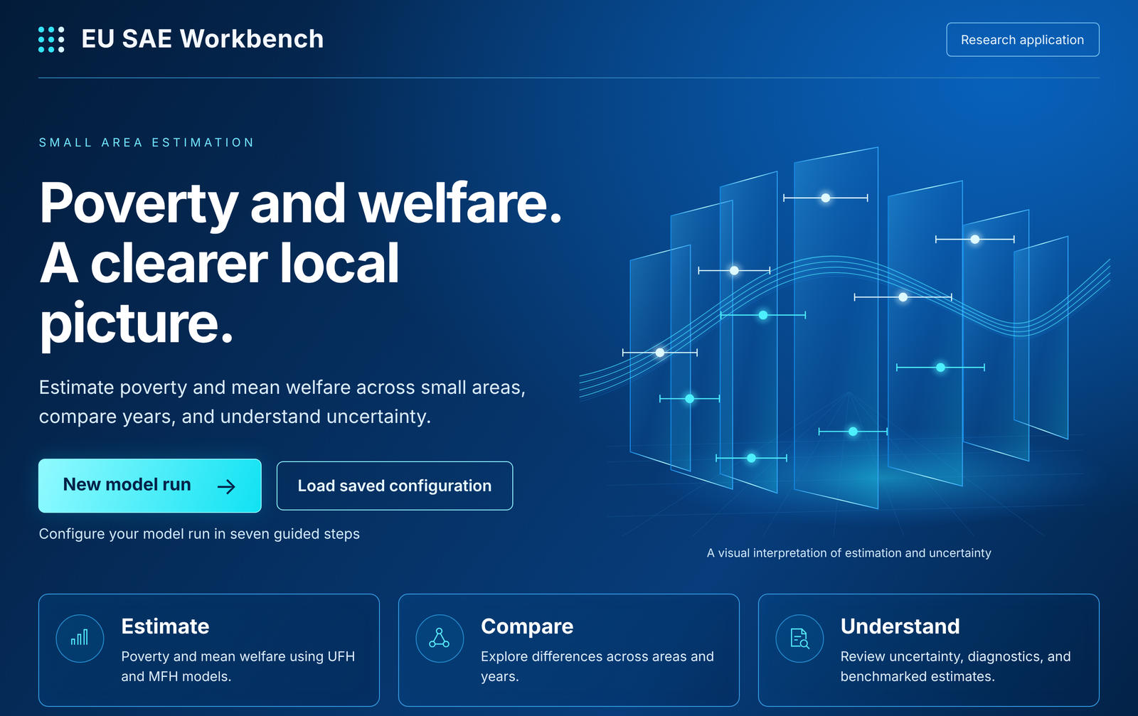
Install and start
EU SAE WORKBENCH · GUIDE 1 OF 3
Install R, download the Workbench and open it in your browser.
Guide 1 Install and start
Guide 2 Running the Workbench
Guide 3 Estimating poverty, anchored poverty and mean welfare
Draft for review, October 2026 · w5p
Notes:
Guide 1 of 3 for the EU SAE Workbench (release w5p, draft for the review meeting). Guide 2 covers the seven steps of the guided version; Guide 3 covers the three worked examples. Sources: Start_Here/README.md and the launchers in Start_Here/.

Slide 2




What you need
BEFORE YOU START
Three things are required. Report tools are usually set up for you.
R 4.2.0 or later
Free, from cran.r-project.org. The newest version your organisation approves is fine.
The Workbench release
One ZIP file under Assets on the project's GitHub Releases page.
Internet on the first launch
The launcher installs the R packages it needs. This takes several minutes, once.
Pandoc, for the reports
Usually nothing to do: the launcher finds Pandoc on the computer or downloads it once.
Not needed: RStudio or any programming. Optional: an API key for the AI assistant (Guide 2).
Notes:
Source: Start_Here/README.md ('Before the first launch'). R 4.2.0 or later; installing the absolute latest R is not required. Pandoc: the launcher reuses an existing Pandoc (RStudio, Positron, Quarto, Homebrew or the pandoc.org installer) or downloads a pinned, checksum-verified copy.

Slide 3
Install R
STEP 1 OF 3
R runs the Workbench in the background. You do not need to open it yourself.
1
Open cran.r-project.org
Choose Download R for Windows, macOS or Linux.
Good to know
Any R from 4.2.0 works; the very latest release is not required.
The launcher finds R by itself in the usual places.
If R is installed somewhere unusual, see 'If something goes wrong' at the end of this guide.
2
Windows
Choose base, download the installer and run it with the default options.
3
macOS
Choose the .pkg installer that matches your chip: Apple silicon or Intel.
4
Managed computer
Ask IT for an approved R 4.2 or later. Do not replace your organisation's R installation.
Notes:
Source: Start_Here/README.md, 'Before the first launch' and 'If R cannot be found' (the launcher searches PATH, R_HOME, the CRAN framework on macOS, Homebrew and the usual system locations; EU_SAE_RSCRIPT overrides).

Slide 4
Download the Workbench
STEP 2 OF 3
One ZIP file from GitHub Releases. Extract all of it before starting.
1
Open the Releases page
github.com/Noboyoshida227/eu-sae-application/releases
EU_SAE_520_w5p/
├─ Start_Here/ launchers
├─ app_wizard.R guided version
├─ app.R classic dashboard
├─ R/ scripts/ tests/
├─ Data/ example data
├─ docs/ guides and notes
├─ outputs/ latest results
└─ app_runs/ one folder per run
2
Download the release ZIP
Under Assets, for example EU_SAE_520_w5p.zip. Not the 'Source code' archives.
3
Windows: unblock, then extract
Right-click the ZIP › Properties › tick Unblock (if shown) › OK, then Extract All.
4
macOS: double-click the ZIP
Move the extracted folder to any folder you can write to.
app_runs/ is created by the first run.
Notes:
Source: Start_Here/README.md. The release file name for this review is EU_SAE_520_w5p.zip; later releases follow the same pattern. Keep a separate copy of earlier installations and saved results when trying a new version.

Slide 5
Start the Workbench
STEP 3 OF 3
Open the Start_Here folder and double-click the launcher for your computer.
Your computer | Guided version (recommended) | Classic dashboard
Windows | Start_Wizard.bat | Start_Dashboard.bat
macOS | Start_Wizard.command | Start_Dashboard.command
Linux | bash Start_Wizard.command | bash Start_Dashboard.command
1
A terminal window opens
R starts, then your browser opens the Workbench.
2
Keep that window open
Closing it stops the Workbench.
3
The first launch is slow
R packages install (several minutes, internet needed). Later launches are quick.
Keep Start_Here inside the package folder: the launchers work from the folder above it.
Notes:
Source: Start_Here/README.md. The guided version (wizard) is recommended; the classic dashboard has the same settings on one page. Both use the same analysis.

Slide 6
On a Mac: two things can block the first launch
MACOS ONLY
macOS treats files from a downloaded ZIP as untrusted. Each fix is needed once.
“Apple could not verify…”
macOS 15 or later: double-click the launcher once and close the message.
Open System Settings › Privacy & Security, scroll to Security and click Open Anyway next to the launcher. Confirm, then double-click it again.
macOS 14 or earlier: right-click the launcher, choose Open, then Open again.
Double-clicking does nothing
The launcher lost its 'executable' permission during unzipping.
In Terminal, type bash and a space, drag the launcher onto the window and press Return. This starts the Workbench and repairs the permission.
Or type chmod +x and a space, drag both .command files from Start_Here onto the window and press Return.
Notes:
Source: Start_Here/README.md, 'macOS: two things that can block the first launch'. The launchers are not code-signed. On a managed computer, a device policy may still block the launcher or the Pandoc download; startup_setup.log in the package folder records what happened.

Slide 7
Reports need Pandoc, and it is usually automatic
REPORTS
Pandoc turns the results into the HTML and Word reports.
Pandoc already on the computer?
RStudio, Positron and Quarto include one. The launcher uses it.
If not, it is downloaded once
A pinned, checksum-verified copy (26–42 MB) goes into your user profile. No administrator rights needed.
No internet?
Install RStudio Desktop, Quarto or Pandoc first. Without Pandoc the analysis still runs, but the report is not produced.
→
→
If no report appears: the run log and startup_setup.log (in the package folder) say why.
Notes:
Source: Start_Here/README.md, 'Pandoc (report rendering)'. EU_SAE_PANDOC can point to a folder that contains pandoc / pandoc.exe for fully offline use.

Slide 8
The front page
FIRST SCREEN
Every session starts here. Choose how to begin.
New model run
Starts with the default settings and opens Step 1 of the seven guided steps (Guide 2).
Load saved configuration
Opens the last saved configuration, or one from a file, and goes to the review step.
Inside the Workbench, Guides and notes and About are in the top bar.

Slide 9
If something goes wrong
REFERENCE
The most common problems at installation and start-up.
What you see | What to do
Packages fail to install on the first launch | Check the internet connection and start the launcher again: it installs only what is missing or out of date. On a managed computer, ask IT for access to the R package repository.
The launcher says R is not installed or could not be found | Install R 4.2 or later. If R is in an unusual folder, set EU_SAE_RSCRIPT to the full path of Rscript (Start_Here/README.md).
The browser does not open | Copy the address shown in the terminal window (http://127.0.0.1:…) into your browser.
The Workbench stops responding | Check that the terminal window is still open. Start the launcher again if it was closed.
No report after a run | See 'Reports need Pandoc'. The run log and startup_setup.log give the reason.
Notes:
Sources: Start_Here/README.md ('If R cannot be found', 'Pandoc', 'During and after a run'). Shiny prints the local address (Listening on http://127.0.0.1:<port>) in the terminal window; the wizard launcher tries ports 7788 to 7791 and then any free port.

Slide 10
You are ready to run a model
NEXT
Guide 2: Running the Workbench, the seven steps from data to results.
Guide 3: Estimating poverty, anchored poverty and mean welfare.
Questions and problem reports: github.com/Noboyoshida227/eu-sae-application/issues

