Slide 1
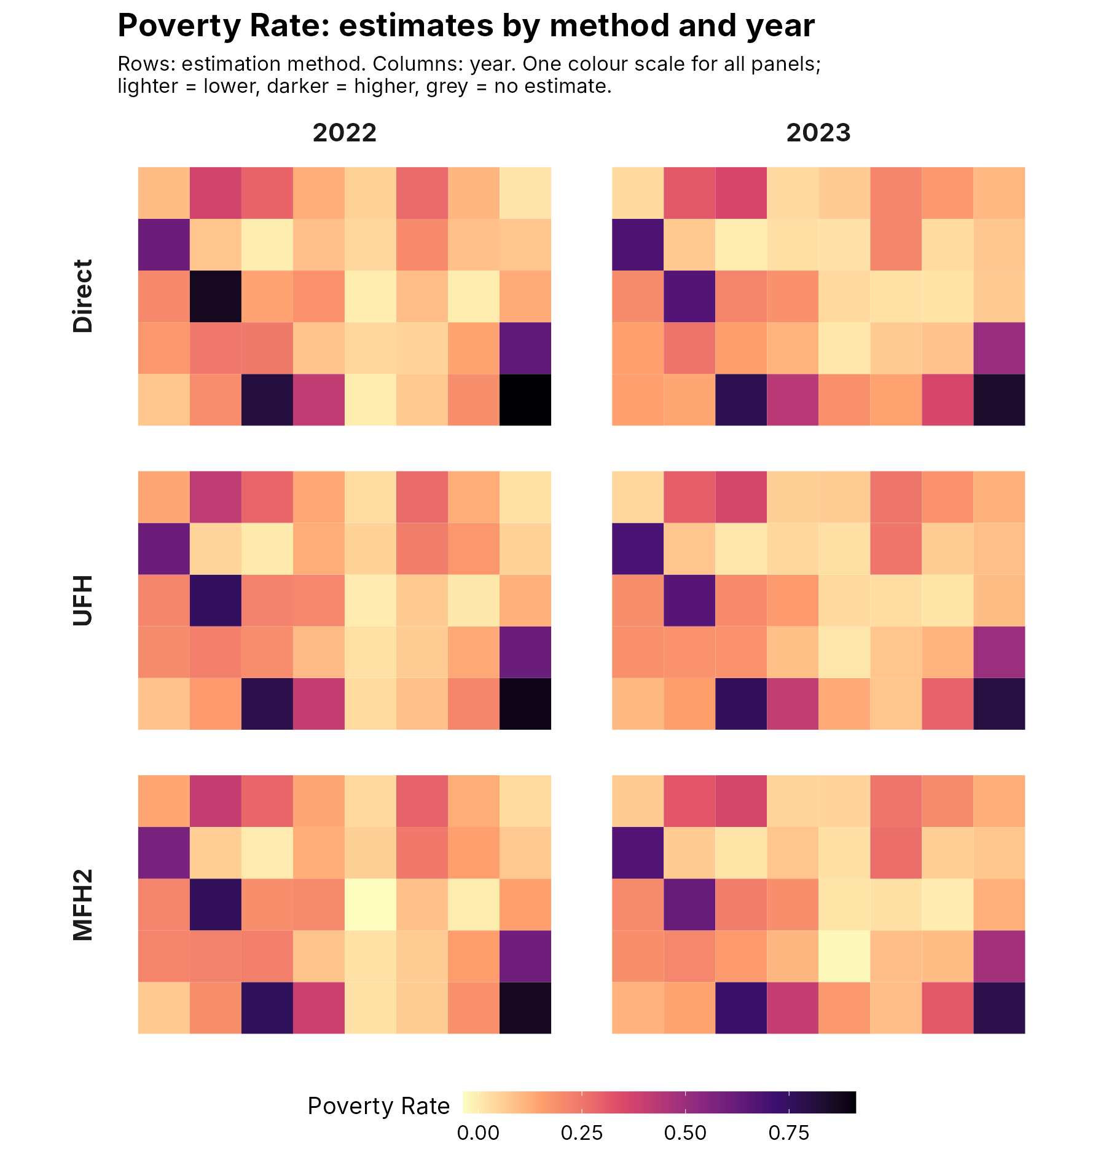
Estimating poverty, anchored poverty and mean welfare
EU SAE WORKBENCH · GUIDE 3 OF 3
Three worked examples: what to set, and how to read the results.
w5p · Historical w5o examples, October 2026
Notes:
Guide 3 of 3 (release w5p, draft for review; retained results are historical w5o runs from October 13, 2026). All examples use the synthetic data in Data/simulated (40 domains, survey years 2022 and 2023). Numbers marked illustrative explain definitions and arithmetic; numbers marked as results come from Workbench runs on the synthetic data with 100 bootstrap replicates.

Slide 2



Three examples, one workflow
OVERVIEW
Each example follows the seven steps of Guide 2. Only Steps 3 and 4 change.
EXAMPLE 1
Poverty headcount
The share of people below each year's poverty line, for example the at-risk-of-poverty threshold.
EXAMPLE 2
Anchored poverty
A poverty line held fixed in real terms, so that the standard does not move with incomes.
EXAMPLE 3
Mean welfare
Average income or consumption per person, in the prices of one year.
Data: Data/simulated (40 domains, survey years 2022 and 2023; incomes treated as those of the year before). The same steps apply to real survey data.

Slide 3
Years and prices: five terms
BEFORE THE EXAMPLES
Files are keyed by survey year. Price indices and poverty lines depend on the year the incomes refer to.
Term | Meaning | Example
Survey year | The year chosen in Step 3. Survey, auxiliary, population and target files use it | 2022, 2023
Income reference year | The year the incomes refer to. In EU-SILC usually the year before the survey | 2021, 2022
CPI reference year | The year in which the index equals 100. It does not change the results | 2015 = 100
Price base year | The year whose prices real welfare is reported in | 2021 prices
Anchor year | The year whose poverty line is held fixed in real terms | 2021 line: 10,000
Only ratios between years matter. CPI 2021 = 110.0 and CPI 2022 = 114.4: welfare of 10,920 in 2022 is 10,920 × 110.0 / 114.4 = 10,500 in 2021 prices.
Notes:
Eurostat: the income reference year for EU-SILC is the calendar year before the survey. In the Workbench, 'Incomes refer to: the calendar year before the survey' applies the index for year t-1 to survey year t (R/pipeline_helpers.R). 114.4 / 110.0 = 1.04.

Slide 4
Poverty headcount with year-specific poverty lines
EXAMPLE 1 OF 3
Each survey year has its own line, for example 60% of that year's median income.

Slide 5
What the poverty headcount measures
EXAMPLE 1 · CONCEPT
The population-weighted share of people whose welfare is below the poverty line of their year.
The measure
FGT(0), the headcount ratio. FGT(1) and FGT(2) measure the depth and severity of poverty.
The poverty line
One line per survey year, in the same currency, period and welfare units (per person or equivalised) as the survey.
EU at-risk-of-poverty
60% of the national median equivalised disposable income. In EU-SILC it refers to the previous year's incomes.
The Workbench uses the lines you supply; it does not calculate national medians. A change in the rate reflects changes in both incomes and the line.
Notes:
Eurostat glossary: at-risk-of-poverty threshold = 60% of national median equivalised disposable income after social transfers. ILC_LI02 publishes the at-risk-of-poverty rate.

Slide 6
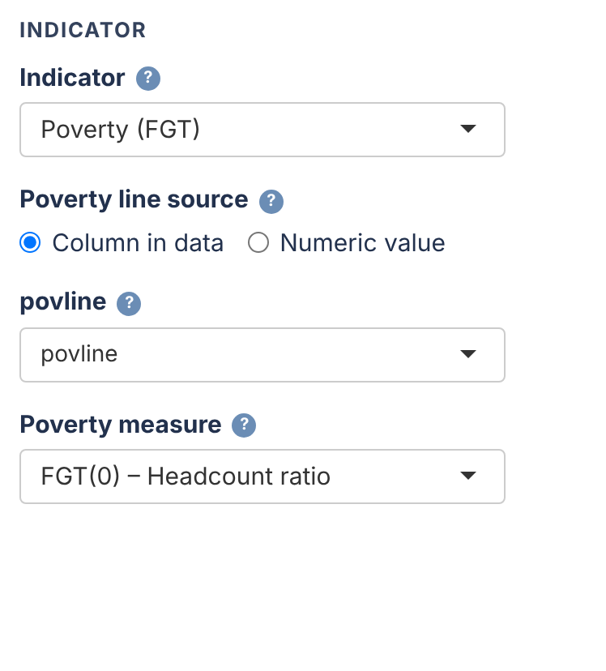
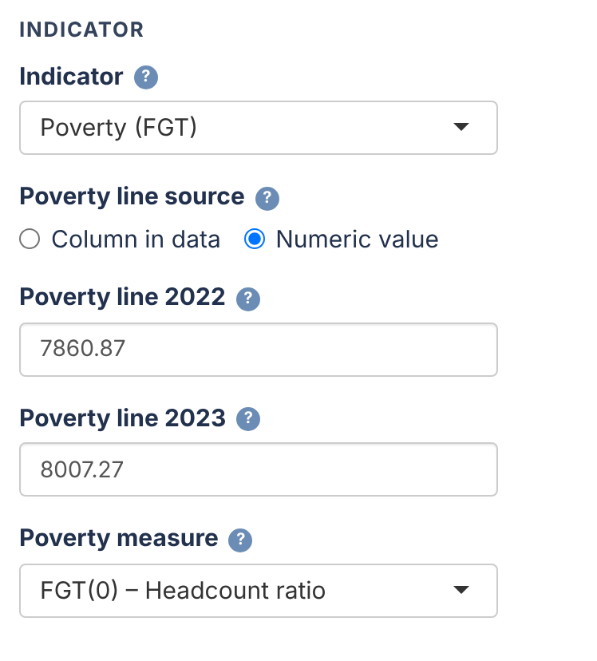
Two ways to give the poverty lines
EXAMPLE 1 · STEP 3
With the same lines, both give the same estimates. Choose Poverty (FGT) and FGT(0) – Headcount ratio.
Column in data: one line per record
Numeric value: one box per survey year
Simulated data: the povline column is 60% of each year's person-weighted median income: 7,860.87 in 2022 and 8,007.27 in 2023.
Notes:
Column in data suits lines that vary across records (for example by region or household type). Numeric value: one 'Poverty line <year>' box per analysis year (app_wizard.R Step 3).

Slide 7
Model settings for poverty rates
EXAMPLE 1 · STEP 4
New runs use the defaults below. Saved choices are retained; examples remain historical.
Setting | Default | Why
UFH transformation | arcsin, with bias correction (bc) | Keeps rates between 0 and 1 and stabilises the variances. For FGT(1) and FGT(2) the app uses 'no'.
UFH model selection | BIC | Prefers simpler models
MFH model | MFH2 | Both years jointly, with correlated area effects
MFH variances and covariance | sm_all, rho_sm_all | Fully smoothed working variances with national sampling correlation
Bootstrap replicates | 500 | Uncertainty of levels and changes
Benchmarking | off | If on, targets must use the same poverty lines
If an MFH variance or correlation ends at its limit, the report flags it and change significance is provisional.
Notes:
UFH FGT0 arcsin retains its analytical effective-sample-size variance; invalid effective sample size falls back to observed sample size. UFH without transformation defaults to sm_all. MFH defaults to sm_all with rho_sm_all. Optional sm_out replaces only missing, nonfinite or strictly below-0.001 variances; it does not replace large variances. Explicit saved choices remain valid. Boundary change significance remains provisional. Historical w5o examples used sm_out / rho_sm_out and 100 replicates.

Slide 8
Reading the results
EXAMPLE 1 · RESULTS
Historical w5o: sm_out / rho_sm_out, 100 replicates. Not results from the new defaults.
22.0% → 21.0%
National direct headcount, 2022 to 2023: −1.0 percentage point
Rows: Direct (survey only), UFH and MFH2. Model estimates are more stable where samples are small.
Changes: use percentage points. Counts of pointwise-significant areas are exploratory. BH and Bonferroni results are also available.
Files: estimates with RMSE and CV in outputs/data/pov_comparison_detailed.xlsx.
Notes:
Run on Data/simulated with the poverty lines in the povline column, historical w5o model settings (sm_out / rho_sm_out) and 100 bootstrap replicates (outputs/tables/national_poverty.csv: 2022 = 0.219938, 2023 = 0.209916). Use the default 500 replicates for real analyses. Figure: outputs/figures/poverty_maps/grid_estimates.png.

Slide 9
Anchored poverty
EXAMPLE 2 OF 3
Keep the poverty standard of one year fixed in real terms, and supply it for every survey year.

Slide 10
A poverty line fixed in real terms
EXAMPLE 2 · CONCEPT
The line keeps the purchasing power of the anchor year's threshold.
Why anchor
With a relative line, poverty can stay flat while real incomes fall. A fixed real standard shows absolute changes in living standards.
Where the lines come from
Use official anchored thresholds where available. Check the anchor year, the income years, the currency and the welfare units.
Two ways to enter them
Numeric value: one line per survey year in Step 3. Column in data: a survey column, when lines vary across records.
Do not recalculate the line from each later year's median: that would move the standard.
Notes:
Eurostat, 'Monitoring the evolution of income poverty and real incomes over time' (anchored at-risk-of-poverty rate). Benchmarking to national or regional targets is a separate choice.

Slide 11
Anchored lines for each survey year
EXAMPLE 2 · THE LINES
Illustration: a 2021 line of 10,000, kept fixed in real terms with the price index of Example 3.
Survey year | Income year | Price index | Anchored line
2022 | 2021 | 100.00 | 10,000
2023 | 2022 | 104.00 | 10,400
2024 | 2023 | 106.08 | 10,608
If the survey's welfare is already in 2021 prices, the anchored line is 10,000 in every year.
These lines are illustrative. They are not the at-risk-of-poverty lines of the simulated data.
Line = 10,000 × index(income year) / index(2021)
Survey 2023 asks about 2022 incomes, so it gets the 2022 line.

Slide 12
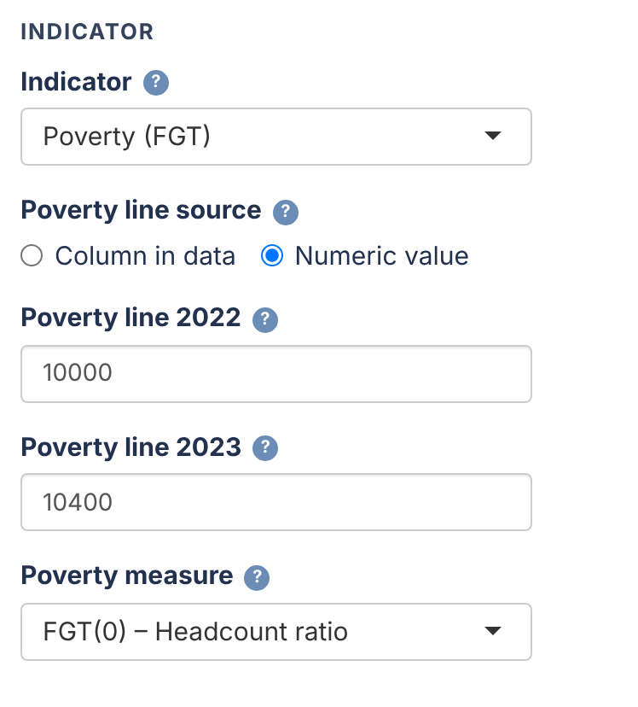
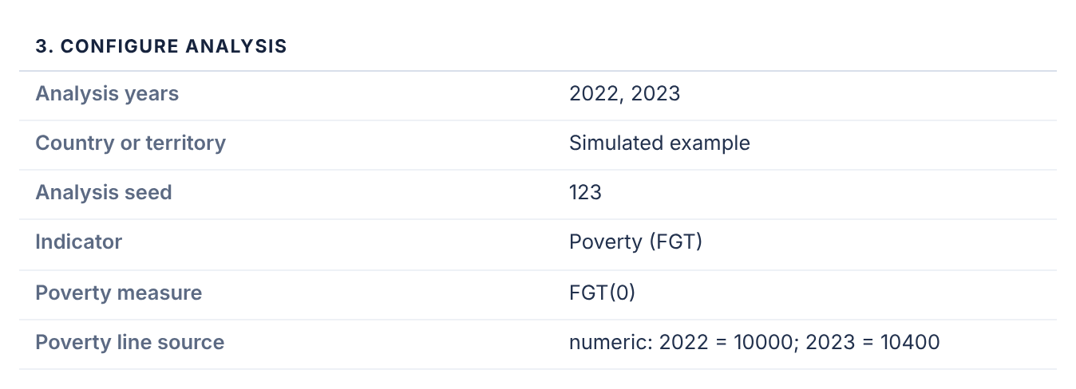
Enter the anchored lines and check them
EXAMPLE 2 · STEPS 3 AND 6
Poverty (FGT), FGT(0), Numeric value. No price conversion: the lines are already in each year's prices.
Step 6: the summary repeats them
Step 3: the anchored lines typed in
Then check data readiness and run the model as in Example 1. Report anchored rates and their changes in percentage points.
Notes:
Keep the threshold source, anchor year, income years and welfare units with the run. If benchmarking, the targets must use the same anchored line.

Slide 13
Mean welfare in real terms
EXAMPLE 3 OF 3
Average income or consumption per person, in the prices of one year.

Slide 14
Two routes to real mean welfare
EXAMPLE 3 · CONCEPT
Changes in current-price welfare include inflation. Choose how prices are handled in Step 3.
Route A: welfare already in constant prices
The survey's welfare was deflated before you received it.
Step 3: constant (real) prices already. No price index is needed.
The year of those prices is optional and used in labels only.
Route B: current prices plus a price index
Welfare is in each year's own prices.
Step 3: current prices: convert with a price index.
Type the index by year, or read it from the CPI file of Step 1.
The default, current prices without conversion, reports nominal changes. It is not one of the two real-welfare routes.
Notes:
Welfare must be the per-person or equivalised measure for each household (or person), not domain means. Price conversion is applied to each record before the area means are calculated (R/pipeline_helpers.R, sae_apply_price_index).

Slide 15
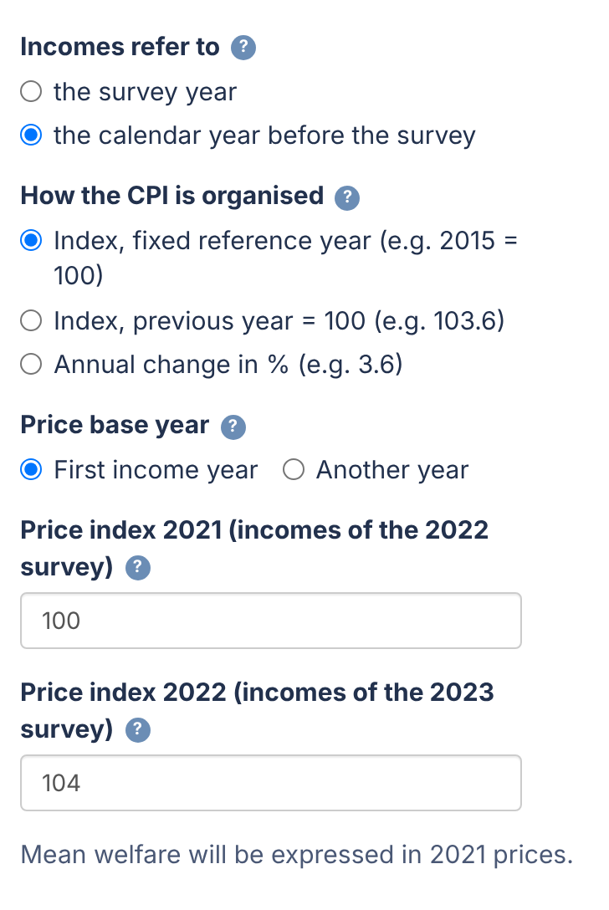
Converting with a price index
EXAMPLE 3 · ROUTE B, STEP 3
Simulated example: incomes of the year before the survey, expressed in 2021 prices.
Setting | Choice
Indicator | Mean welfare
Welfare in the survey data is in | current prices: convert with a price index
Price index values | Type them in by year
Incomes refer to | the calendar year before the survey
How the CPI is organised | Index, fixed reference year
Price base year | First income year (2021)
Price index 2021, 2022 | 100 and 104
The app confirms: “Mean welfare will be expressed in 2021 prices.”
Notes:
The index for income year 2021 applies to the 2022 survey and the index for 2022 to the 2023 survey. The price base year need not be the CPI reference year. Route A (not shown) uses the same step with 'constant (real) prices already' and an optional year of prices.

Slide 16
Three accepted CPI formats
EXAMPLE 3 · ROUTE B
Use one national annual-average series. The three rows below describe the same inflation.
How the CPI is organised | 2021 | 2022 | 2023
Index, fixed reference year | 100.00 | 104.00 | 106.08
Index, previous year = 100 | — | 104.0 | 102.0
Annual change in % | — | 4.0 | 2.0
Fixed index: give the income years and the price base year.
Annual formats: give every annual change up to the latest year needed; the app chains them.
CPI file: one row per year with a year column and the index (decimal commas are accepted).
year,cpi
2021,100.00
2022,104.00
Notes:
Formats: fixed, previous_year and percent_change (R/pipeline_helpers.R, sae_price_index_type). Use annual averages for annual incomes, not December-on-December or monthly figures.

Slide 17
An illustration in 2021 prices
EXAMPLE 3 · ARITHMETIC
Each record is converted before the area means are calculated.
Survey / income year | Price index | Mean in current prices | Mean in 2021 prices
2022 / 2021 | 100.00 | 10,400 | 10,400
2023 / 2022 | 104.00 | 10,920 | 10,500
Real welfare = current-price welfare × index(2021) / index(income year)
+5.00%
change in current prices
+0.96%
real change
Illustrative numbers, not results of the simulated data.
Notes:
10,920 × 100 / 104 = 10,500. Nominal change 100 × (10,920 / 10,400 − 1) = 5.00%. Real change 100 × (10,500 / 10,400 − 1) = 0.96%.

Slide 18
Model settings for mean welfare
EXAMPLE 3 · STEP 4
Log is the default for mean welfare; no transformation remains available. Deflate first.
Setting | Choice | What it means
UFH transformation | log | Models the log of each area's direct arithmetic mean
UFH bias correction | bc_sm | Slud–Maiti correction (emdi) when returning to currency units
MFH transformation | log | The same, for both years jointly
MFH bias correction | Conditional lognormal | exp(η + v/2), v the conditional random-effect variance
Working variances | sm_all | UFH log honors the selector; MFH uses rho_sm_all
Zero and negative incomes stay in the direct means. A log model needs every area mean to be positive; the readiness check (Test 0e) reports this.
Notes:
The target is arithmetic mean welfare. UFH log applies the selected variance option to delta variances V/mean^2; sm_all is the default, while direct and sm_out are available and saved. MFH defaults to sm_all / rho_sm_all on the log scale. The optional sm_out cutoff remains 0.001 on that scale. Corrected UFH predictions are unavailable without a direct estimate; none returns exp(eta). Historical example results retain their old settings.

Slide 19
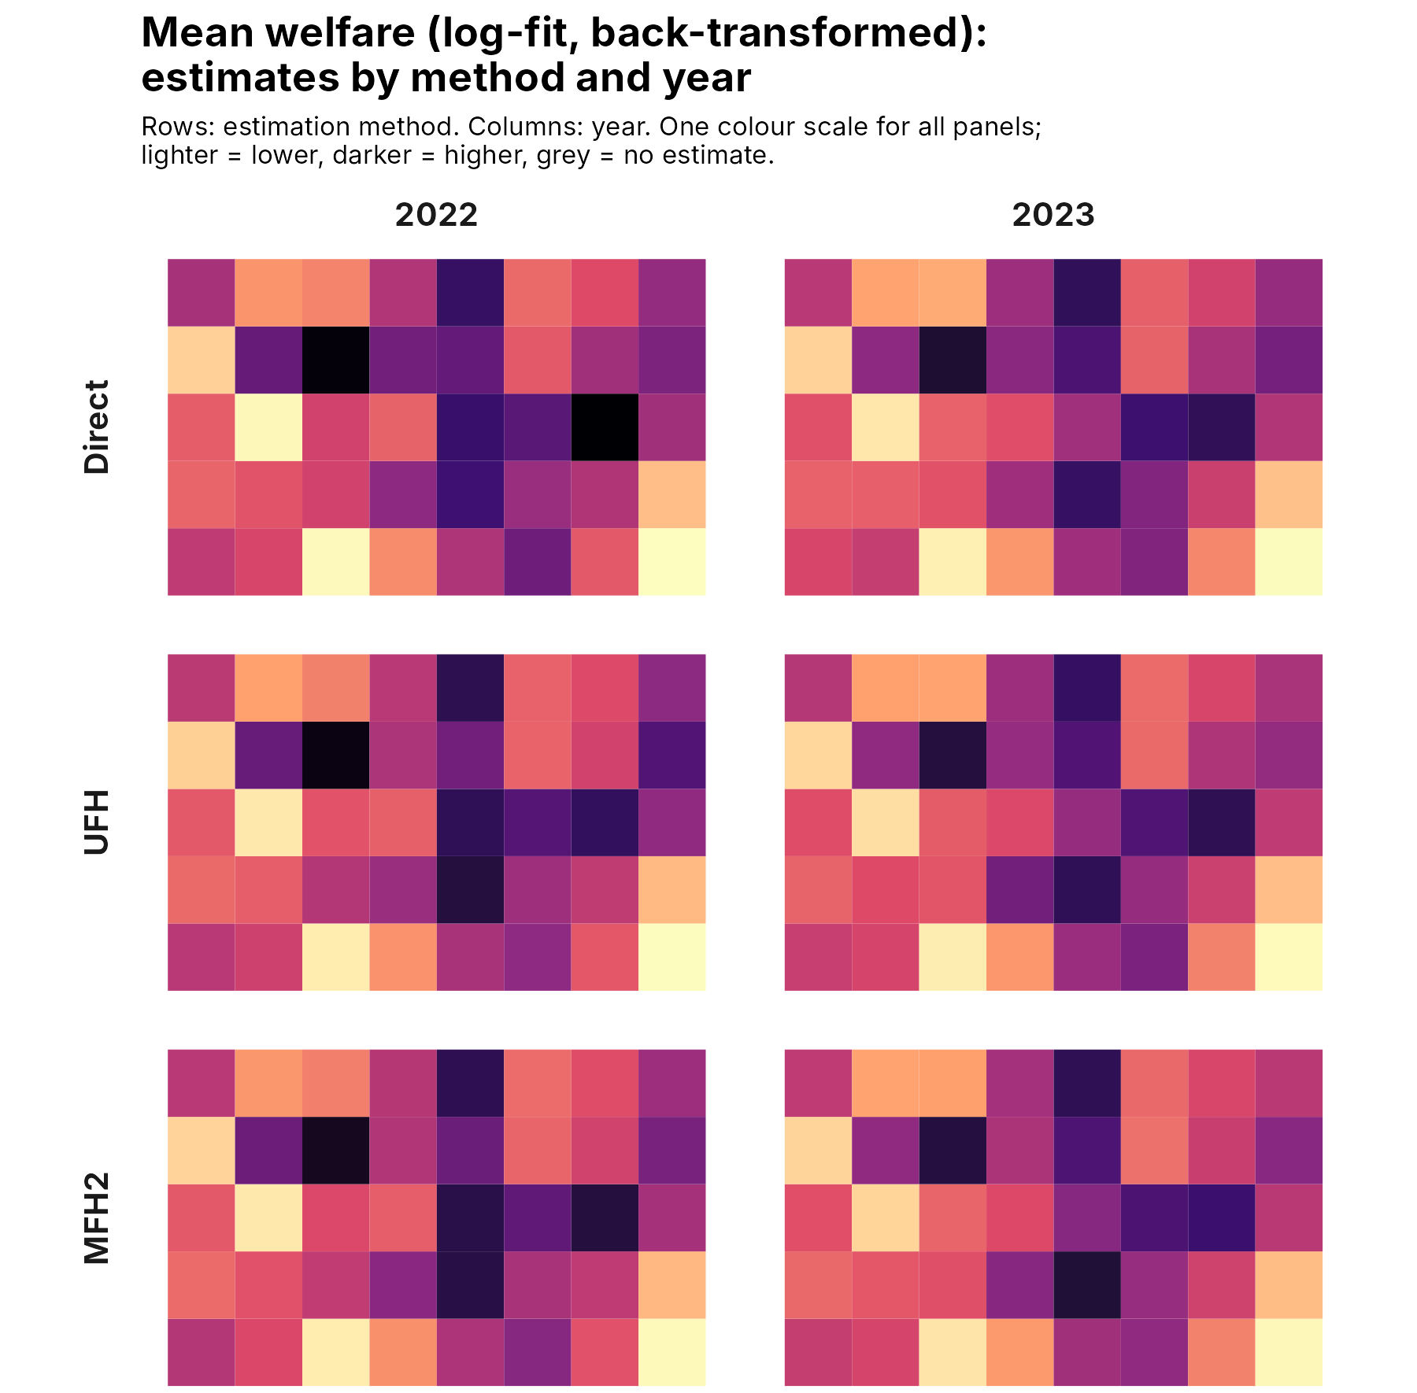
Reading the results
EXAMPLE 3 · RESULTS
Historical w5o, Route B: sm_out / rho_sm_out, 100 replicates. New defaults were not rerun.
15,079 → 14,674
National direct mean welfare in 2021 prices: −2.7% real change
Output | Unit
Levels and RMSE | Currency, in 2021 prices
Changes and their tests | Percentage change of the final means
Change-and-RMSE box plots | ln(mean 2023 / mean 2022), not × 100
Excel columns ending in _eur | Currency units, whatever the currency
Lighter areas: lower mean welfare; darker: higher (2021 prices).
Notes:
Run on Data/simulated with Route B (incomes of the previous calendar year, fixed index 2021 = 100, 2022 = 104, base year 2021), log models and 100 bootstrap replicates. National direct means from outputs/tables/national_poverty.csv: 2022 = 15,078.7, 2023 = 14,674.2. The box plots show log ratios: a value of −0.027 is about a −2.7% change.

Slide 20
Checks before you report any of the three
BEFORE YOU REPORT
The model can only be as consistent as its inputs.
1
Same concept
Welfare, poverty lines and benchmark targets use the same definition, units and prices.
2
Readiness
No ERROR; warnings read and understood, including the weighted population total (Test 0f).
3
Diagnostics
Model fit, bootstrap success and Monte Carlo precision in the report.
4
Boundaries
If an MFH variance or correlation is at its limit, change significance is provisional.
5
Bootstrap
Use the default 500 replicates or more for results you report.
6
Interpretation
Interval coverage is not certified. Compare Direct, UFH and MFH before concluding.
Notes:
Sources: docs/INDEX.html#guidance and docs/INDEX.html#validation. The guidelines note in docs/guidance explains the methods in detail.

Slide 21
Revise each annual estimate once
PUBLICATION POLICY
T = 2 supports this NSO policy. Freezing estimates is not automatic.
Window | Previously reported year | New year
2022, 2024 | Decide the initial 2022 status | 2024 provisional
2024, 2025 | Revise 2024 once, then freeze | 2025 provisional
2025, 2026 | Revise 2025 once, then freeze | 2026 provisional
Revision burden: at most one prior year per release. Longer windows can repeatedly revise several overlapping years.
NSO responsibility: enforce freezes, document exceptional reopening, and archive each window and publication vintage.
Change uncertainty: retain each pair's estimates and MSE/MCPE together. Within-pair uncertainty does not cover differences across frozen vintages.
Notes:
The selected years need not be adjacent. Under this policy each newly reported year is provisional, revised once in the next window when it is the earlier year, then frozen. T = 2 alone does not enforce release timing or freezes. Archive pair-specific estimates, changes, MSE and MCPE with the estimation window and vintage. Published annual estimates from different fits require a separate cross-run uncertainty calculation for formal change inference. See Guidelines Section 15.2 for the alternative policy that publishes only the latest year as final.

Slide 22
Where to read further
MORE DETAIL
Guidelines note: methods, years and prices, and reading the change outputs.
Methodology mapping and validation status: in Guides and notes, inside the Workbench.
Questions and problem reports: github.com/Noboyoshida227/eu-sae-application/issues

