Slide 1
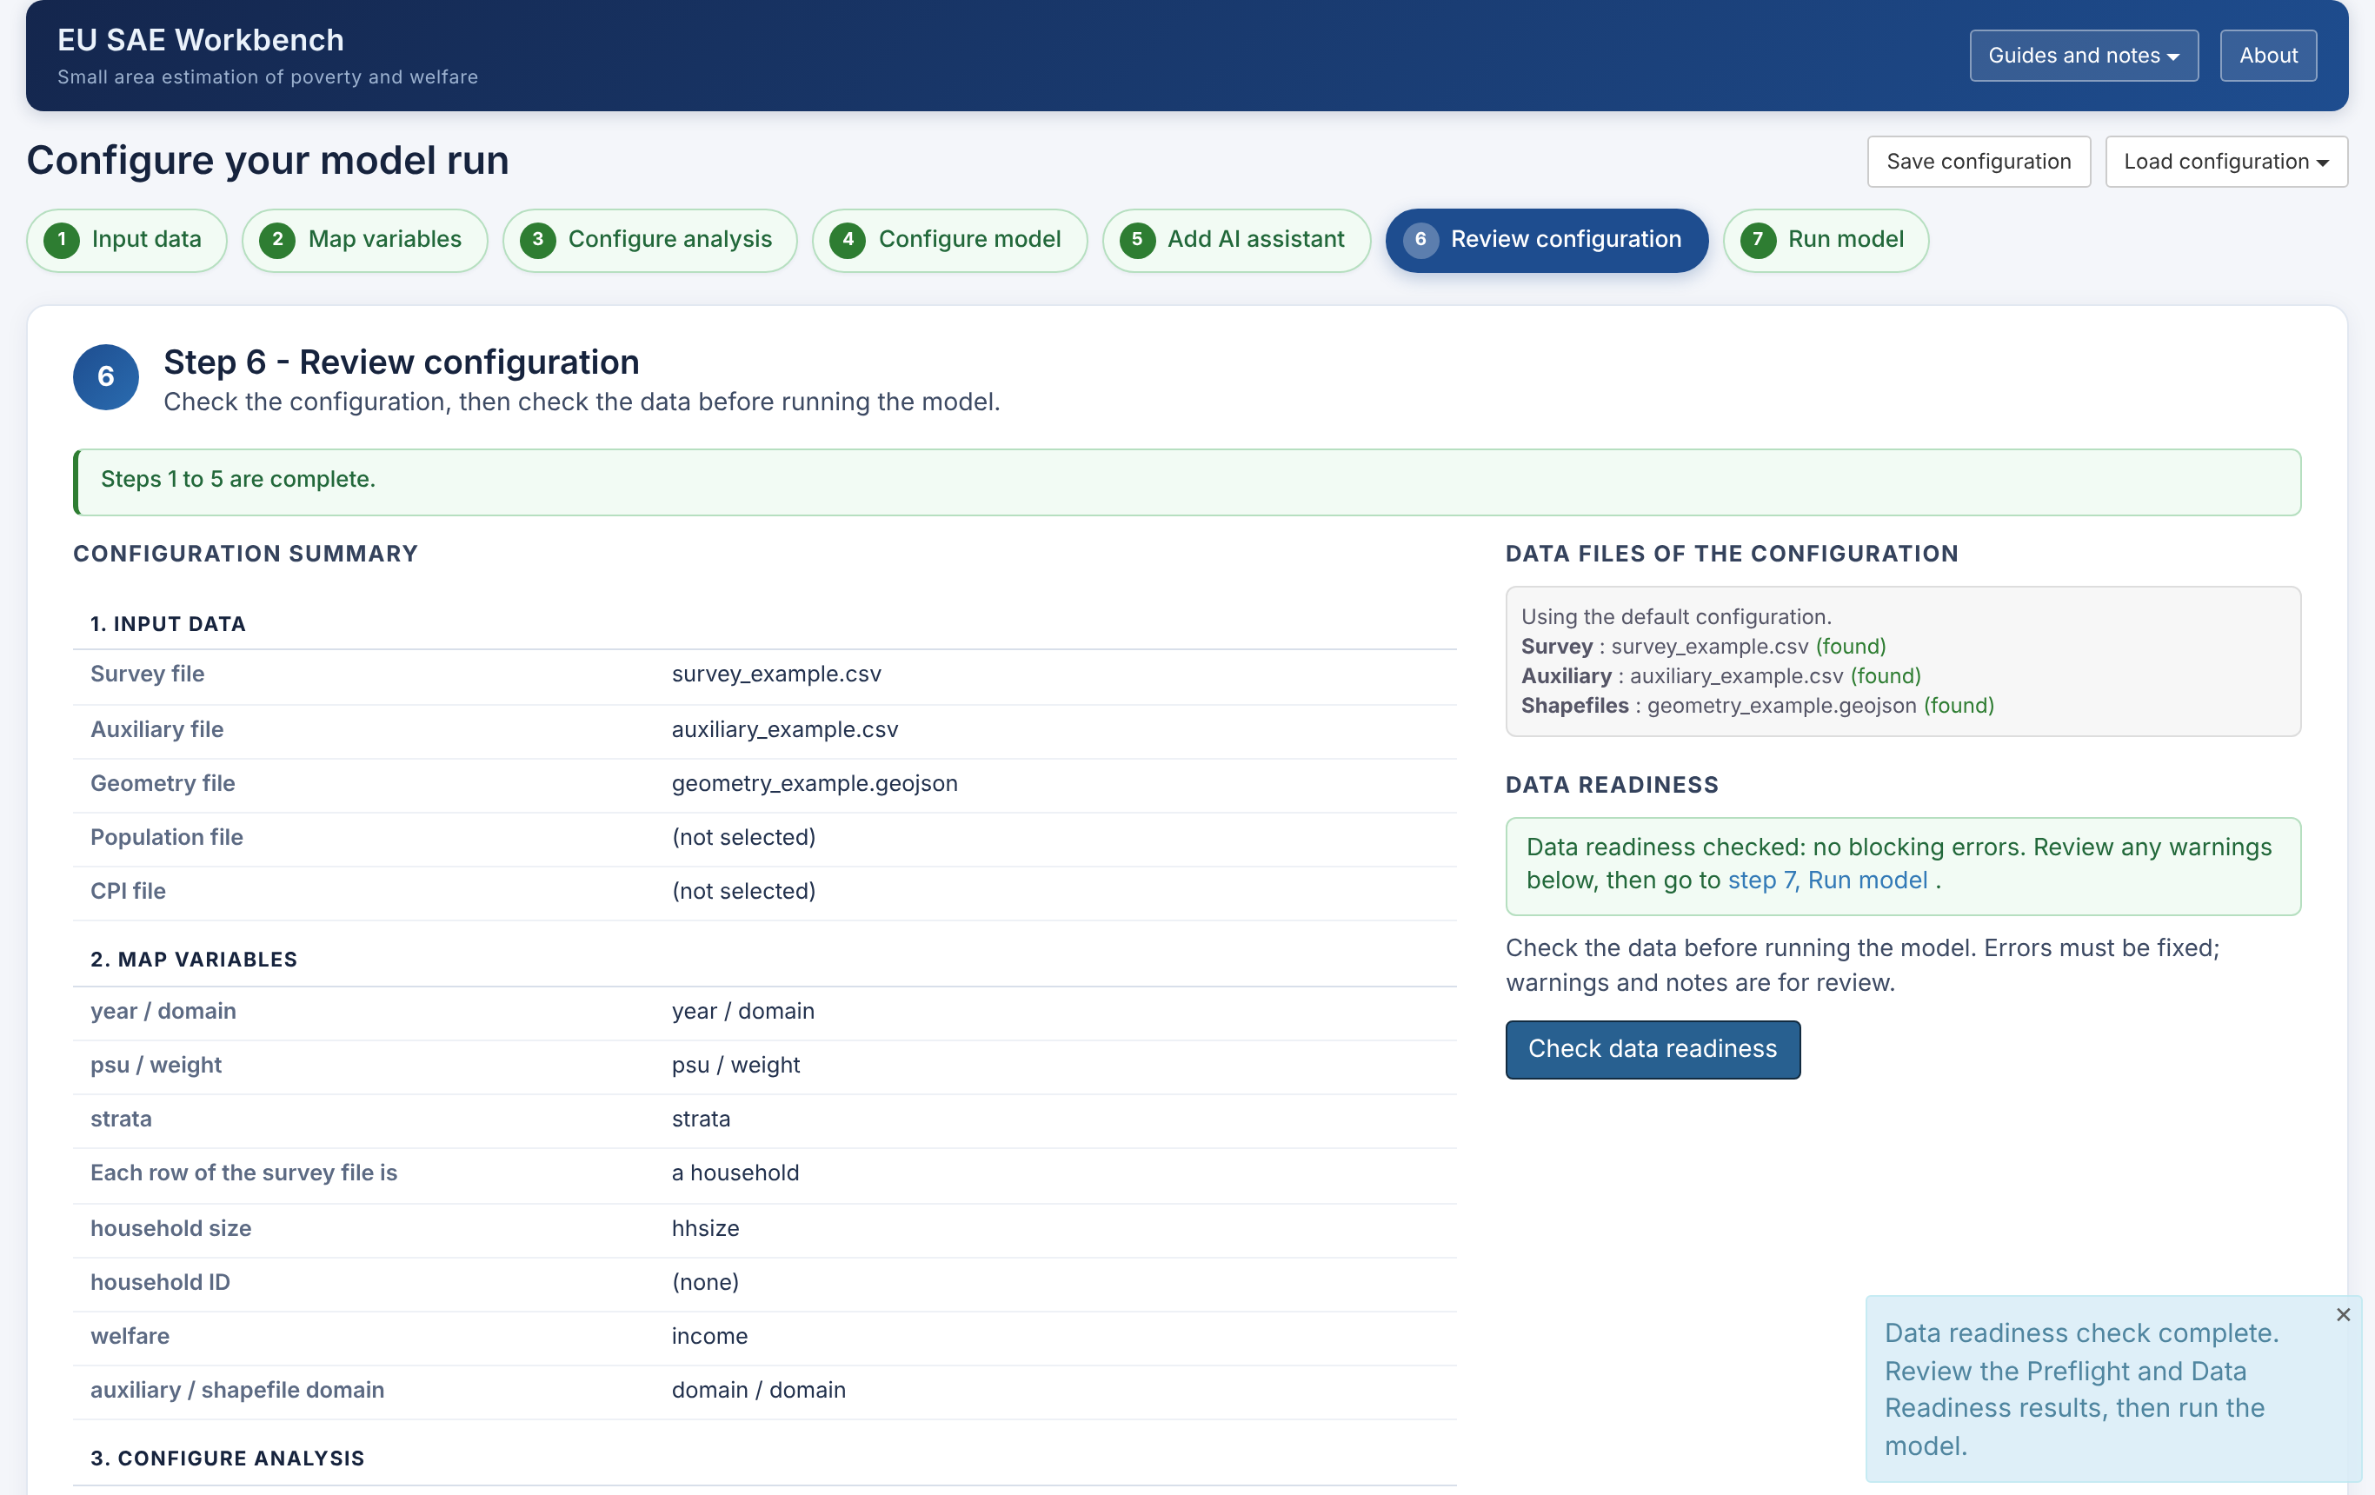
Running the Workbench
EU SAE WORKBENCH · GUIDE 2 OF 3
The seven guided steps, from your data files to the report.
Draft for review, October 2026 · Screens: simulated example data
Notes:
Guide 2 of 3 (release w5o, draft for the review meeting). All screenshots use the synthetic example in Data/simulated (40 domains, survey years 2022 and 2023). Guide 1 covers installation; Guide 3 covers poverty, anchored poverty and mean welfare.

Slide 2
Seven steps from data to results
OVERVIEW
Each step is one screen. You can move freely between them; Run model asks for a data readiness check first.
1
2
3
4
5
6
7
Input data
Select the survey, auxiliary and map files
Map variables
Say which column holds which variable
Configure analysis
Two years and the indicator
Configure model
UFH, MFH and benchmarking
Add AI assistant
Optional report text
Review configuration
Summary and data readiness check
Run model
Progress, then the report
Front page: New model run starts at Step 1 with default settings. Load saved configuration fills every step and opens Step 6.
The classic dashboard (Start_Dashboard) has the same settings on one page and runs the same analysis.

Slide 3



Three files are required
PREPARE YOUR DATA
They can be in any folder. Use the same domain codes in all three.
Survey
Household or person records
Auxiliary
Area covariates
Geometry
Area boundaries
year, domain code, PSU, survey weight and welfare
household size, when each row is a household
welfare per person (per capita or equivalised), not the household total
optional: strata, household ID, poverty line, benchmark group
one row per domain and year
domain code, year and candidate covariates
covers both analysis years
may include areas without survey data
one polygon per domain
a domain code matching the other two files
shapefile: one .zip with the .shp, .shx and .dbf
Formats: R (.rds, .RData), CSV and other text files, Stata, SPSS, SAS, Parquet/Feather and Excel. Geometry: .rds, GeoPackage, GeoJSON, KML/GML or a zipped shapefile.
Notes:
Sources: app_wizard.R Step 1 and Step 2 help texts; R/input_readers.R (accepted formats). A survey file with one row per person is supported from w5o: choose 'a person' in Step 2 (no household size needed).

Slide 4
Optional files
PREPARE YOUR DATA
Add them only when the analysis needs them.
Consumer price index (Step 1)
For mean welfare in constant prices. One row per year: a year column and the index. The values can also be typed in at Step 3.
Domain population sizes (Step 1)
For benchmarking. Domain totals by year, in long or wide format. Without the file, the survey's weighted totals are used.
Benchmark targets (Step 4)
For benchmarking to external figures: a year column and a target column (plus the group column for grouped benchmarking). Without the file, the targets are the survey's direct estimates.
Notes:
Sources: app_wizard.R (population_file, cpi_file, regional_benchmark_file help texts); scripts/population_helpers.R. Benchmark targets must use the same indicator, poverty line and prices as the survey welfare.

Slide 5
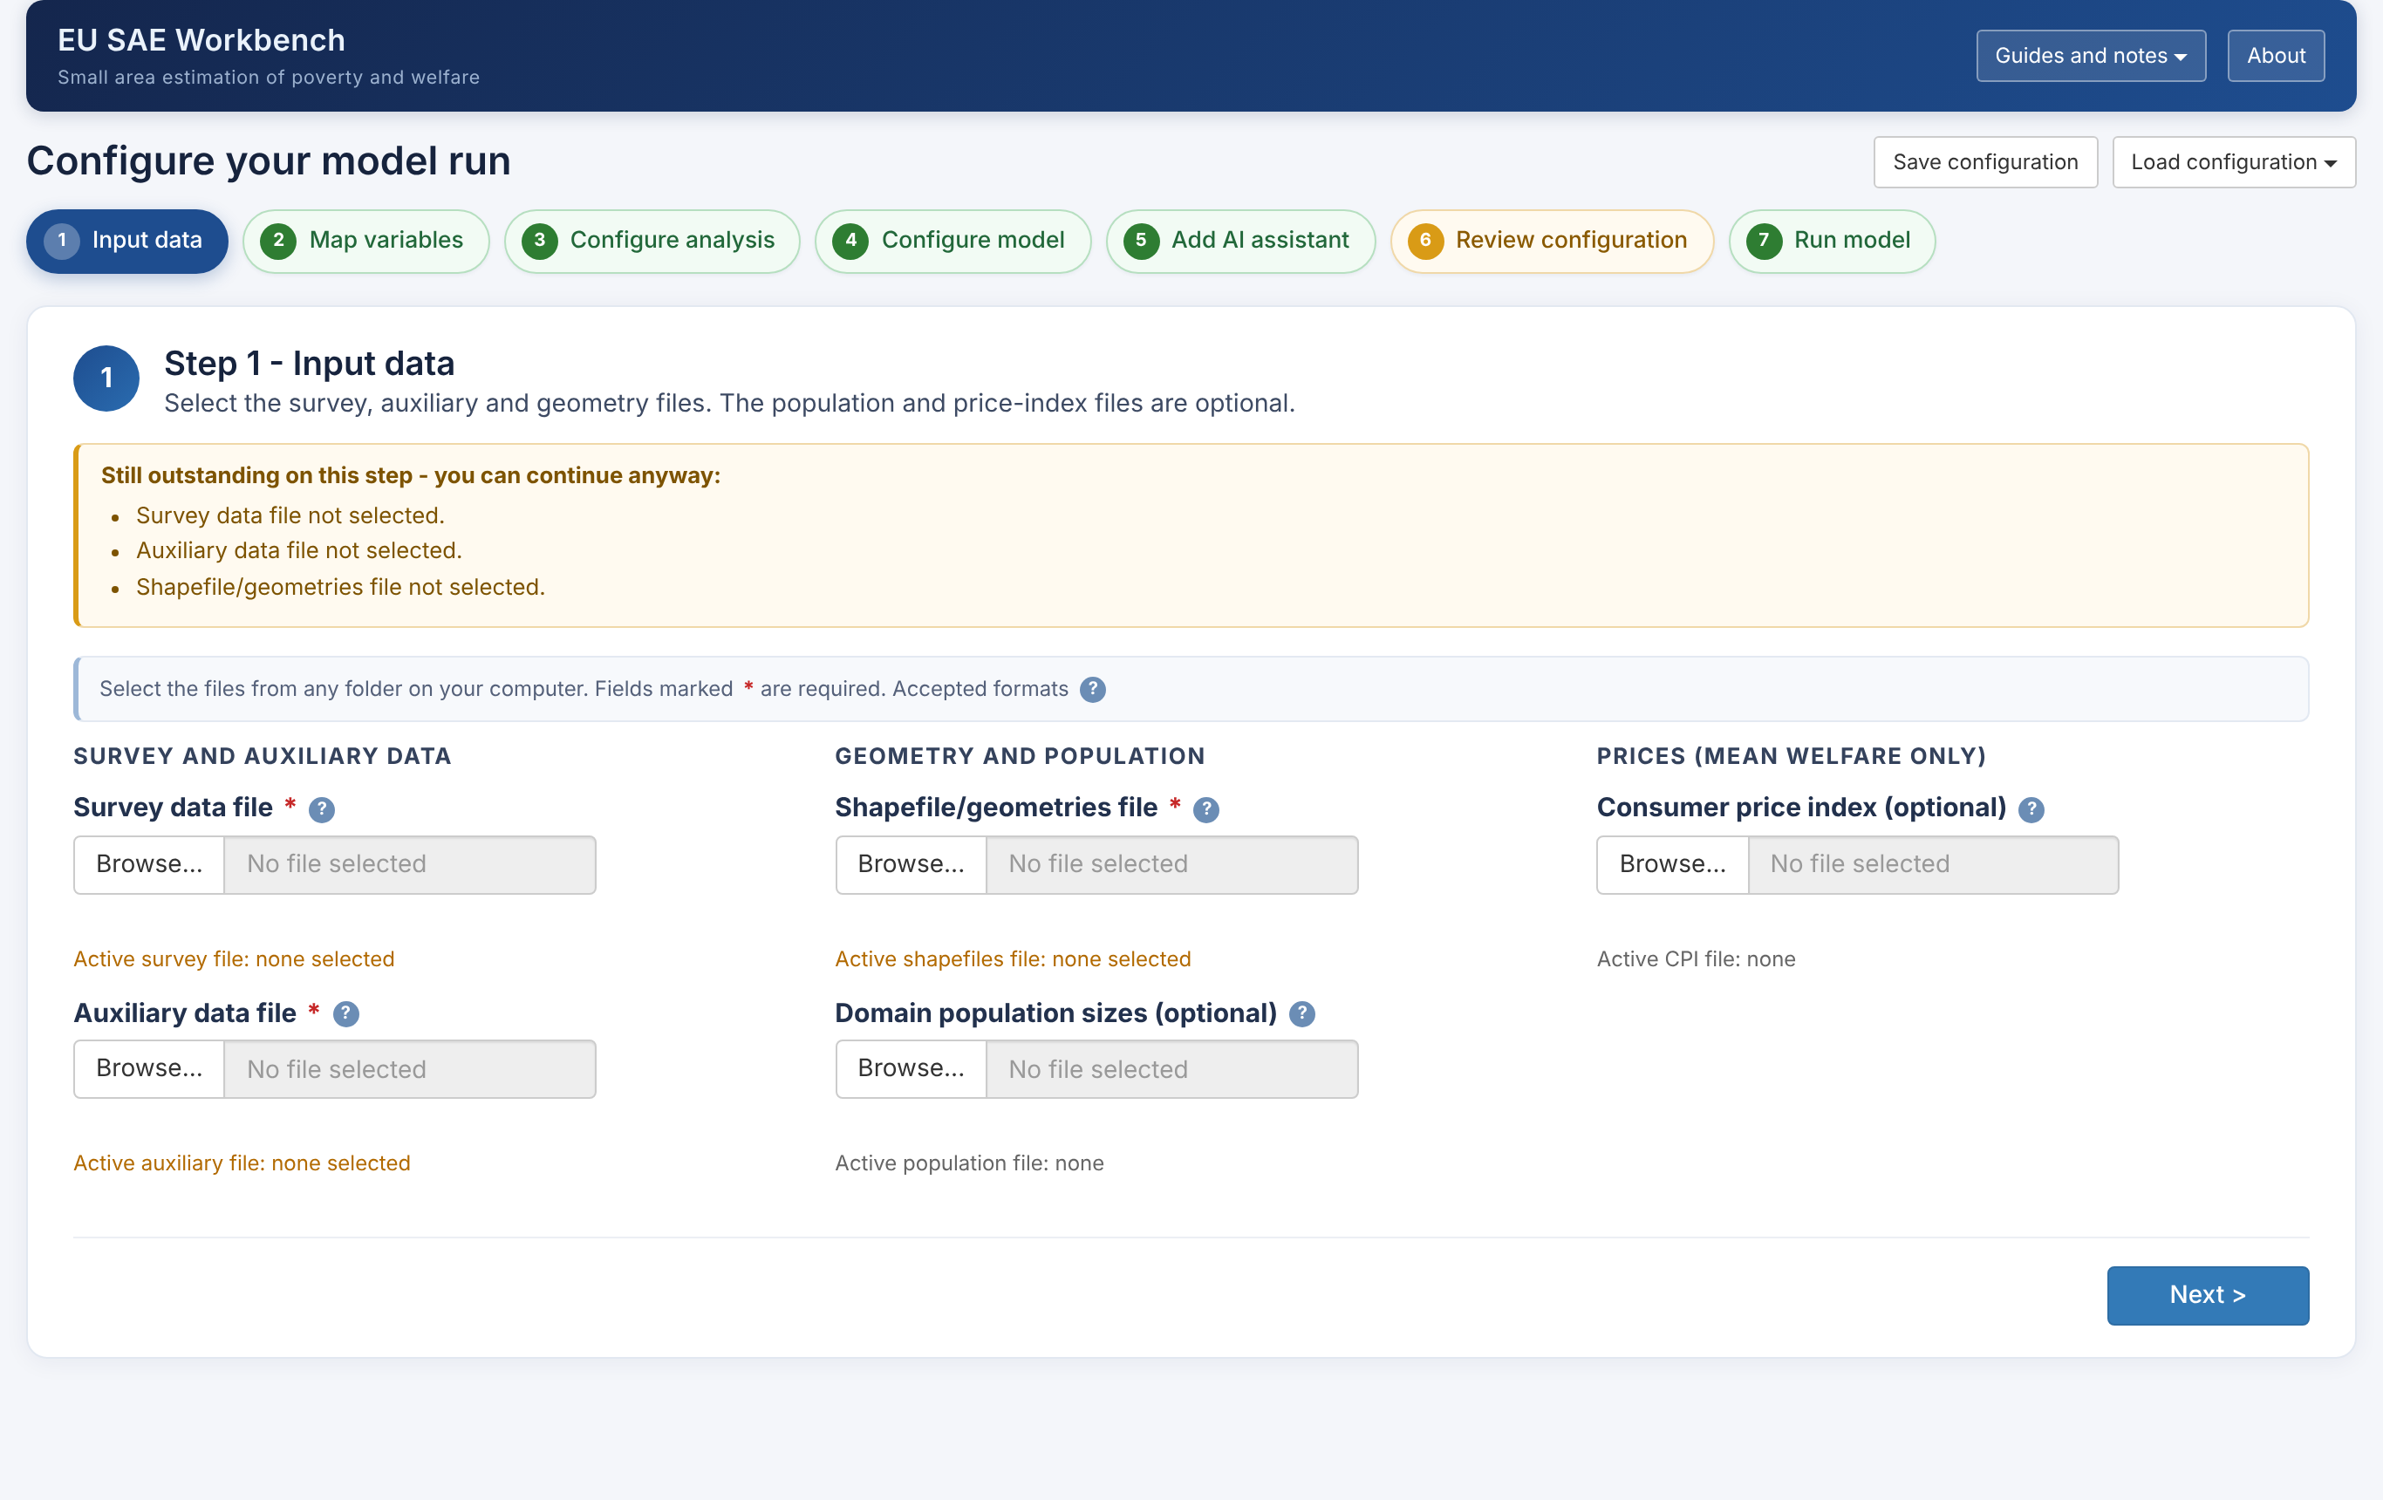
The screen at a glance
ORIENTATION
Every step has the same layout. Step 1 is shown before any file is selected.
1
1
Guides and notes, About
Open the guides from inside the Workbench.
2
3
2
Save and load configuration
Keep all settings for later or for another run.
4
3
Step buttons
Green: done. Amber: missing items. Blue: current. Click to jump.
4
What is still missing
Listed on each step. You can continue anyway.
5
Back and Next
Move through the steps in order.
5

Slide 6
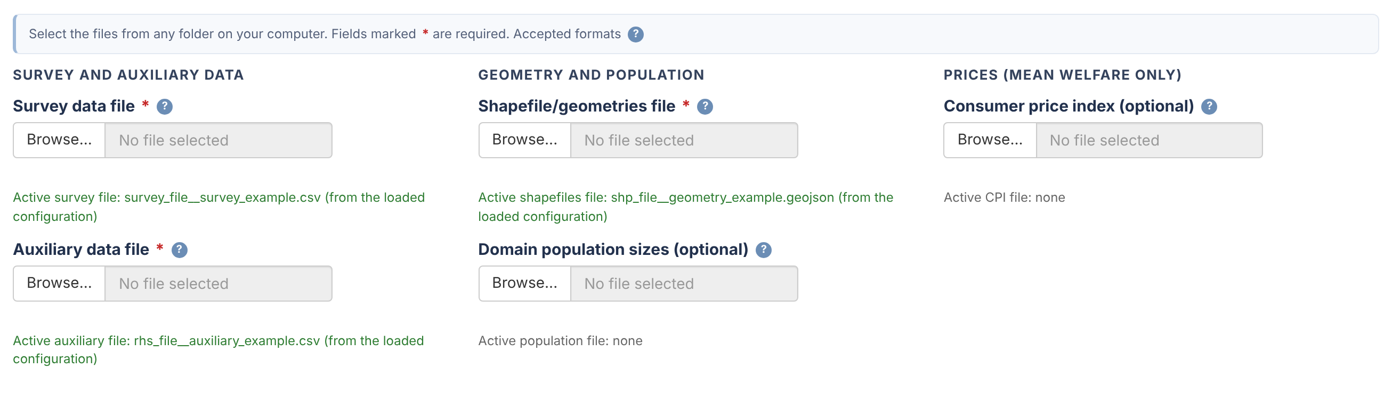
Input data
STEP 1
Browse to each file. Required fields carry a red asterisk.
Required
Survey, auxiliary and geometry files.
Optional
Domain population sizes; a consumer price index for mean welfare.
After loading a configuration
Its files appear under each Browse button. Browse only to change one.

Slide 7
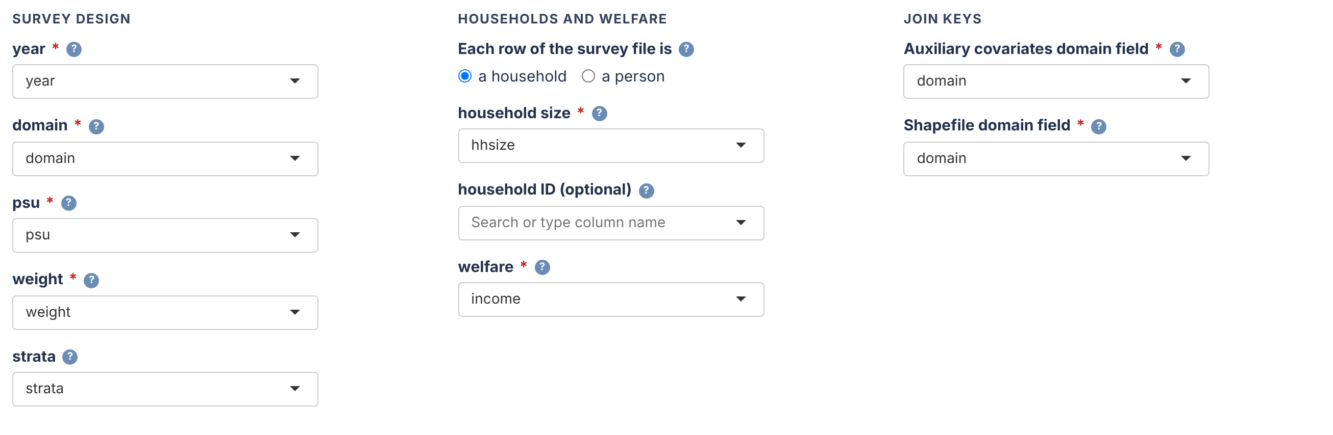
Map variables
STEP 2
Choose the column that holds each variable. The lists show the columns of your files.
Survey design
Year, domain, PSU and weight; strata if the design has them.
Households and welfare
What one row is, household size, and welfare per person.
A field in red
Names a column that is not in the selected file.
Notes:
Simulated example mapping: year=year, domain=domain, psu=psu, strata=strata, weight=weight, household size=hhsize, welfare=income; auxiliary and geometry domain field=domain (Data/simulated/README.md).

Slide 8
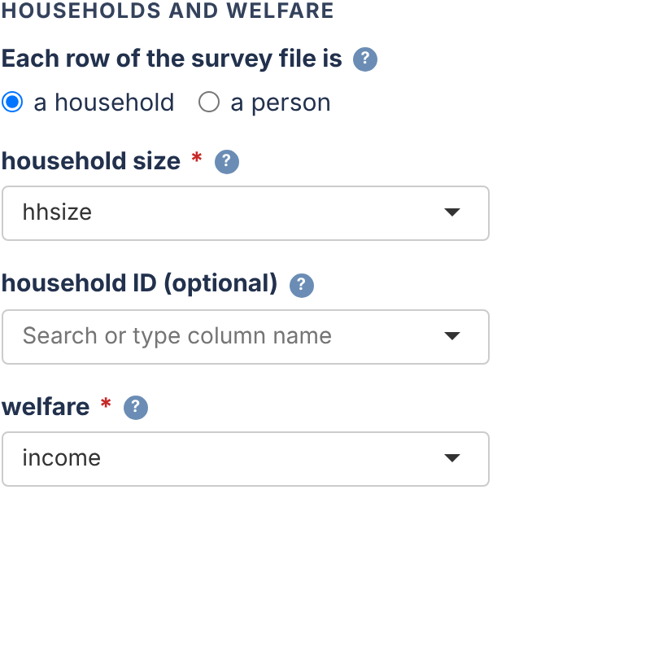
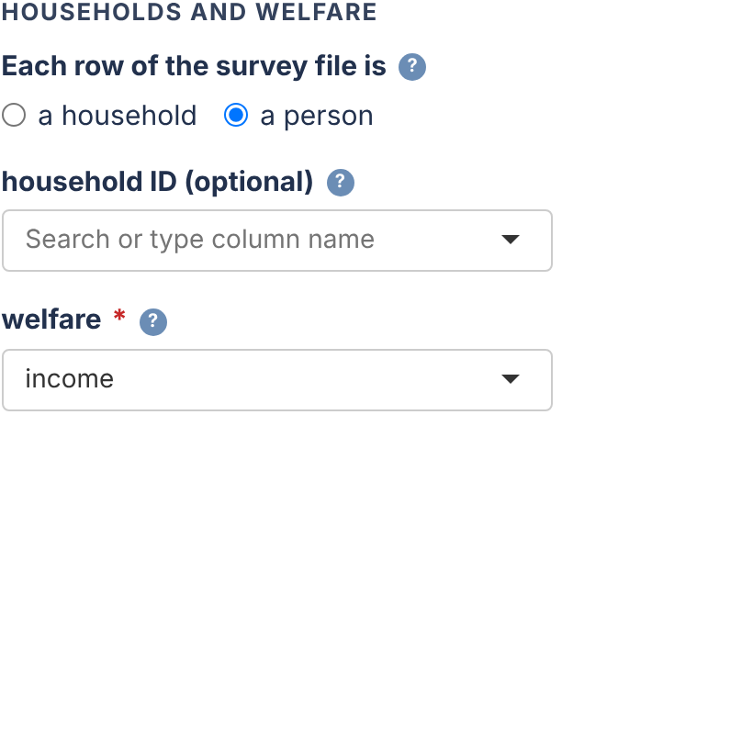
Households or persons?
STEP 2
Tell the Workbench what one row of the survey file is. This decides how people are counted.
A household: weight × household size counts every member.
A person: the weight is used as it is.
Household ID (optional): lets the readiness check confirm the choice.
A person file read as households counts each person once per household member.
A household: household size is required
A person: household size is not used
Notes:
New in w5o. Readiness Test 0f reports the weighted population total and, when a household ID is mapped, stops the run if the file has one row per person but 'a household' is selected (R/pipeline_helpers.R, sae_check_survey_unit). The same check runs in the UFH and MFH steps.

Slide 9
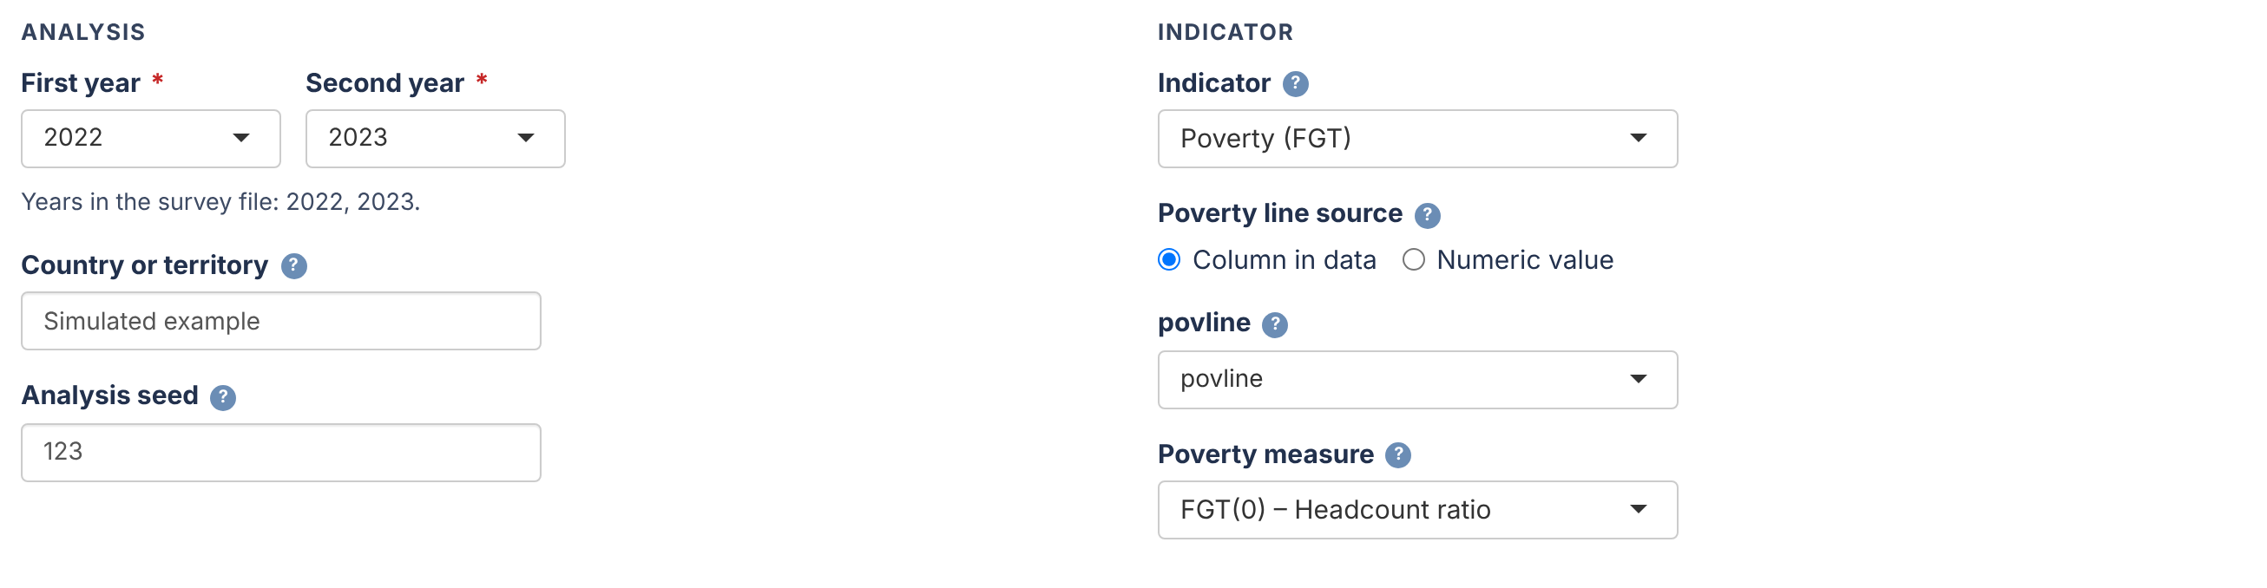
Configure analysis
STEP 3
Pick the two years to compare, then the indicator.
Two years
Chosen from the years found in the survey file.
Analysis seed
The same seed, data, settings and package versions give the same results.
Indicator
A poverty measure (FGT) or mean welfare. Guide 3 covers both.

Slide 10
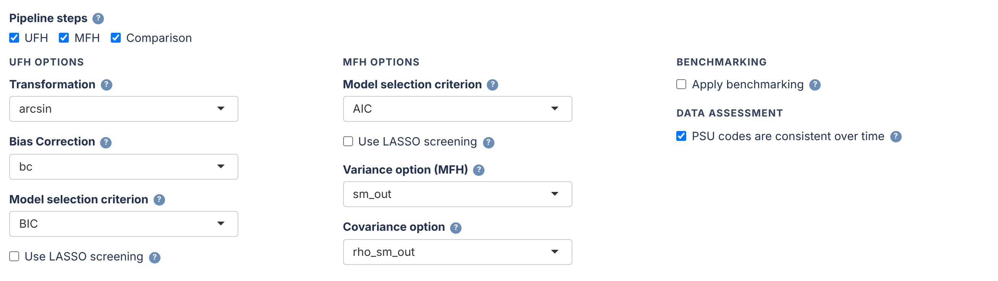
Configure model
STEP 4
Every setting has a default. Check the ones that depend on your data.
Pipeline steps
UFH: one model per year. MFH: both years jointly. Comparison: both side by side.
Defaults
MFH2 and 500 bootstrap replicates. Change them only with a reason.
PSU codes consistent
Under Data assessment: tick only if codes mean the same units in both years.
Notes:
UFH defaults: arcsin transformation with bias correction for poverty rates, BIC; MFH defaults: AIC, sm_out variances, rho_sm_out covariance, MFH2. The PSU answer is recorded with the run; it does not change the estimates. Fewer than 500 replicates are flagged in the Step 6 summary. The example runs in these guides used 100 replicates to save time.

Slide 11
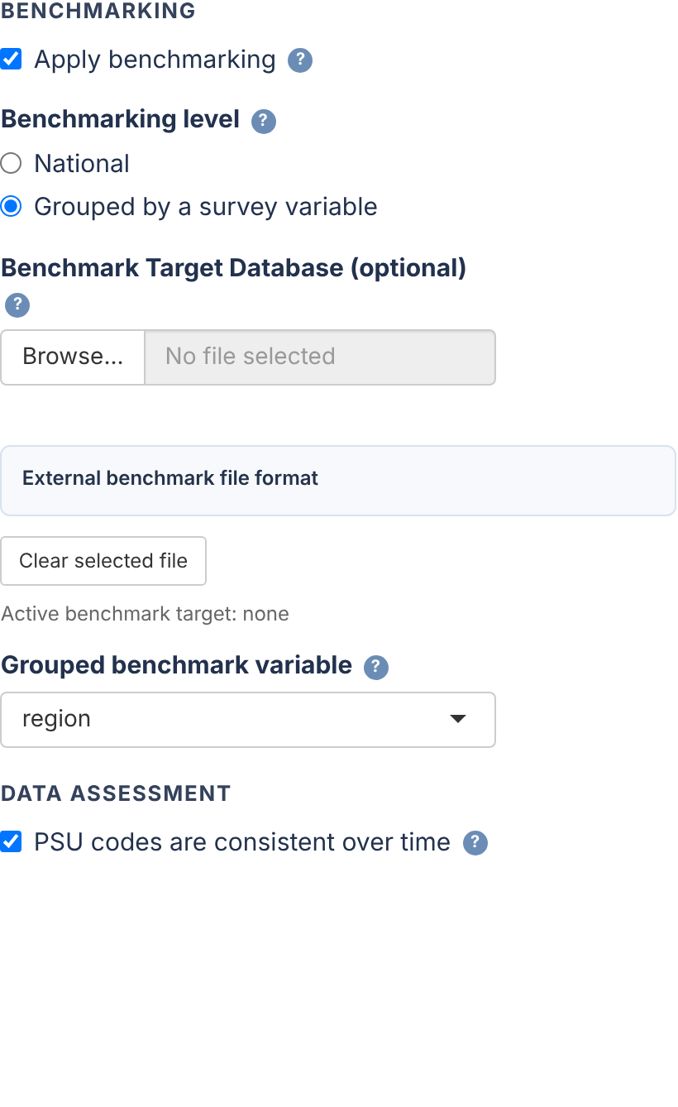
Benchmarking (optional)
STEP 4
Makes the population-weighted average of the domain estimates equal the national or group figure.
National: one constraint for the whole country.
Grouped by a survey variable: one constraint per group, for example region or NUTS2.
Each domain must belong to one group. If a domain has two group codes, the readiness check names it, its codes, years and rows.
Target file (optional): same indicator and prices as the survey. Without it, the survey's direct estimates are the targets.
Notes:
Readiness Test 0g (new in w5o) checks that each domain maps to exactly one benchmark group in the analysis years; the UFH and MFH steps stop with the same message. Uploaded targets are held fixed in the bootstrap; survey-derived targets are recomputed.

Slide 12
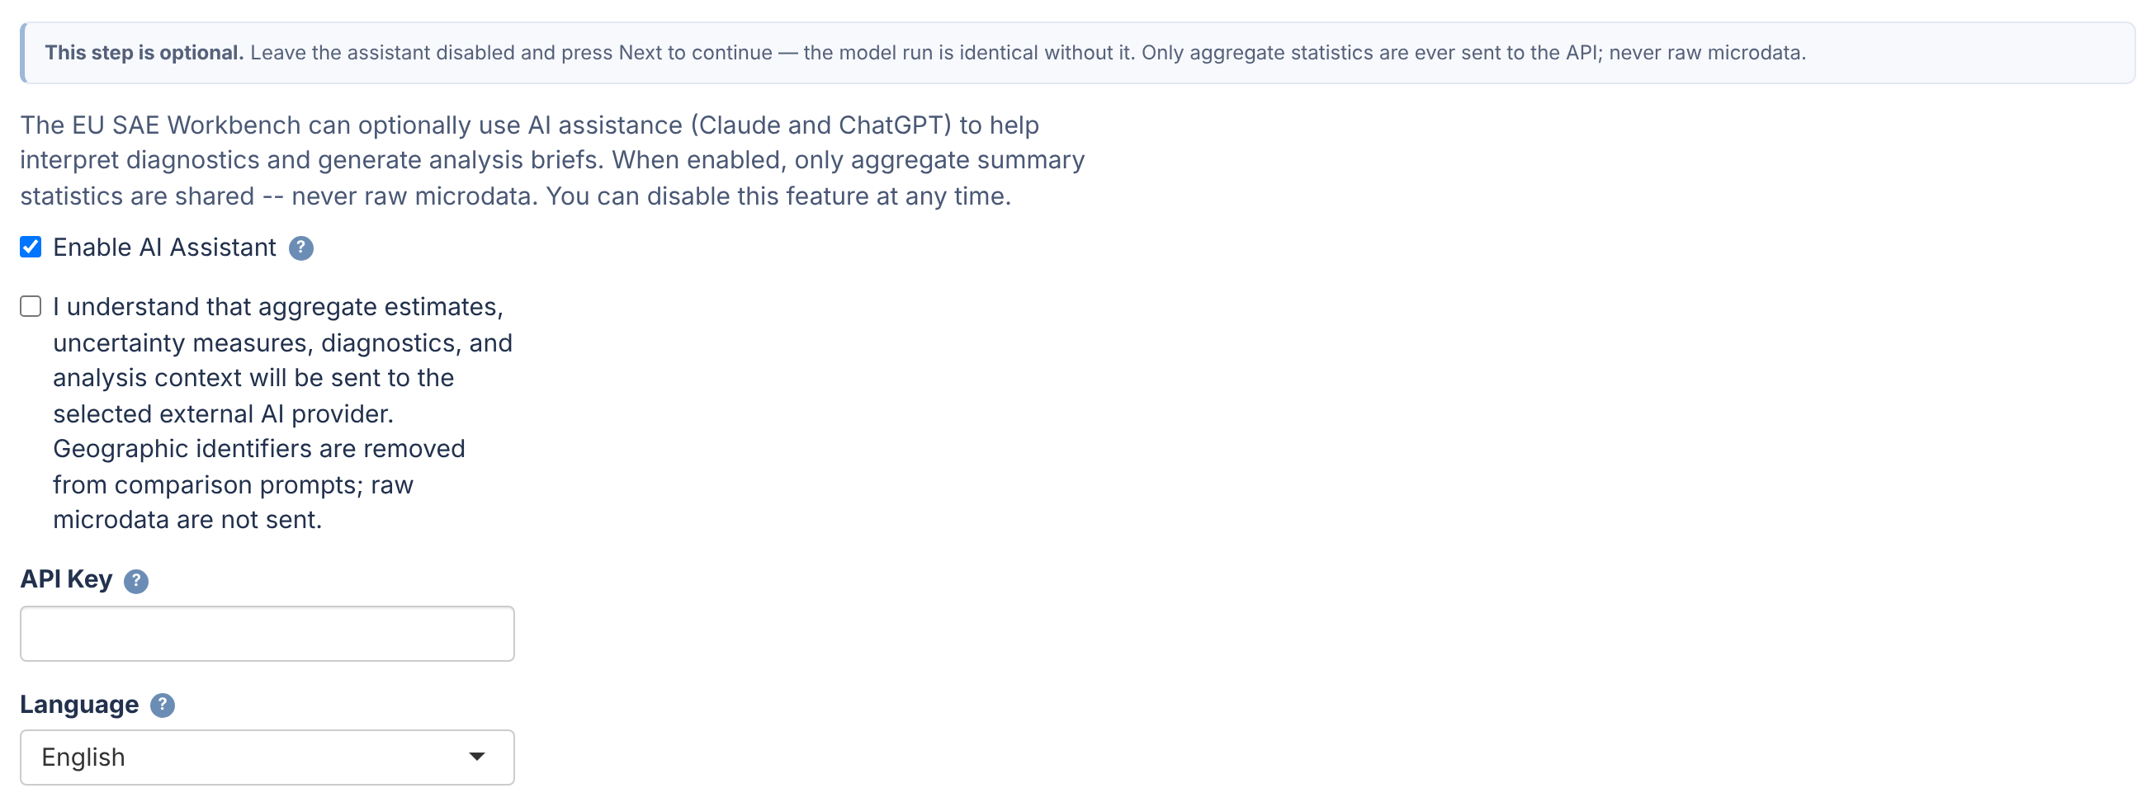
Add AI assistant (optional)
STEP 5
Adds plain-language interpretation to the report. Off by default.
Consent first
Tick Enable and the consent box, then paste a Claude (sk-ant-…) or OpenAI (sk-…) key.
What is sent
Aggregate results only: no microdata, no area names or codes.
Key, language, Comparison
The key is not saved. 24 EU languages and Arabic. Runs with the Comparison step.
Notes:
API keys: Claude Console (platform.claude.com, Settings > API keys) or the OpenAI platform (platform.openai.com/api-keys). API use is billed separately from chat subscriptions. Use only a provider or gateway approved by your organisation. The model run is identical with or without the assistant.

Slide 13
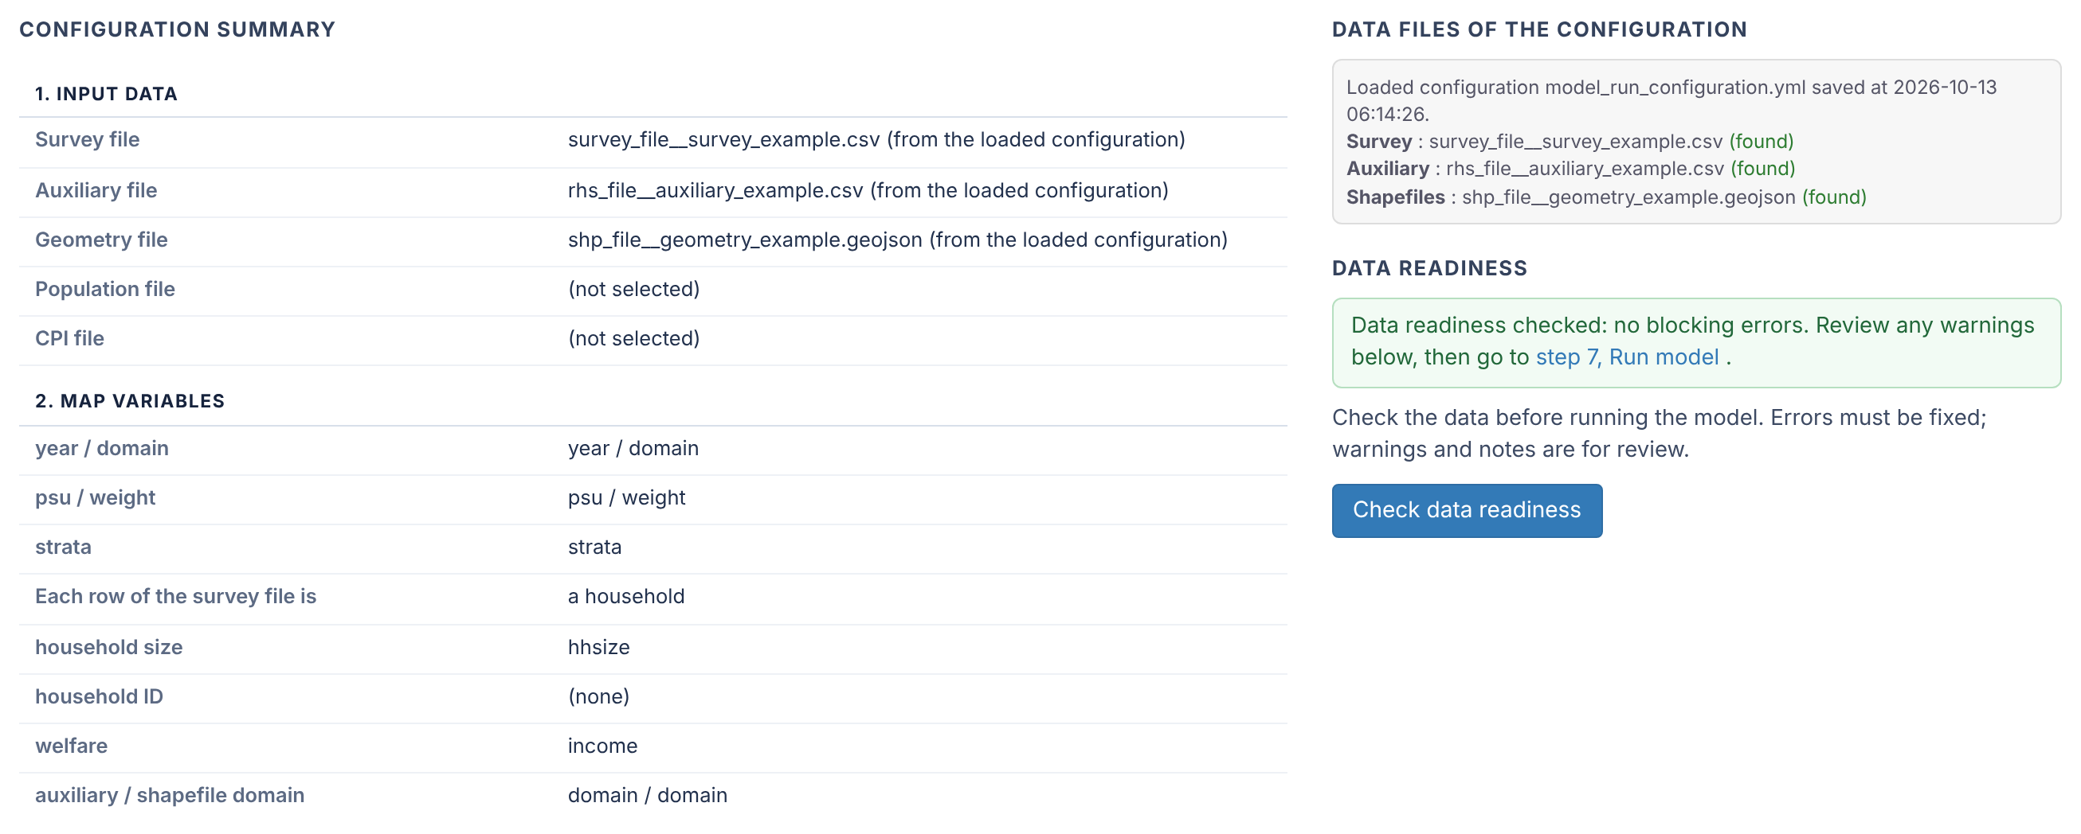
Review configuration
STEP 6
Read the summary, then press Check data readiness.
Summary
Every setting on one page, and where each data file comes from.
Check data readiness
Reads the data and runs the checks. The results appear below the summary.
Changed something?
Check again: the app asks for it after changes to data, mapping, years, indicator or prices.

Slide 14
Reading the data readiness results
STEP 6
ERROR lines must be fixed before the run. WARNING lines and notes are for review.
Test | What it checks
0a, 0b | A year column in both files; both analysis years present in the survey and auxiliary files
0c | Weights and household sizes give valid population weights
0d, 0g | Grouped benchmarking: the group variable exists; each domain belongs to one group
0e | Mean welfare in logs: zero or negative welfare, and positive area means
0f | Households or persons: the weighted population total and, with a household ID, the row type
1 | Covariates: means and correlation with the indicator
2, 3 | The same domains in all files; areas without a direct estimate
4 | The national poverty rate or mean welfare in each year
Further down the same tab: the national rate by year, domain consistency, areas without estimates and the covariate summary.
Notes:
Test labels as printed in the Data Readiness tab (R/validation_checks.R, R/pipeline_helpers.R, app.R). Below the messages the tab shows the national rates, domain consistency, missing estimates and the covariate summary. Passing the readiness check permits estimation; it does not establish model fit.

Slide 15
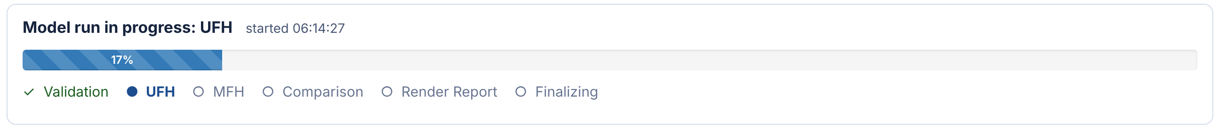
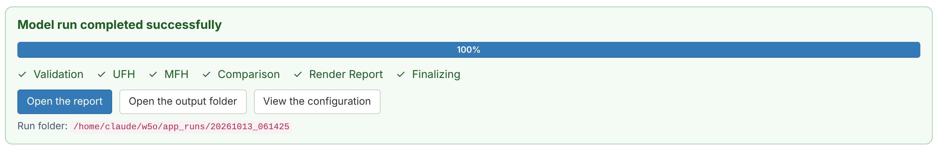
Run model
STEP 7
The run continues in the background. The page shows each stage, then the result.
While the model runs: the stage and its progress
When it is complete: open the report, the output folder or the configuration
Stop ends a run. If a run fails, the panel shows the reason and a button to open the run folder.

Slide 16
Where the results are
RESULTS
outputs/ holds the latest run. Every run is also kept in its own folder.
File or folder | What it contains
outputs/final_report.html, .docx | The report: maps, tables, diagnostics and changes. The Word file is editable.
outputs/data/ | Excel workbooks with Direct, UFH and MFH estimates, MSE, RMSE and CV, and the changes
outputs/figures/ | Maps and charts as PNG files
outputs/tables/ | CSV tables: readiness, fit checks and bootstrap diagnostics
app_runs/<date_time>_<label>/ | A copy of the run's outputs, its log and model_run_configuration.yml
Each run replaces outputs/. To edit the Word report, work on a copy, or use the copy under app_runs/.

Slide 17
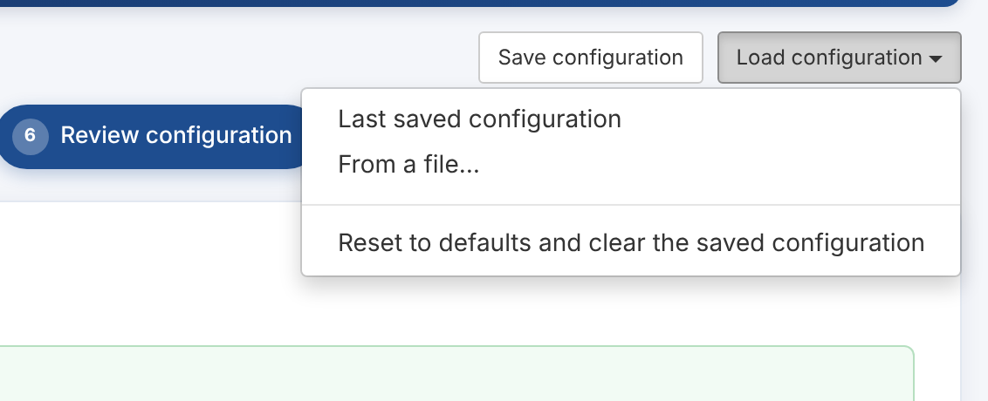
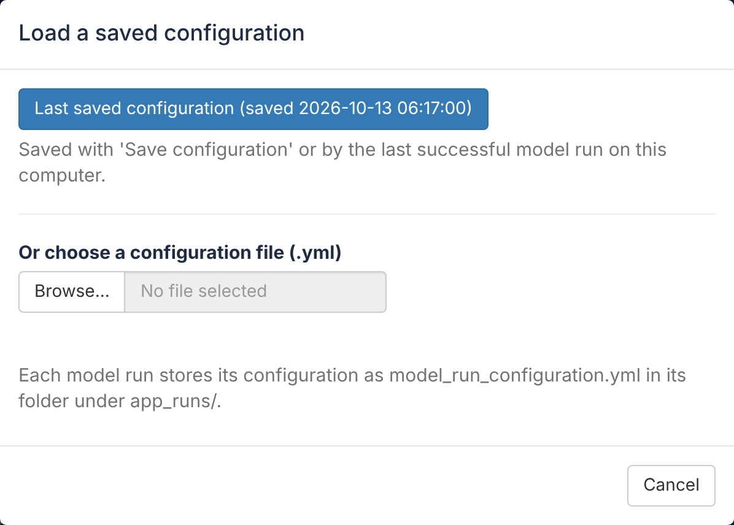
Save, load and repeat a run
CONFIGURATIONS
A configuration holds every setting and where the data files are. Reuse it instead of starting again.
Load configuration menu, on every step
Load saved configuration, on the front page
Save configuration: keeps the settings and copies of the data files in app_runs/_last_setup_files.
Load: the last saved configuration, or a file such as a run's model_run_configuration.yml. The review step opens.
Changed data file? Loading warns if a file differs from the one the configuration was saved with.
Reset to defaults deletes the saved file copies; older run configurations then need their files browsed again.
Notes:
Run configurations point to the copies in app_runs/_last_setup_files. Browsing a corrected file with the same name replaces its copy; loading an older configuration then shows the changed-file warning (SHA-256 checksums recorded with each save and run).

Slide 18
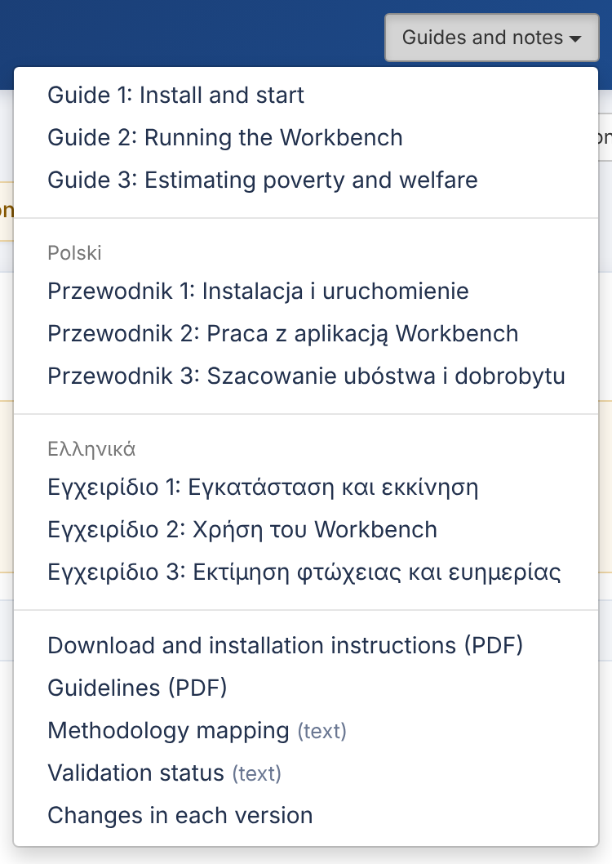
Help inside the Workbench
HELP
Three places to look before asking.
?
Question marks
Hover over the ? next to a field for what it means and which values it accepts.
G
Guides and notes
The three guides in English, Polish and Greek, the guidelines note, the methodology mapping, the validation status and the changes in each version.
i
About
The version you are using.
Problem reports: github.com/Noboyoshida227/eu-sae-application/issues. Attach the run log, never the data.
Guides and notes menu

Slide 19
Every run, in short
CHECKLIST
Before you report results, check more than the map.
Step | Check
1 Input data | The three required files; CPI or population file if needed
2 Map variables | No red fields; household or person rows; household size
3 Configure analysis | Two years from the survey; indicator and poverty line or prices
4 Configure model | Defaults unless you have a reason; PSU answer; benchmarking
5 Add AI assistant | Off, or consent and key
6 Review configuration | Summary read; readiness without ERROR
7 Run model | Report opened; diagnostics, bootstrap results and changes reviewed
Guide 3 shows the settings and the reading of results for poverty, anchored poverty and mean welfare.
Notes:
Before using results: inspect model convergence, bootstrap success and Monte Carlo diagnostics, covariance repairs and benchmark constraints. When an MFH fit is at a variance or correlation boundary, change significance is provisional. Nominal interval coverage is not certified (docs/MCPE_VALIDATION_STATUS.md).

