Slide 1





EU SAE WIZARD & DASHBOARD · 2026
A Practical Guide
to EU_SAE_application_package
Small Area Estimation of poverty and welfare indicators - from setup to outputs.
Front page of the EU SAE app (wizard and dashboard)
Wizard 5.14 · Pre-release for review
Open Start_Here to choose a launcher
Optional: AI with Claude or ChatGPT
Prepared by Nobuo Yoshida
Notes:
User guide for the EU_SAE_520_w5n pre-release, version 5.2.0-rc.6-wizard.5.14, published on GitHub Releases for review by the country teams. It is not a certification of interval coverage. Numerical examples illustrate interpretation and are not validated current country results. Methodology sources: docs/METHODOLOGY_ALIGNMENT.md; docs/MCPE_VALIDATION_STATUS.md; Molina and Romero, Comparable Small Area Estimates over Time, supplied manuscript dated 29 January 2025; Harmening and coauthors, supplied EMDI area-level note. Implementation checked for wizard 5.14 QER candidate (10 October 2026).

Slide 2
OVERVIEW
What you’ll learn
Four parts: setup, the complete wizard, worked examples and optional AI guidance.
01 Setup
Install R, download the app and prepare the required and supplementary datasets.
02 The complete wizard
Follow all six steps, from loading data to checking readiness, running the analysis and finding outputs.
03 Worked examples
Apply the wizard to year-specific poverty, anchored poverty and real mean welfare.
04 AI Assistant (optional)
Set up an approved Claude or ChatGPT provider and review the AI guidance.
EU SAE Wizard & Dashboard · User Guide
2 / 57

Slide 3




OVERVIEW
What is the EU SAE application?
Two interfaces over one analysis engine for small area estimates of poverty and mean welfare.
Two entry points
Check readiness
Inputs and diagnostics, before any model
Use the wizard (six guided steps) or the classic dashboard (one sidebar). Both load survey, auxiliary and geometry data, fit Fay–Herriot models (UFH and MFH), compare them with maps and tables, and can add AI-assisted interpretation.
UFH
Univariate Fay–Herriot: one model per year
MFH
Multivariate Fay–Herriot: years modelled jointly
Compare
Launchers for every system: Start_Here/
UFH vs MFH maps and precision
EU SAE Wizard & Dashboard · User Guide
3 / 57
Notes:
Revision note: merges the former 'three-step pipeline' slide. The model sequence is no longer numbered as steps, to avoid confusion with the six wizard steps. Which models run is chosen under Pipeline steps in wizard Step 4.

Slide 4
OVERVIEW
What you can estimate
Three indicator families, all from the same survey-plus-auxiliary inputs.
INDICATOR 1
INDICATOR 2
INDICATOR 3
Poverty rate
Gap & severity
Mean welfare
FGT(0) · headcount
FGT(1) and FGT(2)
Income or consumption
Share of the population below the poverty line — the standard poverty rate.
Depth of poverty (average shortfall) and severity (more weight on the poorest).
Population-weighted mean welfare (optional log scale), in current or constant prices; changes reported in %.
EU SAE Wizard & Dashboard · User Guide
4 / 57

Slide 5
OVERVIEW
Key terms
Used throughout the guide. Units matter: welfare is per person.
Term | Meaning
Domain | The small area you estimate for (e.g., province); same ID in all three files
Direct estimate | The survey-only estimate for a domain, before any model
UFH / MFH | Fay–Herriot models: one year at a time / both years jointly
PSU | Primary sampling unit: the cluster or area drawn at the first sampling stage
Welfare | Income or consumption per person (per capita or equivalised), not the household total
Weight × household size | How many people each household record represents
RMSE, CV | RMSE = √MSE; CV = RMSE ÷ estimate (×100 when shown as a percentage)
EU SAE Wizard & Dashboard · User Guide
5 / 57
Notes:
Definitions follow the app's mapping help text (app_wizard.R) and scripts/population_helpers.R (person weight = weight × household size).
MSE is the expected squared prediction error and includes both variance and squared bias. RMSE is its square root, in the indicator units. A lower estimated RMSE does not by itself establish correct confidence-interval coverage.

Slide 6

PART 01
Setting up
your computer
Install R, download and launch the app, then prepare your data files.
6 / 57
Notes:
Visual source: AI-generated abstract data-network background, created with the built-in image-generation tool, 7 October 2026. Decorative illustration; not a map or analytical result.

Slide 7




SETUP
Prerequisites at a glance
R and the app are required. Pandoc supports report generation; AI keys are optional.
R
EU SAE app
R 4.2 or later (your approved version)
Wizard and dashboard, from GitHub Releases
cran.r-project.org
eu-sae-application/releases
AI keys
Report generation
Optional · Claude or ChatGPT
Pandoc 2.17+ supports HTML and Word reports. The app finds it or downloads a copy online.
see Part 4 of this guide
RStudio users: see slide 8
EU SAE Wizard & Dashboard · User Guide
7 / 57
Notes:
R and the app are required. Report generation uses Pandoc. The launcher searches for Pandoc 2.17 or later for both HTML and Word reports and downloads a pinned, checksum-verified copy if none is found and downloads are allowed. For users already working in RStudio, updating RStudio Desktop is a convenient remedy when Pandoc is missing or too old. Install the latest stable RStudio compatible with the computer, then restart the wizard. Standalone Pandoc 2.17+ is another option. An existing compatible Pandoc installation needs no update. RStudio itself is optional. Sources: Start_Here/README.md; R/pandoc_bootstrap.R; https://rmarkdown.rstudio.com/docs/reference/find_pandoc.html .

Slide 8

SETUP · 1 OF 4
Install R and check report tools
R runs the app. Pandoc generates HTML and Word reports.
1
Go to cran.r-project.org
2
Choose Download R for Windows, macOS or Linux
Report generation
3
Run the installer with its default options
RStudio bundles Pandoc. Update to the latest stable version compatible with your computer, then restart the wizard. Alternative: standalone Pandoc 2.17+.
4
RStudio users: update RStudio Desktop if Pandoc is missing or too old.
EU SAE Wizard & Dashboard · User Guide
8 / 57
Notes:
Install an approved R version, 4.2 or later, before using the Start_Here launchers. RStudio is optional, but existing RStudio users can update it if Pandoc is unavailable or too old for report generation. Install the latest stable RStudio version compatible with the computer and restart the wizard. The newest Pandoc release is not required. Pandoc 2.17+ supports the app’s HTML and Word reports. The launcher can download a suitable copy if needed. Standalone Pandoc is an alternative, including for offline preparation. Sources: https://cran.r-project.org/ ; https://rmarkdown.rstudio.com/docs/reference/find_pandoc.html ; R/pandoc_bootstrap.R .

Slide 9
SETUP · 2 OF 4
Download the app
Pre-release 5.2.0-rc.6 (wizard 5.14) is the file EU_SAE_520_w5n.zip on GitHub Releases.
1
Under Assets of the pre-release, download EU_SAE_520_w5n.zip from github.com/Noboyoshida227/eu-sae-application/releases — not the "Source code" archives.
EU_SAE_520_w5n/
├── Start_Here/
├── app.R + app_wizard.R
├── R/ + scripts/ + tests/
├── Data/ (examples)
├── docs/
├── outputs/ (empty)
├── LICENSE + NOTICE
└── release_manifest.csv
2
Windows: right-click the ZIP → Properties → tick Unblock (if shown) → OK, then Extract All. macOS: double-click the ZIP.
3
Extract to any convenient folder. You get EU_SAE_520_w5n (5.2.0, wizard 5.14).
4
Open EU_SAE_520_w5n. Launchers are in Start_Here. Example data: Data/simulated/ and Data/Spain/.
EU SAE Wizard & Dashboard · User Guide
9 / 57
Notes:
The pre-release is published on GitHub Releases, marked Pre-release. Keep a separate copy of earlier installations and saved results when reviewing a new version. Package name: EU_SAE_520_w5n, wizard 5.14.

Slide 10


SETUP · 3 OF 4
Launch the app
Open Start_Here and double-click the launcher for your system. If macOS blocks it: System Settings › Privacy & Security › Open Anyway (macOS 14 and earlier: right-click › Open).
Windows: Start_Wizard.bat macOS: Start_Wizard.command
Linux: bash Start_Wizard.command
First launch
Click Start an analysis
Classic dashboard
Missing R packages install first (internet needed). Then the front page opens in your browser.
The wizard opens at Step 1 — Data.
For the alternative interface, use Start_Dashboard.bat or Start_Dashboard.command.
EU SAE Wizard & Dashboard · User Guide
10 / 57
Notes:
[Sources]
- Start_Here/README.md
[/Sources]
Revision note: merges the former 'Automatic package installation' slide. On first launch the launcher installs missing packages, including shiny, emdi, sae, msae, survey, dplyr, tidyr, data.table, readxl, haven, ggplot2, sf, viridis, patchwork, rmarkdown, knitr, gt, xml2, zip, httr, jsonlite and base64enc. Keep the launch window open. macOS guidance follows Start_Here/README.md (macOS 15+: Open Anyway; macOS 14 or earlier: right-click › Open).

Slide 11
SETUP · 4 OF 4 · PREPARE YOUR DATA
Three required files
You select all three in wizard Step 1 with Browse; they can sit in any folder.
DATASET 1
DATASET 2
DATASET 3
Survey
Auxiliary
Geometry
Household microdata
Subnational aggregates
Geographic boundaries
One row per household: year, domain ID, PSU, household weight, household size and per-person welfare (per capita or equivalised, not the household total). Optional: strata.
One row per domain and year (long format): domain ID, year and candidate covariates, covering both analysis years.
Polygons for the target domains, with a domain ID that matches the survey and auxiliary files.
EU SAE Wizard & Dashboard · User Guide
11 / 57
Notes:
Code check (release 5.2.0-rc.6-wizard.5.12): household size is a required mapping and person weights are weight × household size (scripts/population_helpers.R); the auxiliary file needs a year column (R/validation_checks.R). Accepted formats are on the next slide.
Mean-welfare models first calculate the person-weighted arithmetic area mean from eligible records, retaining zero and negative individual welfare values. A log model requires each modelled area mean to be positive and finite.

Slide 12
SETUP · 4 OF 4 · PREPARE YOUR DATA
Data formats are very flexible
Each input accepts many common formats — the app reads them automatically.
SURVEY
AUXILIARY
GEOMETRY
Household data
Area covariates
Boundaries
Any table format
Any table format
Any GIS format
RDS/RData, CSV, TSV, TXT, DAT, Stata, SPSS, SAS, Parquet, Feather and Excel. Person-level file? Add a household-size column of 1s.
The same table formats as the survey: RDS/RData, CSV/TSV/TXT/DAT, Stata, SPSS, SAS, Parquet/Feather, and Excel.
ESRI shapefile .zip (with valid .shp/.shx/.dbf), RDS/RData, GeoPackage (.gpkg), GeoJSON/JSON, KML, and GML.
EU SAE Wizard & Dashboard · User Guide
12 / 57

Slide 13
SETUP · 4 OF 4 · PREPARE YOUR DATA
Supplementary datasets
Add these files when the chosen analysis or benchmarking needs them.
CPI database
Optional. Needed only to convert current-price welfare to constant prices; not needed if welfare is already real. Type CPI values in Step 3, or load a file here (one row per year: year and CPI).
Population data
Optional; used for benchmarking. Domain totals by year, long or wide. Without it, the app uses the sum of weight × household size.
Benchmark targets
Optional; loaded in Step 4. Same indicator and the same prices as the survey welfare you upload. Under CPI conversion, supply current-price targets; the app converts them.
CPI and population files are loaded in Step 1. Years and prices are explained at the start of Part 3.
EU SAE Wizard & Dashboard · User Guide
13 / 57
Notes:
Sources: app_wizard.R Step 1 inputs and Step 3 price-index inputs (CPI values can be typed by year, the default, or read from the CPI file); scripts/population_helpers.R (long or wide population files; used when benchmarking is on); scripts/01_ufh.R and 02_mfh.R (uploaded mean-welfare targets get the same CPI factors as welfare).
Ratio benchmarking operates in the final reported units. In bootstrap replicates, survey-derived targets are recomputed from replicate direct estimates. Uploaded targets are held fixed, so their uncertainty is not modeled.

Slide 14
PART 02
The wizard,
step by step
Six steps from data to run. The classic dashboard offers the same controls in one sidebar.
14 / 57
Notes:
Visual source: AI-generated abstract data-network background, created with the built-in image-generation tool, 7 October 2026. Decorative illustration; not a map or analytical result.

Slide 15

FRONT PAGE
Start here — the front page
The first screen in both interfaces. Click Start an analysis to open the workspace.
localhost:####
What you'll find
Wizard: six steps on a clickable breadcrumb · Dashboard: one sidebar
Check Data Readiness, then Run Analysis
Preflight — live input checks (wizard Step 6)
Data Readiness — filled by Check Data Readiness (Step 6)
Status — progress, run folder and output locations
EU SAE Wizard & Dashboard · User Guide
15 / 57

Slide 16
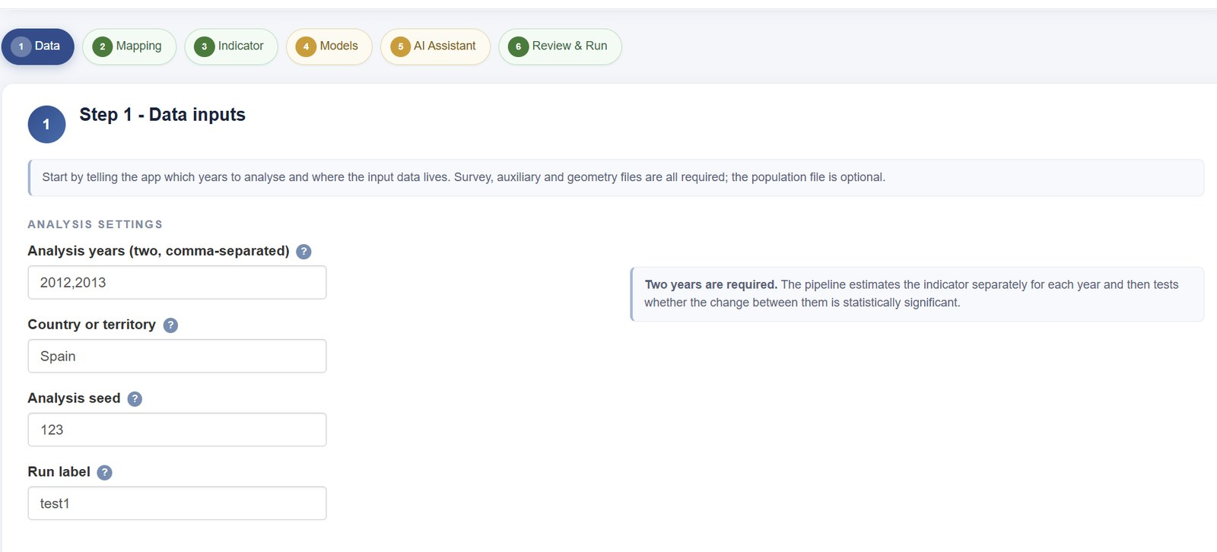
WIZARD
The wizard at a glance
Every one of the six steps shares this layout. Step 1 shown.
Breadcrumb
where you are, and what is still outstanding
Guidance banner
what this step is for, in one line
Form column
the inputs; help panels sit to the right
Back / Next
at the bottom of each step; nothing is locked
EU SAE Wizard & Dashboard · User Guide
16 / 57

Slide 17
WIZARD
Three things to watch
The parts of the screen that tell you whether the run will work.
Breadcrumb - green is complete, amber has an outstanding item, blue is the current step. Clickable.
Validation — green confirms the step; red lists what to fix (here: grouped benchmarking is on but no variable is chosen).
Navigation — Next always works. Only Run Analysis is gated: it runs after Check Data Readiness passes without errors.
EU SAE Wizard & Dashboard · User Guide
17 / 57

Slide 18
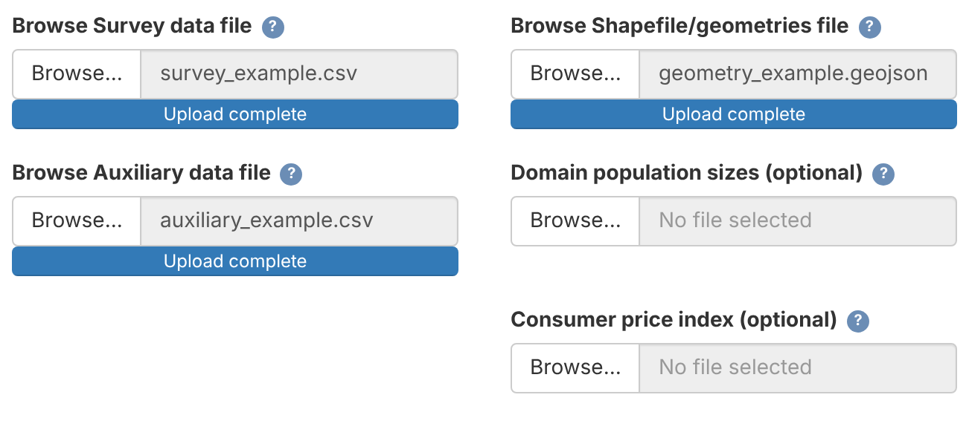
WIZARD · STEP 1 — DATA
Step 1 — Data
Example survey years 2022 and 2023. Set the analysis years, then select the files.
Setting | Example
Analysis years | 2022,2023
Country or territory | Simulated example
Analysis seed | 123
Run label | example_2022_2023
Analysis years
Two survey years, separated by a comma.
Country, seed and run label
Country appears in the report. The seed controls reproducibility. The run label names the archived outputs.
Below the settings: the input files
Survey, auxiliary and geometry files are required.
Population and CPI files are optional. CPI can also be typed in Step 3.
Simulated data: 2022–2023.
EU SAE Wizard & Dashboard · User Guide
18 / 57
Notes:
Example analysis settings for the bundled simulated data: survey years 2022 and 2023, seed 123, run label example_2022_2023. The file-picker screenshot shows the wizard 5.12 interface with Data/simulated files. Enter survey years in Step 1. The examples below use the previous-calendar-year income convention, so income reference years are 2021 and 2022.
The pictured file controls illustrate input selection. Interface screenshots taken before wizard 5.14 remain applicable where the controls are unchanged.

Slide 19
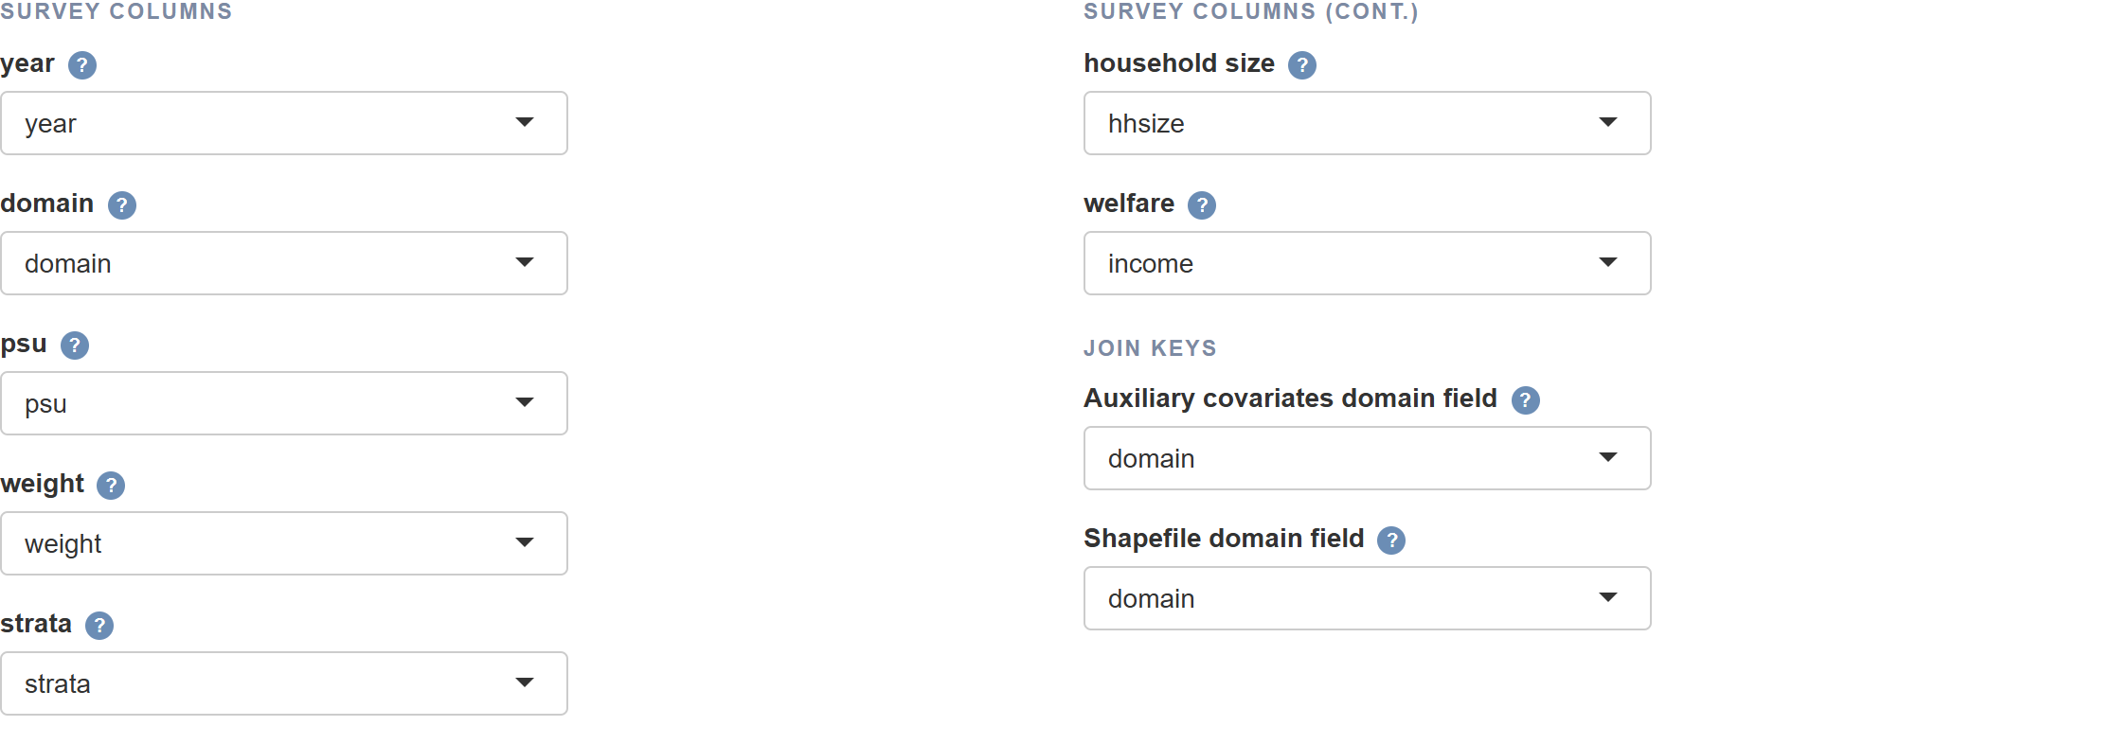
WIZARD · STEP 2 — MAPPING
Step 2 — Variable mapping
Tell the app which column holds which variable.
strata: select the sampling-stratum column when available, otherwise leave blank. welfare: per person. weight: household weight. Match domain IDs across files. Choose the poverty-line column in Step 3. Red = column name not found.
EU SAE Wizard & Dashboard · User Guide
19 / 57
Notes:
The screenshot shows the current wizard with the bundled Data/simulated CSV example files, survey years 2022 and 2023. The optional strata mapping selects the example strata column. Use the survey’s actual sampling-stratum identifier when available. Leave the mapping blank if the survey design has no strata or strata are unavailable. Do not substitute a geographic grouping variable unless it actually identifies the sampling strata. Source: app_wizard.R, Step 2 variable mapping controls.

Slide 20
WIZARD · STEP 3 — INDICATOR
Step 3 — Indicator
Choose what to estimate and confirm the welfare and price basis.
Indicator
Choose Poverty (FGT) or Mean welfare. For headcount rates, choose FGT(0) under Poverty measure.
Poverty lines
Poverty line source: Column in data (choose the column here) or Numeric value (one per analysis year). Match the welfare’s currency, period and units.
Mean-welfare prices
Default: current prices, no conversion (changes include inflation). For real changes, convert with a price index, or choose constant prices already.
Part 3 shows the Step 3 settings for each worked example.
EU SAE Wizard & Dashboard · User Guide
20 / 57
Notes:
General wizard Step 3 overview. Source: app_wizard.R indicator and welfare price controls. For anchored poverty, type each survey year's anchored line under Numeric value, or supply the lines in a survey column and select it.

Slide 21
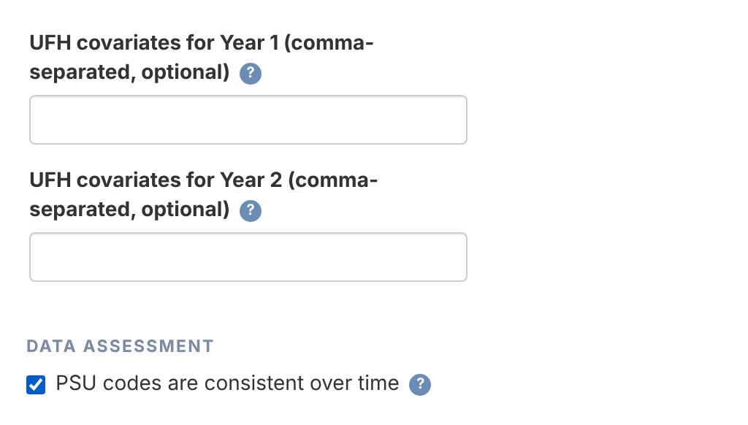
WIZARD · STEP 4 — MODELS
Step 4 — Covariates and PSU consistency
Every Step 4 option has a default. Check these two before you run.
Covariates
One comma-separated list per year, for UFH and for MFH. Blank: stepwise selection picks from all numeric auxiliary columns.
LASSO
Off (default): a list you type is a fixed model. On: LASSO screens the list as a candidate pool before stepwise selection.
PSU consistency
Under Data assessment, tick PSU codes are consistent over time only if the same PSU codes identify the same sampling units in both years. It is recorded with the run settings and does not change the estimates.
Wizard Step 4 (simulated example data)
Pipeline steps at the top of Step 4 choose which of UFH, MFH and Comparison run; all three are on by default.
EU SAE Wizard & Dashboard · User Guide
21 / 57
Notes:
Sources (release 5.2.0-rc.6-wizard.5.12): app_wizard.R Step 4 — 'UFH covariates for Year 1/2', 'MFH covariates for Year 1/2', 'Use LASSO screening', and 'PSU codes are consistent over time' under Data assessment; R/pipeline_helpers.R — blank lists use the eligible numeric auxiliary columns as candidates for stepwise selection.
Screenshot: wizard 5.12 running the bundled simulated example data (Data/simulated, survey years 2022 and 2023). PSU checkbox: recorded in the run settings only; the cross-year sampling covariance is computed from the PSU codes in the data.
Bootstrap uncertainty is conditional on the selected formula, auxiliary variables, populations and sampling covariance estimates. It does not include model-selection or GVF-estimation uncertainty. PSU-code consistency deserves substantive review: the checkbox records a declaration and cannot establish that year-to-year sampling units actually match.

Slide 22
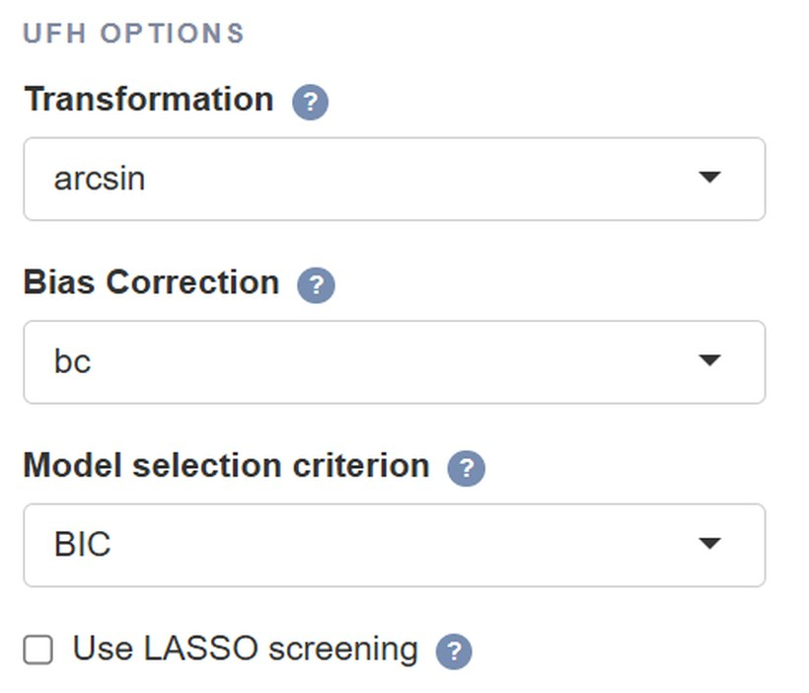
WIZARD · STEP 4 — MODELS
UFH options
Defaults are listed first. Covariates and LASSO are on the previous slide.
Option | Values | What it does
Transformation | FGT(0): arcsin / no welfare: log / no | FGT(0): arcsin for bounded rates. log models the arithmetic area mean.
Bias Correction | arcsin: bc / none log: bc_sm / none | UFH log: native emdi Slud–Maiti correction. none omits correction.
Model selection criterion | BIC (default) / AIC | Criterion for stepwise selection.
Variance option (UFH) | sm_out / sm_all / direct | With no transformation: sm_out smooths missing or < 0.001 variances. sm_all smooths all. direct uses survey variances.
With arcsin, fill missing/zero variances only. With log, use sm_out.
Bootstrap replicates defaults to 500. More draws reduce simulation noise, not model bias.
EU SAE Wizard & Dashboard · User Guide
22 / 57
Notes:
UFH log fits log(Direct), where Direct is the person-weighted arithmetic area mean, with delta-method sampling variance V/Direct². emdi Slud–Maiti bc_sm uses ML and returns corrected predictions for sampled areas. The none option exponentiates without bias correction and keeps the arithmetic-mean estimand. Neither option fits means of individual log welfare or uses a domain smearing ratio. Corrected log predictions for unsampled areas remain unavailable.
With no transformation the UFH variance control is available. sm_out smooths missing or small (<0.001) variances. With arcsin, missing/zero variances are filled. Log uses sm_out on the model scale. Bootstrap replicates (default 500) controls UFH bootstrap MSE as well as MFH uncertainty and benchmarking.
The supplied EMDI note displays a full-real-line arcsine integral; emdi 2.2.3 integrates over [0, pi/2]. The app retains that point estimator and bootstraps the same estimator. Review warnings about substantial Gaussian mass above pi/2. Do not interpret the correction as a guarantee of unbiasedness near boundaries. The naive arcsine inverse clamps to [0, pi/2] before sin² in points and replicates.
Methodology sources: docs/METHODOLOGY_ALIGNMENT.md; docs/MCPE_VALIDATION_STATUS.md; Molina and Romero, Comparable Small Area Estimates over Time, supplied manuscript dated 29 January 2025; Harmening and coauthors, supplied EMDI area-level note. Implementation checked for wizard 5.14 QER candidate (10 October 2026). Source code: scripts/ufh_functions.R; scripts/01_ufh.R; app_wizard.R.

Slide 23
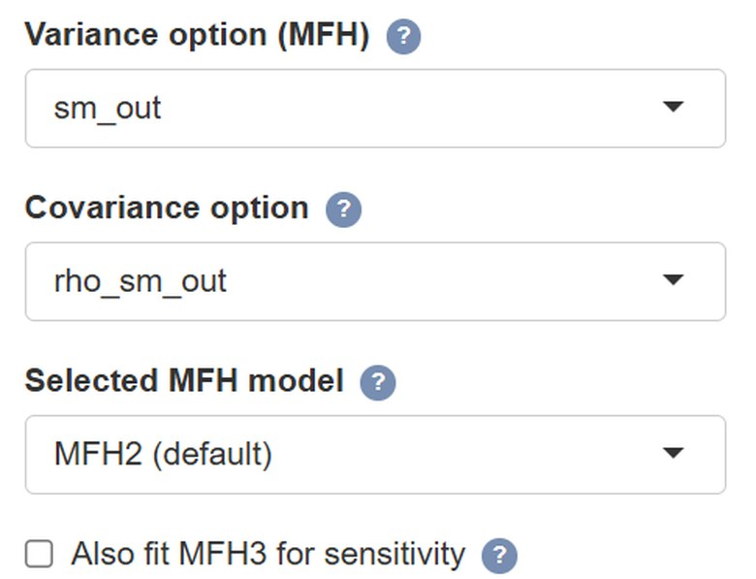

WIZARD · STEP 4 — MODELS
MFH options
MFH2 is the default reported model. Covariates and LASSO are on slide 21.
Option | Values | What it does
Model selection criterion | AIC (default) / BIC | AIC favours predictive fit. UFH uses BIC.
Variance / Covariance option | sm_out / sm_all / direct | Available with log. Covariance choices follow the variance option (default: rho_sm_out).
Transformation (MFH) | log (default) / no | For mean welfare. Bias Correction (MFH): Conditional lognormal / none.
Selected MFH model | MFH2 / MFH1 / MFH3 | MFH2 default. MFH3 starts a checked variance-structure comparison.
Bootstrap replicates | 500 (default) | UFH, MFH and benchmarking. Check successful fits and simulation noise.
Model controls
MFH1: independent year effects MFH2: stationary AR(1), the default
MFH3: time-specific innovation variances, retained only with usable fit and supporting contrast
Zero variance or correlation at its limit: change significance is provisional. See slide 49.
EU SAE Wizard & Dashboard · User Guide
23 / 57
Notes:
MFH2 remains the default after MFH3 convergence problems in the Spanish and Polish applications. MFH1 assumes independent random effects by year, with separate variances. MFH2 uses stationary AR(1) random effects: G(s,t)=innovation variance × rho^|s−t|/(1−rho²). The innovation variance differs from the marginal variance. MFH3 uses time-specific innovation variances and u0~N(0,1), so its first-period variance includes rho². Its fixed initial-state variance makes the model scale sensitive.
Choosing MFH3 starts the Molina–Romero variance-structure sequence. The app falls back to MFH2 when the MFH3 endpoint is unusable or the variance contrast does not support MFH3. A failed fit is not evidence of homogeneous variances. Also fit MFH3 for sensitivity requests an additional comparison without automatically replacing the selected model.
All selected fits require finite predictions and numerical REML endpoint checks, including score, curvature and feasible boundary directions. A package convergence flag alone is insufficient. Genuine zero random-effect variance is valid. MFH2 correlation at ±0.999999 approximates the stationary limit and needs sensitivity review. Sampling covariance repairs occur once before fitting and are reused by the bootstrap.
Bootstrap replicates defaults to 500 and controls UFH bootstrap MSE, MFH annual/change moments and benchmarking. Old saved settings may retain smaller explicit counts. Fifty is only an exploratory check. Inspect accepted refits and Monte Carlo diagnostics, and repeat with more draws where needed. More draws do not establish nominal coverage.
MFH log Bias Correction is Conditional lognormal, exp(eta+v/2), with v=diag(G−G(G+R)^(−1)G). This is a fitted Gaussian conditional-mean extension, distinct from UFH Slud–Maiti bc_sm. Old MFH bc_sm settings map to this method. none omits the variance correction.
Methodology sources: docs/METHODOLOGY_ALIGNMENT.md; docs/MCPE_VALIDATION_STATUS.md; Molina and Romero, Comparable Small Area Estimates over Time, supplied manuscript dated 29 January 2025; Harmening and coauthors, supplied EMDI area-level note. Implementation checked for wizard 5.14 QER candidate (10 October 2026). Source code: R/mfh_model_selection.R; R/mfh_convergence_check.R; R/mfh_bootstrap_helpers.R; scripts/02_mfh.R; app_wizard.R.
Boundary-sensitive inference: The fitted random-effect covariance can lie on a boundary (zero variance or correlation at its numerical limit). Estimates remain available, but normal/delta intervals and p-values can substantially understate uncertainty about change. Treat significance as provisional. Compare Direct results and alternative admissible models before external conclusions. Increasing bootstrap draws alone does not resolve this limitation. The app exports inference_status = boundary_sensitive for these original fits and counts covariance-boundary fits among accepted bootstrap refits. The fraction is diagnostic, with no calibrated safe cutoff. Source: R/mfh_bootstrap_helpers.R; scripts/02_mfh.R; report.Rmd; docs/MCPE_VALIDATION_STATUS.md.

Slide 24
WIZARD · STEP 4 — MODELS
Benchmarking (optional)
Matches population-weighted estimates to targets. Valid zero-variance MFH fits remain eligible.
1 · TURN ON
2 · CHOOSE LEVEL
3 · ADD TARGETS
Apply benchmarking
Benchmarking level
Target file (optional)
Check Apply benchmarking. The Benchmarking level control and optional target database then appear.
Choose National, or Grouped by a survey variable and select the grouping variable (for example region or NUTS2). Use survey-derived or uploaded targets.
Optional file: a year column and a target column (for example target or benchmark), plus a group column if grouped. Same prices as the survey welfare. Without it, direct estimates are the targets.
EU SAE Wizard & Dashboard · User Guide
24 / 57
Notes:
Benchmarking applies the final ratio adjustment in the reported units, including currency units after log back-transformation. The bootstrap repeats this complete estimator, including benchmarking, before accumulating prediction-error second moments. This accounts for the ratio adjustment and correlation between benchmarked estimates. It replaces the older post-hoc rescaling of RMSE.
Survey-derived targets are recomputed from replicate direct estimates. Uploaded external targets remain fixed; their uncertainty is not included. Populations and group membership also remain fixed. Targets must match the indicator, welfare concept and price basis. The app applies the same CPI conversion to uploaded current-price mean-welfare targets as to the survey. Complete usable predictions are required for the requested benchmark population. Genuine zero random-effect variance is not itself a reason to skip benchmarking.
Methodology sources: docs/METHODOLOGY_ALIGNMENT.md; docs/MCPE_VALIDATION_STATUS.md; Molina and Romero, Comparable Small Area Estimates over Time, supplied manuscript dated 29 January 2025; Harmening and coauthors, supplied EMDI area-level note. Implementation checked for wizard 5.14 QER candidate (10 October 2026). Source code: scripts/bench_regional_mfh.R; scripts/01_ufh.R; scripts/02_mfh.R.

Slide 25
WIZARD · STEP 5 — AI ASSISTANT
Step 5 — AI Assistant (optional)
Off by default. Nothing is sent anywhere unless you opt in here.
Two consent boxes before any key
tick Enable AI Assistant and the acknowledgement, then paste a Claude (sk-ant-…) or OpenAI (sk-…) key
Language
AI text comes back in the language you pick — 25 options
Where it lands
labelled blocks in the HTML and Word reports, written during Run Analysis — so enable AI before you run
Keys and providers
see Part 4; keys are never stored on disk
EU SAE Wizard & Dashboard · User Guide
25 / 57

Slide 26


WIZARD · STEP 6 — REVIEW & RUN
Two-stage launch — check, then run
Review your data before the pipeline starts. Catch typos, missing years, and mapping issues early.
Wizard Step 6 · Dashboard sidebar
1. Check Data Readiness
1. Check Data Readiness
Loads inputs; checks variables, years and mappings; fills the Data Readiness tab. No modelling yet.
2. Run Analysis
→
Stage 1 — review
2. Run Analysis
Stage 2 — run the pipeline
Starts only after the check passes with no ERROR. Change an input? Check again. Runs in the background; Stop ends a run.
Click 1, review, then click 2.
Why two stages? You see what the app sees before committing to a long run - catch typos, missing domains, missing household size, or unexpected years early.
EU SAE Wizard & Dashboard · User Guide
26 / 57
Notes:
Passing data readiness permits estimation. It does not establish model fit or inferential validity. MFH results also require independent numerical endpoint checks and enough jointly usable bootstrap draws. Failures stop or make the affected inference unavailable.

Slide 27


WIZARD · STEP 6 — REVIEW & RUN
Preflight tab — inputs at a glance
Updates as you change inputs. Checks that the app can run: folder, packages, years and files.
Project root
Working directory looks correct (the package folder)
What to look for
rmarkdown
Green OK: the check passed
Package 'rmarkdown' is available for report rendering.
Amber Check: needs attention
Analysis years
Two analysis years detected: 2022, 2023
Fix see Recommended actions below the checks
Spatial dependency
Package 'sf' is available.
Variable mappings and data quality are checked by Check Data Readiness (Data Readiness tab).
Input data files
Survey: available | Auxiliary: available | Geometry: missing
EU SAE Wizard & Dashboard · User Guide
27 / 57

Slide 28
WIZARD · STEP 6 — REVIEW & RUN
Data Readiness - diagnostics
Populated when you click Check Data Readiness. Review warnings and errors before Run Analysis.
01
02
03
Year variable present
Requested years available
Covariate summary
Both datasets include a year column.
Survey and auxiliary data include the two requested years.
Mean, SE, correlation and its p-value; most significant first.
04
05
06
Domain/key alignment
Missing direct estimates
National indicator
Checks domain/year keys and geometry domains across all files.
Flags empty domain-year cells.
Population-weighted national poverty or mean welfare for selected years.
EU SAE Wizard & Dashboard · User Guide
28 / 57

Slide 29

OUTPUTS
Where results live
Current outputs are in outputs/. Each run also has an archived copy under app_runs/.
outputs/final_report.html + .docx
outputs/figures/
Same results in both. Word text and tables are editable.
Maps, diagnostics, change and RMSE plots (.png).
pov_comparison_detailed.xlsx
outputs/data/
In outputs/data/. Direct, UFH and MFH estimates with MSE, RMSE, CV (same name for mean welfare).
Also EU_SAE_results.xlsx and change_estimate_comparison.xlsx.
outputs/tables/
app_runs/…/app_config.yml
CSV summaries: readiness, fit checks, covariance repairs and bootstrap diagnostics.
The run’s saved settings, to reload later.
Note Each run overwrites outputs/. Edit a copy of the Word report, or use the archived copy in app_runs/.
EU SAE Wizard & Dashboard · User Guide
29 / 57
Notes:
Inspect model convergence diagnostics, bootstrap success and Monte Carlo diagnostics, mfh_sampling_covariance.csv and run assumptions before using results. MFH annual MSE and cross-year MCPE use the same accepted bootstrap prediction errors. Change MSE=MSE1+MSE2−2×MCPE. Missing or invalid joint moments do not trigger a substitute independence calculation. Pointwise change tests remain the primary display, with BH and Bonferroni sensitivity results. Rerun country setups under this candidate before relying on outputs from older versions. Methodology sources: docs/METHODOLOGY_ALIGNMENT.md; docs/MCPE_VALIDATION_STATUS.md; Molina and Romero, Comparable Small Area Estimates over Time, supplied manuscript dated 29 January 2025; Harmening and coauthors, supplied EMDI area-level note. Implementation checked for wizard 5.14 QER candidate (10 October 2026).
Poverty-change display units in wizard 5.14: change maps and significance plots show percentage points (100 times the stored change and interval endpoints). The report significance table also shows changes and interval bounds in percentage points, and MSE in squared percentage points (10,000 times the stored MSE). Raw significance CSV/Excel fields diff, lb and ub remain proportions, with mse in squared proportions. Display summaries can already use percentage points: change_rmse_by_method.csv and the Domain changes sheet in change_estimate_comparison.xlsx do so. Check the field and sheet labels before converting units. For example, a stored change of -0.02 displays as -2.0 percentage points. These display conversions do not change estimates, p-values or significance decisions. Mean-welfare percentage changes follow the separate conventions on slide 49. Source: scripts/03_comparison.R; R/change_comparison.R; report.Rmd.

Slide 30

CHECKLIST
Every-run checklist
Check data, numerical fit, bootstrap diagnostics and sensitivity before reporting.
SET UP · ONE TIME
IN THE APP · EVERY RUN
Install once. Prepare files (Part 1).
Complete the six steps, then review the evidence.
1 Data | Years and required files
2 Mapping | Variables and survey weights
3 Indicator | Poverty line or welfare prices
4 Models | Covariates and model options
5 AI Assistant | Optional: consent, key and language
6 Review & Run | Check readiness, then run
Results | Open outputs/final_report.html
1
Install R 4.2 or later
2
Download EU_SAE_520_w5n.zip from Assets
3
Start_Here/
Windows: Start_Wizard.bat
macOS: Start_Wizard.command
Current results: outputs/. Saved copy: app_runs/<timestamp>_<run_label>/outputs/.
EU SAE Wizard & Dashboard · User Guide
30 / 57
Notes:
This pre-release includes methodological repairs that can change estimates and conclusions. Rerun the chosen country settings. Compare results, fit endpoints, bootstrap success and Monte Carlo precision, covariance repairs, benchmark constraints and change-test sensitivities. Nominal confidence-interval coverage has not been certified. A small fitted simulation pilot showed some undercoverage, and does not replace broader validation for the intended survey design. Methodology sources: docs/METHODOLOGY_ALIGNMENT.md; docs/MCPE_VALIDATION_STATUS.md; Molina and Romero, Comparable Small Area Estimates over Time, supplied manuscript dated 29 January 2025; Harmening and coauthors, supplied EMDI area-level note. Implementation checked for wizard 5.14 QER candidate (10 October 2026).
Boundary-sensitive inference: The fitted random-effect covariance can lie on a boundary (zero variance or correlation at its numerical limit). Estimates remain available, but normal/delta intervals and p-values can substantially understate uncertainty about change. Treat significance as provisional. Compare Direct results and alternative admissible models before external conclusions. Increasing bootstrap draws alone does not resolve this limitation. The app exports inference_status = boundary_sensitive for these original fits and counts covariance-boundary fits among accepted bootstrap refits. The fraction is diagnostic, with no calibrated safe cutoff. Source: R/mfh_bootstrap_helpers.R; scripts/02_mfh.R; report.Rmd; docs/MCPE_VALIDATION_STATUS.md.

Slide 31
PART 03
Worked
examples
Three analyses, each through the six wizard steps of Part 2. Start with years and prices.
31 / 57
Notes:
Part 3 applies the complete wizard walkthrough to three analyses: poverty headcount using year-specific lines, anchored poverty, and real mean welfare. Visual source: AI-generated abstract data-network background, created with the built-in image-generation tool on 7 October 2026.
All numerical examples in Part 3 are illustrations of definitions, input conventions and arithmetic. They are not validated results from a current wizard 5.14 country run.

Slide 32
PART 3 · BEFORE THE EXAMPLES
Years and prices: five terms
Survey, auxiliary, population and target files use survey years. CPI inputs depend on income years, the price base year and the CPI format. Geometry uses domain IDs.
Term | Meaning | Example
Survey (analysis) year | Typed in Step 1; keys the survey, auxiliary, population and target files | 2022, 2023
Income reference year | Year the incomes refer to; CPI values are entered for these years (EU-SILC: usually the year before) | 2021, 2022
CPI reference year | Where the index equals 100; it does not change results | 2015 = 100
Price base year | Year whose prices are used to report real welfare | 2021 prices
Anchor year | Year whose poverty line is held fixed in real terms | 2021 line: 10,000
Example: CPI 2021 = 110.0, CPI 2022 = 114.4. Welfare 10,920 × 110.0 / 114.4 = 10,500 in 2021 prices.
The CPI reference year (2015) cancels out. Only the ratio between two years matters.
EU SAE Wizard & Dashboard · User Guide
32 / 57
Notes:
Sources: Eurostat EU-SILC metadata (e.g., ilc_simsilc_mt: 'The income reference year for EU-SILC is one calendar year prior to the year of survey'); app code (release 5.2.0-rc.6-wizard.5.12): input files are matched on the analysis (survey) years, and with 'the calendar year before the survey' the CPI for year t−1 is applied to survey year t (R/pipeline_helpers.R).
File keys (pipeline_helpers.R): survey and auxiliary files, population (domain × analysis year) and benchmark targets (year, + group) use the analysis years; Fixed-reference CPI values are keyed by the income years plus the price base year (sae_price_income_years); geometry is matched by the domain field only.
A price base year does not always require a CPI observation: supplied real welfare needs no CPI conversion. Fixed-reference indices require the income-year and base-year indices. Previous-year indices and annual percentage changes require each intervening annual change. See slide 46 and R/pipeline_helpers.R, sae_price_chain_years and sae_price_index_problems.
The numerical example converts welfare in 2022 prices to 2021 prices. All amounts and CPI values are illustrative.

Slide 33
EXAMPLE 1 OF 3
Poverty headcount rates
Using the appropriate poverty line for each year.
Next: poverty-line inputs, indicator settings, model choices and interpretation.
EU SAE Wizard & Dashboard · User Guide
33 / 57
Notes:
Section divider introducing the following complete wizard workflow.

Slide 34
1 POVERTY HEADCOUNT
Year-specific poverty lines
The threshold follows the poverty definition chosen for each year.
Measure
The population-weighted share of people whose welfare is below that year’s poverty line.
Required line
One line per analysis (survey) year, in the same currency, accounting period and welfare units as the survey.
EU at-risk-of-poverty threshold
60% of the national median equivalised disposable income. Supply it per survey year; in EU-SILC it usually reflects the previous year’s incomes.
A change in the rate can reflect changes in both welfare and the poverty threshold.
EU SAE Wizard & Dashboard · User Guide
34 / 57
Notes:
Implementation sources: app.R; app_wizard.R; R/pipeline_helpers.R; scripts/01_ufh.R; scripts/02_mfh.R. Review date: 7 October 2026. All numerical examples are illustrative. EU at-risk-of-poverty rate source: https://ec.europa.eu/eurostat/databrowser/view/ILC_LI02/default/table?lang=en . The app consumes supplied poverty lines; these slides do not imply that it computes national median thresholds.
At-risk-of-poverty threshold definition: Eurostat Statistics Explained glossary, https://ec.europa.eu/eurostat/statistics-explained/index.php?title=Glossary:At-risk-of-poverty_threshold

Slide 35
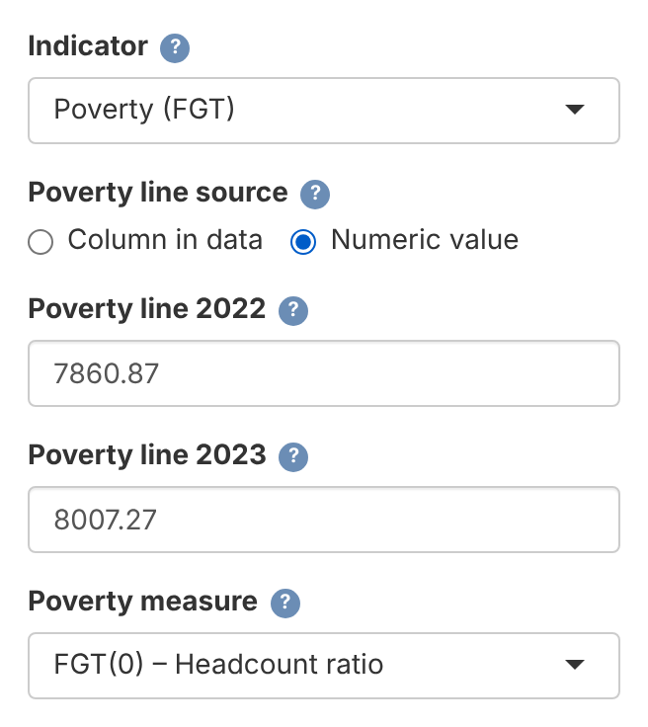
1 POVERTY HEADCOUNT · INPUTS
Poverty-specific inputs and settings
The survey and poverty line must describe the same welfare concept.
Welfare and years
Use the intended per-person or equivalised welfare measure. Supply a poverty line appropriate to each year and to the chosen poverty definition.
Line source
In Step 3, Poverty line source: Column in data (lines vary across records or areas) or Numeric value: one box per analysis (survey) year, as shown. Then choose Poverty (FGT) and FGT(0).
For a household file, person weights are survey weight × household size.
Survey years 2022–2023. Incomes refer to the year before.
EU SAE Wizard & Dashboard · User Guide
35 / 57
Notes:
Sources (release 5.2.0-rc.6-wizard.5.12): app_wizard.R Step 3 — 'Poverty line source' with 'Column in data' (column chosen in Step 3) or 'Numeric value' (one 'Poverty line <year>' box per analysis year); scripts/population_helpers.R — person weights are weight × household size.
Screenshot: wizard 5.12 running the bundled simulated example data (Data/simulated, survey years 2022 and 2023).

Slide 36
1 POVERTY HEADCOUNT · RUN AND RESULTS
Poverty models and interpretation
Use the supplied year-specific lines throughout estimation and interpretation.
Models (Step 4)
For the standard setup, use UFH arcsin with bias correction and MFH2. Review covariates, variance choices and PSU consistency.
Survey year (Step 1) | Income year | Typed in Step 3 | Headcount
2022 | 2021 | Poverty line 2022: 7860.87 | 20.0%
2023 | 2022 | Poverty line 2023: 8007.27 | 18.0%
Lines match slide 35. Illustrative headcounts: change −2.0 percentage points (−10% relative).
If benchmarking is enabled, targets must use the same poverty definition and lines.
EU SAE Wizard & Dashboard · User Guide
36 / 57
Notes:
Illustrative poverty-headcount results for survey years 2022 and 2023, with income reference years 2021 and 2022. The numeric poverty lines match the simulated-data UI screenshot on slide 35 (7,860.87 and 8,007.27). These lines are 60% of each year’s simulated median welfare. Headcounts of 20% and 18% illustrate interpretation and are not claimed to be app output from this dataset. Change = 18 − 20 = −2 percentage points. Relative change = 100 × (18/20 − 1) = −10%.
For FGT(0) near the boundaries, review corrected-arcsine warnings and sensitivity. Model diagnostics and bootstrap precision still require review after a successful run. Enter numeric poverty lines without thousands separators.
Poverty-change display units in wizard 5.14: change maps and significance plots show percentage points (100 times the stored change and interval endpoints). The report significance table also shows changes and interval bounds in percentage points, and MSE in squared percentage points (10,000 times the stored MSE). Raw significance CSV/Excel fields diff, lb and ub remain proportions, with mse in squared proportions. Display summaries can already use percentage points: change_rmse_by_method.csv and the Domain changes sheet in change_estimate_comparison.xlsx do so. Check the field and sheet labels before converting units. For example, a stored change of -0.02 displays as -2.0 percentage points. These display conversions do not change estimates, p-values or significance decisions. Mean-welfare percentage changes follow the separate conventions on slide 49. Source: scripts/03_comparison.R; R/change_comparison.R; report.Rmd.

Slide 37
EXAMPLE 2 OF 3
Anchored poverty headcount rates
EU application: keep the poverty standard fixed in real terms.
Supply the anchored lines: one number per survey year in Step 3, or a survey column.
EU SAE Wizard & Dashboard · User Guide
37 / 57
Notes:
Section divider introducing anchored-poverty estimation using supplied anchored poverty lines.

Slide 38
2 ANCHORED POVERTY · EU APPLICATION
A poverty line fixed in real terms
Keep the anchor-year threshold’s purchasing power constant over time.
Poverty-line source
Use official anchored thresholds where available. Check the anchor year and income reference year, and match the welfare definition and units.
Two inputs
Numeric value: type each survey year’s line in Step 3. Column in data: an anchored_povline column, when lines vary across records.
Step 3
Choose Poverty (FGT) and FGT(0), then Numeric value (one line per survey year) or Column in data (select anchored_povline).
Benchmarking domain estimates to national or regional targets is a separate choice.
EU SAE Wizard & Dashboard · User Guide
38 / 57
Notes:
Implementation sources: app.R; app_wizard.R; R/pipeline_helpers.R; scripts/01_ufh.R; scripts/02_mfh.R. Review date: 7 October 2026. All numerical examples are illustrative. EU anchored-poverty concept: Eurostat, Monitoring the evolution of income poverty and real incomes over time, https://ec.europa.eu/eurostat/documents/3217494/8031566/KS-05-14-075-EN-N.pdf/c3a33007-6cf2-4d86-9b9e-d39fd3e5420c . The anchor year must identify the income-price period underlying the supplied threshold.
Use official anchored thresholds where available, checking their coverage, anchor year, income reference year, currency, welfare definition and unit. Otherwise prepare the lines outside the app and retain the method and source. In Step 3, type one line per survey year under Numeric value, or select a supplied column under Column in data. Both give the same estimates when every record of a year gets the same line (R/pipeline_helpers.R sae_apply_numeric_poverty_lines; scripts/01_ufh.R:275; scripts/02_mfh.R:394).

Slide 39
2 ANCHORED POVERTY · SUPPLIED LINES
Anchored lines for each survey year
Type these in Step 3 or store them in a survey column. Use official thresholds where available.
Survey year | Income reference year | Anchored line
2022 | 2021 | 10,000
2023 | 2022 | 10,400
2024 | 2023 | 10,608
Illustration: the supplied thresholds keep a 2021 poverty standard fixed in real terms.
Previous-year incomes: survey 2022 uses the 2021 threshold, and survey 2023 uses the 2022 threshold.
EU SAE Wizard & Dashboard · User Guide
39 / 57
Notes:
Implementation sources: app.R; app_wizard.R; R/pipeline_helpers.R; scripts/01_ufh.R; scripts/02_mfh.R. Review date: 7 October 2026. All numerical examples are illustrative. EU anchored-poverty concept: Eurostat, Monitoring the evolution of income poverty and real incomes over time, https://ec.europa.eu/eurostat/documents/3217494/8031566/KS-05-14-075-EN-N.pdf/c3a33007-6cf2-4d86-9b9e-d39fd3e5420c . Example uses current-price welfare and an anchored line expressed in each income year’s current prices. If the welfare was already deflated, express the line in that same price basis.
The table shows illustrative supplied thresholds, not published official values. For previous-year incomes, match survey 2022 to income 2021, survey 2023 to income 2022, and survey 2024 to income 2023. Type the threshold for each survey year in Step 3 (Numeric value), or store it on each survey record in a column such as anchored_povline.

Slide 40
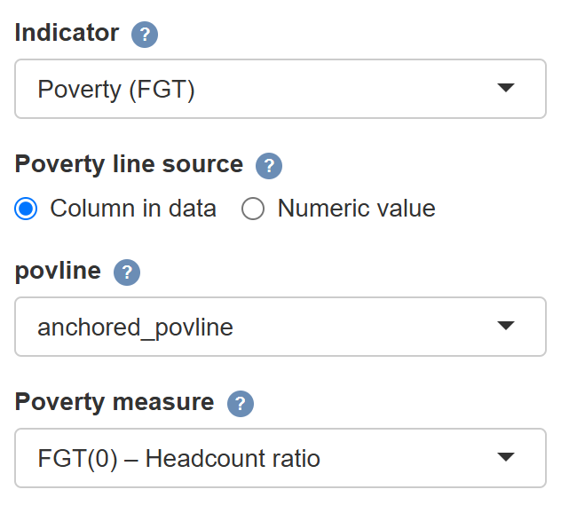
2 ANCHORED POVERTY · SETTINGS
Settings for supplied anchored lines
The app uses the anchored thresholds you supply: typed in Step 3 or in a survey column.
Input
Numeric value: type 10000 (2022) and 10400 (2023) in Step 3. Or use an anchored_povline survey column.
Step 3 · Indicator
Choose Poverty (FGT) and FGT(0). Poverty line source: Numeric value, or Column in data with anchored_povline. No CPI conversion.
Price consistency
Current-price welfare: use each income year’s line in current prices. Welfare already in 2021 prices: the line is 10,000 in every year.
Shown: Column in data. The Numeric value boxes are as on slide 35.
Check that the welfare and anchored line use the same prices and welfare units.
EU SAE Wizard & Dashboard · User Guide
40 / 57
Notes:
Implementation sources: app.R; app_wizard.R; R/pipeline_helpers.R; scripts/01_ufh.R; scripts/02_mfh.R. Review date: 7 October 2026. All numerical examples are illustrative. Retain the threshold source, anchor year, income reference years and welfare units with the run. If the lines were calculated externally, also retain the method and CPI source.
Screenshot: current wizard with a temporary copy of the bundled simulated survey CSV containing an illustrative anchored_povline column. For consistency with the preceding previous-year-income illustration, the column is 10,000 for survey 2022 records and 10,400 for survey 2023 records. The selected column contains supplied anchored lines, using official thresholds where available or lines prepared outside the app. The app’s control label remains povline, but the selected column name is anchored_povline. Any valid column name is allowed. The screenshot shows the Column in data route. With Numeric value, the Step 3 boxes are labelled by survey year (as on slide 35): type each survey year's anchored line (10,000 for 2022 and 10,400 for 2023 here) and replace any pre-filled or restored value (default 5,000). The Step 6 summary then reads 'numeric: 2022 = 10000; 2023 = 10400'.

Slide 41
2 ANCHORED POVERTY · CHECKS
Anchored-poverty checks and interpretation
Check the supplied thresholds before running the standard poverty workflow.
Before the run
Verify the source, anchor year, income years, currency and units. Check each year’s line in the Step 6 summary or your column.
Comparable estimates
Keep the poverty definition, welfare units and model settings consistent when comparing years. The purchasing power of the poverty line stays fixed.
Results
Report anchored headcount rates and changes in percentage points. If benchmarking, use targets based on the same anchored poverty line.
Next: real mean welfare (Example 3).
EU SAE Wizard & Dashboard · User Guide
41 / 57
Notes:
Implementation sources: app.R; app_wizard.R; R/pipeline_helpers.R; scripts/01_ufh.R; scripts/02_mfh.R. Review date: 7 October 2026. All numerical examples are illustrative. EU anchored-poverty concept: Eurostat, Monitoring the evolution of income poverty and real incomes over time, https://ec.europa.eu/eurostat/documents/3217494/8031566/KS-05-14-075-EN-N.pdf/c3a33007-6cf2-4d86-9b9e-d39fd3e5420c . The anchor line should not be recalculated from each later year’s median, because that would change the real poverty standard.

Slide 42
EXAMPLE 3 OF 3
Real mean welfare
Estimate average welfare in a common year’s prices.
Route A: welfare already in real prices · Route B: current-price welfare + CPI
EU SAE Wizard & Dashboard · User Guide
42 / 57
Notes:
Section divider introducing the following complete wizard workflow.

Slide 43
3 REAL MEAN WELFARE
Two routes to real mean welfare
Estimate the population-weighted arithmetic mean in a common year’s prices.
Route A · real welfare
Per-person income or consumption for each household, already in constant prices of one year.
Route B · welfare + CPI
Per-person welfare in current prices plus CPI values (typed or from a file). The app deflates before estimating.
Input and output
Household records with per-person welfare. The app estimates Direct, UFH and MFH mean welfare by domain and year.
Both routes are available. The default is current prices, no conversion — change it in Step 3.
EU SAE Wizard & Dashboard · User Guide
43 / 57
Notes:
Implementation sources: app.R; app_wizard.R; R/pipeline_helpers.R; scripts/01_ufh.R; scripts/02_mfh.R. Review date: 7 October 2026. All numerical examples are illustrative. Household welfare should be the intended per-person or equivalised measure, not an already aggregated domain-mean file. Mapping household size expands household survey weights to persons.
The app retains zero and negative individual welfare in the arithmetic area mean. Price conversion precedes area aggregation. A log model then requires positive finite arithmetic area means and uses delta sampling variances V/mean².

Slide 44
3 REAL MEAN WELFARE · ROUTE A
Welfare already in constant prices
The survey’s per-person welfare is already adjusted for prices.
Survey welfare
Per-person welfare already in constant prices. Both survey years share the price base, welfare definition and currency.
Mapping (Step 2)
Map the real welfare variable as welfare. Retain the survey weights, household size and survey-design mappings from the general walkthrough.
Step 3 · Indicator
Choose Mean welfare. Under Welfare in the survey data is in, choose constant (real) prices already. The price year is optional (labels only).
No CPI conversion is applied. Continue to the mean-welfare model and results slides.
EU SAE Wizard & Dashboard · User Guide
44 / 57
Notes:
Implementation sources: app.R; app_wizard.R; R/pipeline_helpers.R; scripts/01_ufh.R; scripts/02_mfh.R. Review date: 7 October 2026. All numerical examples are illustrative. The optional price year changes labels only. The app cannot verify external temporal or spatial price adjustments. Targets, if supplied, must use the same constant-price basis.

Slide 45
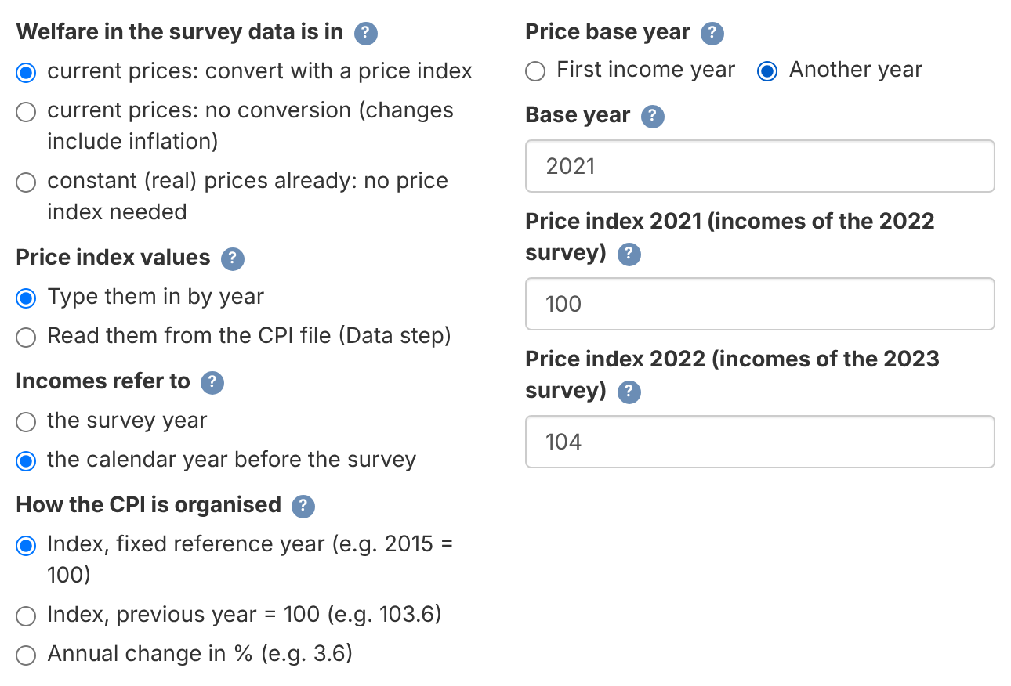
3 REAL MEAN WELFARE · ROUTE B
Current-price welfare plus CPI values
The app converts each household’s welfare, then estimates real mean welfare.
CPI values
Type them by year in Step 3 (default) or read them from a CPI file loaded in Step 1.
Step 3 · Prices
Mean welfare → current prices: convert with a price index.
Step 3 · Years
Set Incomes refer to, How the CPI is organised and Price base year, then fill the CPI years the app lists.
The price base year determines the units of real welfare. It need not be the CPI reference year.
Simulated example: 2022–2023 surveys, incomes of the year before, base year 2021
EU SAE Wizard & Dashboard · User Guide
45 / 57
Notes:
Implementation sources: app.R; app_wizard.R; R/pipeline_helpers.R; scripts/01_ufh.R; scripts/02_mfh.R. Review date: 7 October 2026. All numerical examples are illustrative. The app also permits typing CPI values by year. Current prices: no conversion remains available but gives nominal changes, outside these two real-welfare routes.
Screenshot: wizard 5.12 running the bundled simulated example data (Data/simulated, survey years 2022 and 2023).

Slide 46
3 REAL MEAN WELFARE · ROUTE B
Three accepted CPI formats
CPI file: one row per year (columns year and CPI). Use one national annual-average series.
How the CPI is organised (format key, not file layout) | 2021 | 2022 | 2023
Index, fixed reference year | 100 | 104 | 106.08
Index, previous year = 100 | — | 104 | 102
Annual change in % | — | 4 | 2
year,cpi
2021,100.00
2022,104.00
File for the next example: income years 2021 and 2022. The base year is also 2021.
Fixed index: include the income years and the price base year.
Annual formats: include every intervening annual change. The app chains them.
EU SAE Wizard & Dashboard · User Guide
46 / 57
Notes:
Implementation sources: app.R; app_wizard.R; R/pipeline_helpers.R; scripts/01_ufh.R; scripts/02_mfh.R. Review date: 7 October 2026. All numerical examples are illustrative. Example represents identical inflation in all three formats. For the shown chain, the 2021 annual-change observation is unnecessary. Use a single consistent country series and annual averages for annual income. Supported formats are fixed, previous_year and percent_change in sae_price_index_type().
The three-year format comparison illustrates how fixed-reference, previous-year and annual-percentage-change series relate. The CSV sketch uses only the CPI years needed for the worked example: 2021 and 2022 (survey years 2022 and 2023, previous-year incomes, base year 2021). For annual formats, this example needs only the 2022 change or previous-year index. No separate 2021 annual-change value is needed.

Slide 47
3 REAL MEAN WELFARE · ROUTE B
An illustration in 2021 prices
Survey years 2022 and 2023. Incomes refer to the year before. Price base year 2021, with CPI 2021 = 100.
Survey / income year | CPI | Nominal mean | Mean in 2021 prices
2022 / 2021 | 100.00 | 10,400 | 10,400.00
2023 / 2022 | 104.00 | 10,920 | 10,500.00
Real welfare = current-price welfare × CPI(base) / CPI(income year)
Nominal mean rises 5.00%. Real mean rises 0.96%.
The app converts household observations before fitting the models.
EU SAE Wizard & Dashboard · User Guide
47 / 57
Notes:
Illustrative mean-welfare calculation aligned with slides 45 and 46: survey years 2022 and 2023, income reference years 2021 and 2022, base year 2021. CPI values are 100 and 104. Real means: 10,400 × 100/100 = 10,400; 10,920 × 100/104 = 10,500. Nominal change = 100 × (10,920/10,400 − 1) = 5%. Real change = 100 × (10,500/10,400 − 1) = 0.961538%, rounded to 0.96%. Nominal means are illustrative, not observed results from the simulated file. In the app, conversion occurs on welfare observations before model fitting.

Slide 48
3 REAL MEAN WELFARE · BOTH ROUTES
Step 4: models on the chosen price basis
Price adjustment comes first. Log modelling is a separate decision.
Log + bias correction
Select log. Models use log of the arithmetic Direct area mean, with sampling variance V/Direct². Estimates return to currency units.
Bias correction
UFH: bc_sm uses emdi’s Slud–Maiti correction. MFH: Conditional lognormal uses exp(eta + v/2). none omits correction. The target remains arithmetic mean welfare.
Other model choices
No transformation is an alternative. Review diagnostics and covariates. Use MFH2 by default and check PSU consistency and the covariance settings.
Zero and negative individual welfare stay in Direct. Log models require positive, finite area means.
EU SAE Wizard & Dashboard · User Guide
48 / 57
Notes:
First apply the chosen CPI conversion to individual welfare. Then calculate the person-weighted arithmetic Direct area mean, retaining zero and negative individual welfare values. Transform the positive finite area mean as log(Direct), with delta sampling variance V/Direct². The model does not average individual log incomes.
UFH corrected log predictions use native emdi Slud–Maiti bc_sm under ML. Corrected predictions for unsampled areas are unavailable. MFH Conditional lognormal uses exp(eta+v/2), v=diag(G−G(G+R)^(−1)G), the conditional random-effect variance. This is a model-based extension, not the univariate Slud–Maiti correction. No local arithmetic/geometric smearing factor is used. With none, the app uses exp(eta) and omits bias correction; it does not change the estimand to a geometric mean.
MFH annual MSE and cross-year MCPE are computed from joint bootstrap prediction errors in currency units after back-transformation. Benchmarking, when requested, occurs inside every replicate on that scale. Parameter estimation enters through refitting; the chosen formula, auxiliary variables, populations and sampling covariance estimates remain fixed.
Methodology sources: docs/METHODOLOGY_ALIGNMENT.md; docs/MCPE_VALIDATION_STATUS.md; Molina and Romero, Comparable Small Area Estimates over Time, supplied manuscript dated 29 January 2025; Harmening and coauthors, supplied EMDI area-level note. Implementation checked for wizard 5.14 QER candidate (10 October 2026). Source code: scripts/ufh_functions.R; R/mfh_bootstrap_helpers.R; scripts/01_ufh.R; scripts/02_mfh.R.

Slide 49
3 REAL MEAN WELFARE · BOTH ROUTES
Mean-welfare checks and outputs
Before running, check the Prices row in the Step 6 summary.
Output | Meaning / unit
Levels and RMSE | Currency in the selected constant prices
Changes and significance | Percentage change of the final mean estimates
Change-and-RMSE box plots | ln(m2/m1), without × 100: 0.00957 ≈ 0.96% change. RMSE uses the same log scale.
Excel columns ending in _eur | Changes and interval bounds: currency units. MSE: squared currency units. P-values: no units. The _eur suffix applies to any currency.
Zero variance or correlation at its limit: MFH change significance is provisional. Intervals may be too narrow.
Compare Direct and admissible models. More draws alone do not resolve this limitation.
UFH change intervals assume independent years. Review overlapping samples.
EU SAE Wizard & Dashboard · User Guide
49 / 57
Notes:
The target is arithmetic mean welfare with either bias-correction choice. Percent change=100×(mean2/mean1−1), from the final currency-scale estimates. Confidence intervals use a first-order log-ratio variance from the same annual MSE and cross-year MCPE, then exponentiate the interval. UFH uses the exported period_independence assumption for separate annual fits. MFH uses joint prediction-error moments from the same accepted bootstrap draws.
The MFH bootstrap estimates annual MSE and MCPE after back-transformation and optional ratio benchmarking. Uploaded benchmark targets are fixed and their uncertainty is excluded. Survey-derived targets vary with each replicate. All uncertainty is conditional on the selected model formula and supplied covariates, populations and sampling covariance estimates. Pointwise change tests are primary; inspect BH and Bonferroni sensitivity results for multiple area comparisons. Nominal coverage remains subject to QER validation.
Benchmark targets must match the survey welfare price basis. For current-price welfare converted by CPI, supply matching current-price targets. The app converts them using the same factors.
Box plots show ln(mean2/mean1), without multiplying by 100. In the illustration ln(10500/10400)=0.00956945, corresponding to the exact 0.961538% change. Excel diff_eur, lb_eur and ub_eur have currency units, mse_eur has squared currency units and p_value_eur is dimensionless. The _eur suffix applies to any currency.
Methodology sources: docs/METHODOLOGY_ALIGNMENT.md; docs/MCPE_VALIDATION_STATUS.md; Molina and Romero, Comparable Small Area Estimates over Time, supplied manuscript dated 29 January 2025; Harmening and coauthors, supplied EMDI area-level note. Implementation checked for wizard 5.14 QER candidate (10 October 2026). Source code: scripts/03_comparison.R; R/change_comparison.R; R/mfh_bootstrap_helpers.R.
Boundary-sensitive inference: The fitted random-effect covariance can lie on a boundary (zero variance or correlation at its numerical limit). Estimates remain available, but normal/delta intervals and p-values can substantially understate uncertainty about change. Treat significance as provisional. Compare Direct results and alternative admissible models before external conclusions. Increasing bootstrap draws alone does not resolve this limitation. The app exports inference_status = boundary_sensitive for these original fits and counts covariance-boundary fits among accepted bootstrap refits. The fraction is diagnostic, with no calibrated safe cutoff. Source: R/mfh_bootstrap_helpers.R; scripts/02_mfh.R; report.Rmd; docs/MCPE_VALIDATION_STATUS.md.

Slide 50
PART 04 · OPTIONAL
AI Assistant —
Claude & ChatGPT
Acknowledge the external transfer first; use only an approved provider or gateway, then enter a key.
50 / 57
Notes:
Visual source: AI-generated abstract data-network background, created with the built-in image-generation tool, 7 October 2026. Decorative illustration; not a map or analytical result.

Slide 51


AI ASSISTANT
What the AI Assistant does
Plain-language interpretation in both HTML and Word reports, in your language.
Interpret diagnostics
Review residual patterns
Write report text
Summarises convergence, normality and precision.
Reads Q–Q plots and descriptive normality checks.
Labelled interpretation blocks in the HTML and Word reports.
Privacy Only aggregate tables are sent: no microdata and no domain names or IDs. Each AI block is marked as not yet reviewed; check it before sharing.
EU SAE Wizard & Dashboard · User Guide
51 / 57
Notes:
MFH diagnostics standardize Direct−EBLUP by sqrt(diag(RPR)), where P accounts for fitted fixed effects. Standardized residuals can remain correlated. Treat Shapiro–Wilk and residual-versus-fitted regression summaries as descriptive diagnostics, not exact independent-sample tests. AI interpretation does not establish model validity or interval coverage and requires human review. Methodology sources: docs/METHODOLOGY_ALIGNMENT.md; docs/MCPE_VALIDATION_STATUS.md; Molina and Romero, Comparable Small Area Estimates over Time, supplied manuscript dated 29 January 2025; Harmening and coauthors, supplied EMDI area-level note. Implementation checked for wizard 5.14 QER candidate (10 October 2026). Source code: R/mfh_convergence_check.R; scripts/02_mfh.R.

Slide 52
API KEY · ANTHROPIC CLAUDE
Get a Claude API key
Claude Console (Anthropic) — keys start with sk-ant-
1
Open platform.claude.com — sign up or log in.
2
Settings → API keys — or go to platform.claude.com/settings/keys directly.
3
Create a new key — give it a name and copy it.
Claude
4
Add credit in Billing — pay-as-you-go; a Claude chat plan does not include API credit.
Anthropic
5
Tick both consent boxes in Step 5, then paste the key.
sk-ant-…
Key format
EU SAE Wizard & Dashboard · User Guide
52 / 57
Notes:
Source: https://platform.claude.com/docs/en/get-api-key (keys live at platform.claude.com/settings/keys).

Slide 53
API KEY · OPENAI CHATGPT
Get a ChatGPT (OpenAI) API key
OpenAI's developer platform — keys start with sk-
1
Open platform.openai.com — sign up or log in.
2
Dashboard → API Keys — or go to platform.openai.com/api-keys directly.
3
Create a new key — give it a name and copy it.
ChatGPT
4
Add credit in Billing — pay-as-you-go; a ChatGPT plan does not include API credit.
OpenAI
5
Tick both consent boxes in Step 5, then paste the key.
sk-…
Key format
EU SAE Wizard & Dashboard · User Guide
53 / 57

Slide 54
AI ASSISTANT
Enable the AI Assistant in the app
Two consent boxes, one key, one language — then you’re ready.
AI Assistant (optional)
Enable AI and acknowledge the external transfer
1
The key is never stored on disk — re-enter it after each relaunch.
Both controls are required before key entry.
✓
Enable AI Assistant
I understand that aggregate estimates … will be sent to the selected external AI provider.
2
Enter a Claude or OpenAI key
✓
Detected from the prefix (sk-ant-… or sk-…). Gateways: set SAE_*_BASE_URL before launch.
API Key
sk-ant-••••••••••••••••
3
Pick your language
Language
25 options. Every AI response comes back in that language.
English
▾
EU SAE Wizard & Dashboard · User Guide
54 / 57

Slide 55
AI ASSISTANT
25 languages supported
Every AI response is returned in the language you pick.
Bulgarian
Croatian
Czech
Danish
Dutch
25
English
Estonian
Finnish
French
German
Greek
Hungarian
Irish
Italian
Latvian
Lithuanian
Maltese
Polish
Portuguese
Romanian
languages
24 EU official · + Arabic
Slovak
Slovenian
Spanish
Swedish
Arabic
EU SAE Wizard & Dashboard · User Guide
55 / 57

Slide 56

REFERENCE
Troubleshooting
Quick fixes for the most common stumbling blocks.
Package errors on launch
Data file not selected or not found
Re-run the launcher you used. It reinstalls missing packages automatically.
Use Browse for each file in Step 1. Accepted formats are listed in Part 1.
Report or Word file missing
AI key or timeout errors
Check the run log, Pandoc, xml2 and zip; fix and regenerate. Word failure leaves HTML intact.
Paste only the key (no quotes or spaces); check billing. Timeouts: try again; see the run log.
Run Analysis won’t start
Geometry readiness error
Click Check Data Readiness again after any change, and fix every ERROR line.
IDs must match the survey and the mapped domain field. Shapefiles: a .zip with .shp, .shx, .dbf.
EU SAE Wizard & Dashboard · User Guide
56 / 57

Slide 57


PRE-RELEASE FOR REVIEW
Review before circulation
Rerun selected country setups
Check fit and uncertainty
Coverage is not certified
EU_SAE_520_w5n.zip
Review bootstrap diagnostics and sensitivity
Boundary fits: change significance is provisional
Questions? Nobuo Yoshida · github.com/Noboyoshida227/eu-sae-application/issues
Notes:
Wizard 5.14 is a pre-release for review. Recompute selected country analyses and review any changes in substantive conclusions before circulation. Check convergence boundaries, covariance repairs, bootstrap success and Monte Carlo precision, benchmark constraints and multiplicity sensitivities. The fitted pilot is limited and showed some undercoverage. The guide’s numerical examples remain illustrative. Polish and Greek versions of this guide are in docs/instructions. Methodology sources: docs/METHODOLOGY_ALIGNMENT.md; docs/MCPE_VALIDATION_STATUS.md; Molina and Romero, Comparable Small Area Estimates over Time, supplied manuscript dated 29 January 2025; Harmening and coauthors, supplied EMDI area-level note. Implementation checked for wizard 5.14 QER candidate (10 October 2026).
Boundary-sensitive inference: The fitted random-effect covariance can lie on a boundary (zero variance or correlation at its numerical limit). Estimates remain available, but normal/delta intervals and p-values can substantially understate uncertainty about change. Treat significance as provisional. Compare Direct results and alternative admissible models before external conclusions. Increasing bootstrap draws alone does not resolve this limitation. The app exports inference_status = boundary_sensitive for these original fits and counts covariance-boundary fits among accepted bootstrap refits. The fraction is diagnostic, with no calibrated safe cutoff. Source: R/mfh_bootstrap_helpers.R; scripts/02_mfh.R; report.Rmd; docs/MCPE_VALIDATION_STATUS.md.

