Slide 1

第2部
RTコンポーネント作成入門
宮本 信彦
国立研究開発法人産業技術総合研究所
ロボットイノベーション研究センター
ロボットソフトウェアプラットフォーム研究チーム

Slide 2
インストールの確認(Windows)
OpenRTM-aist
  OpenRTM-aist-1.1.2-RELEASE_x86.msi
  インストール後に再起動する(2回再起動を必要とする環境もある)
  Visual Studio 2013以外(2010、2012、2015)を使用する場合は環境変数を変更(個別に対応します)
    「RTM_VC_VERSION」をvc10、vc11、vc13
    ツールで変更可能(OpenRTM-aistトップページ→ダウンロード→OpenRTM-aist (C++版))→1,1,2-RELEASE→ツールを使った「 RTM_VC_VERSION 」設定手順
Python
  python-2.7.10.msi
    2.7.11は不具合が発生するため非推奨
  ※OpenRTM-aistの32bit版をインストールする場合Pythonも32bit版をインストールする。
  OpenRTM-aistの64bitをインストールする場合はPythonも64bit版をインストールする。
PyYAML
  PyYAML-3.11.win32-py2.7.exe
CMake
  cmake-3.5.2-win32-x86.msi
Doxygen
  doxygen-1.8.11-setup.exe
Visual Studio
  Visual Studio 2013 Community Edition

Slide 3
インストールの確認(Ubuntu)
OpenRTM-aist
  $ sudo sh pkg_install_ubuntu.sh
CMake
  $ sudo apt-get install cmake cmake-gui
Doxygen
  $ sudo apt-get install doxygen
RT System Editor、RTC Builder
  eclipse442-openrtp112v20160526-ja-linux-gtk-x86_64.tar.gzを適当な場所に展開
Java
  $ sudo apt-get default-jre
OpenCV
  $ sudo apt-get install libopencv-dev libcv2.4 libcvaux2.4 libhighgui2.4
OpenCVのサンプルコンポーネント
  自分でビルドする
    $ svn co http://svn.openrtm.org/ImageProcessing/trunk/ImageProcessing/opencv/
    $ cd opencv
    $ mkdir work
    $ cd work
    $ cmake ..
    $ make
    $ sudo make install
Code::Blocks(任意)
  $ sudo apt-get install codeblocks

Slide 4
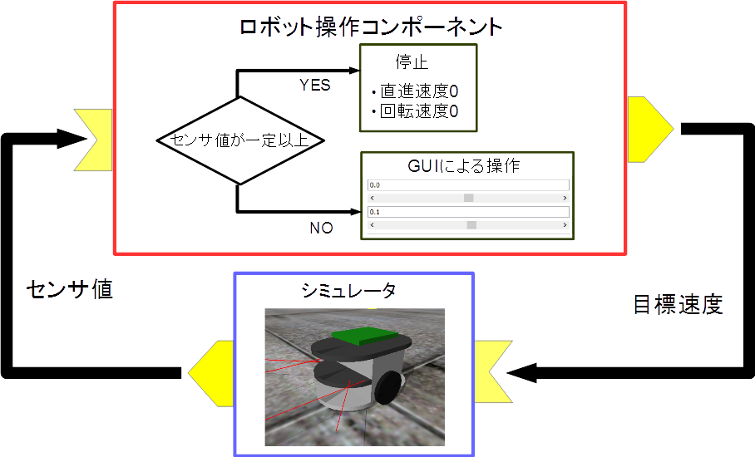
実習内容
シミュレータ上の車輪型移動ロボット(Raspberry Piマウス)の操作を行うコンポーネントの作成
  GUIにより目標速度入力
  センサ値が一定以下の場合に停止

Slide 5
全体の手順
RTC Builderによるソースコード等のひな型の作成
ソースコードの編集、ビルド
  ビルドに必要な各種ファイルを生成
    CMakeLists.txtの編集
    CMakeにより各種ファイル生成
  ソースコードの編集
    RobotController.h、 RobotController.cppの編集
  ビルド
    Visual Studio、Code::Blocks
RTシステムエディタによるRTシステム作成、動作確認
  RTシステム作成
    データポート接続、コンフィギュレーションパラメータ設定
Notes:
At first, I’d like to mention about RT.
What is RT?
RT means Robot Technology.
This is not only standalone robots like this, but also robotic elements, sensors, actuators and so on.
We have studied on RT-Middleware.
RT-Middleware is software platform to integrate these RT-elements.

Slide 6
コンポーネント開発ツール
RTC Builderについて

Slide 7
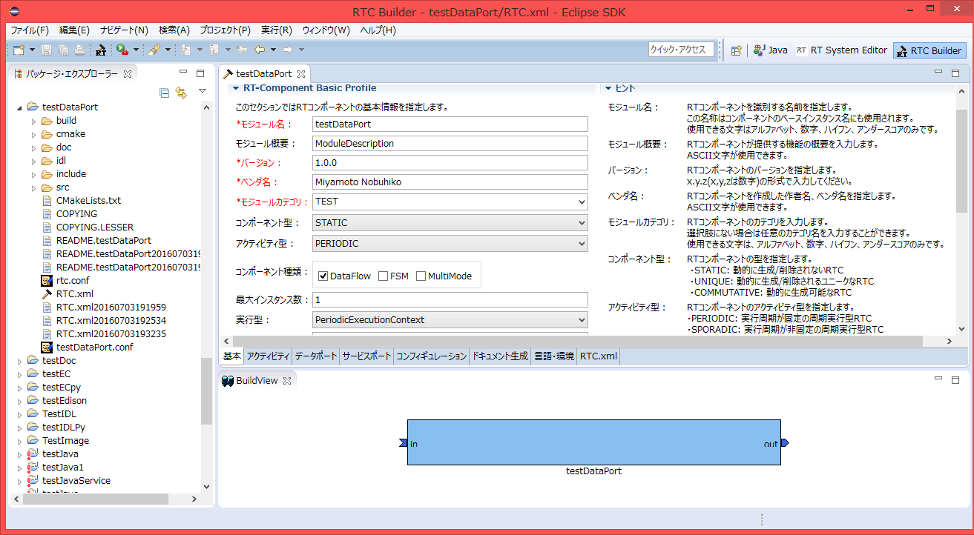
RTC Builder
コンポーネントのプロファイル情報を入力し，ソースコード等のひな型を生成するツール
  C++、Python、Javaのソースコードを出力
Notes:
At first, I’d like to mention about RT.
What is RT?
RT means Robot Technology.
This is not only standalone robots like this, but also robotic elements, sensors, actuators and so on.
We have studied on RT-Middleware.
RT-Middleware is software platform to integrate these RT-elements.

Slide 8
RTC Builderの起動
起動する手順
  Windows 7
    「スタート」→「すべてのプログラム」→「OpenRTM-aist 1.1.2」→「Tools」→「OpenRTP」
  Windows 8.1
    「スタート」→「アプリビュー(右下矢印)」→「OpenRTM-aist 1.1.2」→「OpenRTP」
    ※同じフォルダに「RTSystemEditorRCP」がありますが、これはRTC Builderが使えないので今回は「OpenRTP」を起動してください。
  Ubuntu
    Eclipseを展開したディレクトリに移動して以下のコマンド
    $ ./openrtp
Notes:
At first, I’d like to mention about RT.
What is RT?
RT means Robot Technology.
This is not only standalone robots like this, but also robotic elements, sensors, actuators and so on.
We have studied on RT-Middleware.
RT-Middleware is software platform to integrate these RT-elements.

Slide 9
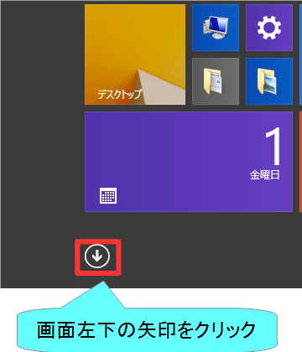
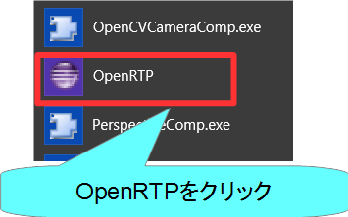
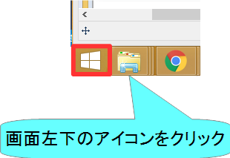
RTC Builderの起動
Windows 8.1
デスクトップ
スタート画面
アプリビュー
Notes:
At first, I’d like to mention about RT.
What is RT?
RT means Robot Technology.
This is not only standalone robots like this, but also robotic elements, sensors, actuators and so on.
We have studied on RT-Middleware.
RT-Middleware is software platform to integrate these RT-elements.

Slide 10
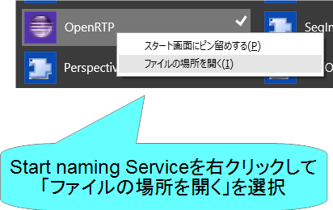
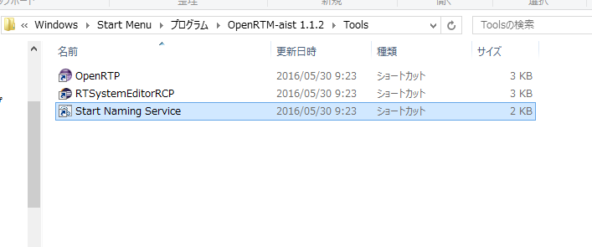
RTC Builderの起動
いちいちアプリビューから起動するのは非常に手間がかかるため、以下の作業をしてスタートメニューのフォルダを開いておくことをお勧めします。
Notes:
At first, I’d like to mention about RT.
What is RT?
RT means Robot Technology.
This is not only standalone robots like this, but also robotic elements, sensors, actuators and so on.
We have studied on RT-Middleware.
RT-Middleware is software platform to integrate these RT-elements.

Slide 11
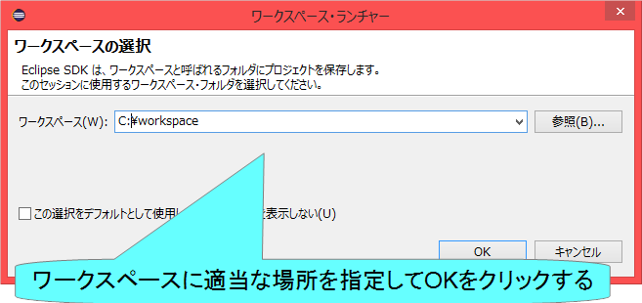
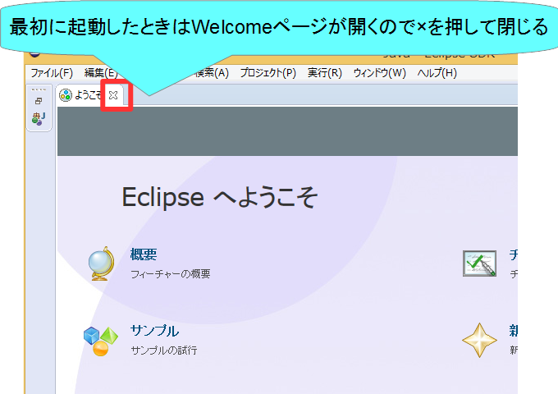
RTC Builderの起動
Notes:
At first, I’d like to mention about RT.
What is RT?
RT means Robot Technology.
This is not only standalone robots like this, but also robotic elements, sensors, actuators and so on.
We have studied on RT-Middleware.
RT-Middleware is software platform to integrate these RT-elements.

Slide 12
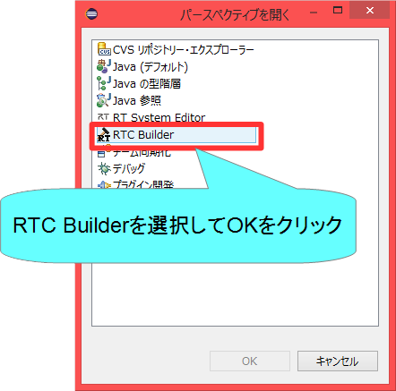
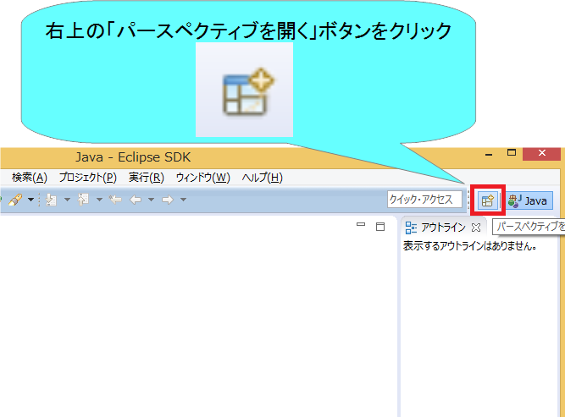
RTC Builderの起動
Notes:
At first, I’d like to mention about RT.
What is RT?
RT means Robot Technology.
This is not only standalone robots like this, but also robotic elements, sensors, actuators and so on.
We have studied on RT-Middleware.
RT-Middleware is software platform to integrate these RT-elements.

Slide 13
プロジェクト作成
Flipコンポーネントのスケルトンコードを作成する。
  車輪型移動ロボット操作コンポーネント
    GUIでロボットを操作
    センサ値が一定以上の場合に停止
Notes:
At first, I’d like to mention about RT.
What is RT?
RT means Robot Technology.
This is not only standalone robots like this, but also robotic elements, sensors, actuators and so on.
We have studied on RT-Middleware.
RT-Middleware is software platform to integrate these RT-elements.

Slide 14
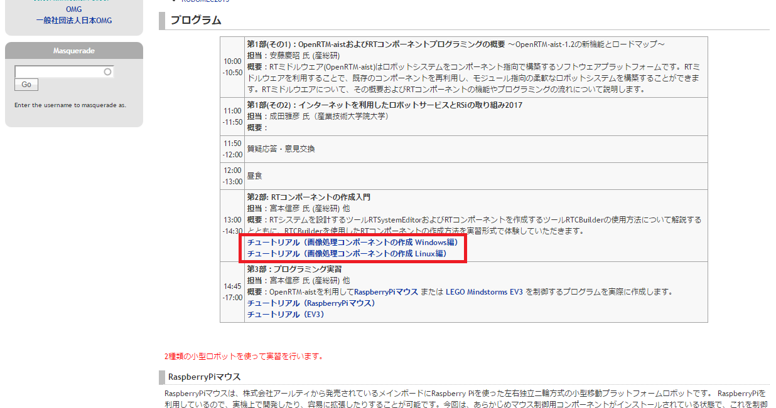
資料
早稲田大学・RTミドルウェア講習会のページから以下のページに移動
  チュートリアル（ Raspberry Piマウスシミュレータ Windows編）
  チュートリアル（ Raspberry Piマウスシミュレータ Linux編）
Notes:
At first, I’d like to mention about RT.
What is RT?
RT means Robot Technology.
This is not only standalone robots like this, but also robotic elements, sensors, actuators and so on.
We have studied on RT-Middleware.
RT-Middleware is software platform to integrate these RT-elements.

Slide 15
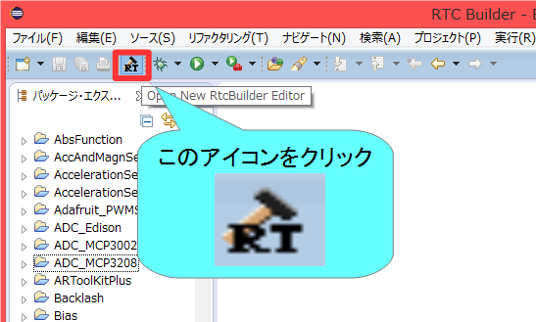
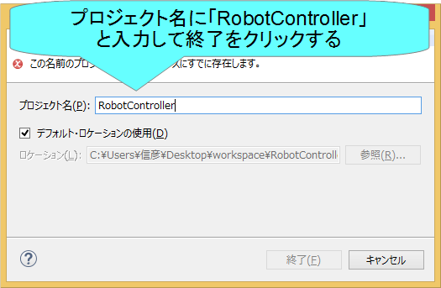
プロジェクト作成
Eclipse起動時にワークスペースに指定したディレクトリに「Flip」というフォルダが作成される
  この時点では「RTC.xml」と「.project」のみが生成されている
以下の項目が設定する
  基本プロファイル
  アクティビティ・プロファイル
  データポート・プロファイル
  サービスポート・プロファイル
  コンフィギュレーション
  ドキュメント
  言語環境
  RTC.xml
Notes:
At first, I’d like to mention about RT.
What is RT?
RT means Robot Technology.
This is not only standalone robots like this, but also robotic elements, sensors, actuators and so on.
We have studied on RT-Middleware.
RT-Middleware is software platform to integrate these RT-elements.

Slide 16
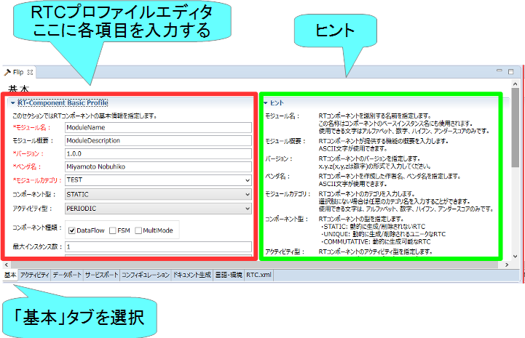
基本プロファイルの入力
RTコンポーネントのプロファイル情報など，コンポーネントの基本情報を設定．
コード生成，インポート/エクスポート，パッケージング処理を実行
Notes:
At first, I’d like to mention about RT.
What is RT?
RT means Robot Technology.
This is not only standalone robots like this, but also robotic elements, sensors, actuators and so on.
We have studied on RT-Middleware.
RT-Middleware is software platform to integrate these RT-elements.

Slide 17
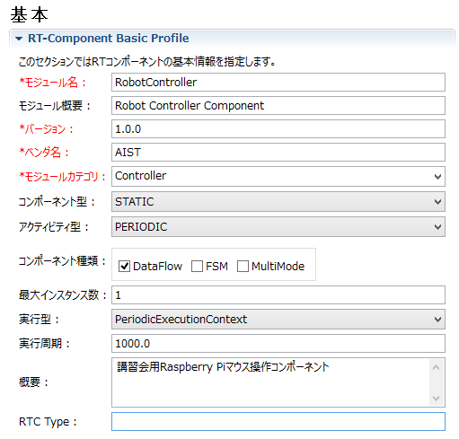
基本プロファイルの入力
モジュール名
  RobotController
モジュール概要
  任意(Robot Controller Component)
バージョン
  任意(1.0.0)
ベンダ名
  任意
モジュールカテゴリ
  任意(Controller)
コンポーネント型
  STATIC
アクティビティ型
  PERIODIC
コンポーネントの種類
  DataFlow
最大インスタンス数
  1
実行型
  PeriodicExecutionContext
実行周期
  1000.0
概要
  任意
Notes:
At first, I’d like to mention about RT.
What is RT?
RT means Robot Technology.
This is not only standalone robots like this, but also robotic elements, sensors, actuators and so on.
We have studied on RT-Middleware.
RT-Middleware is software platform to integrate these RT-elements.

Slide 18
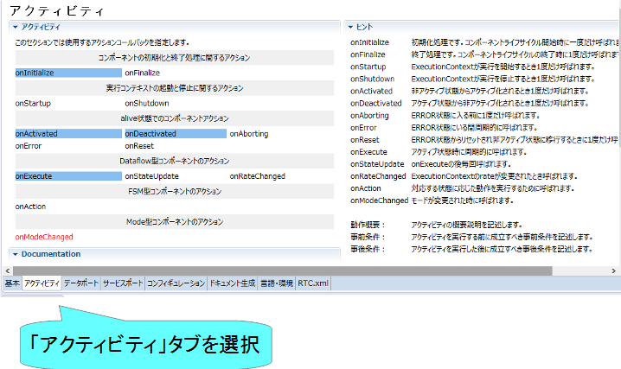
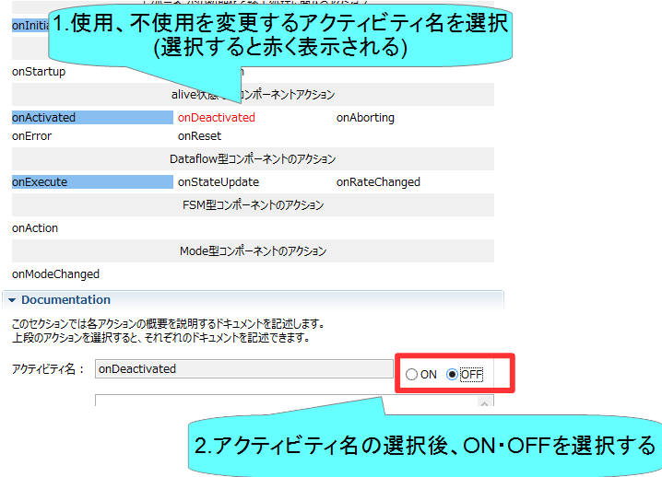
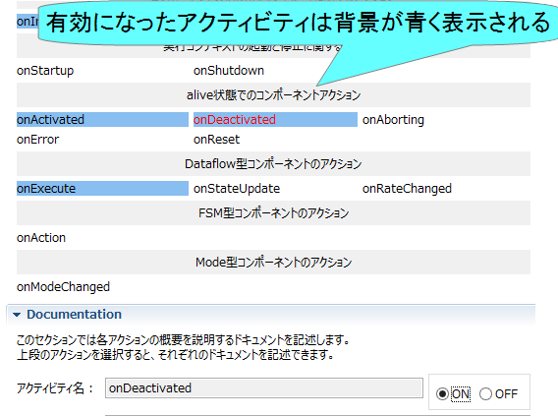
アクティビティの設定
使用するアクティビティを設定する
指定アクティビティを有効にする手順
Notes:
At first, I’d like to mention about RT.
What is RT?
RT means Robot Technology.
This is not only standalone robots like this, but also robotic elements, sensors, actuators and so on.
We have studied on RT-Middleware.
RT-Middleware is software platform to integrate these RT-elements.

Slide 19
アクティビティの設定
コールバック関数 | 処理
onInitialize | 初期化処理
onActivated | アクティブ化されるとき1度だけ呼ばれる
onExecute | アクティブ状態時に周期的に呼ばれる
onDeactivated | 非アクティブ化されるとき1度だけ呼ばれる
onAborting | ERROR状態に入る前に1度だけ呼ばれる
onReset | resetされる時に1度だけ呼ばれる
onError | ERROR状態のときに周期的に呼ばれる
onFinalize | 終了時に1度だけ呼ばれる
onStateUpdate | onExecuteの後毎回呼ばれる
onRateChanged | ExecutionContextのrateが変更されたとき1度だけ呼ばれる
onStartup | ExecutionContextが実行を開始するとき1度だけ呼ばれる
onShutdown | ExecutionContextが実行を停止するとき1度だけ呼ばれる
Notes:
At first, I’d like to mention about RT.
What is RT?
RT means Robot Technology.
This is not only standalone robots like this, but also robotic elements, sensors, actuators and so on.
We have studied on RT-Middleware.
RT-Middleware is software platform to integrate these RT-elements.

Slide 20
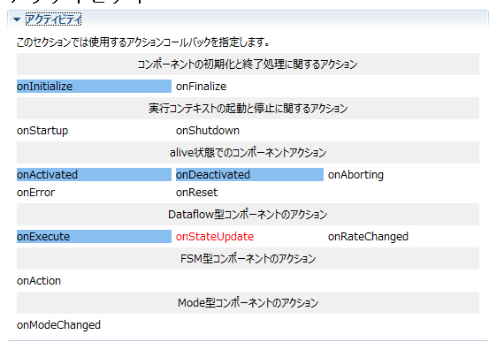
アクティビティの設定
以下のアクティビティを有効にする
  onInitialize
  onActivated
  onDeactivated
  onExecute
Documentationは適当に書いておいてください
  空白でも大丈夫です
Notes:
At first, I’d like to mention about RT.
What is RT?
RT means Robot Technology.
This is not only standalone robots like this, but also robotic elements, sensors, actuators and so on.
We have studied on RT-Middleware.
RT-Middleware is software platform to integrate these RT-elements.

Slide 21
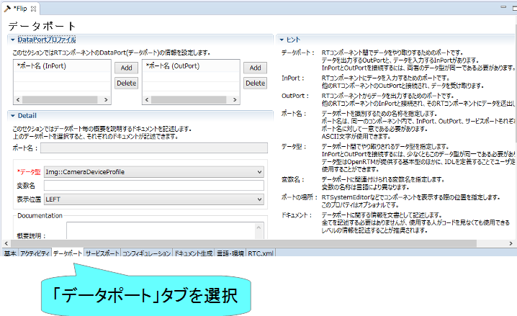
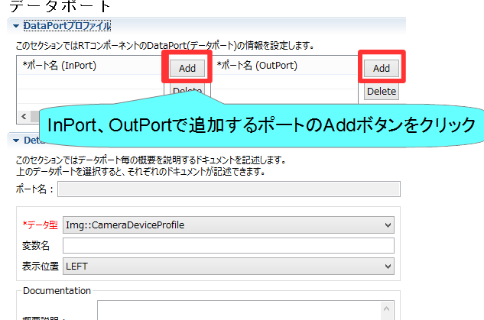
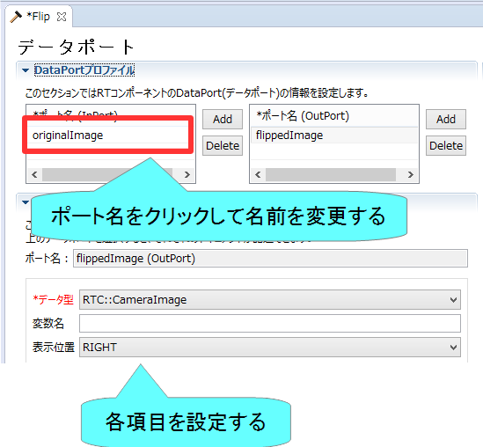
データポートの設定
InPort、OutPortの追加、設定を行う
データポートを追加する手順
Notes:
At first, I’d like to mention about RT.
What is RT?
RT means Robot Technology.
This is not only standalone robots like this, but also robotic elements, sensors, actuators and so on.
We have studied on RT-Middleware.
RT-Middleware is software platform to integrate these RT-elements.

Slide 22
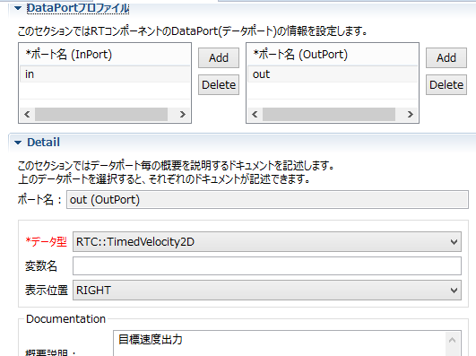
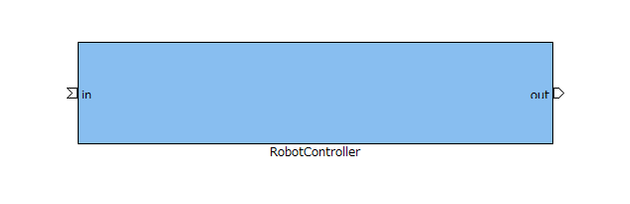
データポートの設定
以下のInPortを設定する
  in
    データ型： RTC::TimedVelocity2D
    他の項目は任意
以下のOutPortを設定する
  out
    データ型： RTC::TimedShortSeq
    他の項目は任意
Notes:
At first, I’d like to mention about RT.
What is RT?
RT means Robot Technology.
This is not only standalone robots like this, but also robotic elements, sensors, actuators and so on.
We have studied on RT-Middleware.
RT-Middleware is software platform to integrate these RT-elements.

Slide 23
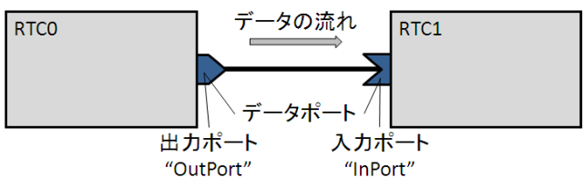
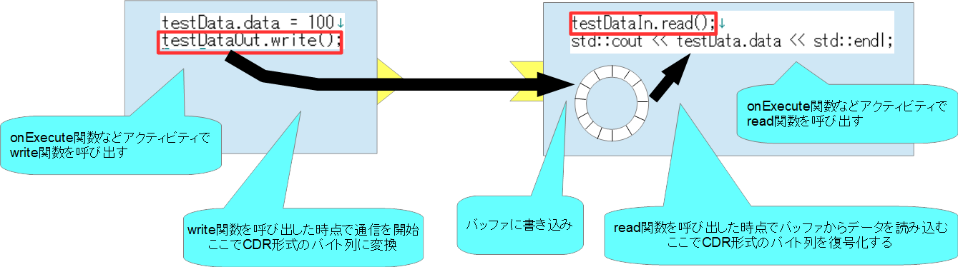
データポートについて
連続したデータを通信するためのポート
以下の例はデータフロー型がpush、サブスクリプション型がflush、インターフェース型がcorba_cdrの場合
Notes:
At first, I’d like to mention about RT.
What is RT?
RT means Robot Technology.
This is not only standalone robots like this, but also robotic elements, sensors, actuators and so on.
We have studied on RT-Middleware.
RT-Middleware is software platform to integrate these RT-elements.

Slide 24
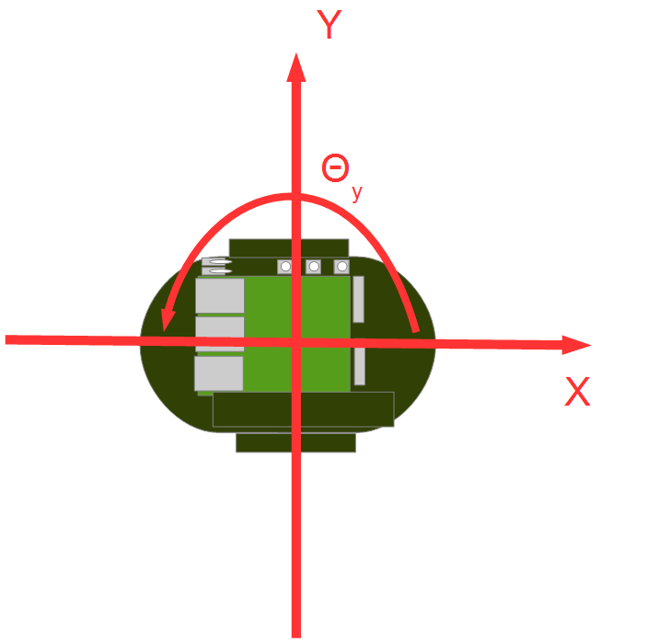
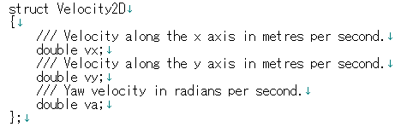
RTC::TimedVelocity2D型について
ExtendedDataTypes.idlで定義されている移動ロボットの速度を表現するのためのデータ型
  vx: X軸方向の速度
  vy: Y軸方向の速度(車輪が滑らないと仮定するとvyは0)
  Va: Z軸周りの角速度
vxで直進速度、vaで回転速度を指令
Notes:
At first, I’d like to mention about RT.
What is RT?
RT means Robot Technology.
This is not only standalone robots like this, but also robotic elements, sensors, actuators and so on.
We have studied on RT-Middleware.
RT-Middleware is software platform to integrate these RT-elements.

Slide 25
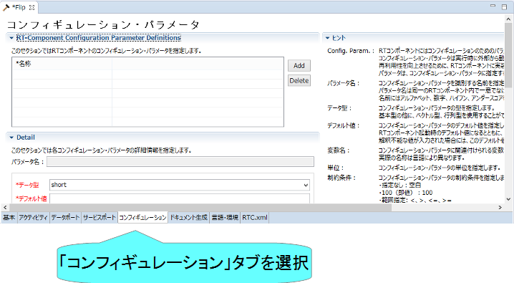
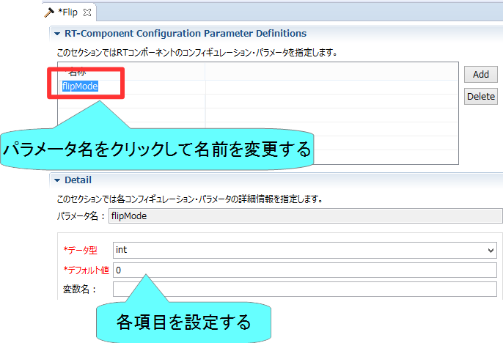
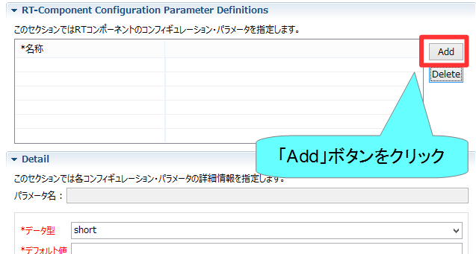
コンフィギュレーションの設定
コンフィギュレーションパラメータの追加、設定を行う
コンフィギュレーションパラメータを追加する手順
Notes:
At first, I’d like to mention about RT.
What is RT?
RT means Robot Technology.
This is not only standalone robots like this, but also robotic elements, sensors, actuators and so on.
We have studied on RT-Middleware.
RT-Middleware is software platform to integrate these RT-elements.

Slide 26
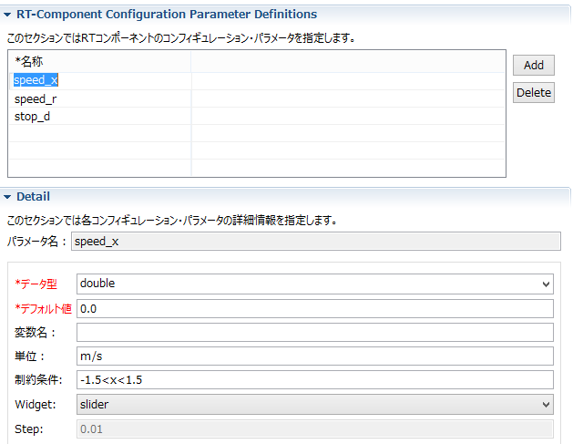
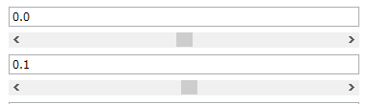
コンフィギュレーションの設定
以下のコンフィギュレーションパラメータを設定する
  speed_x
    データ型：double
    デフォルト値： 0.0
    制約条件：-1.5<x<1.5
    Widget：slider
    他の項目は任意
  speed_r
    データ型：double
    デフォルト値： 0.0
    制約条件：-2.0<x<2.0
    Widget：slider
    他の項目は任意
GUI(スライダー)による移動ロボットの操作ができるようにする
Notes:
At first, I’d like to mention about RT.
What is RT?
RT means Robot Technology.
This is not only standalone robots like this, but also robotic elements, sensors, actuators and so on.
We have studied on RT-Middleware.
RT-Middleware is software platform to integrate these RT-elements.

Slide 27

コンフィギュレーションパラメータの制約、Widgetの設定
RT System Editorでコンフィギュレーションパラメータを編集する際にGUIを表示する
Widget：text
制約条件：0<=x<=100
Widget：spin
Step：10
制約条件：0<=x<=100
Widget：slider
Step：10
Notes:
At first, I’d like to mention about RT.
What is RT?
RT means Robot Technology.
This is not only standalone robots like this, but also robotic elements, sensors, actuators and so on.
We have studied on RT-Middleware.
RT-Middleware is software platform to integrate these RT-elements.

Slide 28


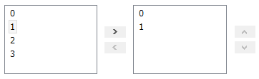
コンフィギュレーションパラメータの制約、Widgetの設定
制約条件：(0,1,2,3)
Widget：radio
制約条件：(0,1,2,3)
Widget：checkbox
制約条件：(0,1,2,3)
Widget：ordered_list
Notes:
At first, I’d like to mention about RT.
What is RT?
RT means Robot Technology.
This is not only standalone robots like this, but also robotic elements, sensors, actuators and so on.
We have studied on RT-Middleware.
RT-Middleware is software platform to integrate these RT-elements.

Slide 29
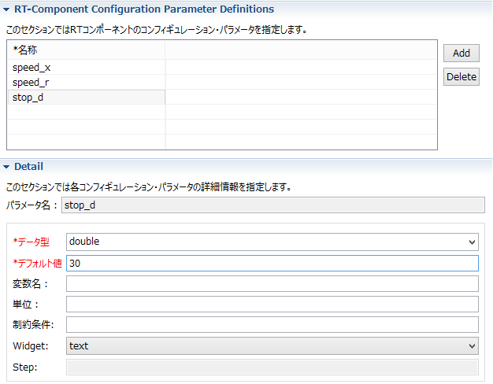
コンフィギュレーションの設定
以下のコンフィギュレーションパラメータを追加
  stop_d
    データ型：double
    デフォルト値： 30
    他の項目は任意
センサ値がこの値以上の場合に停止
Notes:
At first, I’d like to mention about RT.
What is RT?
RT means Robot Technology.
This is not only standalone robots like this, but also robotic elements, sensors, actuators and so on.
We have studied on RT-Middleware.
RT-Middleware is software platform to integrate these RT-elements.

Slide 30
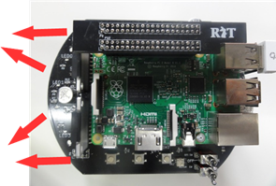
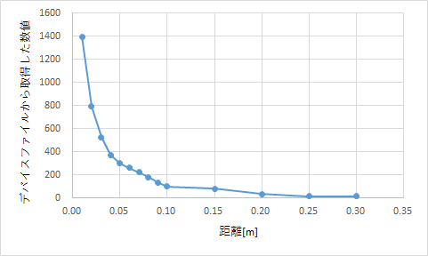
Raspberry Piマウスの距離センサ
Raspberry Piマウス実機には距離センサが搭載されている
  計測した値はきょりが物体までの距離が近いほど大きな値となる
シミュレータでもこのデータに近い値を計算して出力している
Notes:
At first, I’d like to mention about RT.
What is RT?
RT means Robot Technology.
This is not only standalone robots like this, but also robotic elements, sensors, actuators and so on.
We have studied on RT-Middleware.
RT-Middleware is software platform to integrate these RT-elements.

Slide 31
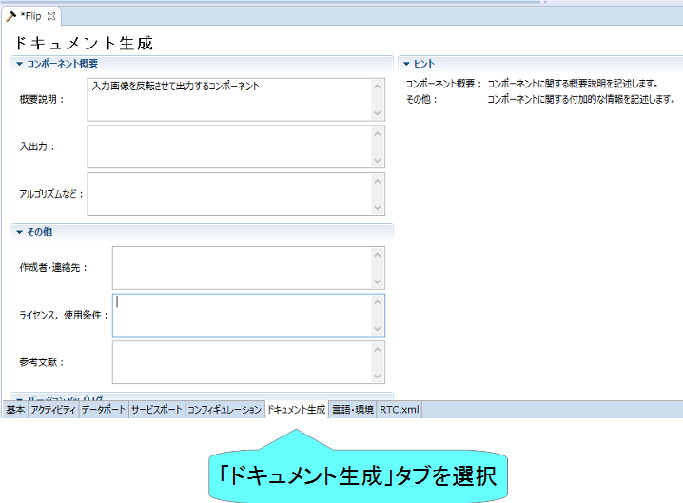
ドキュメントの設定
各種ドキュメント情報を設定
今回は適当に設定しておいてください。
  空白でも大丈夫です
Notes:
At first, I’d like to mention about RT.
What is RT?
RT means Robot Technology.
This is not only standalone robots like this, but also robotic elements, sensors, actuators and so on.
We have studied on RT-Middleware.
RT-Middleware is software platform to integrate these RT-elements.

Slide 32
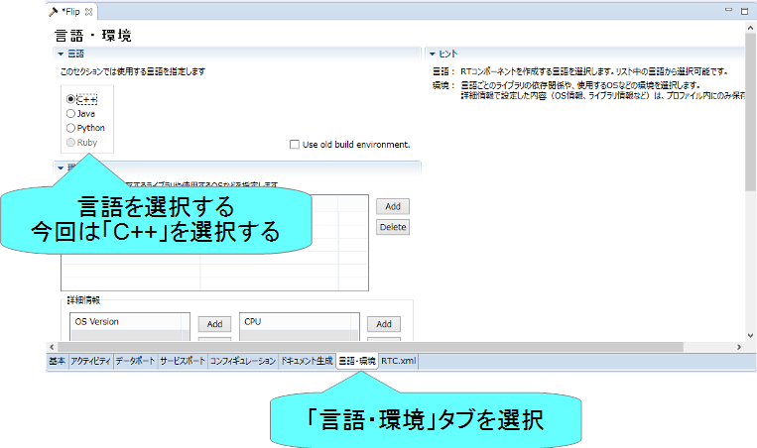
言語の設定
実装する言語，動作環境に関する情報を設定
Notes:
At first, I’d like to mention about RT.
What is RT?
RT means Robot Technology.
This is not only standalone robots like this, but also robotic elements, sensors, actuators and so on.
We have studied on RT-Middleware.
RT-Middleware is software platform to integrate these RT-elements.

Slide 33
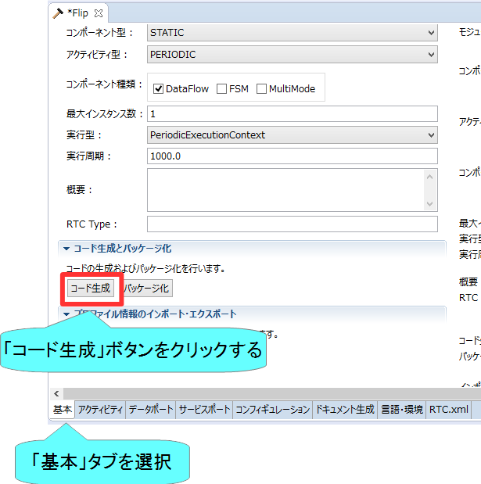
スケルトンコードの生成
基本タブからコード生成ボタンを押すことでスケルトンコードが生成される
  Workspace\RobotController以下に生成
    ソースコード
      C++ソースファイル(.cpp)
      ヘッダーファイル(.h)
        このソースコードにロボットを操作する処理を記述する
    CMakeの設定ファイル
      CMakeLists.txt
    rtc.conf、RobotController.conf
    以下略
  ファイルが生成できているかを確認してください
Notes:
At first, I’d like to mention about RT.
What is RT?
RT means Robot Technology.
This is not only standalone robots like this, but also robotic elements, sensors, actuators and so on.
We have studied on RT-Middleware.
RT-Middleware is software platform to integrate these RT-elements.

Slide 34
ソースコードの編集、RTCのビルド

Slide 35
手順
ビルドに必要な各種ファイルを生成
  CMakeLists.txtの編集
  CMakeにより各種ファイル生成
ソースコードの編集
  RobotController.hの編集
  RobotController.cppの編集
ビルド
  Windows： Visual Studio
  Ubuntu： Code::Blocks
Notes:
At first, I’d like to mention about RT.
What is RT?
RT means Robot Technology.
This is not only standalone robots like this, but also robotic elements, sensors, actuators and so on.
We have studied on RT-Middleware.
RT-Middleware is software platform to integrate these RT-elements.

Slide 36
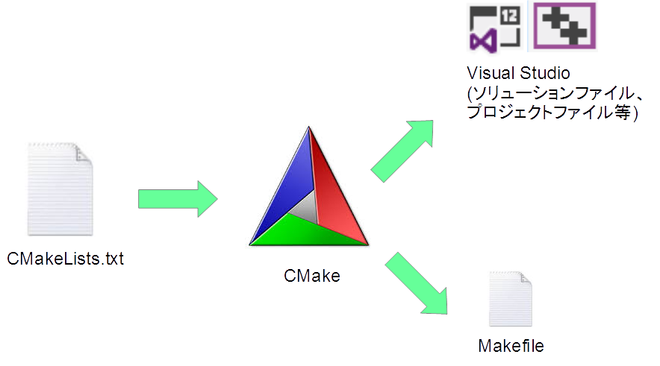
CMake
ビルドに必要な各種ファイルを生成
  CMakeLists.txtに設定を記述
    RTC Builderでスケルトンコードを作成した時にCMakeLists.txtも生成されている
Notes:
At first, I’d like to mention about RT.
What is RT?
RT means Robot Technology.
This is not only standalone robots like this, but also robotic elements, sensors, actuators and so on.
We have studied on RT-Middleware.
RT-Middleware is software platform to integrate these RT-elements.

Slide 37
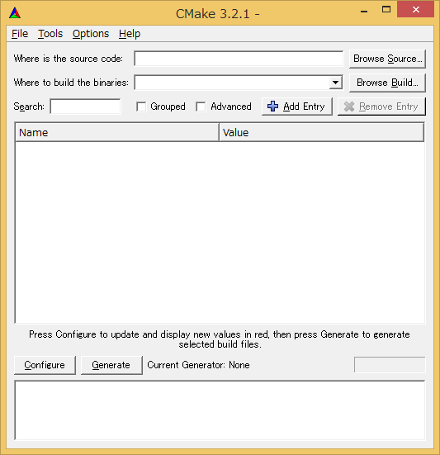
ビルドに必要なファイルの生成
CMakeを使用する
  Windows 7
    「スタート」→「すべてのプログラム」→「CMake 3.5.2」→「CMake (cmake-gui)」
  Windows 8.1
    「スタート」→「アプリビュー(右下矢印)」→「CMake 3.5.2」→「CMake (cmake-gui)」
  Ubuntu
    コマンドで「cmake-gui」を入力
Notes:
At first, I’d like to mention about RT.
What is RT?
RT means Robot Technology.
This is not only standalone robots like this, but also robotic elements, sensors, actuators and so on.
We have studied on RT-Middleware.
RT-Middleware is software platform to integrate these RT-elements.

Slide 38
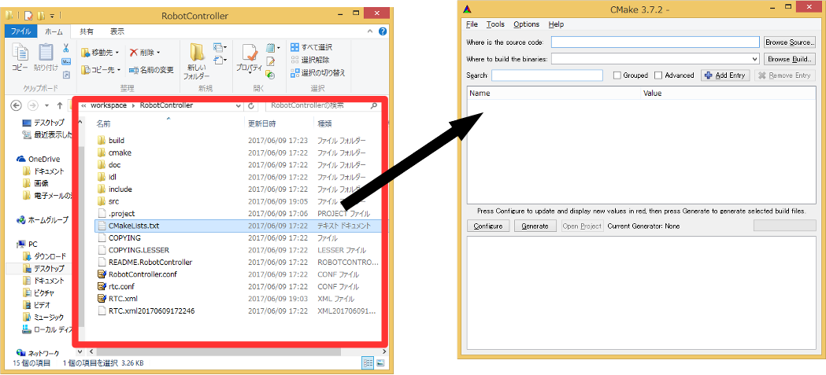
ビルドに必要なファイルの生成
CMakeLists.txtをcmake-guiにドラックアンドドロップ
  CMakeLists.txtはRTC Builderで生成したプロジェクトのフォルダ
  (例： C:\workspace\RobotController)
Notes:
At first, I’d like to mention about RT.
What is RT?
RT means Robot Technology.
This is not only standalone robots like this, but also robotic elements, sensors, actuators and so on.
We have studied on RT-Middleware.
RT-Middleware is software platform to integrate these RT-elements.

Slide 39
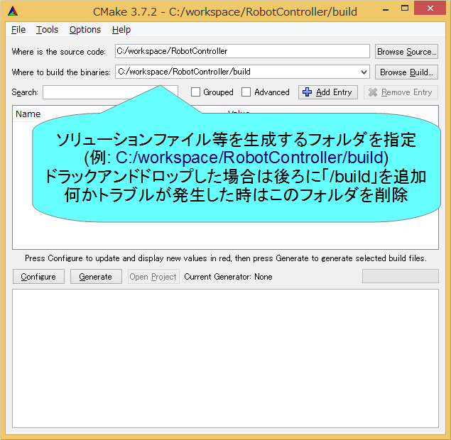
ビルドに必要なファイルの生成
Notes:
At first, I’d like to mention about RT.
What is RT?
RT means Robot Technology.
This is not only standalone robots like this, but also robotic elements, sensors, actuators and so on.
We have studied on RT-Middleware.
RT-Middleware is software platform to integrate these RT-elements.

Slide 40
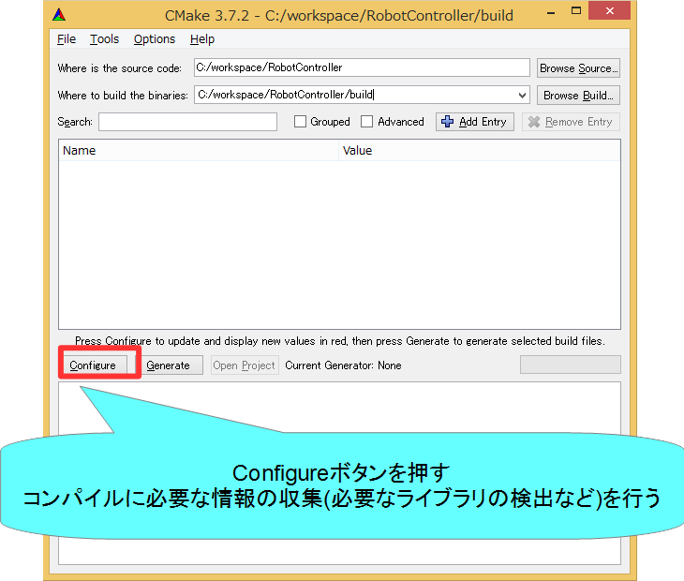
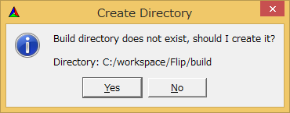

ビルドに必要なファイルの生成
Notes:
At first, I’d like to mention about RT.
What is RT?
RT means Robot Technology.
This is not only standalone robots like this, but also robotic elements, sensors, actuators and so on.
We have studied on RT-Middleware.
RT-Middleware is software platform to integrate these RT-elements.

Slide 41
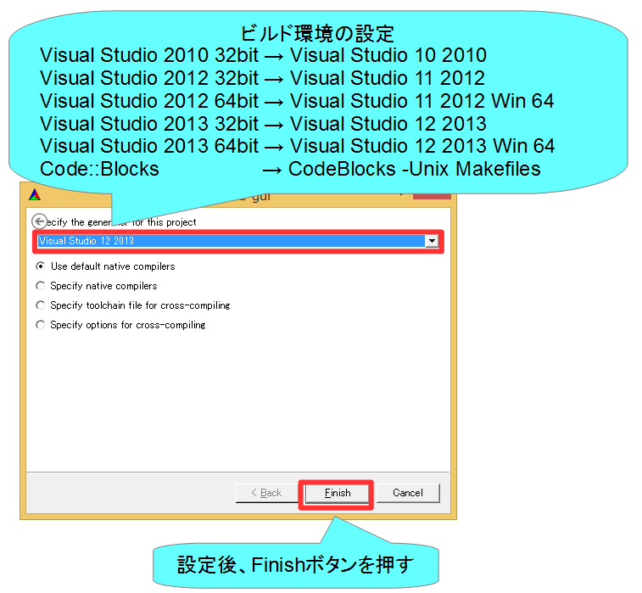
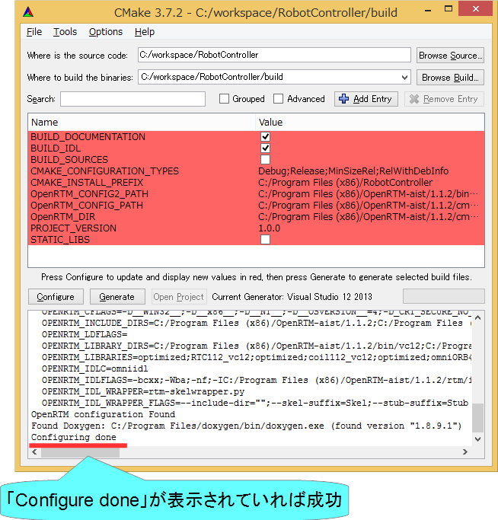
ビルドに必要なファイルの生成
Notes:
At first, I’d like to mention about RT.
What is RT?
RT means Robot Technology.
This is not only standalone robots like this, but also robotic elements, sensors, actuators and so on.
We have studied on RT-Middleware.
RT-Middleware is software platform to integrate these RT-elements.

Slide 42
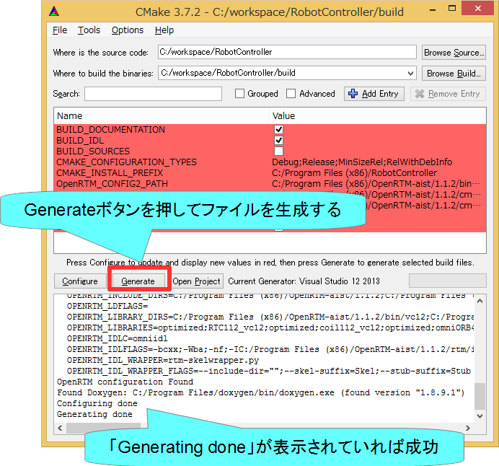
ビルドに必要なファイルの生成
Notes:
At first, I’d like to mention about RT.
What is RT?
RT means Robot Technology.
This is not only standalone robots like this, but also robotic elements, sensors, actuators and so on.
We have studied on RT-Middleware.
RT-Middleware is software platform to integrate these RT-elements.

Slide 43


ソースコードの編集
Windows
  buildフォルダの「RobotController.sln」をダブルクリックして開く
Ubuntu
  buildフォルダの「RobotController.cbp」をダブルクリックして開く
Notes:
At first, I’d like to mention about RT.
What is RT?
RT means Robot Technology.
This is not only standalone robots like this, but also robotic elements, sensors, actuators and so on.
We have studied on RT-Middleware.
RT-Middleware is software platform to integrate these RT-elements.

Slide 44


ソースコードの編集
Windows
  Visual Studioが起動
Ubuntu
  Code::Blocksが起動
Notes:
At first, I’d like to mention about RT.
What is RT?
RT means Robot Technology.
This is not only standalone robots like this, but also robotic elements, sensors, actuators and so on.
We have studied on RT-Middleware.
RT-Middleware is software platform to integrate these RT-elements.

Slide 45


ソースコードの編集
RobotController.hの編集
Visual Studio
Code::Blocks
Notes:
At first, I’d like to mention about RT.
What is RT?
RT means Robot Technology.
This is not only standalone robots like this, but also robotic elements, sensors, actuators and so on.
We have studied on RT-Middleware.
RT-Middleware is software platform to integrate these RT-elements.

Slide 46

ソースコードの編集
RobotController.hの編集
Notes:
At first, I’d like to mention about RT.
What is RT?
RT means Robot Technology.
This is not only standalone robots like this, but also robotic elements, sensors, actuators and so on.
We have studied on RT-Middleware.
RT-Middleware is software platform to integrate these RT-elements.

Slide 47


ソースコードの編集
RobotController.cppの編集
  詳細はUSBメモリの資料を参考にしてください
Visual Studio
Code::Blocks
Notes:
At first, I’d like to mention about RT.
What is RT?
RT means Robot Technology.
This is not only standalone robots like this, but also robotic elements, sensors, actuators and so on.
We have studied on RT-Middleware.
RT-Middleware is software platform to integrate these RT-elements.

Slide 48


ソースコードの編集
RobotController.cppの編集
Notes:
At first, I’d like to mention about RT.
What is RT?
RT means Robot Technology.
This is not only standalone robots like this, but also robotic elements, sensors, actuators and so on.
We have studied on RT-Middleware.
RT-Middleware is software platform to integrate these RT-elements.

Slide 49

ソースコードの編集
RobotController.cppの編集
Notes:
At first, I’d like to mention about RT.
What is RT?
RT means Robot Technology.
This is not only standalone robots like this, but also robotic elements, sensors, actuators and so on.
We have studied on RT-Middleware.
RT-Middleware is software platform to integrate these RT-elements.

