Slide 1
第2部 RTコンポーネント作成入門
宮本 信彦
国立研究開発法人産業技術総合研究所
ロボットイノベーション研究センター
ロボットソフトウェアプラットフォーム研究チーム

Slide 2
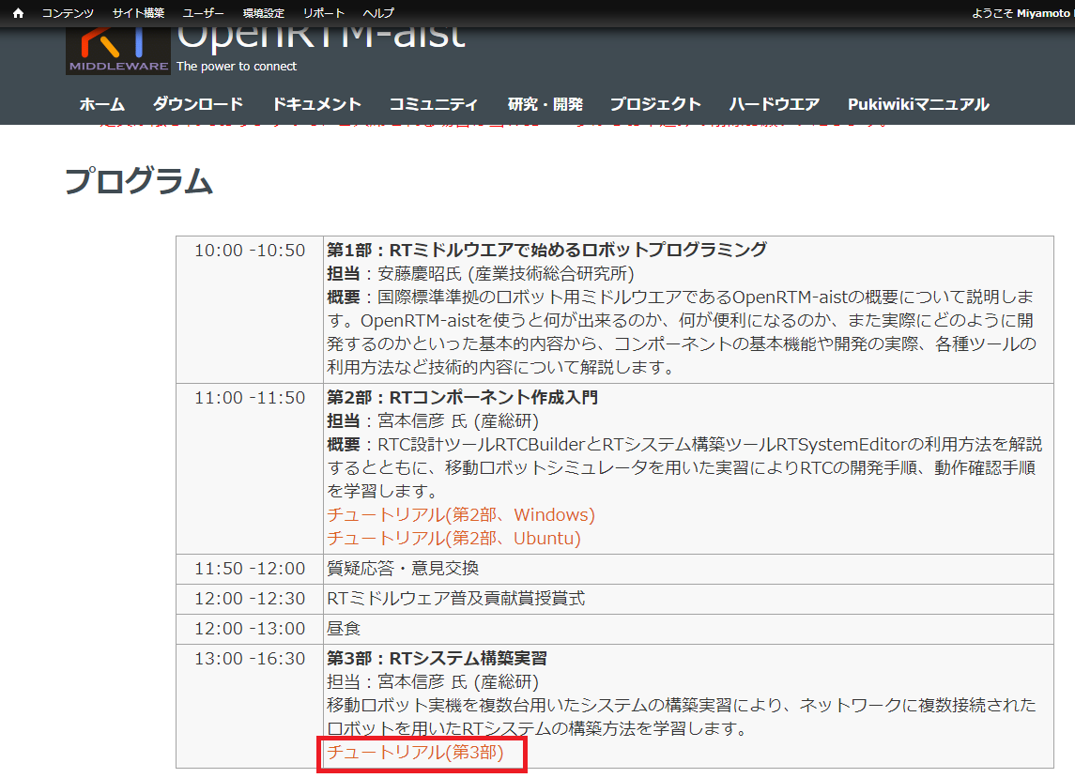
資料
USBメモリで配布
「WEBページ」フォルダのHTMLファイルを開く
チュートリアル(EV3、第3部) _ OpenRTM-aist.html
もしくはRTミドルウェア講習会のページからリンクをクリック
チュートリアル(第2部、Windows)
チュートリアル(第2部、Ubuntu)
2
Notes:
2
At first, I’d like to mention about RT.
What is RT?
RT means Robot Technology.
This is not only standalone robots like this, but also robotic elements, sensors, actuators and so on.
We have studied on RT-Middleware.
RT-Middleware is software platform to integrate these RT-elements.

Slide 3
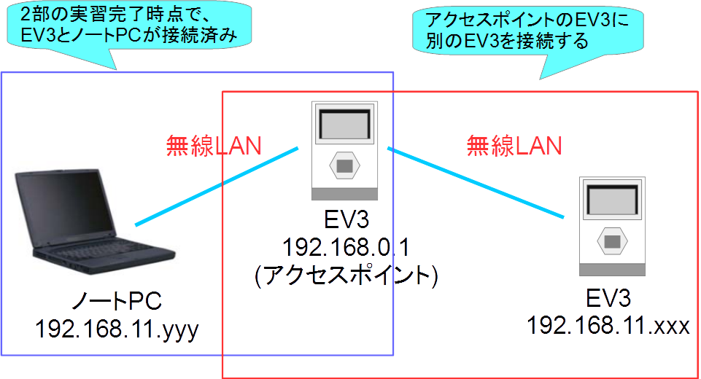
複数台のEV3が連携するシステムの構築
アクセスポイントのEV3にノートPCと別のEV3を接続する
3
Notes:
3
At first, I’d like to mention about RT.
What is RT?
RT means Robot Technology.
This is not only standalone robots like this, but also robotic elements, sensors, actuators and so on.
We have studied on RT-Middleware.
RT-Middleware is software platform to integrate these RT-elements.

Slide 4
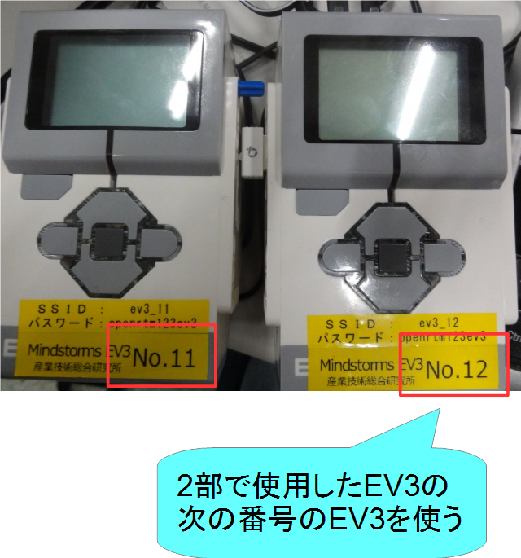
EV3配布
EV3の番号を確認
Educator Vehicleの組立て
2部と同じ手順
4
Notes:
4
At first, I’d like to mention about RT.
What is RT?
RT means Robot Technology.
This is not only standalone robots like this, but also robotic elements, sensors, actuators and so on.
We have studied on RT-Middleware.
RT-Middleware is software platform to integrate these RT-elements.

Slide 5
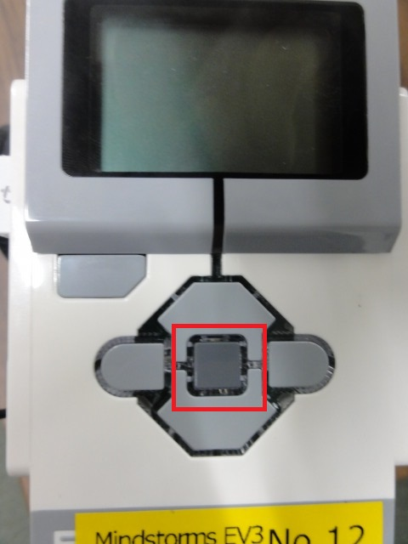
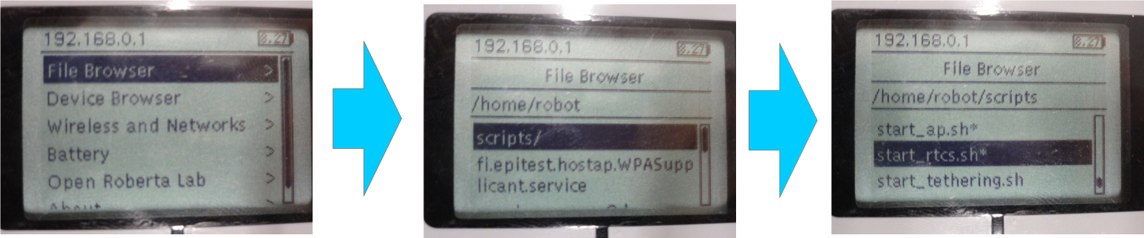
EV3(2台目の接続)
電源投入
中央のボタンを押す
スクリプトファイル実行(RTCの起動)
ボタン操作で「File Browser」→「scripts」→「start_rtcs.sh」を選択
5
Notes:
5
At first, I’d like to mention about RT.
What is RT?
RT means Robot Technology.
This is not only standalone robots like this, but also robotic elements, sensors, actuators and so on.
We have studied on RT-Middleware.
RT-Middleware is software platform to integrate these RT-elements.

Slide 6
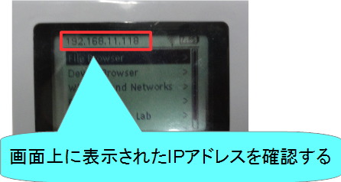
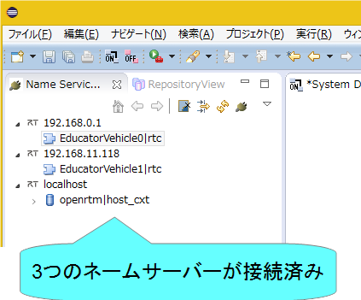
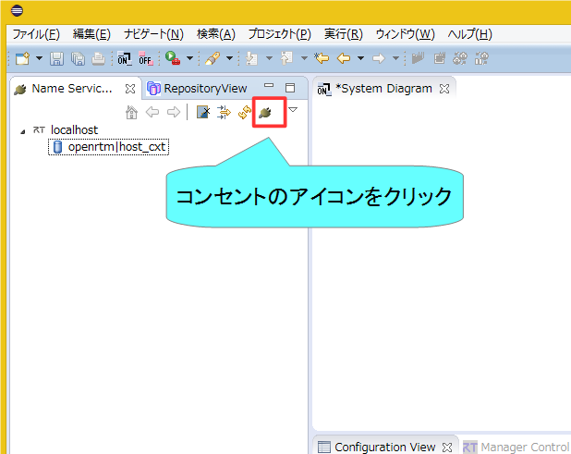
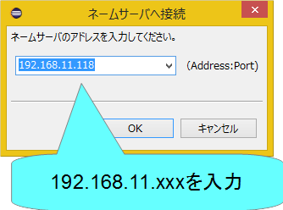
EV3(2台目の接続)
ネームサーバーの接続
EV3の画面上に表示されたIPアドレスを入力する
6
Notes:
6
At first, I’d like to mention about RT.
What is RT?
RT means Robot Technology.
This is not only standalone robots like this, but also robotic elements, sensors, actuators and so on.
We have studied on RT-Middleware.
RT-Middleware is software platform to integrate these RT-elements.

Slide 7
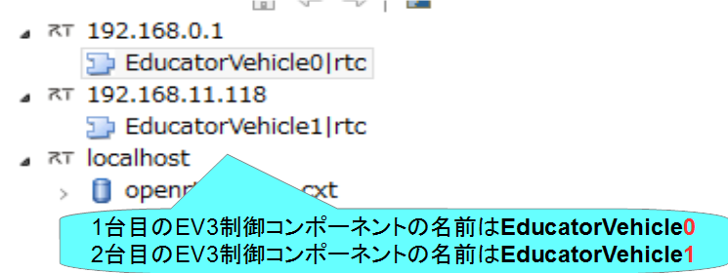
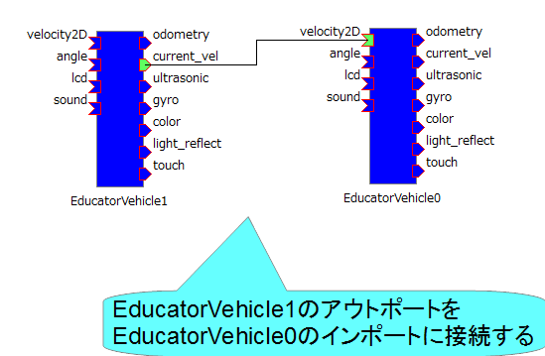
動作確認
データポートの接続
EducatorVehicle1(2台目)の現在の速度出力をEducatorVehicle0(1台目)の目標速度入力に接続する。
7
Notes:
7
At first, I’d like to mention about RT.
What is RT?
RT means Robot Technology.
This is not only standalone robots like this, but also robotic elements, sensors, actuators and so on.
We have studied on RT-Middleware.
RT-Middleware is software platform to integrate these RT-elements.

Slide 8
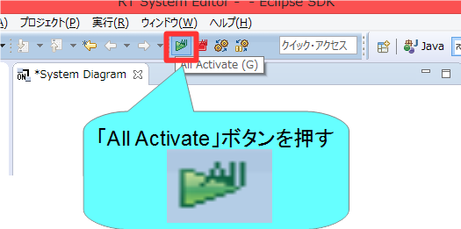
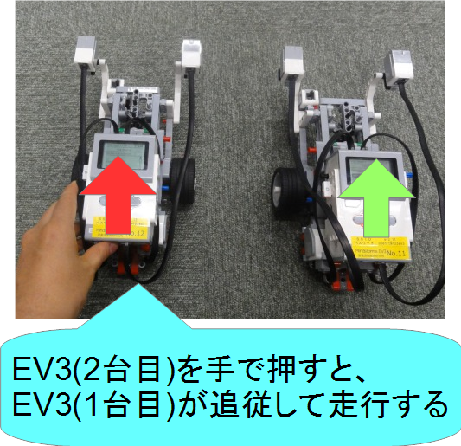
動作確認
RTCをアクティブ化する
8
Notes:
8
At first, I’d like to mention about RT.
What is RT?
RT means Robot Technology.
This is not only standalone robots like this, but also robotic elements, sensors, actuators and so on.
We have studied on RT-Middleware.
RT-Middleware is software platform to integrate these RT-elements.

Slide 9
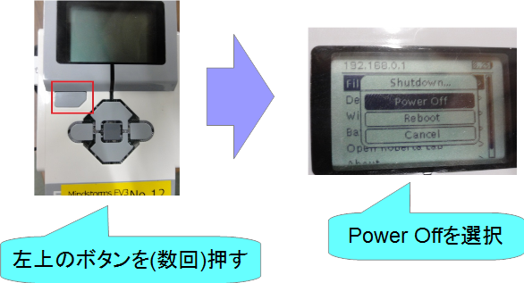
おわりに
これで実習は一通り終了です。
時間が余った場合は、以下のような課題に挑戦してみてください。
EV3(2台目)のタッチセンサのオンオフでEV3(1台目)を操作
ジョイスティックコンポーネントで2台同時に操作
EV3をしゃべらせる
各種センサの利用(カラーセンサ、超音波センサ、ジャイロセンサ)
実習を終了する際について
タッチセンサなどの実習中に取り付けた部品は、取り外して実習前の状態で返却してください
EV3の電源をオフにして返却してください
9
Notes:
9
At first, I’d like to mention about RT.
What is RT?
RT means Robot Technology.
This is not only standalone robots like this, but also robotic elements, sensors, actuators and so on.
We have studied on RT-Middleware.
RT-Middleware is software platform to integrate these RT-elements.

