Slide 1
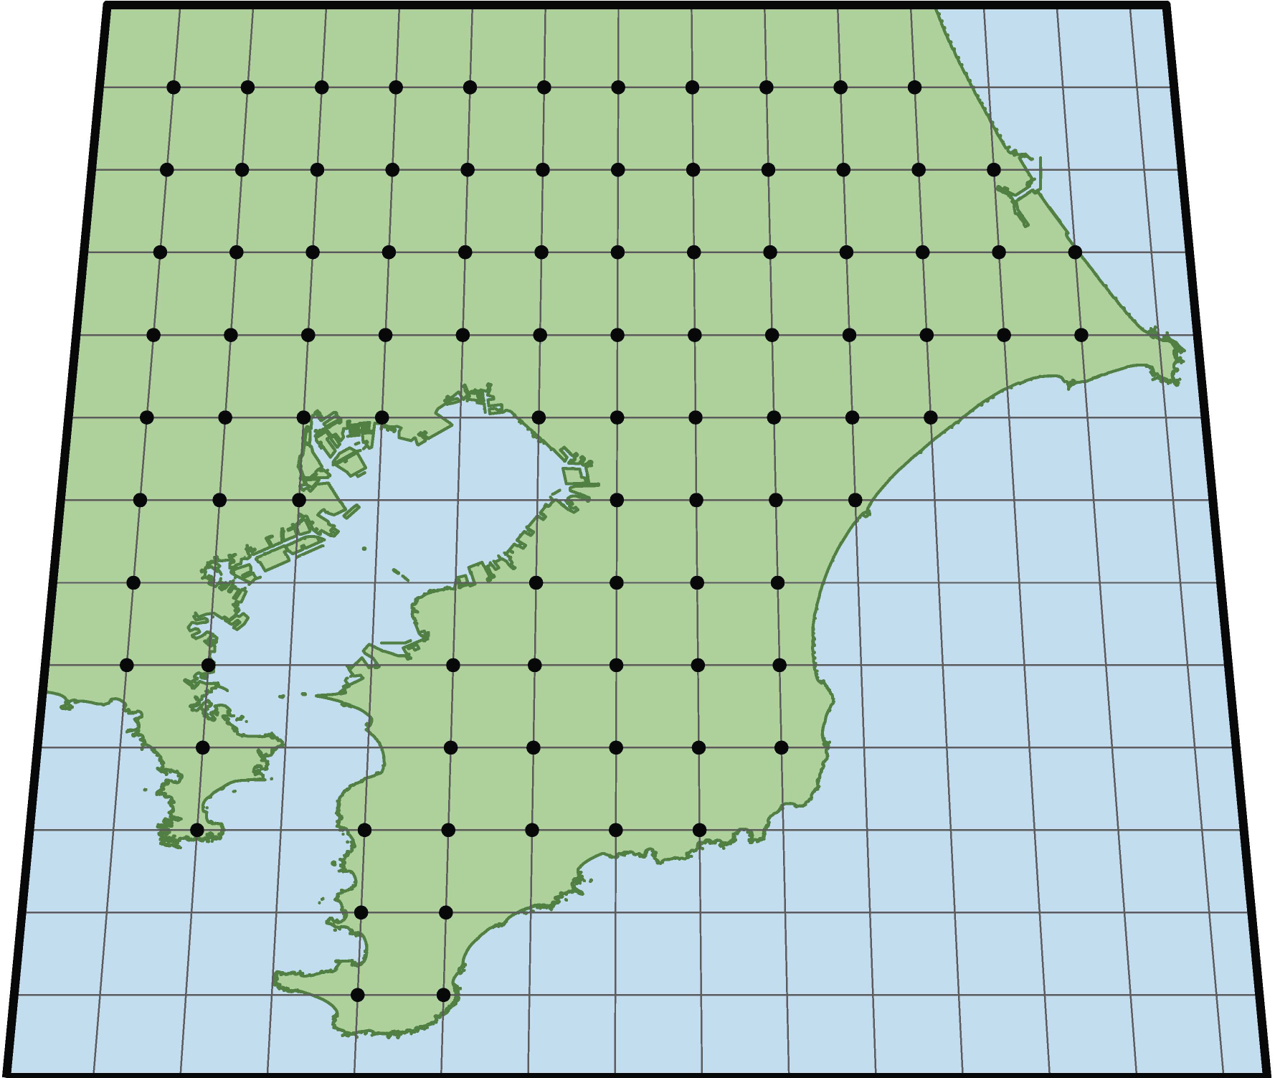
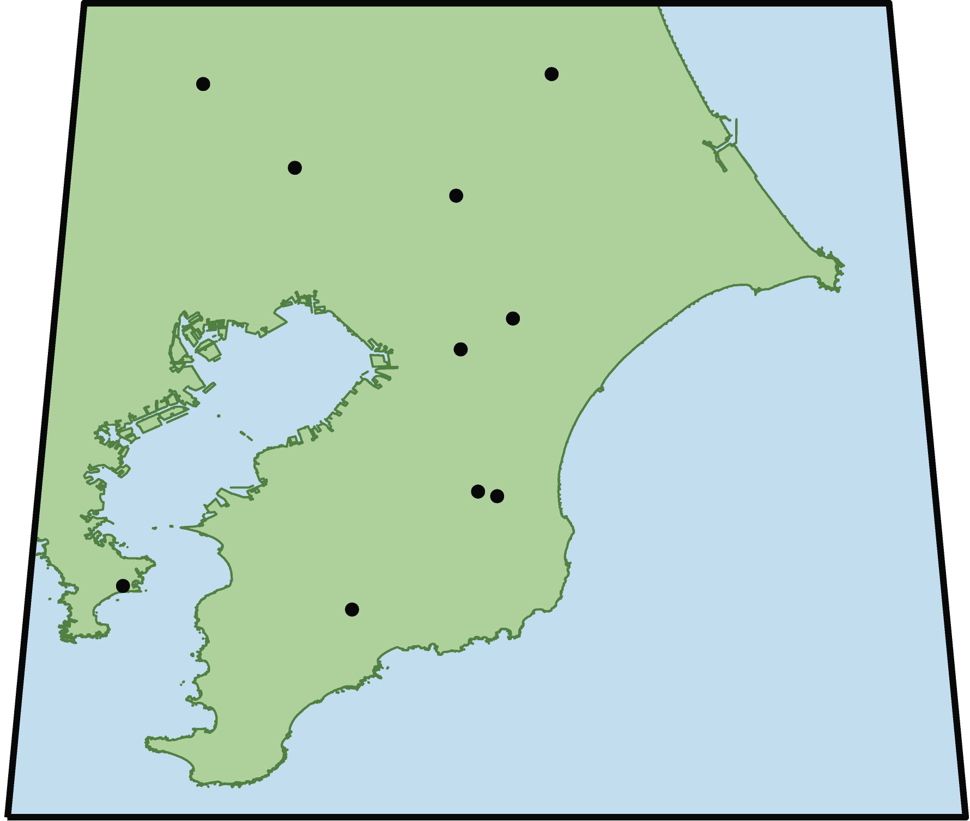
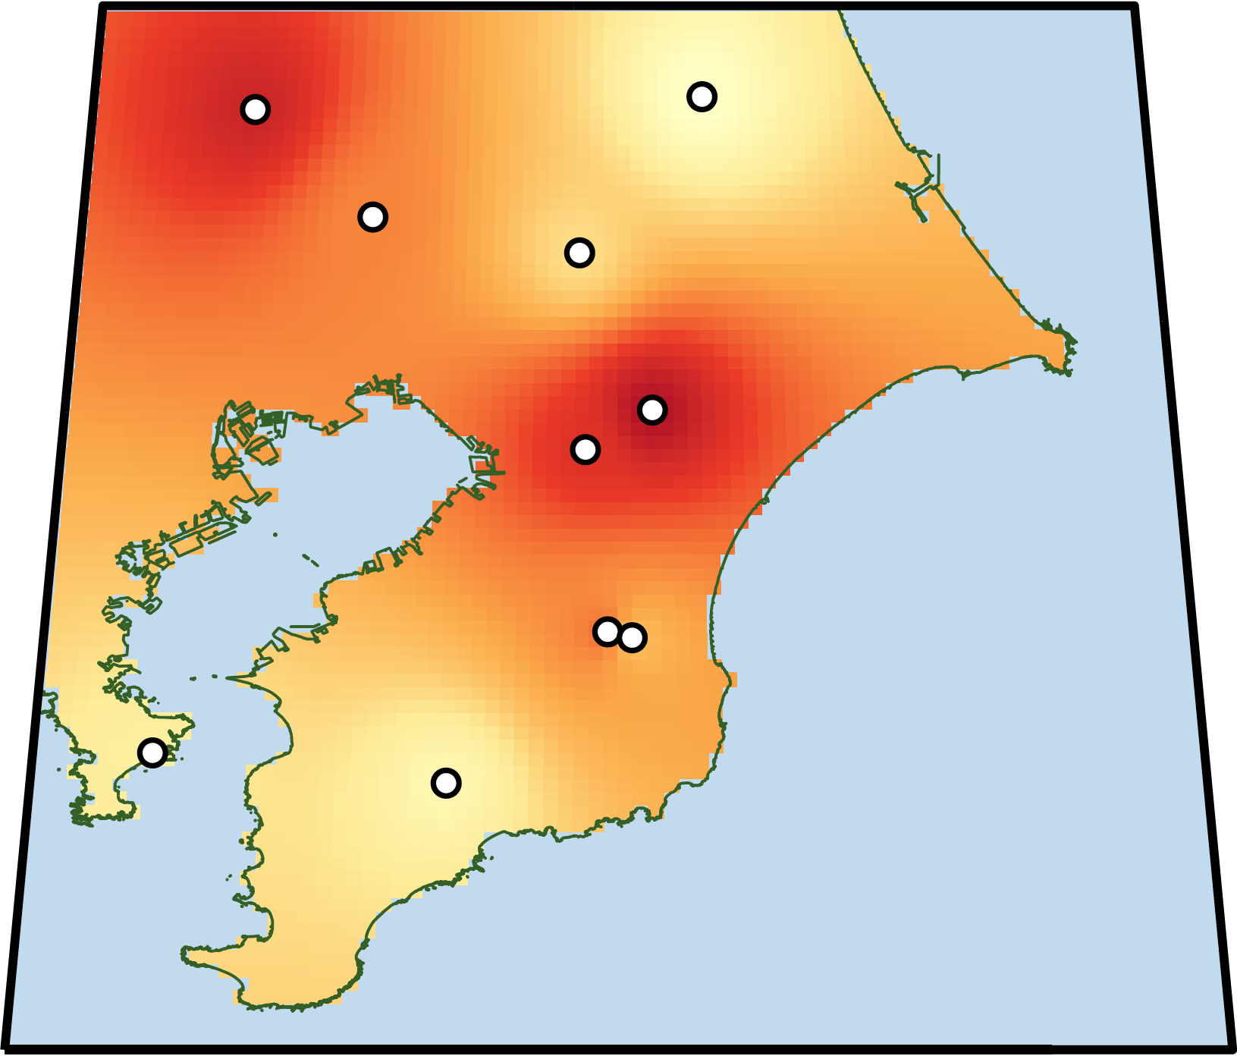
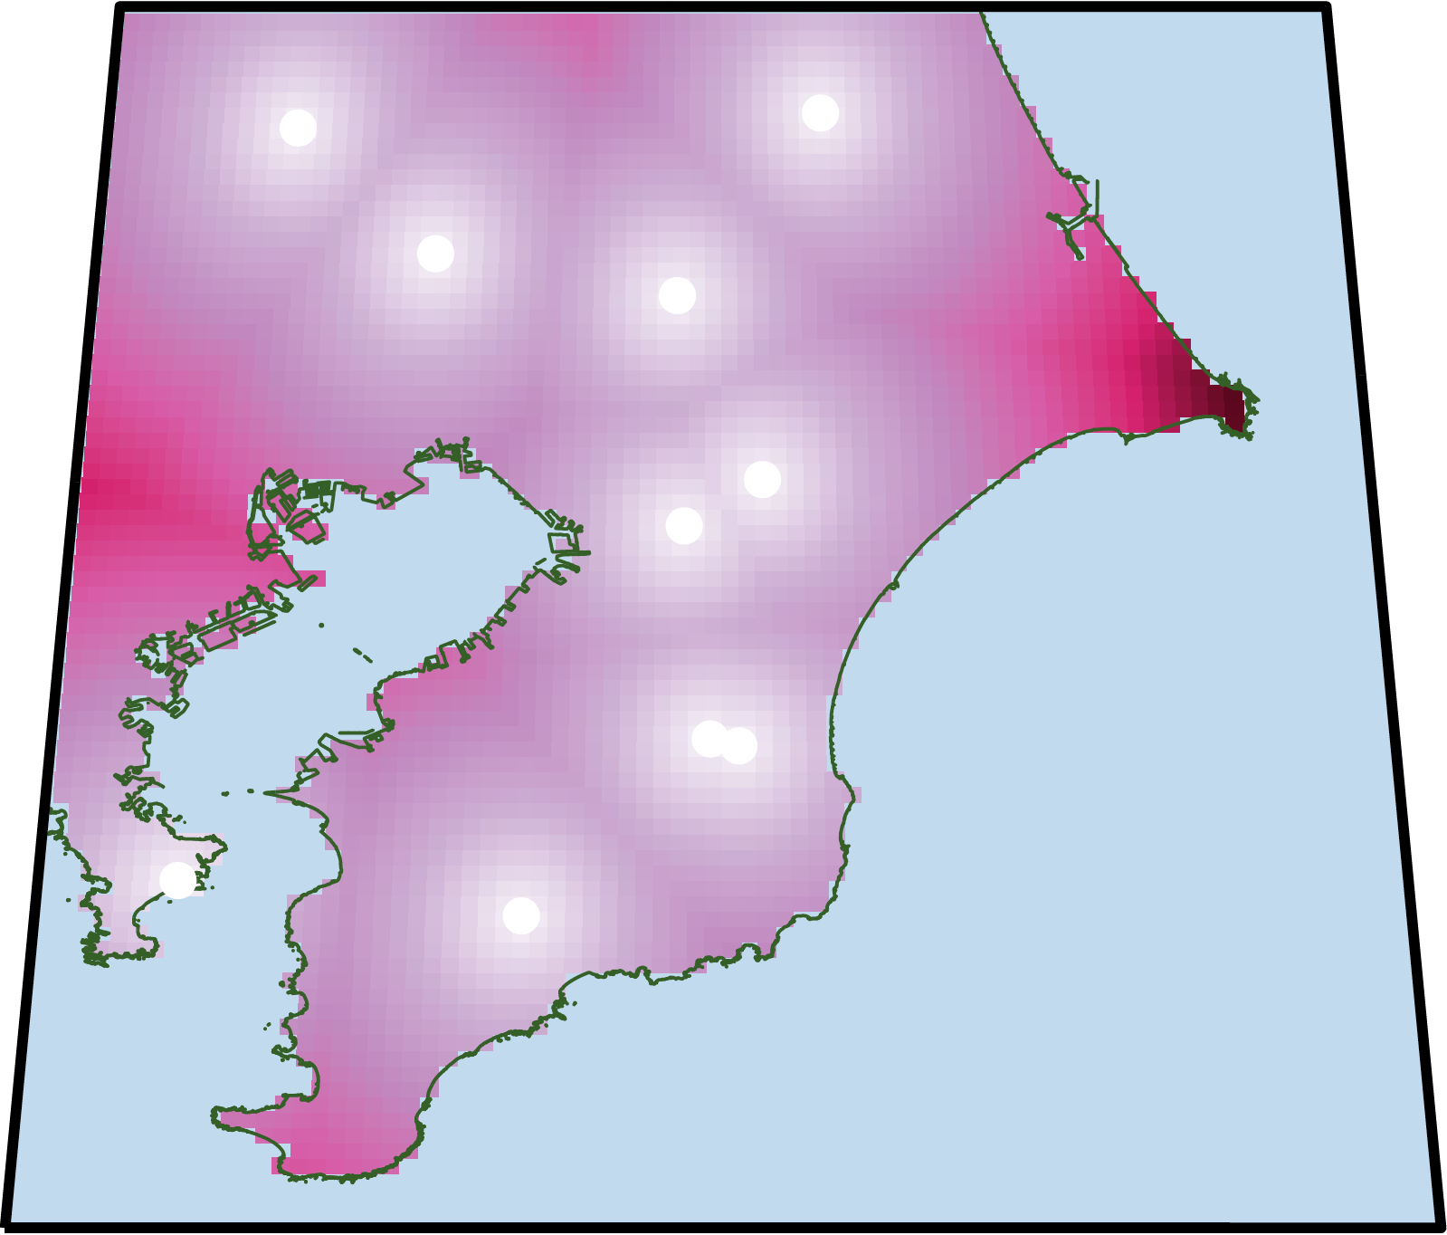
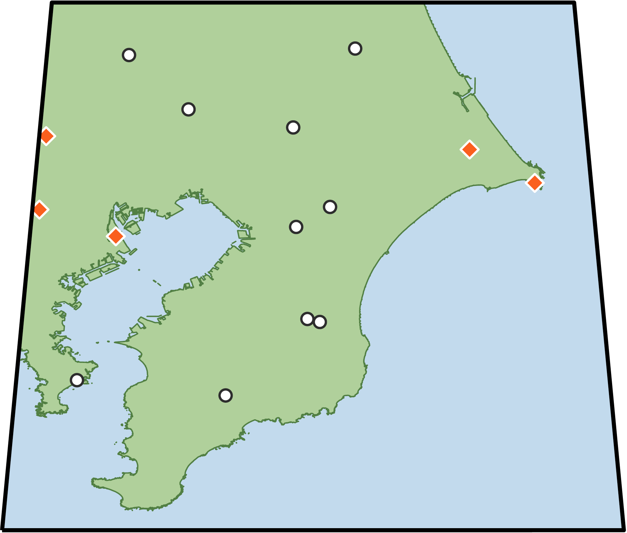
Traditional Sampling
(e.g., Grid sampling)
(B) Bayesian Adaptive Sampling (BAS) Framework
1. Initial Sampling
2. Spatial Modeling
Few points & Priors
4. Additional Sampling
3. Acquisition Function Design
Resource-Intensive
Collection
Data Analysis
Blind Exploration
Often inefficient, misses hotspots,
and high cost & effort

