Slide 1
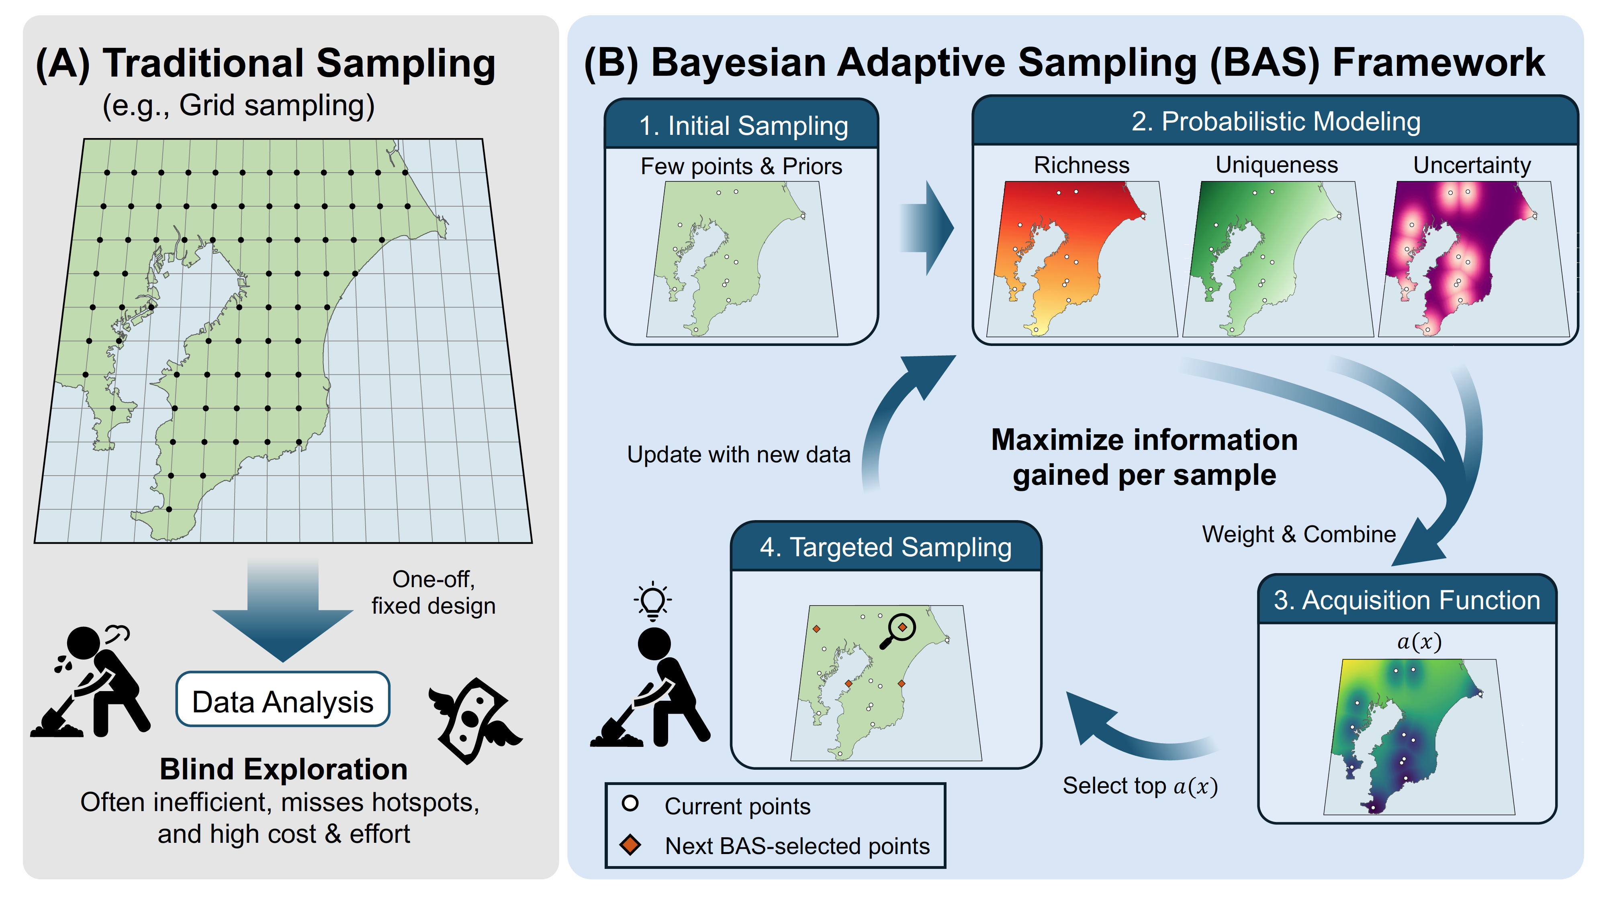
(A) Traditional Sampling
(B) Bayesian Adaptive Sampling (BAS) Framework
(e.g., Grid sampling)
2. Probabilistic Modeling
1. Initial Sampling
Few points & Priors
Richness
Uniqueness
Uncertainty
Update with new data
Maximize information
gained per sample
4. Targeted Sampling
Weight & Combine
One-off,
fixed design
3. Acquisition Function
a(x)
Data Analysis
Blind Exploration
Select top a(x)
Often inefficient, misses hotspots,
and high cost & effort
Current points
Next BAS-selected points

