Slide 1
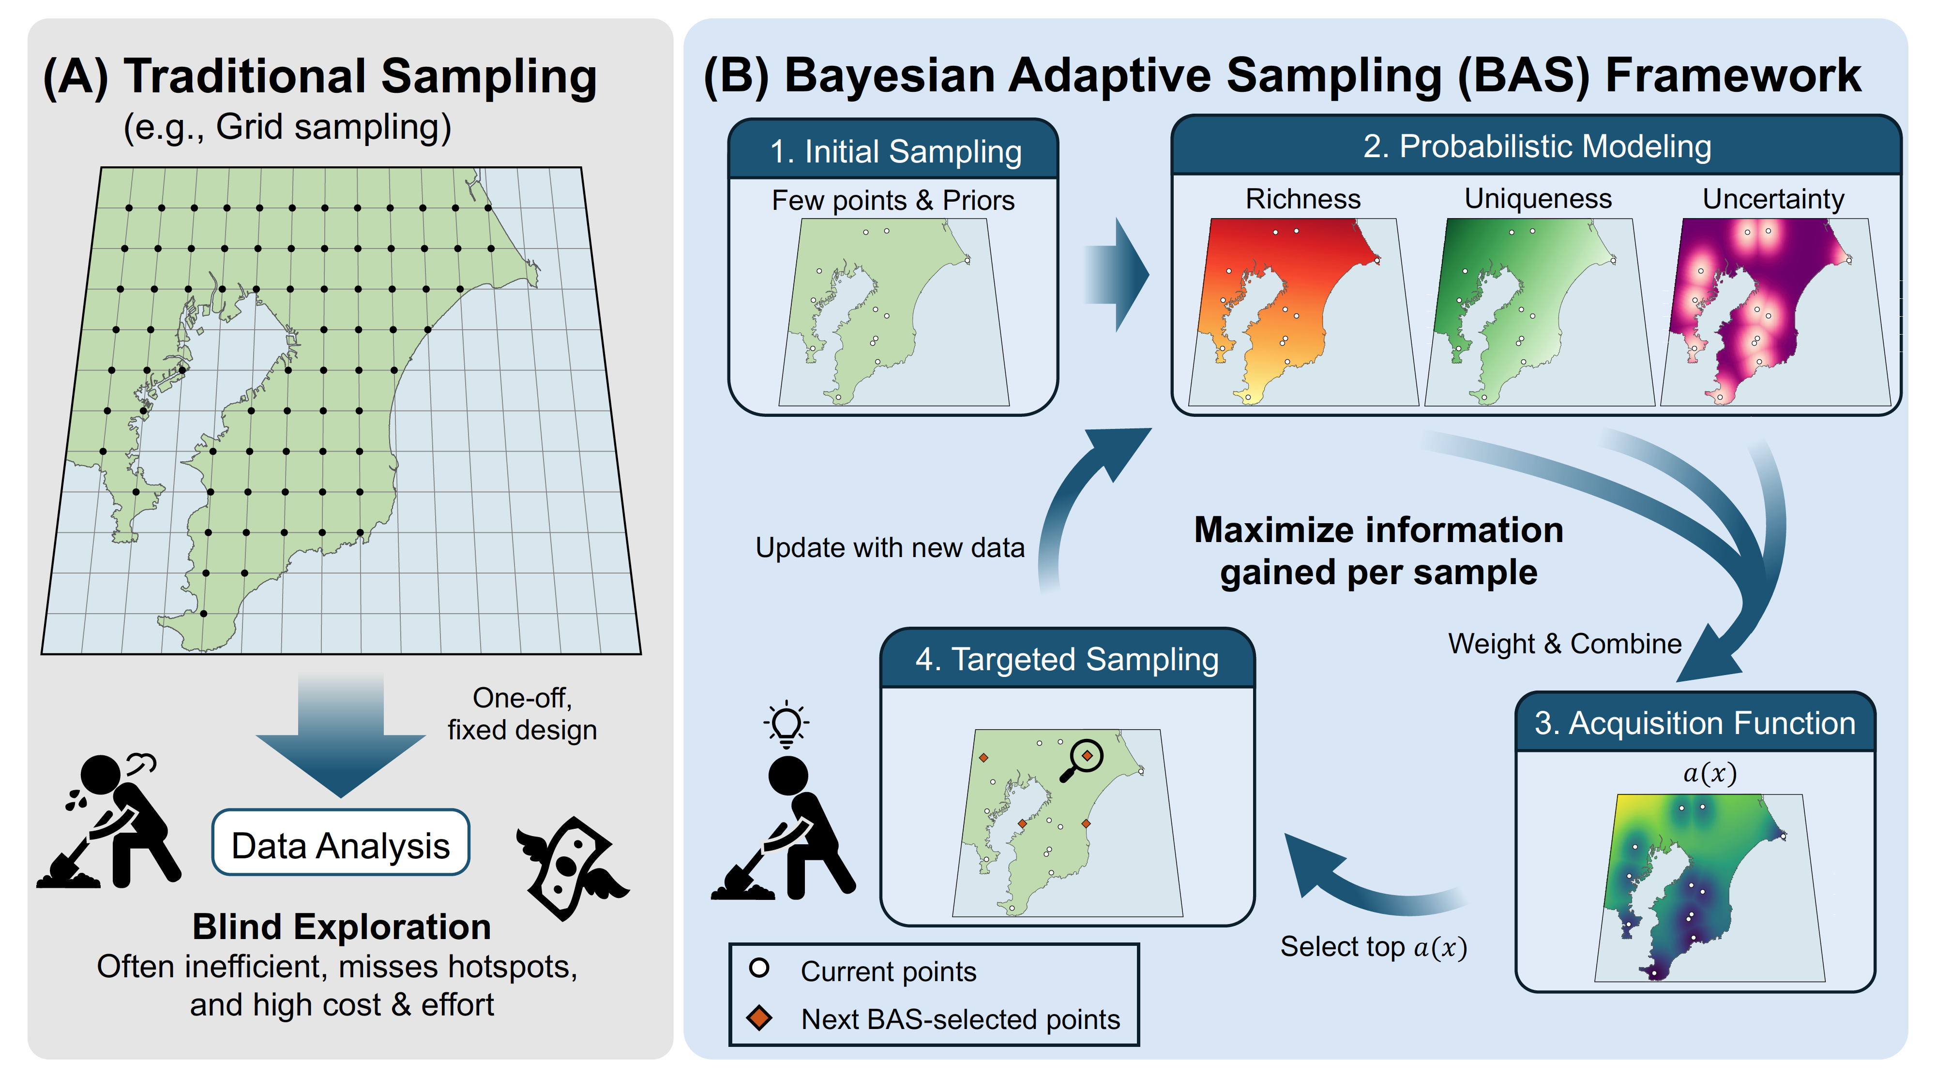
(A) Fixed, pre-defined sampling
(B) Bayesian Adaptive Sampling (BAS) Framework
(e.g., grid sampling)
2. Probabilistic Modeling
1. Initial Sampling
Few points & covariates
Richness
Uniqueness
Uncertainty
Update with new data
Maximize information
gained per sample
4. Targeted Sampling
Weight & Combine
One-off,
fixed design
3. Acquisition Function
a(x)
Data Analysis
Representative coverage
Select top a(x)
Information gained during the survey
is not used to choose further sites
Current points
Next BAS-selected points

