Slide 1
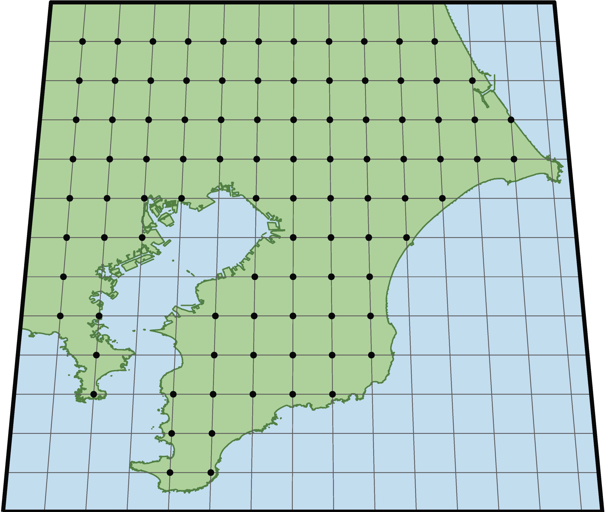
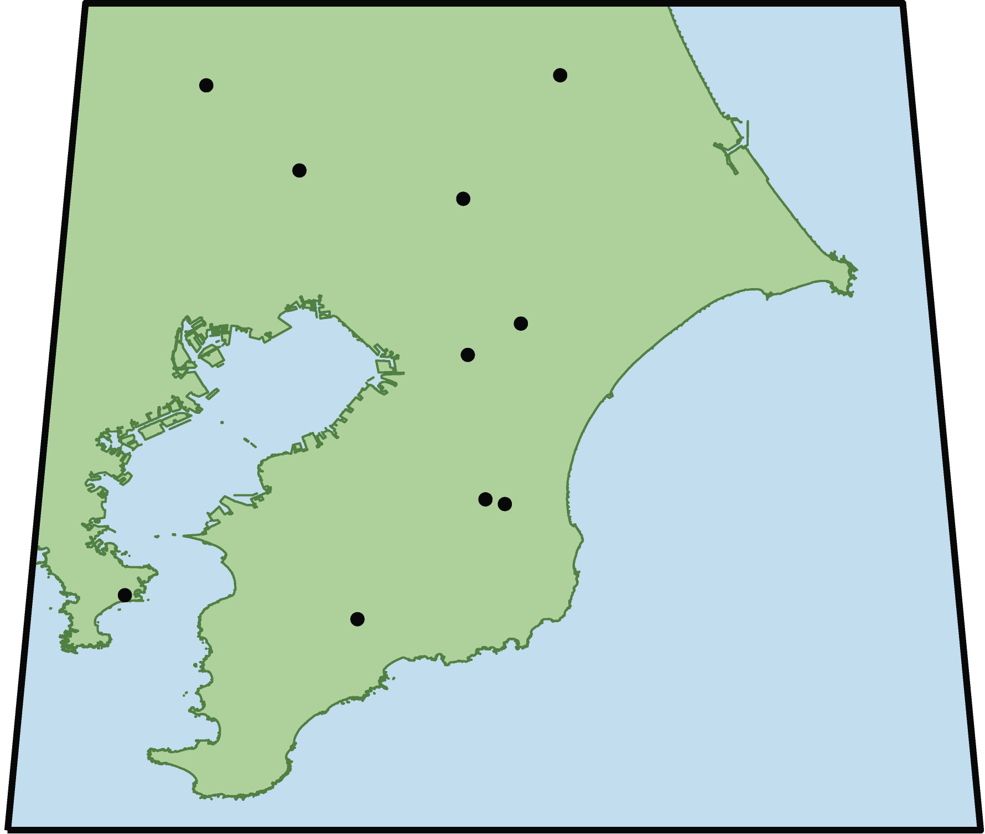
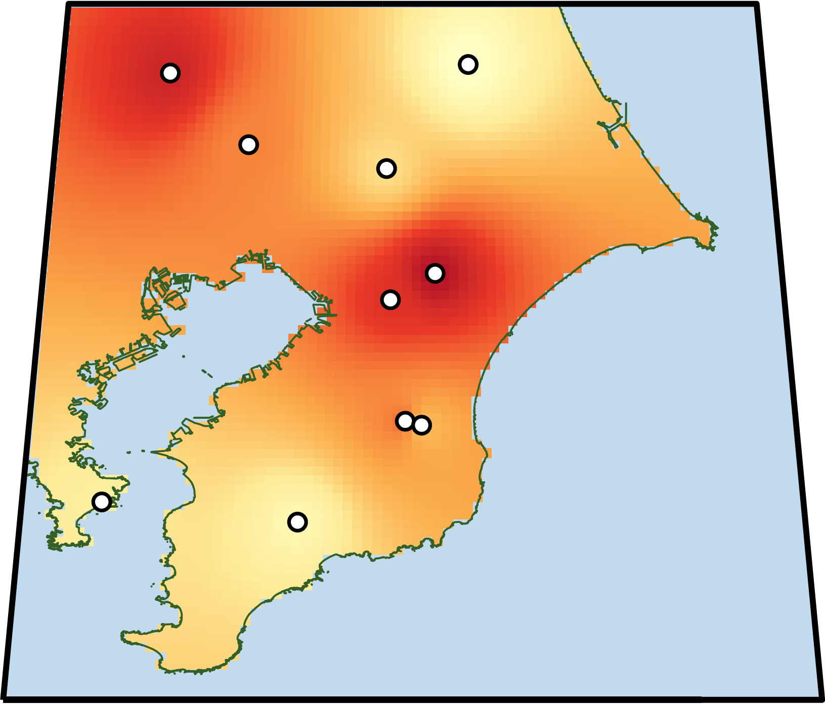
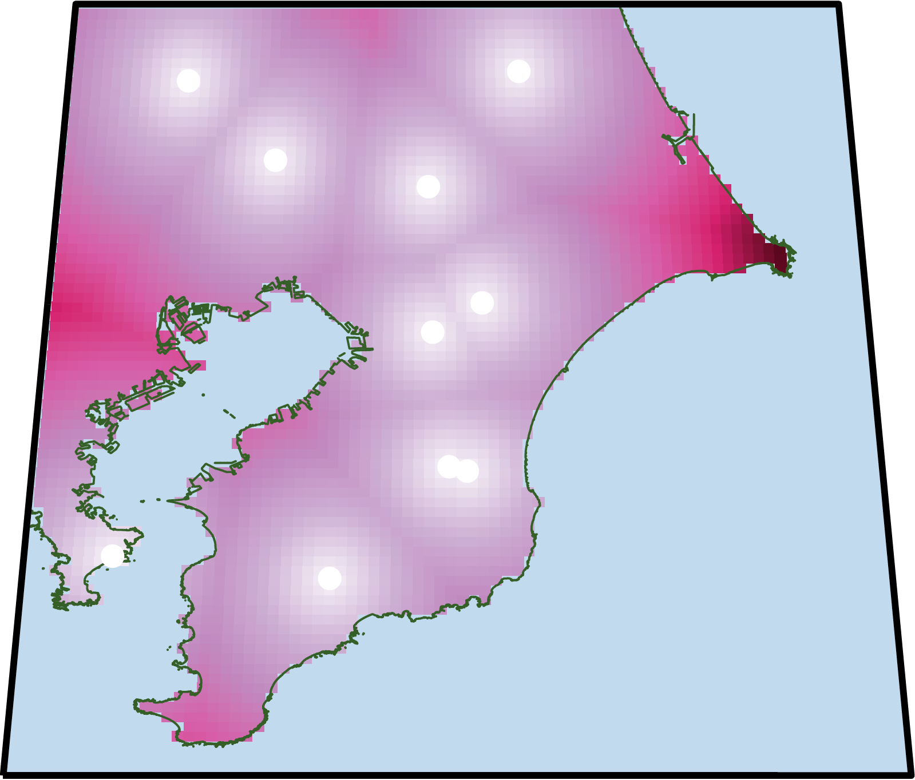
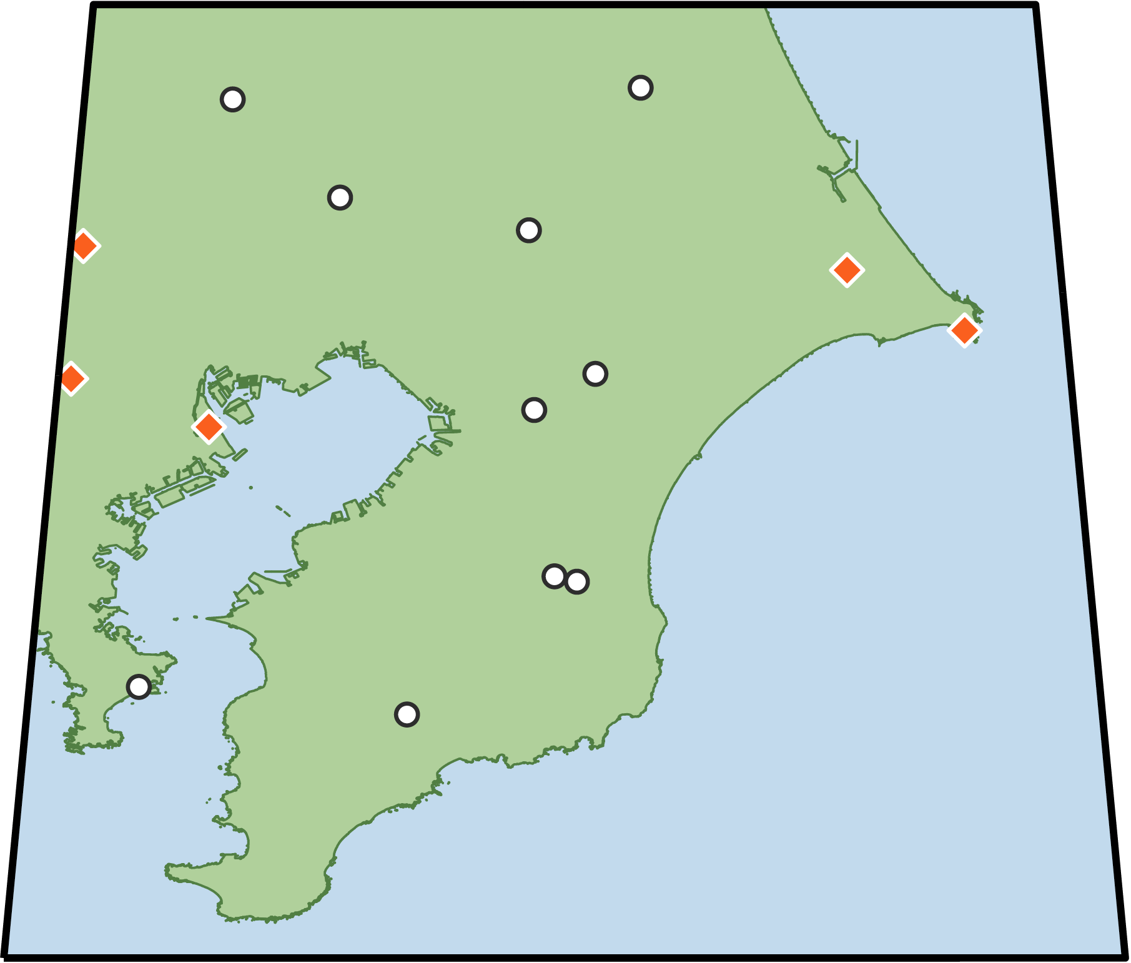
Fixed, Pre-defined Sampling
(e.g., Grid sampling)
(B) Bayesian Adaptive Sampling (BAS) Framework
1. Initial Sampling
2. Spatial Modeling
Few points & covariates
4. Additional Sampling
3. Acquisition Function Design
Sample
Collection
Data Analysis
Representative Coverage
Information gained during the survey
is not used to choose further sites

