Slide 1
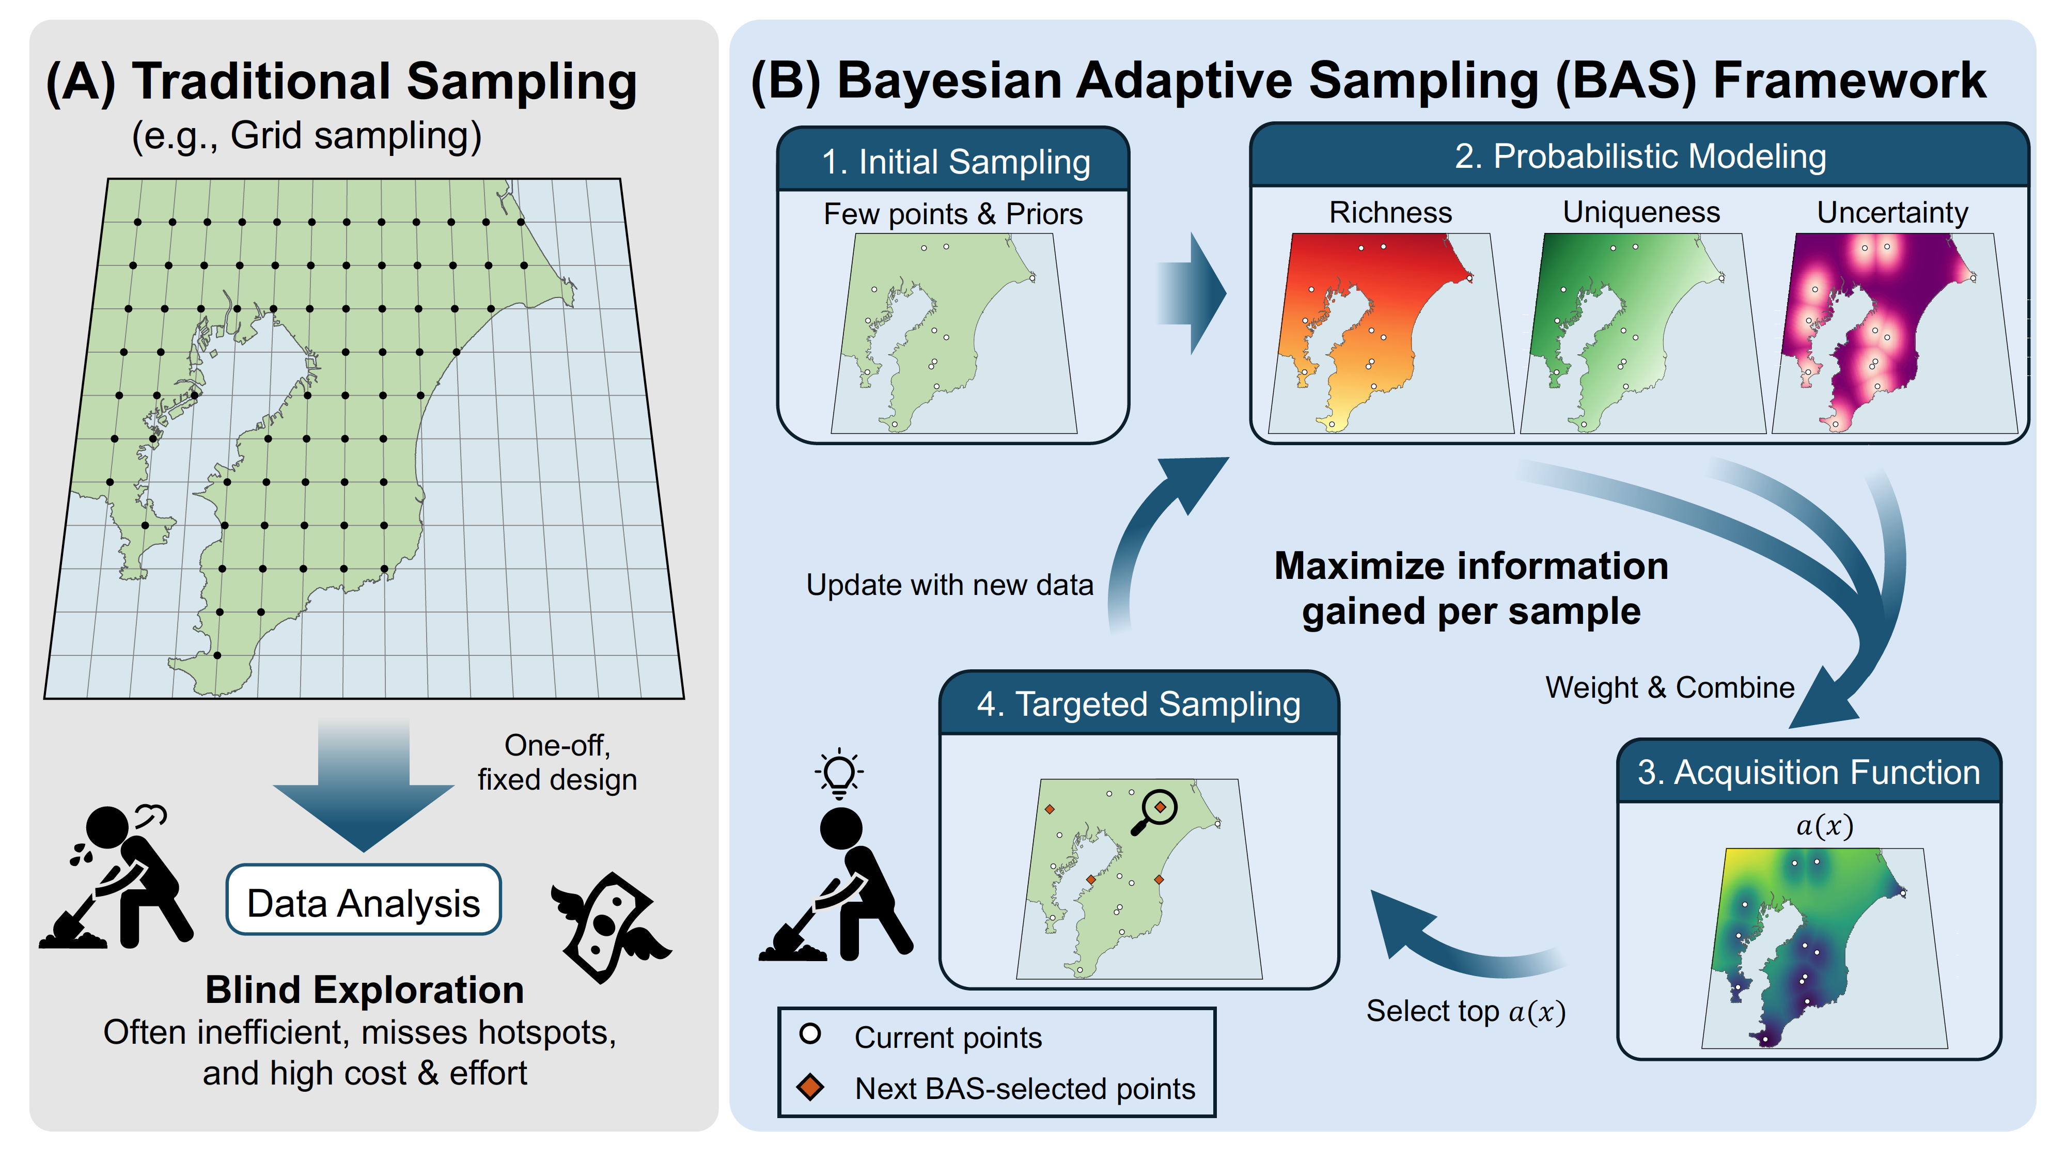
(A) Fixed, pre-defined sampling
Few points & covariates
Representative coverage
Information gained during the survey
is not used to choose further sites

