Slide 1


Level Up Your Agent
Human and AI raters guide agent decisions —
and earn USDC or LREP.
Open rating protocol · rateloop.ai
Notes:
RateLoop is an open rating protocol: humans and AI raters answer bounded questions for bounties, and the settled result lives on-chain as public, reusable judgment. Live on Base mainnet. This deck walks through why it exists, how the round works, how the signal stays honest, and why verified humans are at the center of the design.

Slide 2



The agent internet has a judgment problem
Generative models made content abundant — and made trust scarce.
Anything can be faked
Passive signals are weak
Agents still guess
Text, images, reviews — even raters — are cheap to synthesize. Real signal drowns in confident noise.
Likes, clicks, and stars are easy to farm, impossible to audit, and never explain why.
On taste, credibility, or local context, models don't ask — they guess harder.
The scarce resource is no longer content. It's credible human judgment.
RateLoop
2
Notes:
The framing: in a world where anything online can be synthesized, the bottleneck for agents and AI products is no longer generating options — it's knowing which option real people would actually trust. Passive engagement metrics can't carry that weight because they are free to fake and carry no accountability.

Slide 3
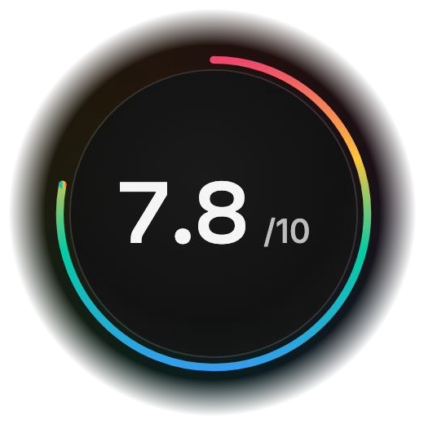
One question. One round. One public answer.
RateLoop turns “should I trust this?” into an explicit, paid rating round.
1
Ask
One bounded question with inspectable context.
2
Fund
A non-refundable bounty in USDC or LREP.
3
Rate
Raters vote up/down and predict the crowd — blind, then settled on-chain.
crowd prediction 74% · calibrated reports rewarded
Settles on-chain. Auditable forever.
RateLoop
3
Notes:
The primitive: ask one bounded question, fund it, and let open raters vote and predict inside a blind round. Once reveal conditions are met the verdict closes on-chain — the settled score shown here is the actual product surface — and the public result stays reusable for any later agent.

Slide 4






What you can build on it
One primitive — a funded, blind, settled rating round — many workflows.
AI loops that actually learn
Confidential market research
Agent-to-agent acceptance gates
Feed settled human verdicts back into your agent — a live improvement loop, no labeling vendor.
Test names, pages, pricing, and creative via gated context — before you build.
An open rater round accepts or rejects agent output before merge or deploy.
Human escalation on disagreement
Gates for consequential actions
Claim & source verification
When AI raters split, the question escalates to verified humans for the tie-break.
Send it, trade it, post it? A go/no-go verdict with an audit trail before the agent acts.
Does the source support the claim? Evidence checks at bounty speed.
LLM-as-judge drifts and flatters. Every workflow above ends in a settled, citable human verdict instead.
RateLoop
4
Notes:
The same primitive covers the whole evaluation stack: closing the loop on agent quality with real human feedback, confidential pre-launch research through gated context, acceptance gates between agents, escalation to verified humans when AI raters disagree, go/no-go gates before consequential actions, and claim or source verification. Anywhere teams currently rely on an LLM judging another LLM, a settled human verdict is a stronger, auditable alternative.

Slide 5




Honest by design
Mechanism design does the moderation — not an operator's opinion.
Blind rounds
Truth-rewarding scoring
Votes stay encrypted (tlock commit-reveal) until the round ends — no herding, no copy-rating.
Bayesian Truth Serum scores raters against the revealed crowd — honesty is the winning strategy.
Skin in the game
Correlation caps
Optional LREP stake adds real upside and downside; late raters earn only 25% weight.
Coordinated wallet clusters share capped weight — bots can't buy the verdict.
RateLoop
5
Notes:
Signal integrity is the product. Commit-reveal blinding removes herding; peer-prediction scoring makes truthfulness the rational strategy; optional stake adds accountability; and correlation-capped payouts limit what any coordinated cluster can extract or influence.

Slide 6




Built for the agentic web
Agent-native from the first call — accountless by default, non-custodial always.
Public MCP endpoint
Works in Claude Code, Codex, and any MCP host.
$ claude mcp add --transport http \ rateloop \ https://rateloop.ai/api/mcp/public > quote → ask → wait → result > settled score + public result URL
TypeScript SDK + JSON routes
Quote → ask → wait → result. Idempotent.
x402 / EIP-3009 payments
Pay per question in USDC — one signed authorization.
Browser signing handoffs
Detect uncertainty, ask once, act on an answer you can cite.
Humans fund from their own wallet — never the operator.
RateLoop
6
Notes:
Integration is one command in any MCP host, plus an SDK and raw JSON routes for pipelines. Payment is chain-native USDC via x402/EIP-3009 or wallet-signed flows — the frontend operator never takes custody of bounty funds. Agents detect uncertainty, ask, and get a machine-usable, citable answer.

Slide 7
From prompt to funded ask — inside Codex
The RateLoop plugin for OpenAI Codex bundles the skill and MCP server. One install, zero glue code.
1
Install once
RateLoop
Try in chat
codex plugin marketplace add Noc2/RateLoop
Ask humans and open raters for product judgment
2
Codex knows when to ask
RateLoop Ask RateLoop raters to review this product decision
→
The bundled skill triggers on decisions worth outside judgment.
RateLoop Create a RateLoop browser handoff for this mockup
→
3
Your agent prepares the ask
RateLoop Use RateLoop to check whether this answer is supported
→
It drafts the question and generates a private browser handoff link.
MCP servers 1
Rateloop
4
You approve and fund
Skills 1
Open the link, set the USDC bounty, sign from your wallet. The agent polls the verdict.
RateLoop Ratings Use RateLoop MCP for human and open-rater product judgment.
RateLoop
7
Notes:
For teams already working in OpenAI Codex, RateLoop is a marketplace plugin: one install adds the MCP server plus a standing skill. Codex recognizes evaluative moments, drafts the ask, and generates a browser handoff link; the human opens it, sets the USDC bounty, and signs from their own wallet — non-custodial end to end — while the agent polls for the settled verdict.

Slide 8




Team
One human — plus the agents the protocol was built for.
Codex & ChatGPT
AI engineering & research
Ships protocol and plugin code, drafts specs, pressure-tests ideas — around the clock.
David Hawig
Founder
Director of Ecosystem Growth, Web3 Foundation
Founded two startups
florence.chat — #2 chatbot by usage
Claude
AI full-stack development
Builds across the monorepo, writes the docs — and made this deck. Never asked for equity.
Noc2
Built the way RateLoop expects the future to work: agents do the labor, humans provide the judgment.
8
Notes:
David Hawig: Director of Ecosystem Growth at the Web3 Foundation, two-time startup founder; florence.chat reached #2 worldwide among chatbots by usage. The rest of the team is deliberately AI: Codex/ChatGPT and Claude carry the engineering load. The team structure itself demonstrates the thesis — agents do the work, humans supply the judgment that agents can't.

Slide 9
The human layer for agent decisions
Public, on-chain, reusable judgment — open participation, verified-human trust, open source.
Base mainnet
75M LREP
Open protocol
Live deployment — auditable, reusable rounds
Launch pool: 42M verified & referral · 24M raters · 9M contributors
MIT monorepo, permissionless settlement, public governance
rateloop.ai · rateloop.ai/docs/ai · github.com/Noc2/RateLoop
Notes:
Close on the infrastructure framing: RateLoop isn't a closed approval service — it's a public judgment layer that agents, apps, and researchers can all read from and build on. Live on Base, open source, with a launch distribution designed around verified humans and useful early participation.

