Slide 1
Parallelization of a n-body interaction solver with CUDA
CINECA Summer School - Final Project
Amadio Carolina
Baldini Samuele
Casablanca Manuel
Mannocci Enrico

Slide 2
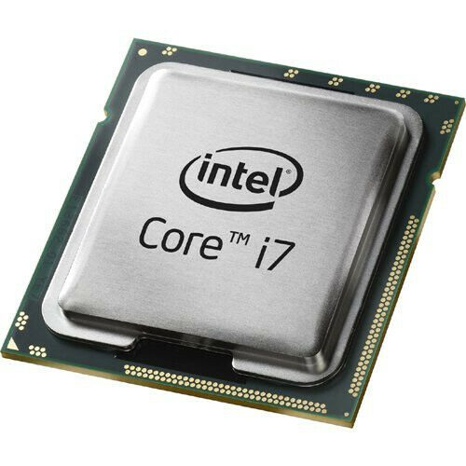

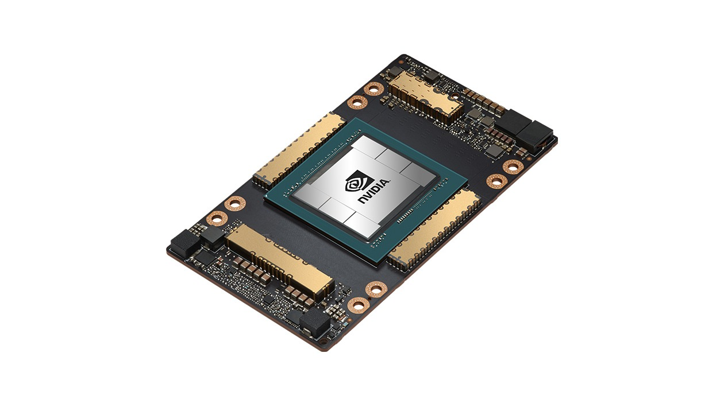

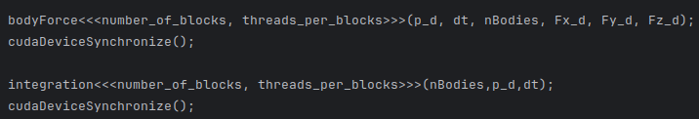
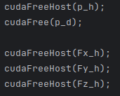
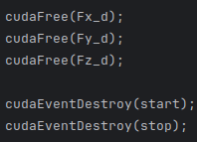
The Main code
Notes:
-inizializzato host e device (cpu -gpu )
- per ogni iter 2 kernels + sincronzzazione
- libero memoria host device

Slide 3
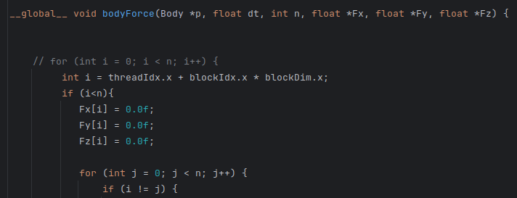
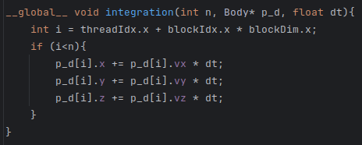
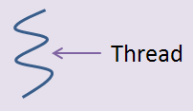
The kernels
Notes:
i) iterate diventa il numero globale della particella
ii) ogni thread calcola la forza su una particella

Slide 4
Results & developments
Serial version:
Time at final iteration 500: 2250 seconds
CUDA version:
Time at final Iteration 500: 5.504 seconds
Next:
Profiling with NVIDIA Nsight System
400x

Slide 5


Thanks for Teaching Us!

