Slide 1
Simulation PARAMETERS
Common to Simulation and Real robot | Automnomous navigation (NAV2 + Vector Field controller) | Assissted teleoperation (Vector field controller) | Mapping
nav_type:=none | NO | NO | YES
nav_type:=on_fly | YES | YES | YES
nav_type:=localize | YES | YES | NO
 | Drivers (simulated actuators & sensors) | Controllers (joystick & keyboard) | RVIZ2 Visualization
Mode := COMPLETE | YES | YES | YES
Mode:=API | YES | NO | NO

Slide 2
Real robot NUC PARAMETERS
Version:=NUC | Drivers (simulated actuators & sensors) | Controllers (joystick & keyboard) | RVIZ2 Visualization | Run navigation features (nav_type parameter should be specified here if YES)
Mode := DRIVERS | YES | NO | NO | NO
Mode:=API | YES | NO | NO | YES

Slide 3
Real robot CLIENT PARAMETERS
Version:=CLIENT | Drivers (simulated actuators & sensors) | Controllers (joystick & keyboard) | RVIZ2 Visualization | Run navigation features (nav_type parameter should be specified here if YES)
Mode := DRIVERS | NO | YES | YES | YES
Mode:=API | NO | YES | YES | NO

Slide 4
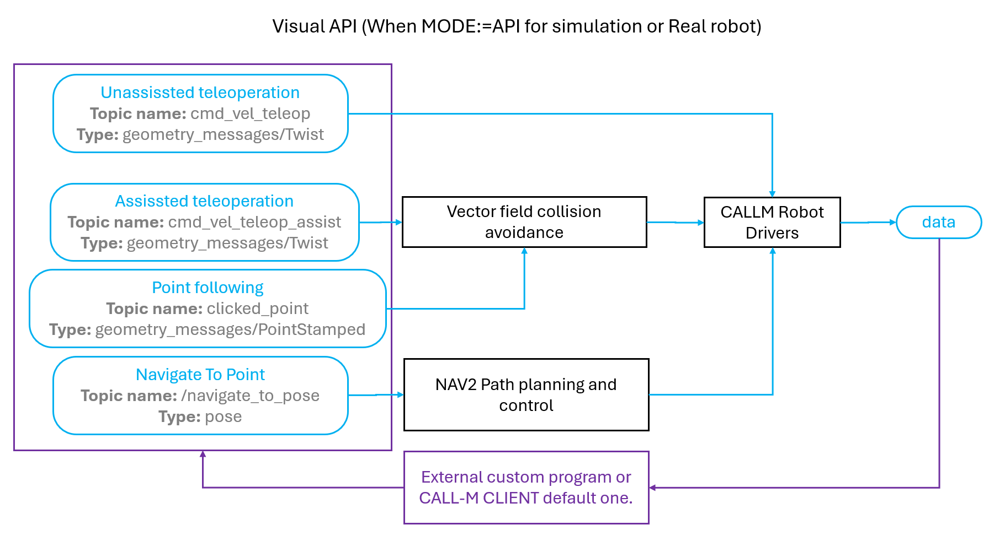
Visual API (When MODE:=API for simulation or Real robot)
Unassissted teleoperation
Topic name: cmd_vel_teleop
Type: geometry_messages/Twist
Assissted teleoperation
Topic name: cmd_vel_teleop_assist
Type: geometry_messages/Twist
Vector field collision avoidance
CALLM Robot Drivers
data
Point following
Topic name: clicked_point
Type: geometry_messages/PointStamped
Navigate To Point
Topic name: /navigate_to_pose
Type: pose
NAV2 Path planning and control
External custom program or CALL-M CLIENT default one.

Slide 5
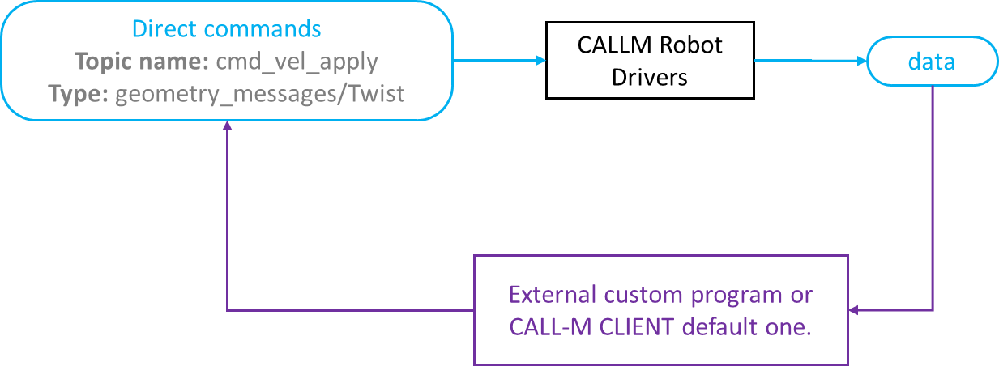
Visual API (When MODE:=DRIVERS for Real robot)
Direct commands
Topic name: cmd_vel_apply
Type: geometry_messages/Twist
CALLM Robot Drivers
data
External custom program or CALL-M CLIENT default one.

