Slide 1
Policy
1st timestep
S₀
a₀
Rewards
2nd timestep
S₁
a₁
Episode
Rewards
3rd timestep
S₂

Slide 2

High dimensional Data
High dimensional Data
μ
Encoder
Decoder
σ
Latent
Space
ϵ
N(0,1)
μ
Latent
space
8
σ

Slide 3
High dimensional Data
High dimensional Data
Encoder
Decoder
Latent
Space

Slide 4
Flowchart of Methodology
RL
Forward
Backward
Right turn

Slide 5
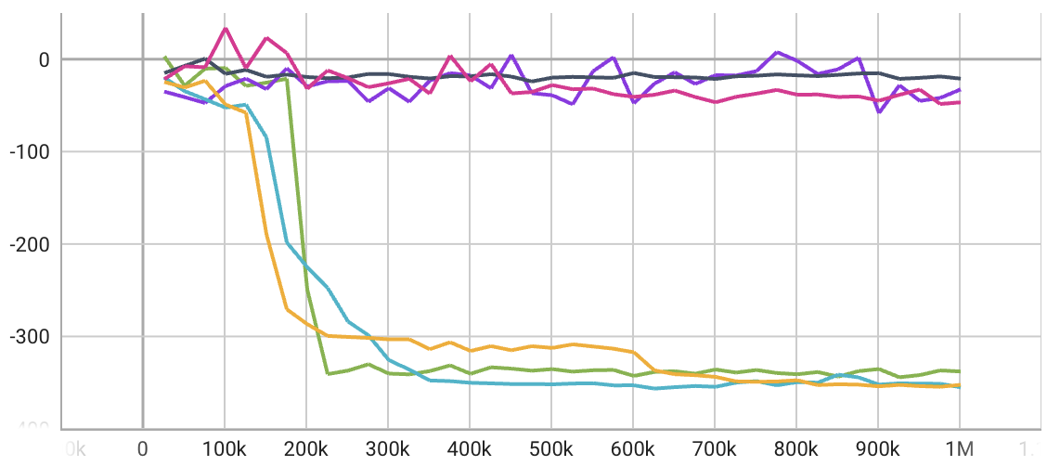
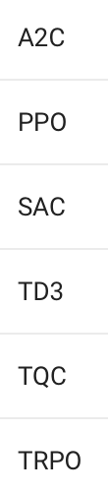
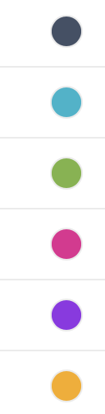
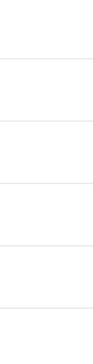
Bw
Mean
reward
Learning
time
-21
7 m
-355
2 m
-337
2.5 h
-46
1 h
-32
16.9 h
-352
4 m

Slide 6
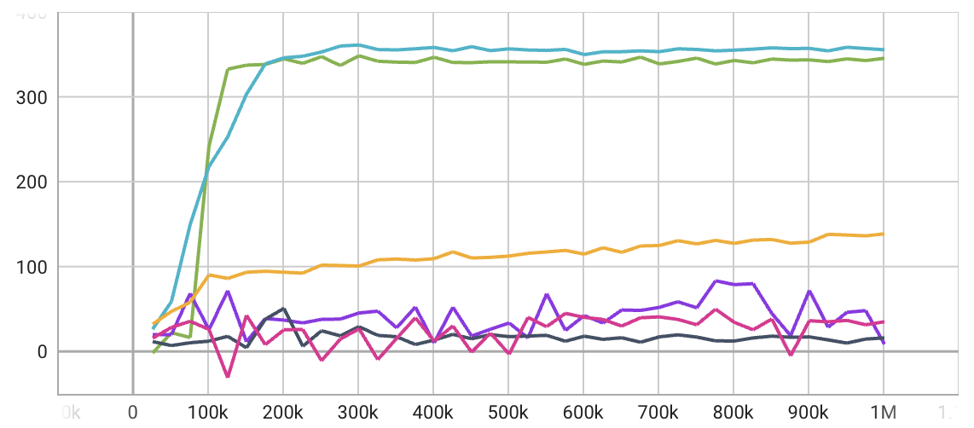
Front
Mean
reward
Learning
time
15
7 m
355
2 m
345
1.6 h
35
2.7 h
8
3.3 h
138
4 m

Slide 7
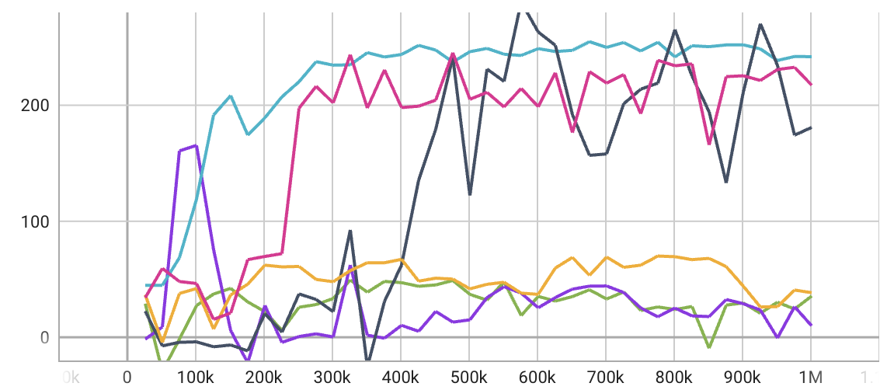
Right
Mean
reward
Learning
time
180
8 m
241
2 m
35
7.6 h
217
1.2 h
9
3.6 h
38
4 m

Slide 8
Right
Front
Bw
Mean
reward
Learning
time
Mean
reward
Learning
time
Mean
reward
Learning
time
180
8 m
15
7 m
-21
7 m
241
2 m
355
2 m
-355
2 m
35
7.6 h
345
1.6 h
-337
2.5 h
217
1.2 h
35
2.7 h
-46
1 h
9
3.6 h
8
21 h
-32
16.9 h
38
4 m
138
4 m
-352
4 m
 | Right |  | Front |  | Backward
 | Mean Reward | Learning Time | Mean Reward | Learning Time | Mean Reward | Learning Time
A2C | 180 | 8m | 15 | 7m | -21 | 7m
PPO | 241 | 2m | 355 | 2m | -355 | 2m
SAC | 35 | 7.7h | 245 | 1.6h | -337 | 2.5h
TD3 | 217 | 1.2h | 35 | 2.7h | -46 | 1h
TQC | 9 | 3.6h | 8 | 21h | -32 | 16.9h
TRPO | 38 | 4m | 138 | 4m | -352 | 4m

Slide 9
A single Result of
Swimmer
Action
Observation
1,000
frame
0
1
0
1
2
3
4
5
6
7
10,000 times render with different seed
Action
Observation
Action
Observation
0
Action
Observation
10,000
1
0
1
2
3
4
5
6
7
0
Action
Observation
1
0
1
2
3
4
5
6
7
1,000
frame
0
1
0
1
2
3
4
5
6
7
0
1
0
1
2
3
4
5
6
7

Slide 10
Action
Observation
Action
Observation
0
Action
Observation
1
0
1
2
3
4
5
6
7
10,000
0
Action
Observation
1
0
1
2
3
4
5
6
7
1,000
frame
0
1
0
1
2
3
4
5
6
7
0
1
0
1
2
3
4
5
6
7
Action
Observation
Action
Observation
0
Action
Observation
1
2
3
4
5
6
7
8
9
(10,000,1000,10)
0
Action
Observation
1
2
3
4
5
6
7
8
9
0
1
2
3
4
5
6
7
8
9
0
1
2
3
4
5
6
7
8
9

Slide 11
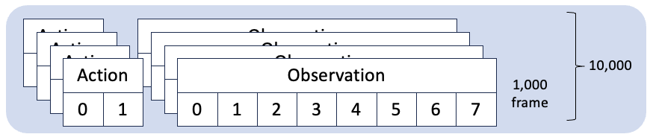
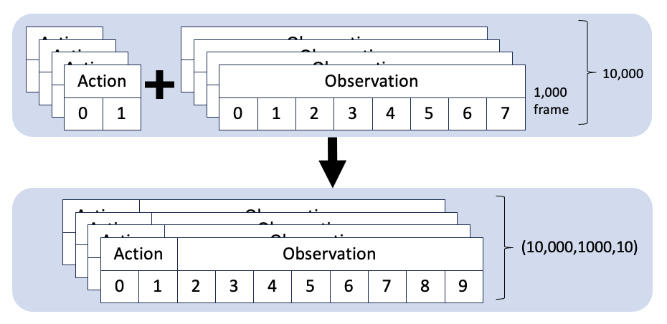
Output of Reinforcement Learning
Input Dataset
np.array([10,000,1000,10])

Slide 12
Reconstruction Loss, KL Divergence
Encoder
Decoder
Latent
space
Input shape
[10000, 1000, 10]
output shape
[10000, 1000, 10]
64
32
8
8
32
64

Slide 13
Reconstruction Loss
KL Divergence
Encoder
Decoder
Input shape
[10000, 1000, 10]
μ
Latent
space
output shape
[10000, 1000, 10]
64
32
8
8
32
64
σ
N(0,1)
ϵ

Slide 14
Reconstruction Loss
KL Divergence
Encoder
Decoder
Input shape
[10000, 1000, 10]
μ
Latent
space
output shape
[10000, 1000, 10]
64
32
8
8
32
64
σ
N(0,1)
ϵ
Latent
space
64
FCL
32
FCL
8
FCL
8
FCL
32
FCL
64
FCL
ReLU
ReLU
Reparameterize
ReLU
ReLU

Slide 15


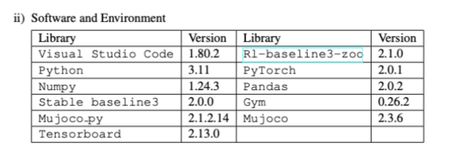
ARM
32GB RAM
VS Code
Encoder
Decoder

Slide 16

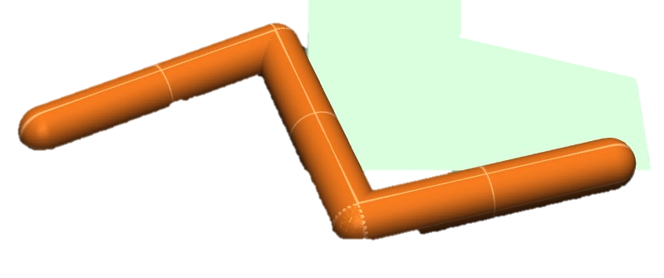
Reinforcement Learning
Wrapper
RL-baseline3-zoo
Stable-baseline3
Wrapper
Gym
Mujoco
Wrapper
VAE and NN
Neural Network for Predicting
Variational AutoEncoder
Mujoco
Rendering
Encoder
μ
Decoder
σ
ϵ
Latent
Space
N(0,1)

Slide 17

Act[1]
Head
b’
c
Head
a
Tail
c’
Tail
Act[0]
a’
b

Slide 18
Input
Latent Dimension
FC
128 Neurons
FC
64 Neurons
FC
Output
Latent Dimension

