Slide 1
Policy
1st timestep
S₀
a₀
Rewards
2nd timestep
S₁
a₁
Episode
Rewards
3rd timestep
S₂

Slide 2
Flowchart of Methodology
RL
forward
backward
Jelly fish
Right turn

Slide 3
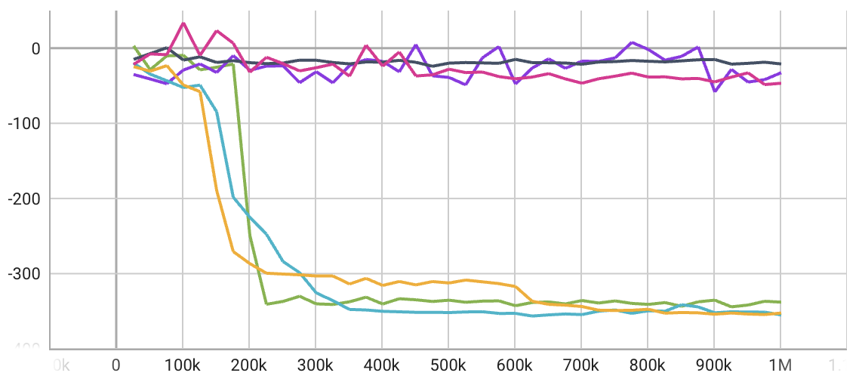
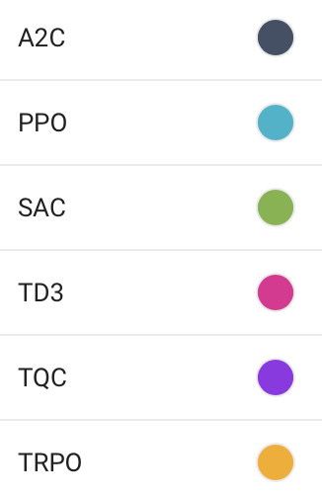
Bw
Mean
reward
Learning
time
-21
7 m
-355
2 m
-337
2.5 h
-46
1 h
-32
16.9 h
-352
4 m

Slide 4
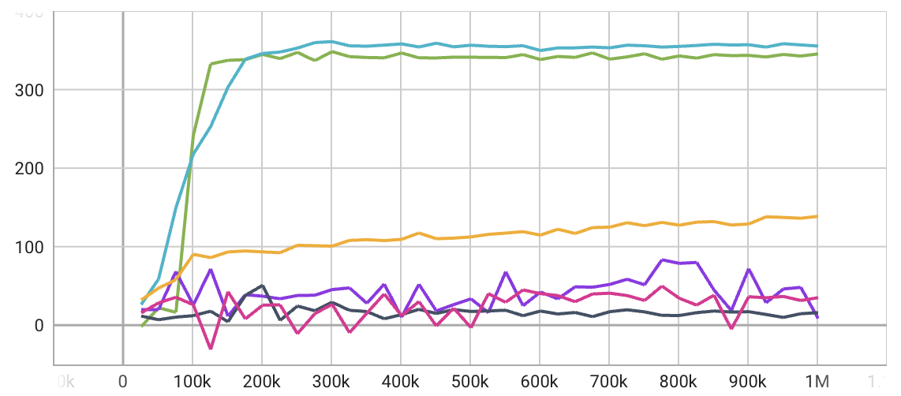
Front
Mean
reward
Learning
time
15
7 m
355
2 m
345
1.6 h
35
2.7 h
8
21 h
138
4 m

Slide 5
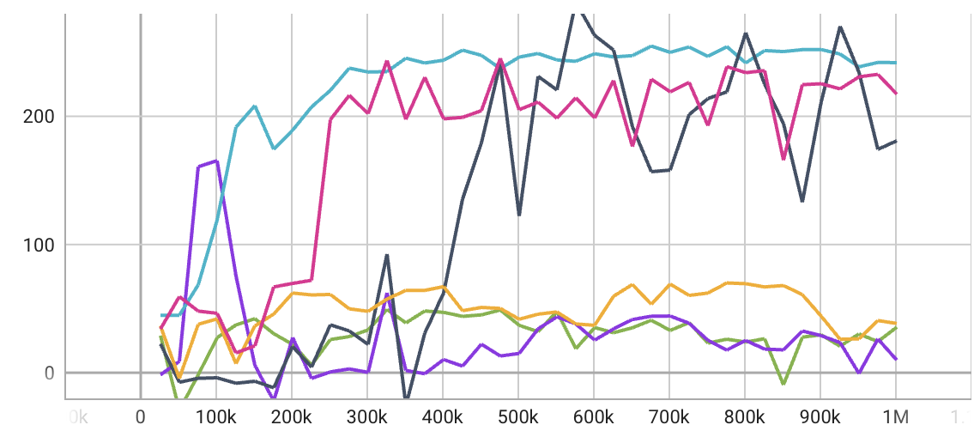
Right
Mean
reward
Learning
time
180
8 m
241
2 m
35
7.6 h
217
1.2 h
9
3.6 h
38
4 m

Slide 6
A single Result of
Swimmer
Action
Observation
1,000
frame
0
1
0
1
2
3
4
5
6
7
10,000 times render with different seed
Action
Observation
Action
Observation
0
Action
Observation
10,000
1
0
1
2
3
4
5
6
7
0
Action
Observation
1
0
1
2
3
4
5
6
7
1,000
frame
0
1
0
1
2
3
4
5
6
7
0
1
0
1
2
3
4
5
6
7

Slide 7
Action
Observation
Action
Observation
0
Action
Observation
1
0
1
2
3
4
5
6
7
10,000
0
Action
Observation
1
0
1
2
3
4
5
6
7
1,000
frame
0
1
0
1
2
3
4
5
6
7
0
1
0
1
2
3
4
5
6
7
Action
Observation
Action
Observation
0
Action
Observation
1
2
3
4
5
6
7
8
9
(10,000,1000,10)
0
Action
Observation
1
2
3
4
5
6
7
8
9
0
1
2
3
4
5
6
7
8
9
0
1
2
3
4
5
6
7
8
9

Slide 8
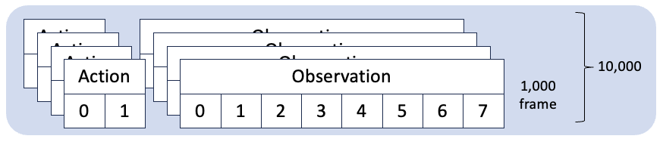
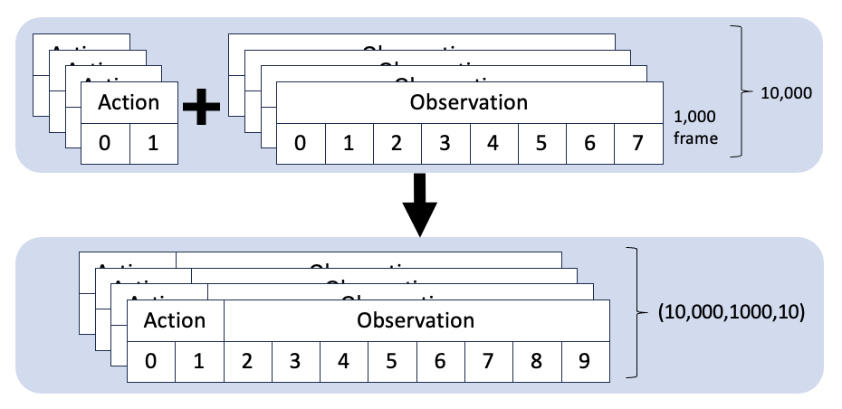
Output of Reinforcement Learning
Input Dataset
np.array([10,000,1000,10])

