Slide 1
Intro to C++ Game Dev
With Noctis Games

Slide 2
What is C++?
A programming language created by Bjarne Stroustrup
Designed with the goal of combining the speed/performance of C with the flexibility of Simula
Used in all of the major AAA Game Engines:
Source Engine – Half-Life, Counter-Strike, Left 4 Dead, Portal 2, Titanfall 2
Fox Engine - Metal Gear Solid V, P.T.
CryEngine - Crysis series, Ryse: Son of Rome, Prey
Unreal Engine - Injustice 2, Mighty No. 9, Life Is Strange
Frostbite - Battlefield series, Dragon Age: Inquisition, Mass Effect: Andromeda

Slide 3
Why Should I Learn C++?
Even if you are developing a game in Unity or GameMaker Studio, you’re still using C++, since that is what these tools are written in
So C++ is superior? No, of course not, there is never just one best way of doing something. Several amazing games are built using Unity, like:
RUST
Hearthstone: Heroes of Warcraft
Shadow Puppeteer
C++ is for those who want full control over their game development:
Not dependent on 3rd party frameworks
Skills transfer to more than just game development

Slide 4

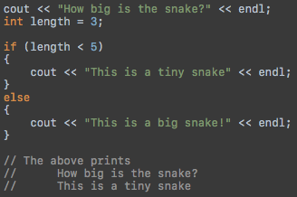

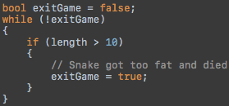
C++ Crash Course Part I
Data is stored into a variable with a type, here are some examples:
Numbers - bool, int, double, float
Text - char, string
Code can be placed into if blocks, for loops, and while loops:

Slide 5

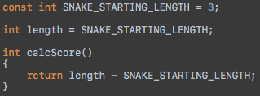


C++ Crash Course Part II
Every C++ program starts with the following function:
A function is a little block of reusable code that can be called:
A function can also accept parameters:
In this function, the snake’s length is being subtracted by its starting length to calculate the player’s score. The result is returned back to the caller of the function.

Slide 6
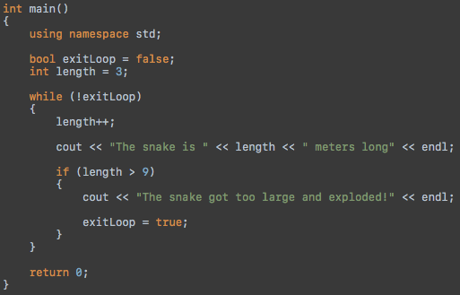
C++ Crash Course Part III
Okay, let’s see what a basic complete program looks like:

Slide 7
Game Dev Time!
We are going to be developing the classic Snake game
Game Design Goals:
Must keep track of score
Must be easy to control
Must have “game over” conditions, so there is an actual challenge
Must not contain any bugs!
If you want to follow along, go to this URL on your laptop: https://goo.gl/DJj7Qb
Or if you’re feeling frisky, compile the code yourself: https://github.com/NoctisGames/IntroToCPlusPlusGameDev

Slide 8
Now it's your Turn!
Once you’re ready, here are a few ways you can enhance the Snake Game:
Make the snake pop out on the other side instead of crashing into the wall
Spawn multiple food pellets at a time
Spawn obstacles other than walls
Add a 2 player mode where one player uses "WASD" and the other uses "IJKL”
Make the snake move faster as time goes on to increase the challenge
Display the score during gameplay instead of just at the end

Slide 9
Happy Coding!
Some Amazing Books to get you learning and coding in C++ fast:
C++ Without Fear: A Beginner's Guide That Makes You Feel Smart (3rd Edition)
Beginning C++ Through Game Programming (Fourth Edition)

Slide 10



Follow Us
@noctisgames
@NoctisG4mes
@noctis_games

