Slide 1
CS174A Discussion 1C
Week 1 Notes
Steven Zeng

Slide 2
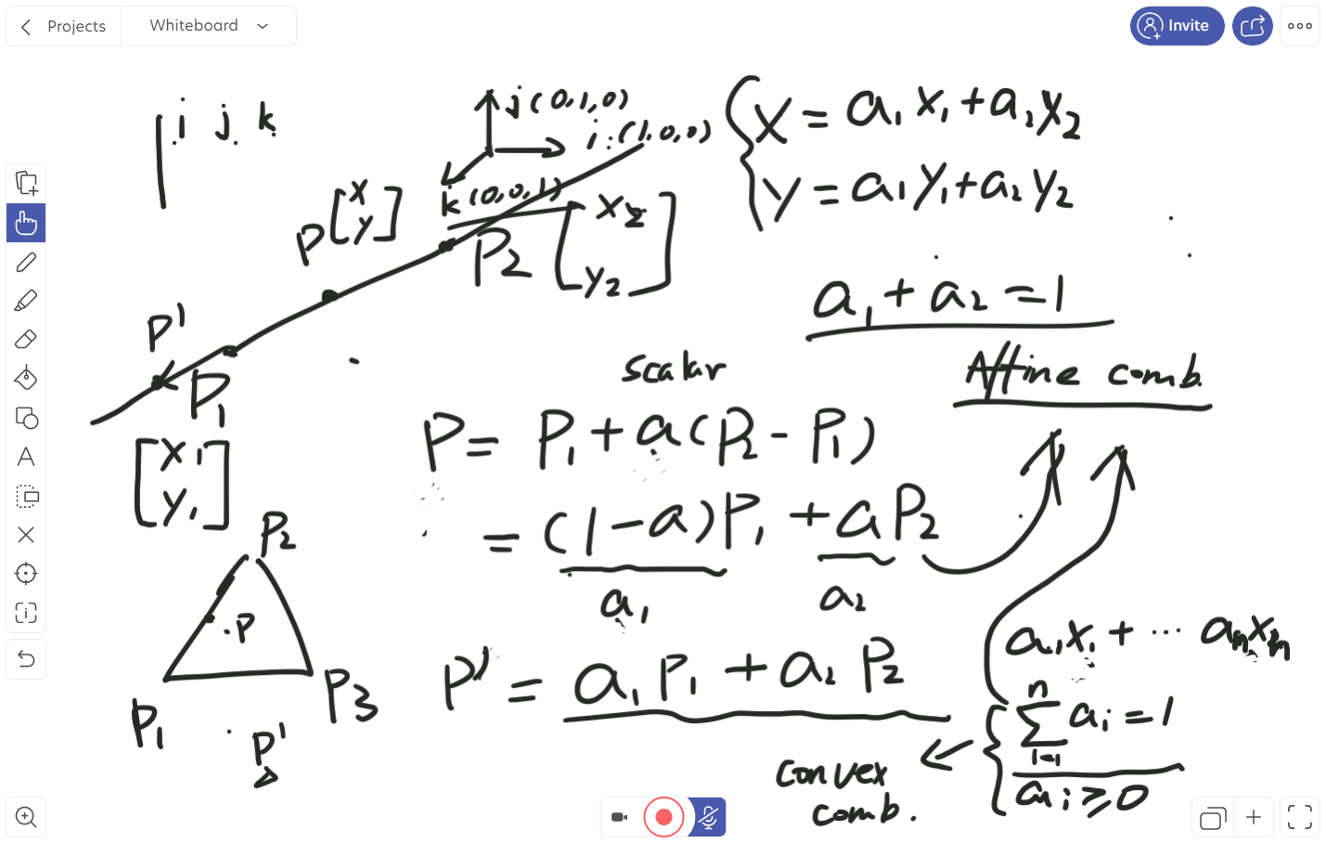

Slide 3
