Slide 1

Quality Assessment for Riyadh Bank App

Slide 2



Group:7
Ghadeer Alshalawi
Hanan Almutairi
Razan Bajaaman
440020493
440022269
440022262
Supervisor Name: Dr. Lamees Alhazzaa

Slide 3
CONTENTS OF Presentation
Introduction About Riyadh Banking App
The Steps We Followed in This Workshop
Distribution of The Tasks
Security Issues
Code Quality Issues
Design Issues
Conclusion

Slide 4
The Steps We Followed in This Workshop:
01
02
03
04
05
06
Extract Application APK
Use MobSF tool to start the static analysis
Download the source code From MobSF Tool
We Use Githup’s Extension Codacy
checked the code quality and design structure
We Used The App to Check The interfaces Design

Slide 5
Riyadh Bank App
A mobile bank application that provide most of the banking services provided by Riyad Bank branches .
for example :Transfer & Payment from Credit Card and Request Credit Card Limit Increase and etc.

Slide 6
01
Security Issues

Slide 7
PROBLEM and Recommendation
PROBLEM
Recommendation
App can read and write on external storge
Try to use internal storage only
or
follow Android's guidelines for external storage, which contain some steps that help reduce the risks of using external storage

Slide 8
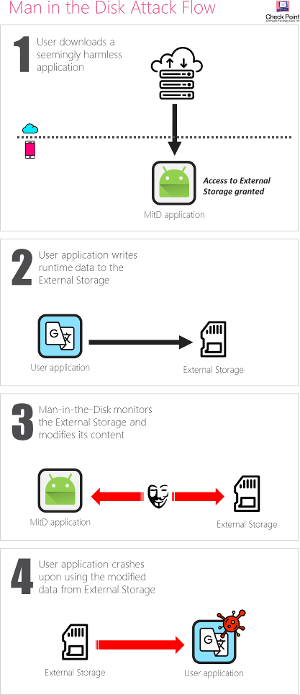
Man in the disk Attack Flow

Slide 9
PROBLEM and Recommendation
PROBLEM
Recommendation
Using SHA-1 as cryptographic algorithm
1- replaced with more secure alternatives and you can check owasp.com for more information about it.
2- Verify that cryptographic algorithms are up to date and in-line with industry standards.

Slide 10
PROBLEM and Recommendation
PROBLEM
Recommendation
The App uses an insecure Random Number Generator
use Cryptographically secure RNGs generate random numbers that pass statistical randomness tests, and are resilient against prediction attacks

Slide 11
PROBLEM and Recommendation
PROBLEM
Recommendation
Ensure that you use proper file permissions so Temporary files should be writable and readable only by the process that owns the file.
2- Randomize temporary file names ,This will ensure that temporary files will not be created in predictable places.
App creates temp file. Sensitive information should never be written into a temp file

Slide 12
PROBLEM and Recommendation
PROBLEM
Recommendation
1-Other applications must be prevented from accessing application resources and completely
2-in case that the application needs to share these resources, permissions must be set and approved by the user and explain in it about the risks of sharing these resources and why the application needs it.
App services, activities and objects is shared

Slide 13
02
Code Quality Issues

Slide 14
1\ No documentation
2\ Empty method body
3\ Unused import
4\ Too long method
5\ No validation
6\ And others

Slide 15
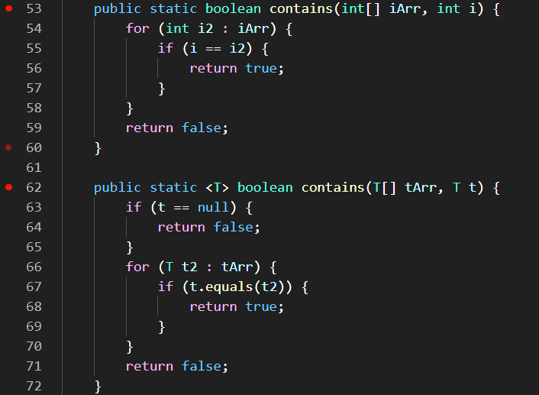
1\ No documentation

Slide 16
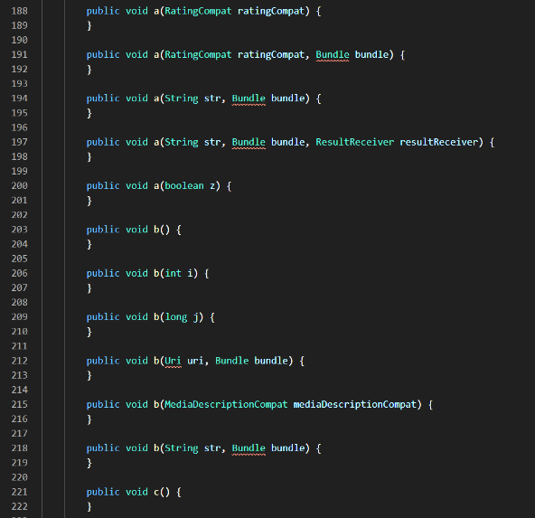
2\ Empty method body

Slide 17
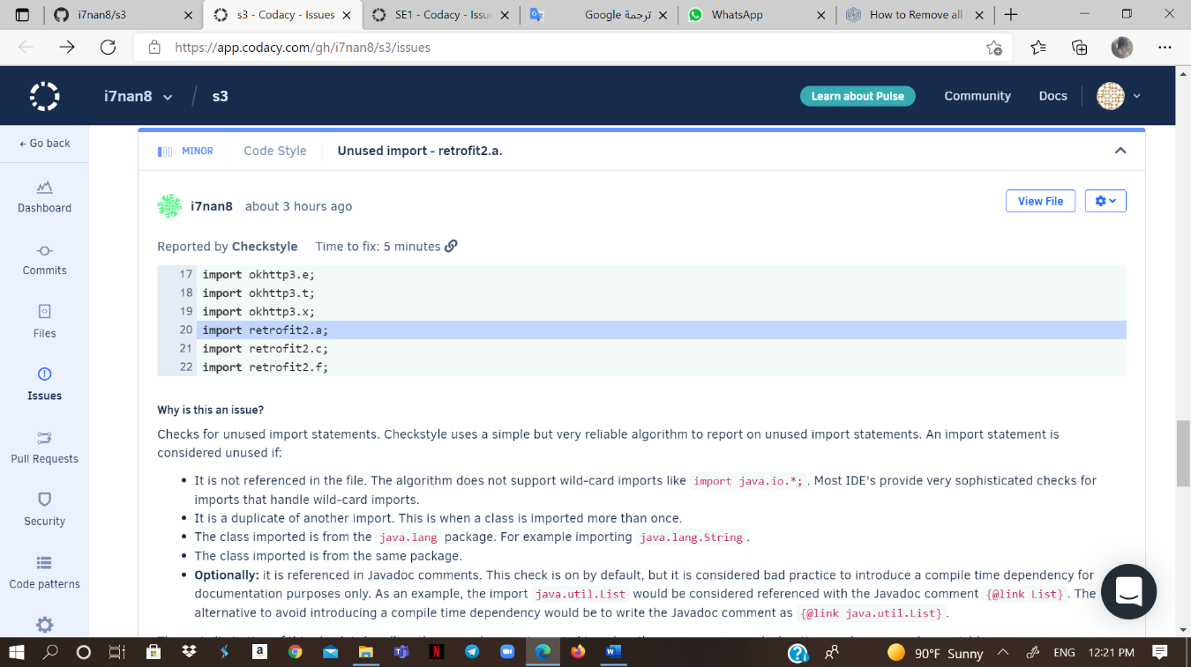
3\ Unused import

Slide 18
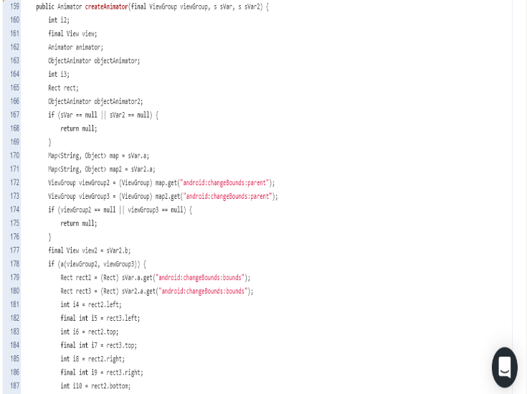
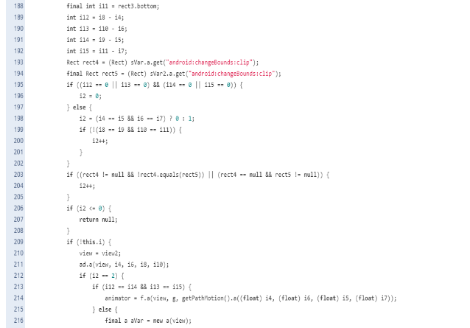
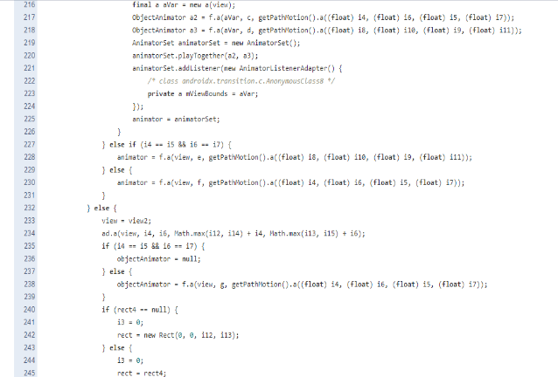
4\ Too long method

Slide 19
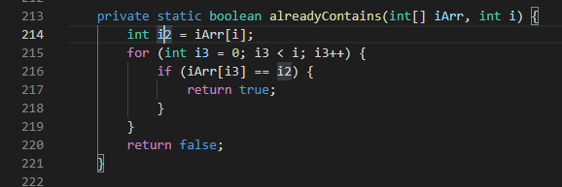
5\ No validation

Slide 20
6\ others
1- Meaningful identifiers
2- Unused private method
3 -Unnecessary constructer
4- Class naming conventions

Slide 21
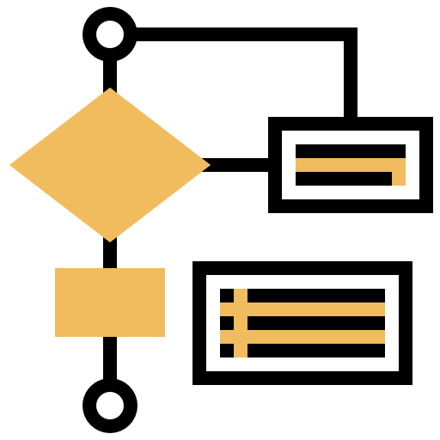
03
Design Issues

Slide 22
THEY USED :
1 )
2 )
3 )
Composite pattern
Observer Pattern
describes a group of objects that is treated the same way as a single instance of the same type of object.
supports the server and client system, so that the client asks the server for notifications about anything it is interested in.
Adapter Pattern
Convert the interface of a class into another interface clients expect.

Slide 23


OUR RECOMNDATION :
Facade pattern
Decorator Pattern
By hiding the details of the system.
Supports updating part of the system without the need to update the entire system.

Slide 24
04
Application interface design

Slide 25
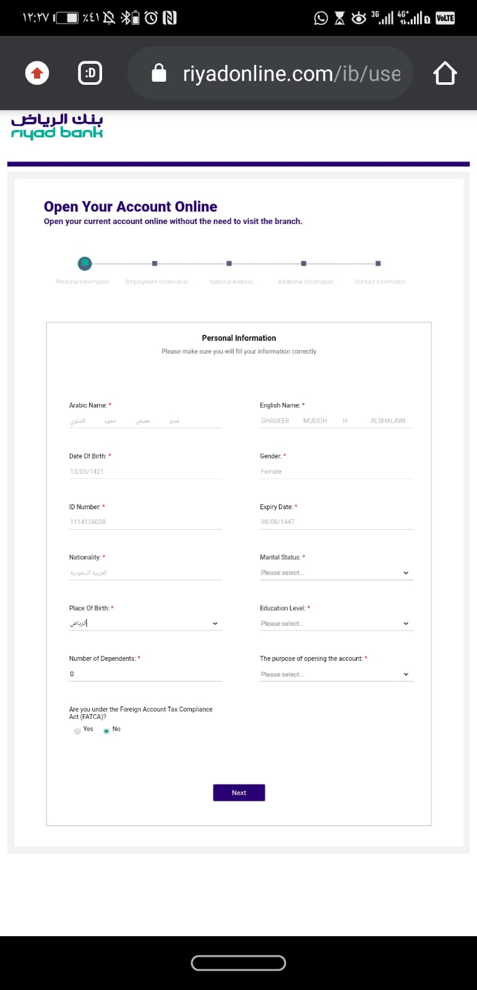
There is no Arabic interface

Slide 26

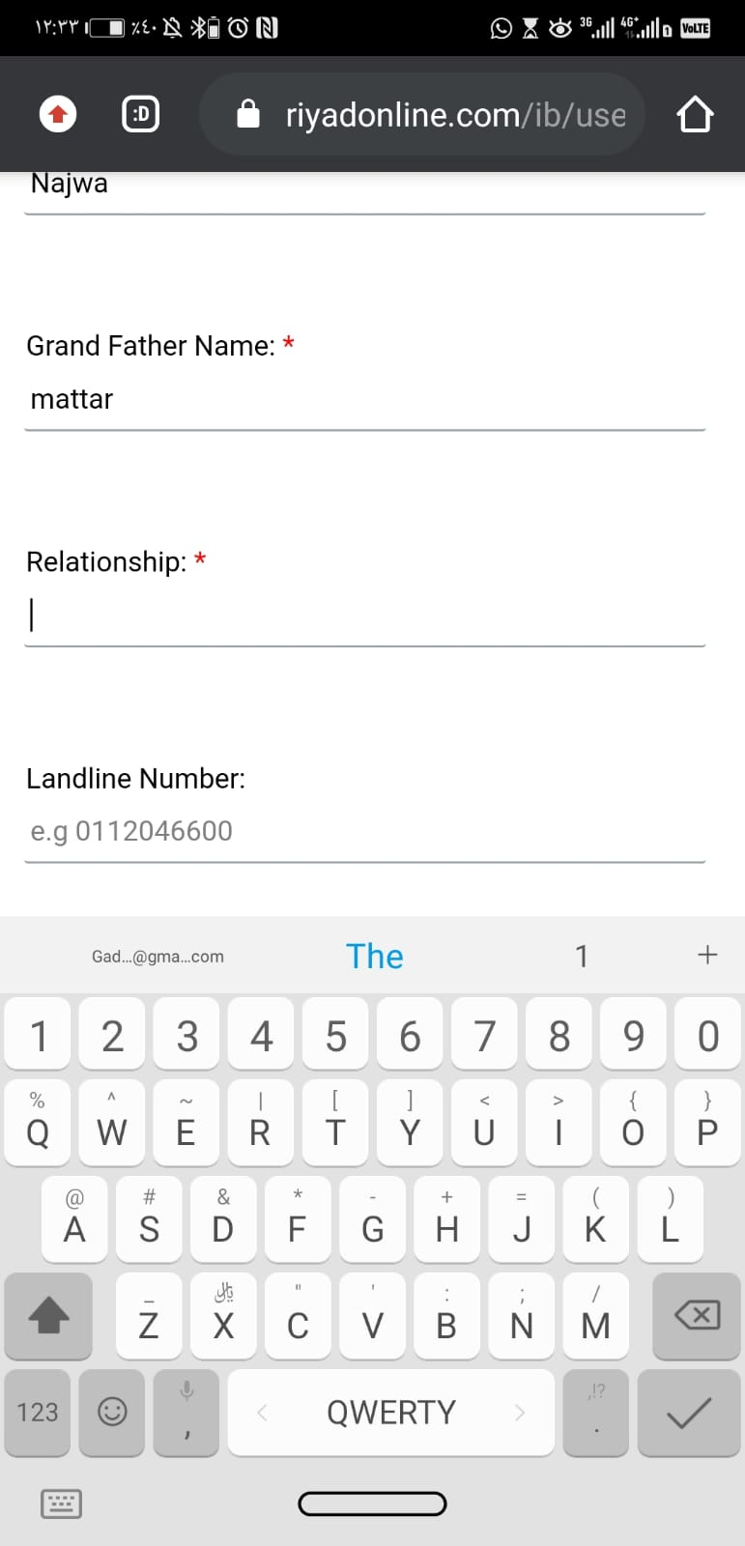
It is better to use some tools to help fill in the data

Slide 27

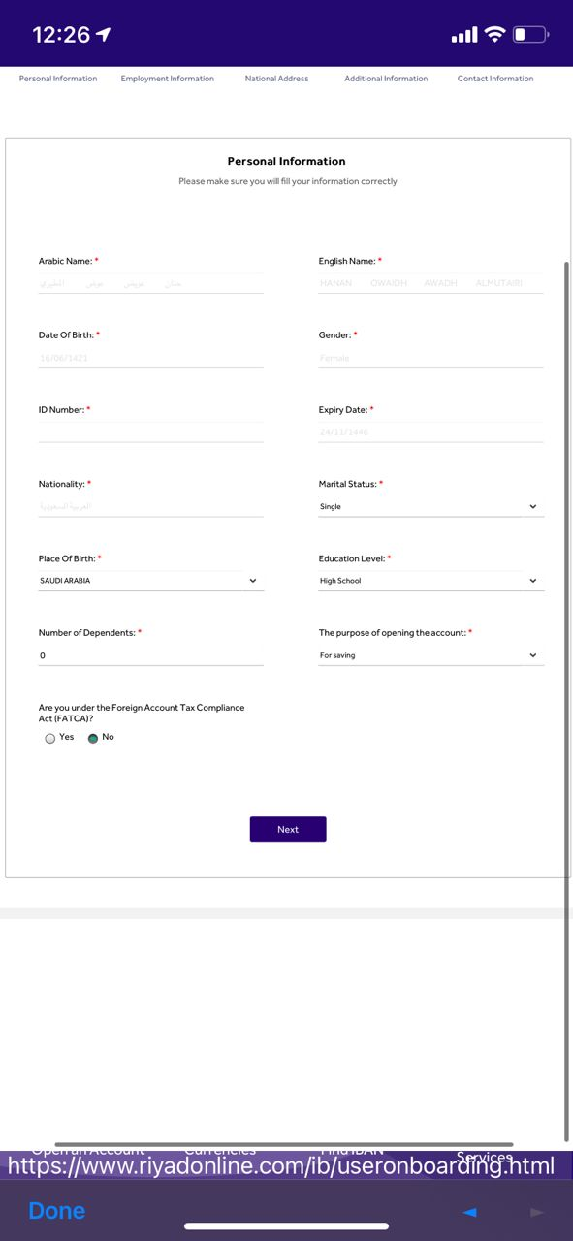
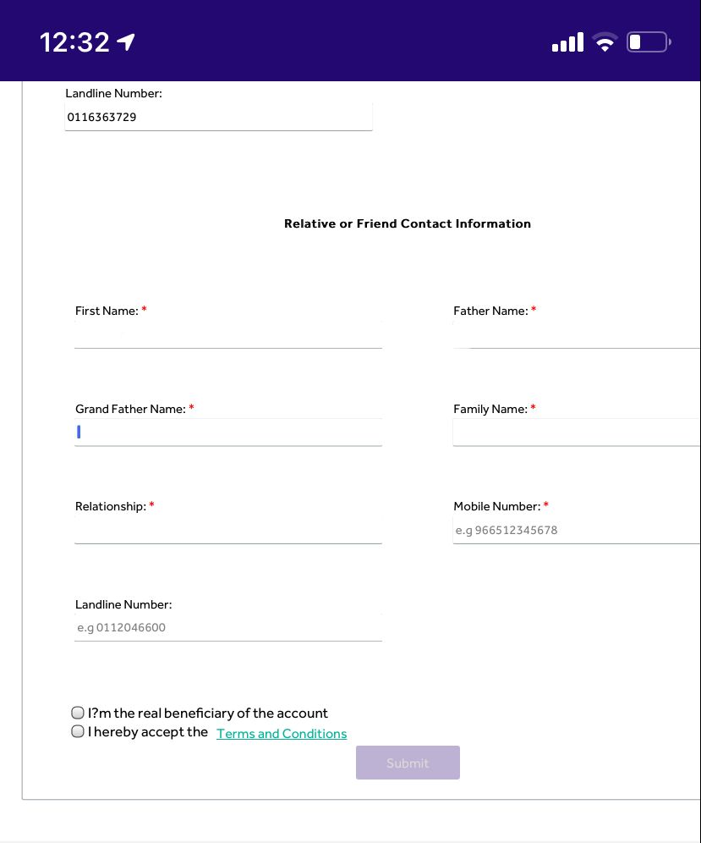
Unimportant or redundant questions that may annoy the user

Slide 28
Conclusion
After we analyzed the application and found some issues with it, our view of banking applications changed, which we believed that it's safe and free from errors. These errors may be simple and has no effect from the application developers point view, but they may become a threat to the security and safety of the application and also may be confusing for future developers of the application We expect to resolve the issues that we mentioned it and improve the security and quality of the code to get better code and improve the usability of the application

