Slide 1


Mocha: the Unit-tester
Bob Schmertz <rschmertz@yahoo.com>
By TJ Holowaychuk, of ExpressJS fame
“simple, flexible, fun”
Supports testing on server side and client side
Supports various testing behaviors (expect, should, assert) thru 3rd-party libraries. Chai is a good choice here.

Slide 2
Why I use it
TDD a proven approach to software development
High visibility – comes out well in comparison with similar tools such as Vows, QUnit, Jasmine
Understandable approach to testing asynchronous stuff.
NYAN cat reporter

Slide 3
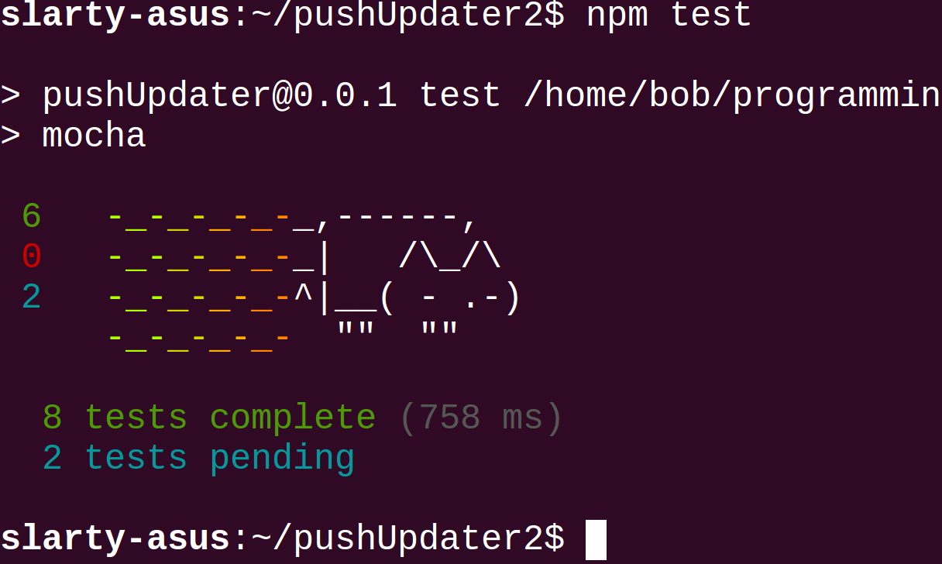
NYAN NYAN NYAN-NYAN...

Slide 4
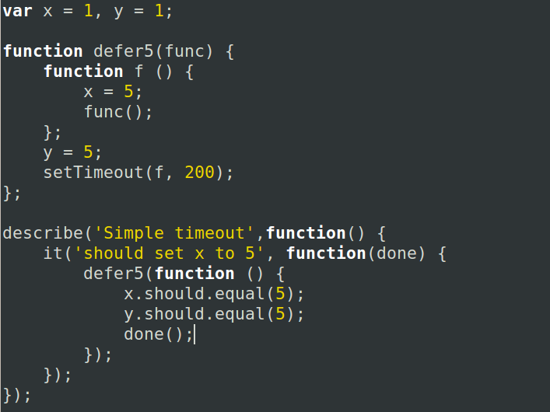
Sample Code:

