Slide 1
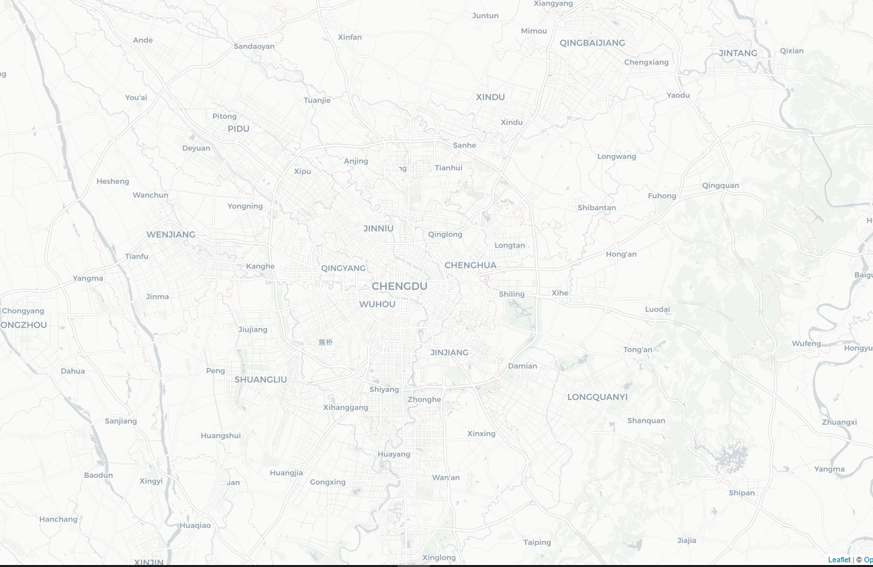
Car | Route Calculated from Backend
Car0 (Red) | [0,10,11,0,17,14,0,15,16,0]
Car1 (Blue) | [1,12,13,1]
Car2 (Green) | [2,18,2]
{18}
{13}
{12}
{1}
{16}
{15}
{14}
{17}
{0}

Slide 2
{18}
{13}
{12}
{1}
{16}
{15}
{14}
{17}
{0}

