Slide 1
A Tale of Two (or more) Asynchrony
by Adam Crabtree
Founder of BayNode, Noderiety

Slide 2
Asynchrony
Definition: any object or function that represents an asynchronous value or error.

Slide 3
Asynchrony: Representations
Definition: any object or function that represents an asynchronous value or error.

Slide 4
Asynchrony: Examples
// Callbacks
function callback(err, value) {
if(err) {
// do something with err
return;
}
// do something with value
}
// Promises
promise.then(function(value) {
// do something with value
}
, function(err) {
// do something with err
})

Slide 5
Asynchrony: Contracts
All asynchrony have a contract:
Errbacks (Implicit): https://gist.github.com/CrabDude/10907185
Promises A+ (Explicit via a spec): http://promises-aplus.github.io/promises-spec/
Ideally, they have tests as well: https://github.com/promises-aplus/promises-tests

Slide 6
Asynchrony: Errback Contract
Function that takes 2 arguments
first argument is an error
second argument is the result
Never pass both
error should be instanceof Error
Must never excecute on the same tick of the event loop
Must be passed as last argument to function
Return value is ignored
Must not throw / must pass resulting errors
Must never be called more than once

Slide 7
Asynchrony: Promises Spec
Promises/A+
An open standard for sound, interoperable JavaScript promises—by implementers, for implementers.
Terminology
"promise" is an object or function with a then method whose behavior conforms to this specification.
"thenable" is an object or function that defines a then method.
"value" is any legal JavaScript value (including undefined, a thenable, or a promise).
"exception" is a value that is thrown using the throw statement.
"reason" is a value that indicates why a promise was rejected.
Requirements
Promise States
A promise must be in one of three states: pending, fulfilled, or rejected.
When pending, a promise:
may transition to either the fulfilled or rejected state.
When fulfilled, a promise:
must not transition to any other state.
must have a value, which must not change.
When rejected, a promise:
must not transition to any other state.
must have a reason, which must not change.
Here, "must not change" means immutable identity (i.e. ===), but does not imply deep immutability.
The then Method
A promise must provide a then method to access its current or eventual value or reason.
A promise's then method accepts two arguments:
promise.then(onFulfilled, onRejected)
Both onFulfilled and onRejected are optional arguments:
If onFulfilled is not a function, it must be ignored.
If onRejected is not a function, it must be ignored.
If onFulfilled is a function:
it must be called after promise is fulfilled, with promise's value as its first argument.
it must not be called before promise is fulfilled.
it must not be called more than once.
If onRejected is a function,
it must be called after promise is rejected, with promise's reason as its first argument.
it must not be called before promise is rejected.
it must not be called more than once.
onFulfilled or onRejected must not be called until the execution context stack contains only platform code. [3.1].
onFulfilled and onRejected must be called as functions (i.e. with no this value). [3.2]
then may be called multiple times on the same promise.
If/when promise is fulfilled, all respective onFulfilled callbacks must execute in the order of their originating calls to then.
If/when promise is rejected, all respective onRejected callbacks must execute in the order of their originating calls to then.
then must return a promise [3.3]. promise2 = promise1.then(onFulfilled, onRejected);
If either onFulfilled or onRejected returns a value x, run the Promise Resolution Procedure[[Resolve]](promise2, x).
If either onFulfilled or onRejected throws an exception e, promise2 must be rejected with e as the reason.
If onFulfilled is not a function and promise1 is fulfilled, promise2 must be fulfilled with the same value as promise1.
If onRejected is not a function and promise1 is rejected, promise2 must be rejected with the same reason as promise1.
The Promise Resolution Procedure
The promise resolution procedure is an abstract operation taking as input a promise and a value, which we denote as [[Resolve]](promise, x). If x is a thenable, it attempts to make promise adopt the state of x, under the assumption that x behaves at least somewhat like a promise. Otherwise, it fulfills promise with the value x.
This treatment of thenables allows promise implementations to interoperate, as long as they expose a Promises/A+-compliant then method. It also allows Promises/A+ implementations to "assimilate" nonconformant implementations with reasonable then methods.
To run [[Resolve]](promise, x), perform the following steps:
If promise and x refer to the same object, reject promise with a TypeError as the reason.
If x is a promise, adopt its state [3.4]:
If x is pending, promise must remain pending until x is fulfilled or rejected.
If/when x is fulfilled, fulfill promise with the same value.
If/when x is rejected, reject promise with the same reason.
Otherwise, if x is an object or function,
Let then be x.then. [3.5]
If retrieving the property x.then results in a thrown exception e, reject promise with e as the reason.
If then is a function, call it with x as this, first argument resolvePromise, and second argumentrejectPromise, where:
If/when resolvePromise is called with a value y, run [[Resolve]](promise, y).
If/when rejectPromise is called with a reason r, reject promise with r.
If both resolvePromise and rejectPromise are called, or multiple calls to the same argument are made, the first call takes precedence, and any further calls are ignored.
If calling then throws an exception e,
If resolvePromise or rejectPromise have been called, ignore it.
Otherwise, reject promise with e as the reason.
If then is not a function, fulfill promise with x.
If x is not an object or function, fulfill promise with x.
If a promise is resolved with a thenable that participates in a circular thenable chain, such that the recursive nature of [[Resolve]](promise, thenable) eventually causes [[Resolve]](promise, thenable) to be called again, following the above algorithm will lead to infinite recursion. Implementations are encouraged, but not required, to detect such recursion and reject promise with an informative TypeError as the reason. [3.6]

Slide 8
Asynchrony: Results
Definition: any object or function that represents an asynchronous value or error.

Slide 9
Asynchrony
There are two primary results to any operation, a value or an error.
Asynchrony must deal with both.
Sometimes manually
Sometimes automatically

Slide 10
Asynchrony: Bad Error Handling
Throwing the error violates the callback contract:
function readCurrentFileAsString(callback) {
fs.readFile(__filename, function(err, data) {
// BAD
if (err) throw err
callback(null, String(data))
})
}

Slide 11
Asynchrony: Good Error Handling
Bubble the error to maintain the callback contract:
function readCurrentFileAsString(callback) {
fs.readFile(__filename, function(err, data) {
callback(err, data && String(data))
})
}
function readCurrentFileAsString() {
return fs.promisifiedReadFile(__filename)
.then(String)
}

Slide 12
Control-flow: Why?
Juggle values, enforce ordering, coalesce errors
function readCurrentFileAsString(callback) {
stepup([
function($) {
fs.readFile(__filename, $.first())
setTimeout($.none(), 1000)
},
function($, data) {
return String(data)
}
], callback)
}

Slide 13
Control-flow: Why? (Promises)
Juggle values, enforce ordering, coalesce errors
function readCurrentFileAsString(callback) {
var deferred = q.defer();
setTimeout(deferred.resolve, 1000)
return q.all([
fs.promisifiedReadFile(__filename),
deferred.promise
])
.then(String)
}

Slide 14
Control-flow: Guardians of Contract
Control-flow is the gatekeeper that enforces the asynchrony contract
When calling into 3rd party code, don’t trust it to properly follow the callback contract
Ensure it doesn’t throw an uncaughtException
with trycatch (built into stepup)
Promises wrap all callbacks in try/catch

Slide 15
Errors vs Exceptions
An exception is an unrecoverable error
Implicit: null.foo
Explicit: throw new Error(‘fail’)
Exceptions tear the stack
Every frame on a call stack must eventually be popped
Ultimately, the cause of unrecoverability
Desired when we need to crash

Slide 16
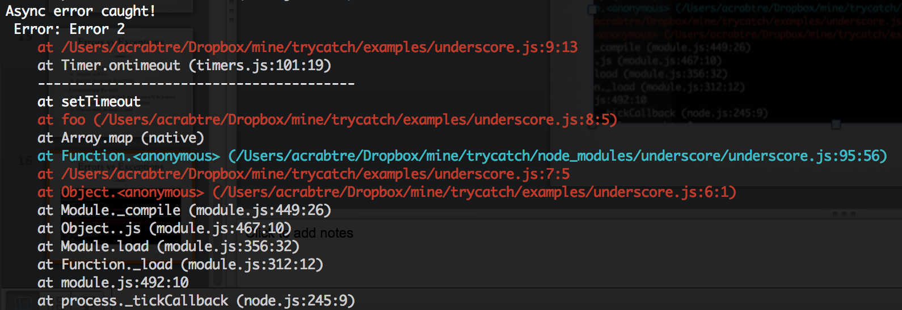
Errors vs Exceptions

Slide 17
Exceptions in Node.js
Exceptions are communicated via process.on(‘uncaughtException’)

Slide 18
trycatch
trycatch, asynchronous try/catch support: https://github.com/CrabDude/trycatch
Wraps core/userland boundary in try/catch
Prevents core stack from tearing, ensuring core stack frames are always allowed to unwind
trycatch(function() {
setTimeout(function() {throw new Error(v)}, 10)
}, function(err) {
console.log("Async error caught!\n", err.stack);
});

