Slide 1
Airbag and other influences on accident fatalities The purpose of this project is to determine the impact of the Airbag and other predictors responsible for accident fatalities based on multiple methods.
STAT 694
Toshov Nodirjon

Slide 2
Research question
1. What are the main factors that influence accident fatality?
(How do airbag, speed of impact, airbag, seatbelt, weight, age and other factors affect accident fatality?)
2. How well does the model fit the data?

Slide 3
Data Description
nassCDS data from DAAG package in R
US data, for 1997-2002,
from police-reported car crashes in which there is a harmful event
from which at least one vehicle was towed.
data are restricted to front-seat occupants
26217 observations, 15 variables
Exclude 153 rows with missing data, making project data to have 26063 rows

Slide 4
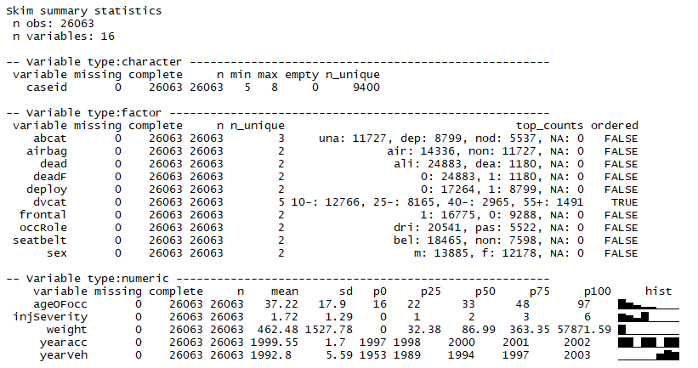
Data Description

Slide 5
Data Description
Response Variable | Description
dead | factor with levels alive dead
Predictor Variables | Description
dvcat | ordered factor with levels (estimated impact speeds) 1-9km/h, 10-24, 25-39, 40-54,55+
abcat | Did one or more (driver or passenger) airbag(s) deploy? This factor has levels deploy, nodeploy, unavailable
ageOFocc | age of occupant in years
airbag | a factor with levels none airbag
dead | factor with levels alive dead
frontal | a numeric vector; 0 = non-frontal, 1=frontal impact
occRole | a factor with levels driver pass
seatbelt | a factor with levels none belted
sex | a factor with levels f m
weight | Observation weights, albeit of uncertain accuracy, designed to account for varying sampling probabilities.
yearacc | year of accident
yearVeh | Year of model of vehicle; a numeric vector

Slide 6
Method
Logistic Regression
Response variable: dead
Predictors variables: dvcat, weight, airbag, seatbelt, frontal, sex, age, ageOFocc, abcat and occRole
Backwards stepwise selection
AIC for model selection
Cross Validation

Slide 7
Method
Data is divided into training group and test group
Group | Count | %
Training Group | 18244 | 70%
Test Group | 7819 | 30%
Total | 26063

Slide 8
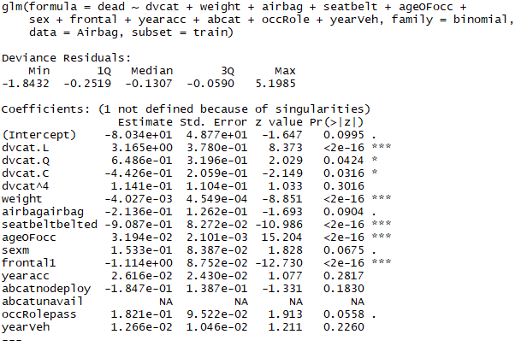
Method
Compute first mode with the most number of predictor variables from training data

Slide 9
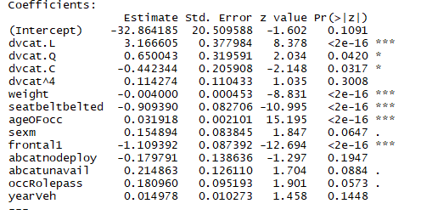
Method
Backwards stepwise selection by step() function
glm2 <- step(glm1)
summary(glm2)

Slide 10
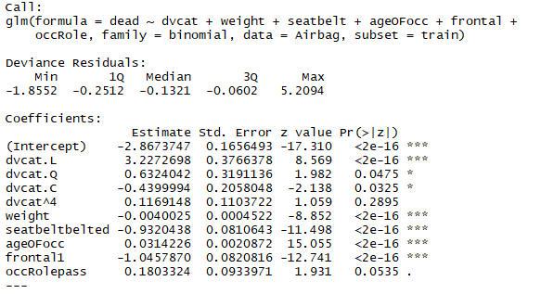
Method
Manually remove insignificant variables: abcat, sex, and yearVeh

Slide 11

Method
Comparing AIC

Slide 12
Result
Probability of fatality is significantly influenced by:
impact speed
seatbelt
location of injury
weight
Age of occupants

Slide 13

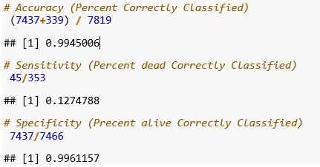
Result
Cross validation by confusion matrix

Slide 14
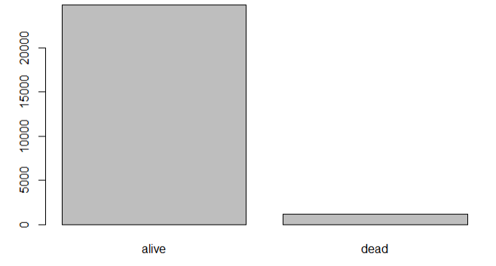

Discussion
High accuracy and specificity, but low sensitivity due to unbalanced data
Limitation of this analysis could be multicollinearity between predictor variables
Diagnostic and assumption of logistic regression were not considered because it’s out of scope of study

Slide 15
Thank You!

