Slide 1

BRITISH
AIRWAYS
Forage Internship

Slide 2
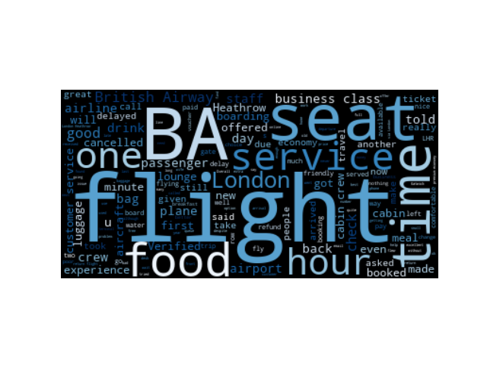
British Airways
Reviews Overview
Neutral
1%
Word Cloud
340
Negative
34%
Negative
650
Positive
10
Positive
65%
Neutral
flight 1836
trip 926
service 711
london 606
seat 515
time 484
food 469
crew 454
good 419
seats 415
Topic occurences

