Slide 1

BRITISH
AIRWAYS
Forage Internship

Slide 2
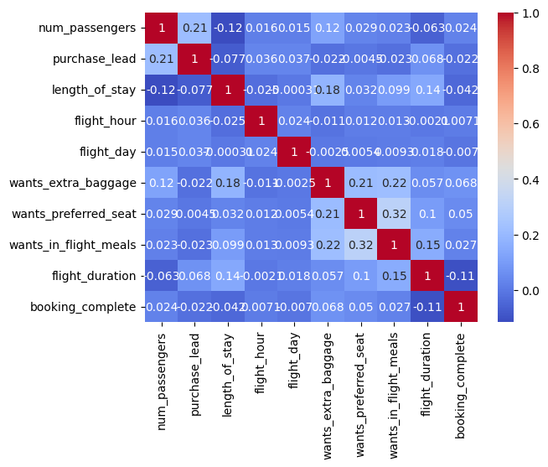
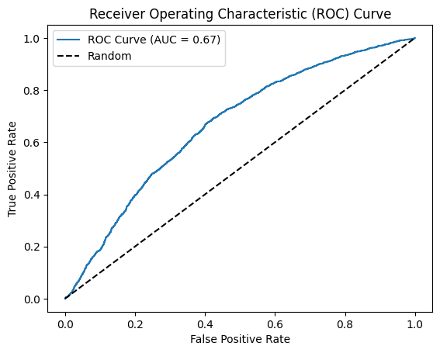
British Airways
Task 2
Accuracy = 0.852
Algorithm = Linear Regression
AUC = 0.67
Correlation Scores

