Slide 1
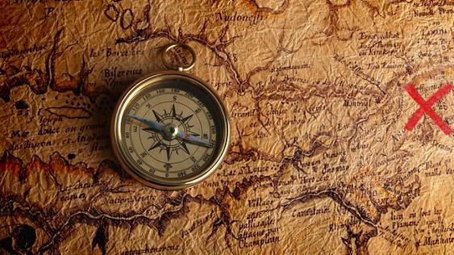
Odyssey of the forgotten
Team 7
Notes:
Niki

Slide 2
Story
Our game tells the story of an individual awakening on a deserted island surrounded by ancient ruins. To escape, players must solve puzzles and make critical decisions that shape their fate.
It's an immersive, high-stakes adventure where their choices determine whether they leave the island with their life intact.
Players need to explore into the ruins to locate crucial plane components for their escape from the island.
Notes:
Niki

Slide 3
Welcome to Odyssey of the forgotten
Odyssey of the forgotten is an immersive and captivating experience designed for players who seek thrilling challenges and engaging narratives.
Key Features:
Explore a dynamic, randomly generated game world.
Experience a rich storyline that keeps you immersed.
Solve riddles, conquer puzzles, and face exciting events.
Collect and manage items in your inventory.
Achieve high scores to unlock different endings.
Purpose of Presentation:
We'll take you through the game's unique aspects, design decisions, and what makes it a must-have for RetroBazinga Ltd.
Notes:
Niki

Slide 4

"Immersive Storyline"
Our game offers an immersive narrative that draws players into an exciting storyline filled with mystery and discovery.
The narrative captivates players through:
Engaging character interactions.
Unraveling secrets about the game world.
Challenging players to make choices that impact the story's outcome.
The storyline keeps players engaged, eager to uncover the next chapter, and invested in the game's world.
This Photo by Unknown author is licensed under CC BY-NC.

Slide 5
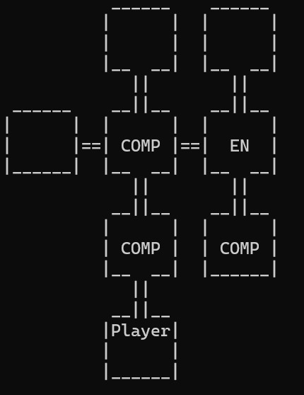
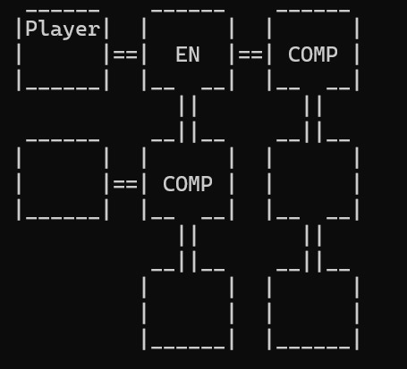
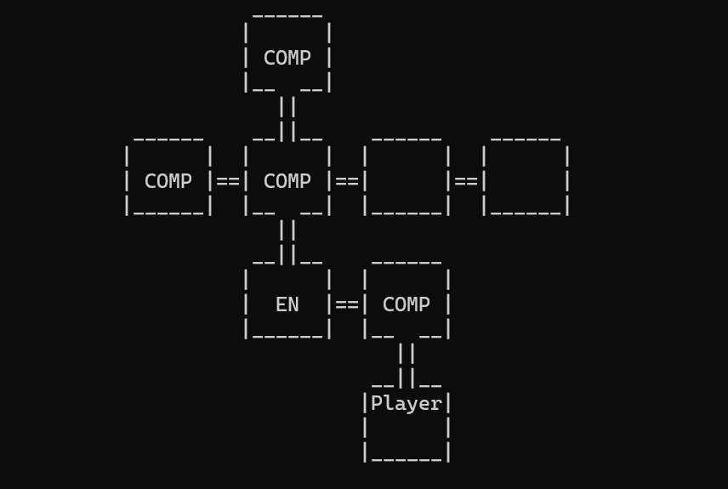
Generated Map Examples
"Explore a Dynamic Game World"
Our game features a dynamically generated world, ensuring a unique experience with each playthrough.
Randomly generated map:
Offers different room layouts and challenges.
Encourages players to adapt and strategize.
Enhances replayability and keeps players coming back for more.
Room significance:
Required rooms drive the game's progression.
Optional rooms add depth, variety, and bonus rewards.
This Photo by Unknown author is licensed under CC BY-SA.

Slide 6

"Interact with Your Environment"
Our game promotes interactivity, allowing players to engage with their surroundings.
Players can:
Inspect and interact with items and objects in rooms.
Choose their actions and decisions, affecting the game's progression.
Experience dynamic responses based on their choices.

Slide 7

"Face Challenges, Earn Rewards"
In our game, players encounter various challenges in different room types.
Clearing rooms:
Completing objectives unique to each room type.
Receiving rewards such as items, and score increases.
Challenges vary from mental puzzles to skill-based tasks, ensuring an exciting mix of gameplay experiences.
This Photo by Unknown author is licensed under CC BY.

Slide 8
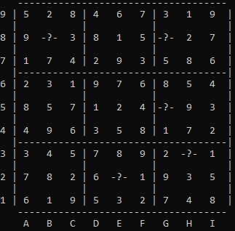
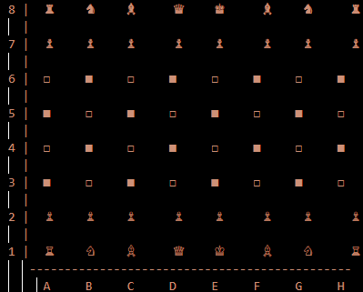

Game Challenge Examples
Sudoku
Riddles
Chess

Slide 9
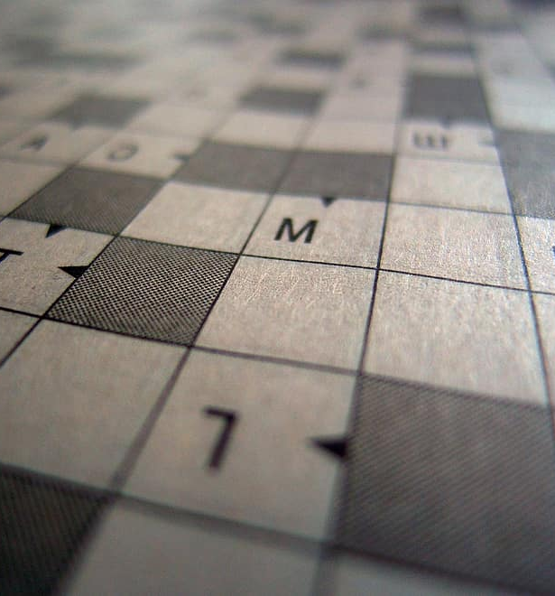

"Collect and Manage Items"
Players can collect and manage items in their inventory, a crucial aspect of gameplay.
Items serve as tools for:
Solving puzzles.
Overcoming obstacles.
Advancing through the game.
Proper item management is key to success, encouraging strategic thinking.

Slide 10
Game Architecture
In our game, we employ a diverse set of techniques to maintain dynamic gameplay and enhance its scalability. These techniques include:
- Leveraging Object-Oriented Programming for creating a dynamic and extensible gaming experience.
- Utilizing child classes to broaden the spectrum of available puzzles.
- Applying encapsulation to ensure streamlined code navigation and effortless adjustments.
- Harnessing dictionaries to store and manage initial values for in-game objects.

Slide 11

“Player Scoring"
Our game introduces a progression system tied to scores and items
Items:
Items earned through puzzles and found in rooms advance the player to completion
Showcase a player's achievements and expertise.
Scoring:
Rewards players for their performance.
Score adapts to players decisions within the game.

Slide 12
Summary
Overall, Odessey of the Forgotten should be purchased by RetroBehzinga LTD because it is a unique experience which provides the player with the ability to make their own decisions which affects the outcome of the game.
The game offers a dynamic structure that allows for easy addition of new puzzles and rooms in the future, extending the playtime of the game.

Slide 13
Future implementation/ ideas
Leaderboards
Time Limits
Achievements/ Titles
More Variety in Puzzles
More Stages
Difficulty Options affecting scores and certain Puzzles
More Robust algorithm to automate new sudoku/chess puzzles based on user input

Slide 14
Game Demonstration

Slide 15

"Q&A"
We open the floor to any questions, comments, or discussions.
Thank you for your attention and interest in our game.
This Photo by Unknown author is licensed under CC BY-SA.

