Slide 1
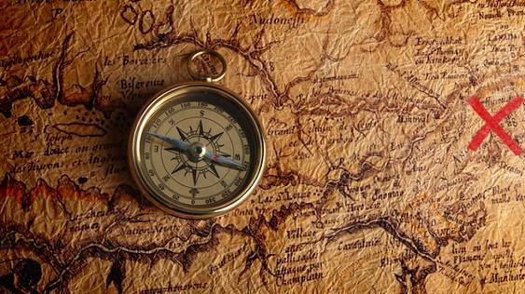
Odyssey of the forgotten
Team 7

Slide 2
Welcome to Odyssey of the forgotten
Odyssey of the forgotten is an immersive and captivating experience designed for players who seek thrilling challenges and engaging narratives.
Key Features:
Explore a dynamic, randomly generated game world.
Experience a rich storyline that keeps you immersed.
Solve riddles, conquer puzzles, and face exciting events.
Collect and manage items in your inventory.
Earn titles, accumulate scores, and compete on leaderboards.
Purpose of Presentation:
We'll take you through the game's unique aspects, design decisions, and what makes it a must-have for RetroBazinga Ltd.

Slide 3

"Immersive Storyline"
Our game offers an immersive narrative that draws players into an exciting storyline filled with mystery and discovery.
The narrative captivates players through:
Engaging character interactions.
Unraveling secrets about the game world.
Challenging players to make choices that impact the story's outcome.
The storyline keeps players engaged, eager to uncover the next chapter, and invested in the game's world.
This Photo by Unknown author is licensed under CC BY-NC.

Slide 4
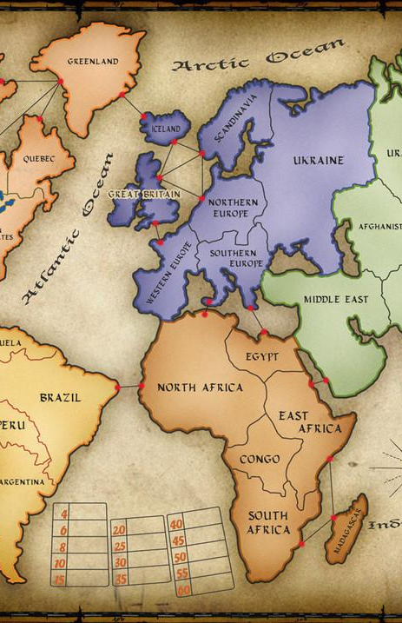
"Explore a Dynamic Game World"
Our game features a dynamically generated world, ensuring a unique experience with each playthrough.
Randomly generated map:
Offers different room layouts and challenges.
Encourages players to adapt and strategize.
Enhances replayability and keeps players coming back for more.
Room significance:
Required rooms drive the game's progression.
Optional rooms add depth, variety, and bonus rewards.
This Photo by Unknown author is licensed under CC BY-SA.

Slide 5
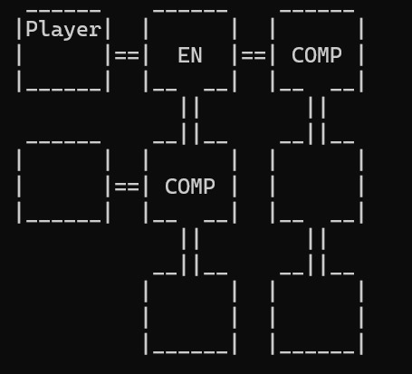
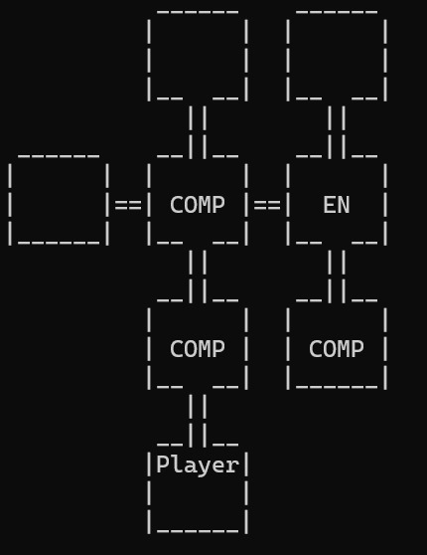
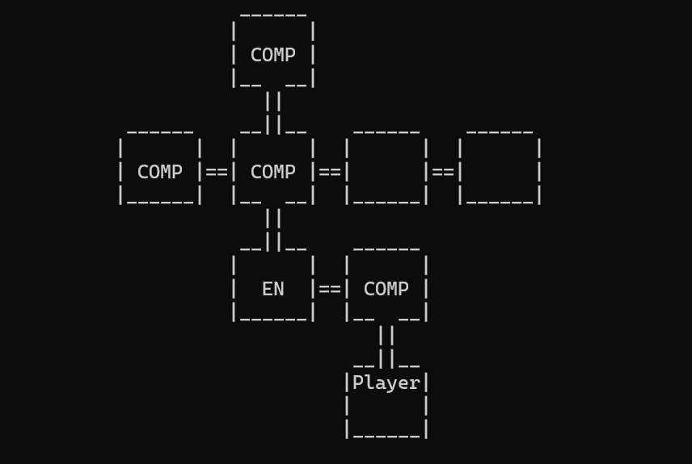
Example Maps generated

Slide 6

"Interact with Your Environment"
Our game promotes interactivity, allowing players to engage with their surroundings.
Players can:
Inspect and interact with items and objects in rooms.
Choose their actions and decisions, affecting the game's progression.
Experience dynamic responses based on their choices.

Slide 7

"Face Challenges, Earn Rewards"
In our game, players encounter various challenges in different room types.
Clearing rooms:
Completing objectives unique to each room type.
Receiving rewards such as items, titles, and score increases.
Challenges vary from mental puzzles to skill-based tasks, ensuring an exciting mix of gameplay experiences.
This Photo by Unknown author is licensed under CC BY.

Slide 8
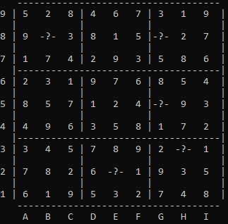
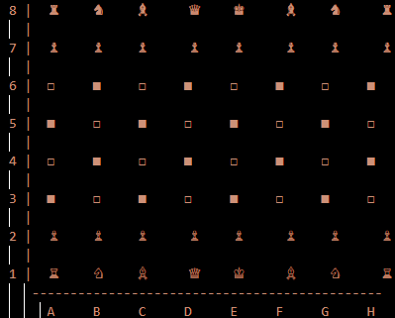

Game Challenge Examples
Sudoku
Riddles
Chess

Slide 9
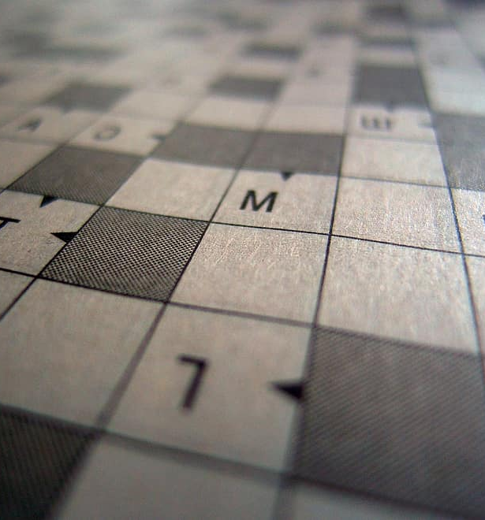

"Collect and Manage Items"
Players can collect and manage items in their inventory, a crucial aspect of gameplay.
Items serve as tools for:
Solving puzzles.
Overcoming obstacles.
Advancing through the game.
Proper item management is key to success, encouraging strategic thinking.

Slide 10

"Earning Titles and Scoring"
Our game introduces a progression system tied to titles and scores.
Titles:
Earned by completing rooms and achieving specific goals.
Showcase a player's achievements and expertise.
Scoring:
Rewards players for their performance.
Encourages competition and leaderboard standings.

Slide 11

"Q&A"
We open the floor to any questions, comments, or discussions.
Thank you for your attention and interest in our game.
This Photo by Unknown author is licensed under CC BY-SA.

