Slide 1
Stocks Analyzer — Retail Top 5
IRONHACK – BOOTCAMP EXTENSION – Project 1
Created by: Nodirbek Saidov

Slide 2
Project Idea and Real-World Demand
Investors struggle to quickly see Buy / Hold / Sell
Need for simple tools, not complex platforms
Our solution: Streamlit Stocks Analyzer
Notes:
Today I’ll present my project: a Stocks Analyzer Dashboard built in Streamlit. Imagine you’re an retail investor.
You hold 10, maybe 20 stocks in your portfolio.
Every day, prices move up and down, and you keep asking: Which ones are still strong? Which are too risky? Which could I sell? And are there good dividend stocks I can rely on?
Most tools like TradingView or Finviz are great, but they are too complex or costly. Beginners get lost.
So the goal was to build a lightweight, easy-to-use dashboard that helps investors: - Analyze their chosen watchlist. - Get Top-5 Buy, Hold, Sell recommendations. - Identify Dividend Kings (top yielders). - Visualize results with charts and a market map. This addresses the real demand for clarity and simplicity in stock analysis.

Slide 3
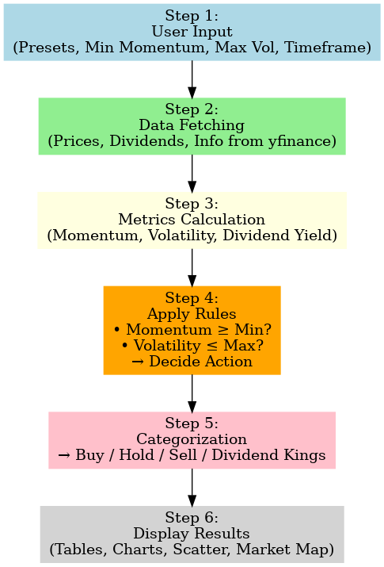
Project Structure
UI
Process
Sidebar → filters & stock selection
Main Page → Top 5 tables
Main Page → Growth charts, Risk vs Return, Market Map
Notes:
Step one: You choose your universe and filters in the sidebar.
For example, US Big Tech, or the DAX, or even all global stocks.
Then you set rules:
Min Momentum (%): How much positive trend is needed to call it a Buy.
Max 60D Volatility (%): The risk filter — exclude stocks that move too wildly.
Timeframe: Do you want a short-term view (like 1 week) or long-term (like 1 year)?
At this moment, the app transforms these user-friendly inputs into numeric parameters.
(Code behind it: get_windows(timeframe) → short_days, long_days, period)
Step two: The app fetches data from yfinance.
For each stock, it pulls:
The last 1–2 years of prices,
Dividend history,
Company info like sector or market cap.
This data is cached, so it runs quickly even if you repeat the analysis.
Step three: Indicators are computed.
For each ticker, we calculate:
Momentum → % change over short and long windows (like 21 vs 63 days).
Volatility → how much it fluctuated in the past 60 days.
Dividend Yield → income return from the past year.
This turns raw price data into insights about direction, risk, and stability.
Step four: Decision rules.
Now the fun part — classifying stocks.
If both short and long momentum are above the minimum threshold, and volatility is low, → Buy.
If both are negative, → Sell.
Otherwise, → Hold.
(In code: decide_action(row) checks these thresholds.)
Step five: Ranking.
Not every Buy is equal — so we rank them.
Top 5 Buys are the strongest by momentum.
Top 5 Sells are the weakest.
Top 5 Holds are the most stable (lowest volatility).
Dividend Kings are the highest yielders.
This creates clear, actionable shortlists.
Step six: Visualization.
Numbers are nice, but visuals tell the story.
Growth charts → see how Buy or Sell candidates performed over time.
Scatter plot → Risk vs Return: X-axis is volatility, Y-axis is momentum.
Market Map → Finviz-style treemap: size = market cap, color = momentum.
In a glance, you see which stocks are stable, risky, or rising stars.

Slide 4
Live Demo
Notes:
“Let’s imagine I am the user now.
I open the sidebar, choose “US Big Tech.”
Set Min Momentum = 3%, Max Volatility = 35%, timeframe = “Month.”
Click Analyze Selection.
What happens? The app fetches, calculates, classifies, and instantly shows:
Top 5 Buys (like AAPL, MSFT),
Top 5 Holds,
Top 5 Sells,
and Dividend Kings.
Below that, I see charts confirming the signals and a market map summarizing everything visually.
So in under 10 seconds, I have clarity: where is strength, weakness, risk, and income potential.”

Slide 5
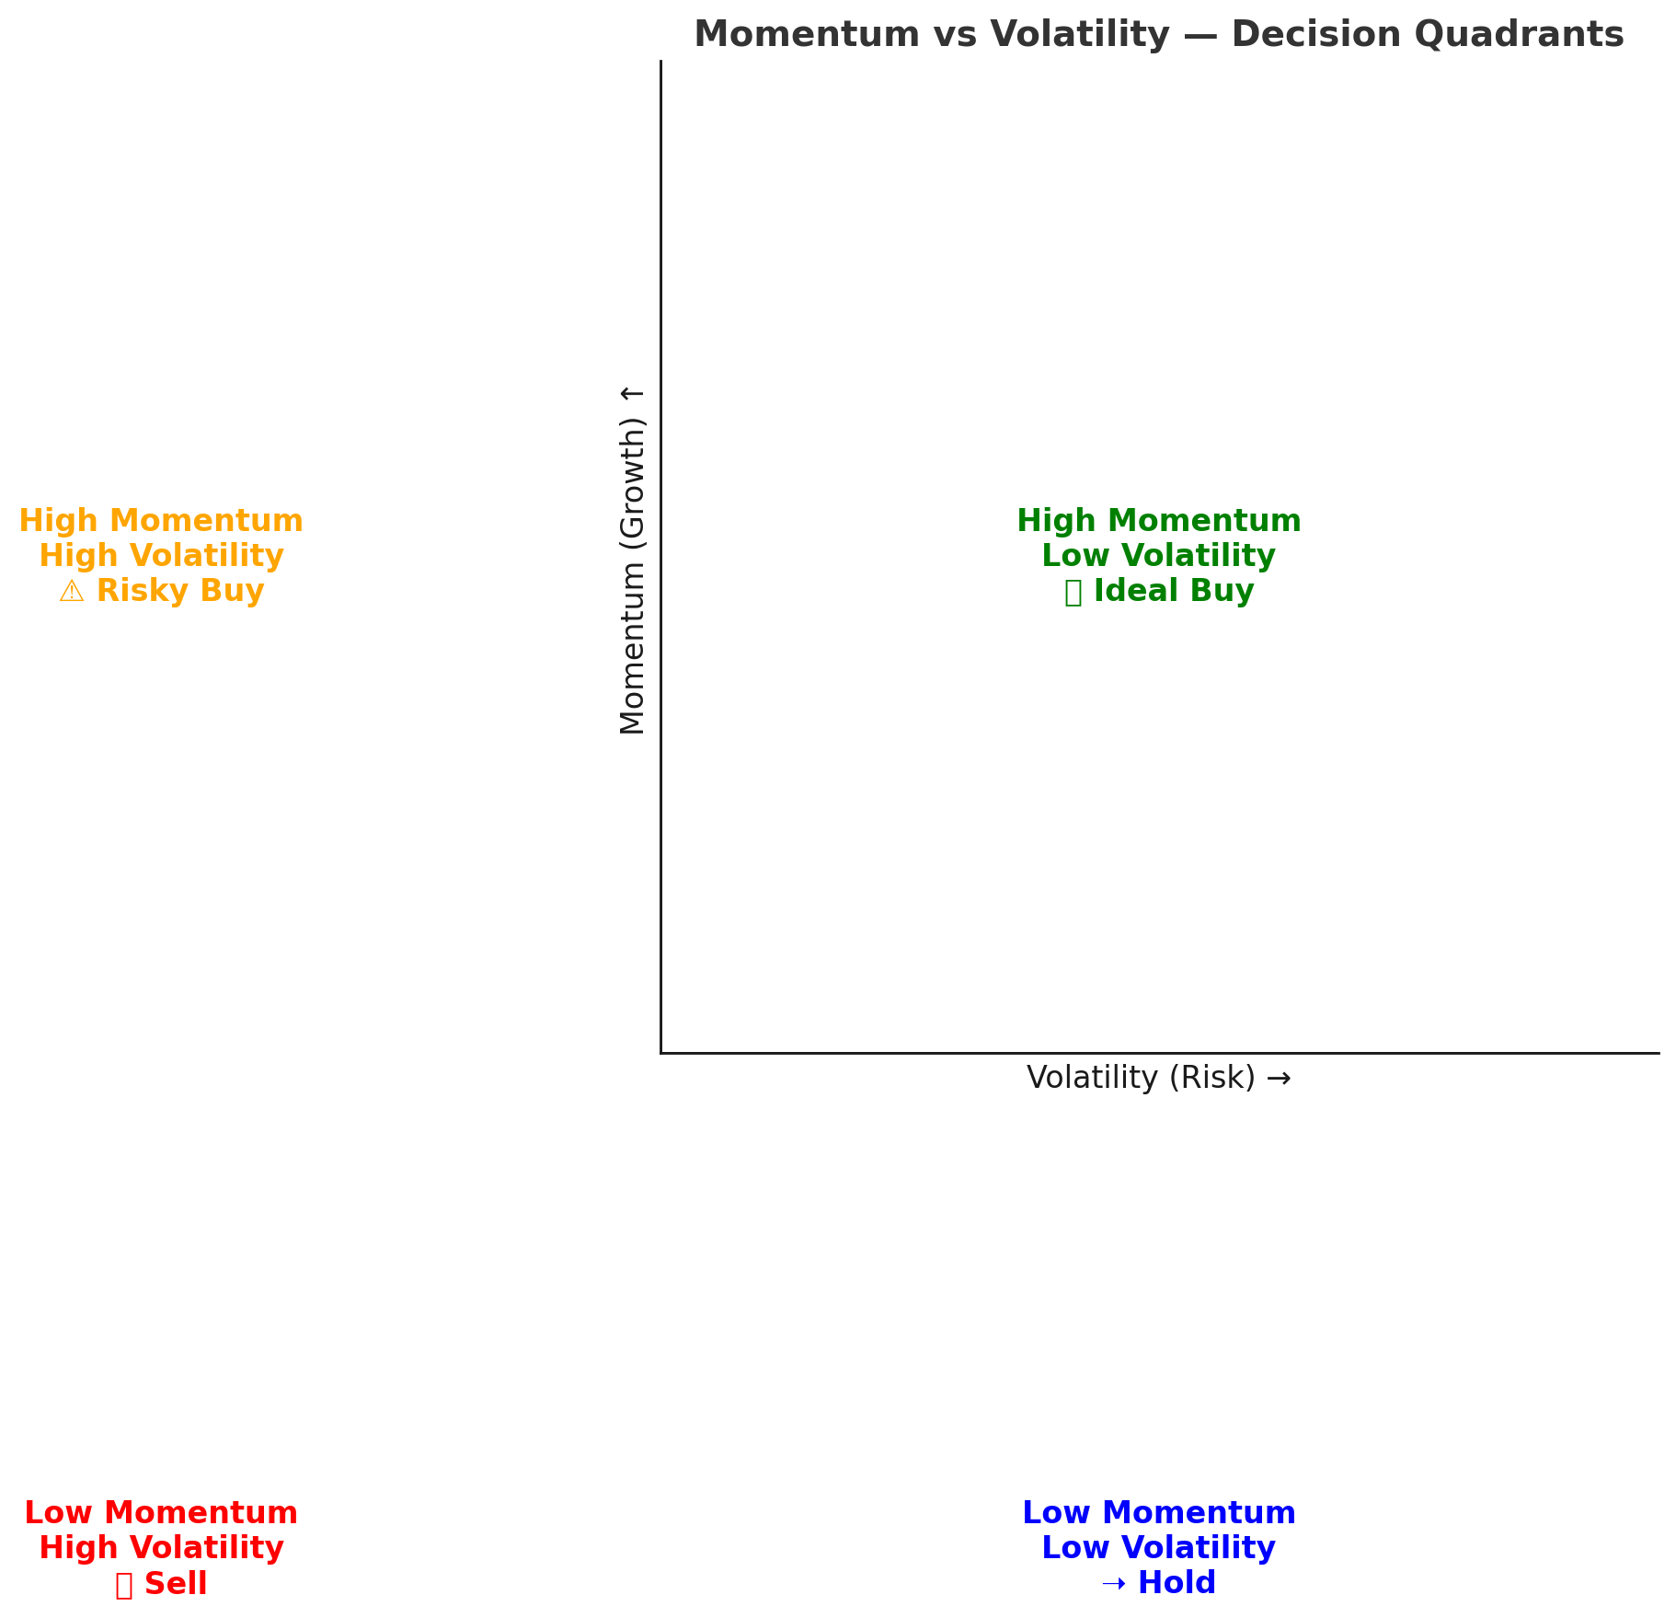
High momentum / low volatility = ideal Buy
High momentum / high volatility = risky Buy
Low momentum / low volatility = Hold
Low momentum / high volatility = Sell
Notes:
⚡
Min Momentum (%)
This is the minimum % growth trend a stock must show (in both short-term and long-term momentum) to be considered a Buy.
Example:
If you set Min Momentum = 5%, only stocks that have grown at least 5% in both short and long lookback windows will qualify as a Buy.
A stock that grew +10% in 3 months and +12% in 6 months ✅ qualifies as Buy.
A stock that grew +2% short-term but +8% long-term ❌ does not qualify — because both must be above 5%.
If you lower it to 2%, you’ll get more Buy candidates, but they may be weaker trends.
👉 Think of it like a performance threshold — higher = stricter.
⚡
Max 60D Volatility (%)
This is the risk filter: how much a stock’s price swings (up and down) over the last 60 trading days (about 3 months).
Example:
If you set Max Volatility = 50%, it allows even very jumpy stocks (big ups and downs) into the Buy list.
If you lower it to 20%, only stable, less risky stocks make it through.
👉 Volatility measures consistency vs rollercoaster.
In short:
Momentum filter = strength of growth (performance).
Volatility filter = stability of that growth (risk).
Playing with these two sliders changes whether your Top 5 Buy list shows fast-moving but risky tech stocks (high momentum, high volatility) or slower but stable dividend payers (lower momentum, low volatility).
High momentum / low volatility = ideal Buy
High momentum / high volatility = risky Buy
Low momentum / low volatility = Hold
Low momentum / high volatility = Sell

Slide 6
Wrap-up & Next Steps
Simplifies stock analysis
Real-world demand → quick clarity
Future: AI agents, news sentiment analysis
Thank you!
Notes:
*“To wrap up:
This is not just data fetching. It’s a full analysis pipeline: data → indicators → rules → rankings → visuals.
It helps investors cut through noise and focus on what matters.
And since it’s modular, I could extend it later with AI-based news sentiment or natural language stock queries.”*

