Slide 1
Ansible - ELK

Slide 2
Ansible - ELK
Reminder
Advancement
Deliverable
Blocking points
GitHub

Slide 3
Topology

Slide 4
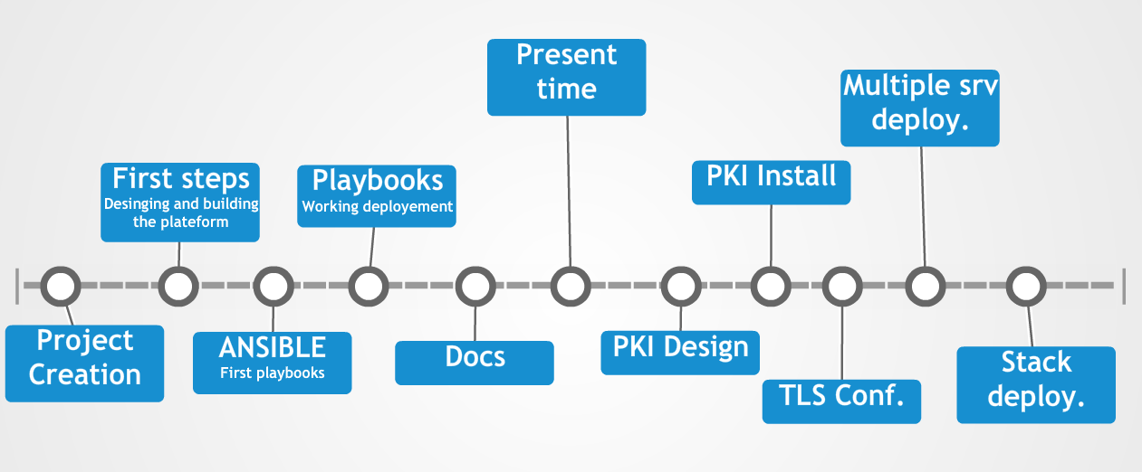
Advancement

Slide 5
Deliverable
Some documentations : Ansible & ELK
Install playbooks
Rsyslog conf files
Logstash groks
Templates exemples (nginx,syslog,apache,…)
Available here https://github.com/Nodulaire/ELK-Ansible

Slide 6
Blocking point
Standardisation of the received logs ( grok )
Sizing of the hardware
Relevant kibana dashboard
PKI Integration

Slide 7
GitHub
Progression is availaible on our GitHub at this link https://github.com/Nodulaire/ELK-Ansible
To get our entire projet simply do :
git clone https://github.com/Nodulaire/ELK-Ansible.git

