Slide 1
Ansible - ELK

Slide 2
Ansible - ELK
Reminder
Advancement
Deliverable
Blocking points
GitHub

Slide 3
Topology

Slide 4
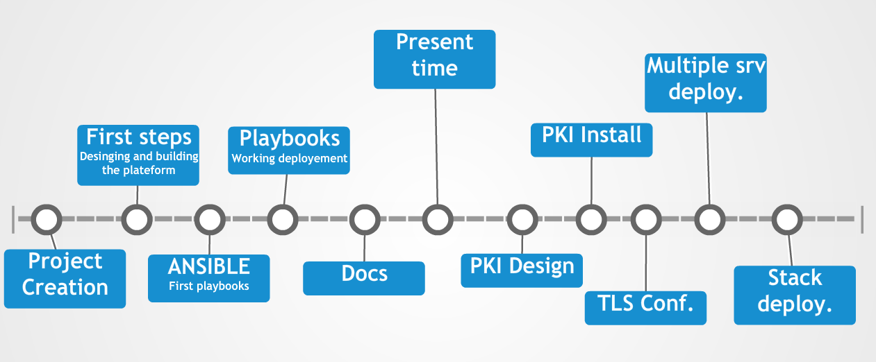
Advancement

Slide 5
Documentation
Documentation/
├── Ansible-Install-v1.md
├── ELK-Stack-Deployment-v1.md
├── Elasticsearch-Info-v1.md
├── Images
│ ├── Ansible
│ │ ├── ansible_deployement_playbook.png
│ │ ├── ansible_logo.png
│ │ ├── ansible_principe_schema
│ │ └── ansible_principe_schema.png
│ ├── Kibana
│ │ ├── Kibana-info-extendedLog.png
│ │ ├── Kibana-info-loading.png
│ │ └── Kibana-info-visualise.png
│ └── Maquette
│ ├── infra-maquette.png
│ ├── infra-maquette.xml
│ └── timeline.png
├── Kibana-Info-v1.md
├── Logstash-Info-v1.md
├── README.md
└── Workflow.md

Slide 6
Deliverable
Some documentations : Ansible & ELK
Install playbooks
Rsyslog conf files
Logstash groks
Templates exemples (nginx,syslog,apache,…)
Available here https://github.com/Nodulaire/ELK-Ansible

Slide 7
Blocking point
Standardisation of the received logs ( grok )
Sizing of the hardware
Relevant kibana dashboard
PKI Integration

Slide 8
GitHub
Progression is availaible on our GitHub at this link https://github.com/Nodulaire/ELK-Ansible
To get our entire projet simply do :
git clone https://github.com/Nodulaire/ELK-Ansible.git

