Slide 1
Transforming Simulation Outcomes for Enhanced Decision-Making Accessibility
Noé Flandre
Research Project Presentation – Friday 17th May
Noé Flandre
Enhancing Simulations Outcomes for Decision-Making
0

Slide 2
Question
How to transform simulation outcomes into clear, unbiased explanations that support decision-making activities among non-experts?
Noé Flandre
Enhancing Simulations Outcomes for Decision-Making
2
Noé Flandre
Enhancing Simulations Outcomes for Decision-Making
1

Slide 3
Organization
1
Understanding the need for Transformation of Simulation Outcomes
2
Methodological Approach for Transformation
3
Evaluation
Noé Flandre
Enhancing Simulations Outcomes for Decision-Making
3
Noé Flandre
Enhancing Simulations Outcomes for Decision-Making
2

Slide 4
Understanding the need for Transformation of Simulation Outcomes
1
Noé Flandre
Enhancing Simulations Outcomes for Decision-Making
4
Noé Flandre
Enhancing Simulations Outcomes for Decision-Making
3

Slide 5
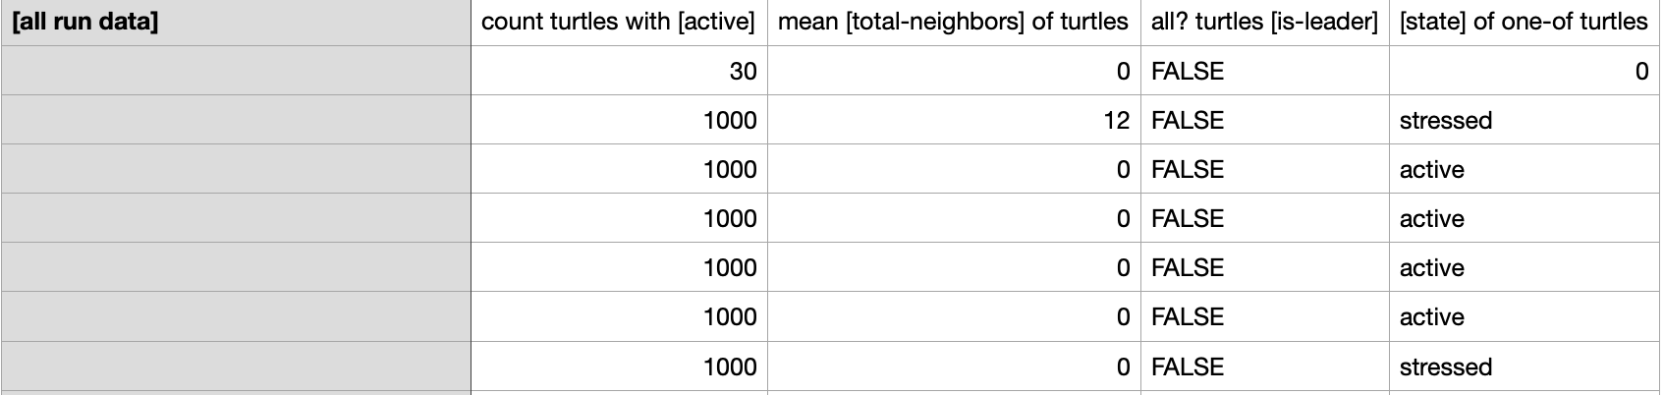

Understanding the need for Transformation of Simulation Outcomes
Noé Flandre
Enhancing Simulations Outcomes for Decision-Making
5
Noé Flandre
Enhancing Simulations Outcomes for Decision-Making
4

Slide 6
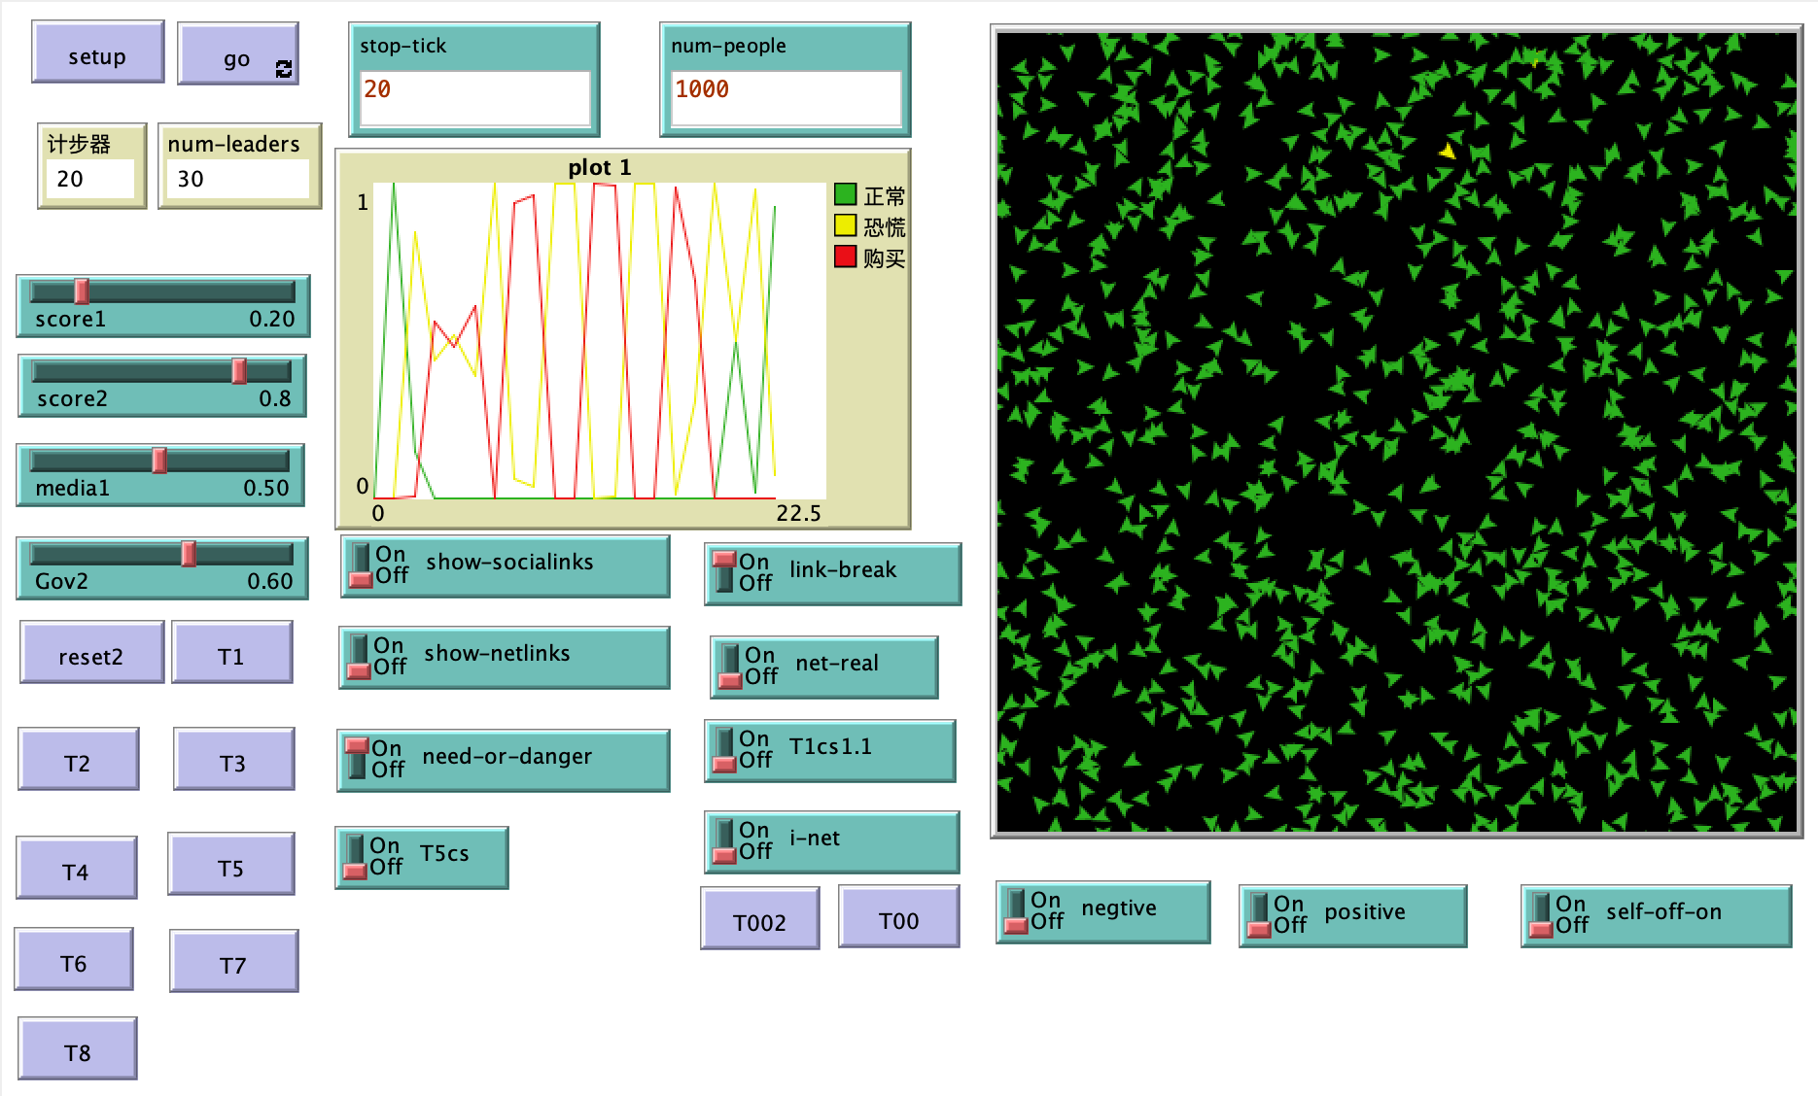
Understanding the need for Transformation of Simulation Outcomes
Noé Flandre
Enhancing Simulations Outcomes for Decision-Making
5

Slide 7
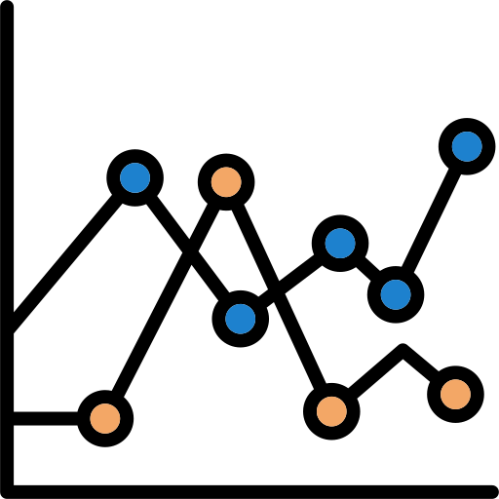
Understanding the need for Transformation of Simulation Outcomes
Classic Plots
Complexity for Non-Experts
Risk of Misinterpretation
Cognitive Overload
Analysis Required
Noé Flandre
Enhancing Simulations Outcomes for Decision-Making
6

Slide 8

Understanding the need for Transformation of Simulation Outcomes
Use of LLMs
Contextual and Clear Explanations
Reduction of Bias and Error
Interaction and Adaptative Learning
Comprehensive Insights
Noé Flandre
Enhancing Simulations Outcomes for Decision-Making
7

Slide 9

Understanding the need for Transformation of Simulation Outcomes
Impact
Improved Policy Decisions
Responsiveness
Broader Participation and Collaboration
Noé Flandre
Enhancing Simulations Outcomes for Decision-Making
8

Slide 10

Questions break
Noé Flandre
Enhancing Simulations Outcomes for Decision-Making
9

Slide 11
Methodological Approach for Transformation
2
Noé Flandre
Enhancing Simulations Outcomes for Decision-Making
10

Slide 12
Methodological Approach for Transformation
1
Data Extraction and Pre-processing
2
Narrative Generation using LLMs
3
Empathy and Relatability
Noé Flandre
Enhancing Simulations Outcomes for Decision-Making
11

Slide 13

Methodological Approach for Transformation
Data Extraction and Pre-processing
Extract key data and parameters
pynetlogo
pandas
Describe data
statsmodels
prophet
Explanations with LLMs
Noé Flandre
Enhancing Simulations Outcomes for Decision-Making
12

Slide 14
Methodological Approach for Transformation
Narrative Integration using LLMs
Documentation
Contextualization
Comments
LLM knowledge
Narrative Interpretation
Noé Flandre
Enhancing Simulations Outcomes for Decision-Making
13

Slide 15
Methodological Approach for Transformation
Empathy and Relatability
Defining user’s persona and scenario
Embedding empathy & insights
Allowing interaction with the LLM (UI : Streamlit)
Noé Flandre
Enhancing Simulations Outcomes for Decision-Making
14

Slide 16
Questions break
Noé Flandre
Enhancing Simulations Outcomes for Decision-Making
15

Slide 17
Evaluation
3
Noé Flandre
Enhancing Simulations Outcomes for Decision-Making
16

Slide 18

Evaluation
Criteria
Accuracy
Bias
Clarity
Relevance
Noé Flandre
Enhancing Simulations Outcomes for Decision-Making
17

Slide 19
Evaluation
Method
1. Qualitative : Lab
2. Quantitative : Automated
Noé Flandre
Enhancing Simulations Outcomes for Decision-Making
18

Slide 20

Evaluation
Qualitative
User Feedback :
- Interviews (clarity, usefulness, bias)
- Surveys (reading ease, flow, grammar)
Likert Scale
Noé Flandre
Enhancing Simulations Outcomes for Decision-Making
19

Slide 21

Evaluation
Quantitative
Models
Comparing LLMs Models : Prometheus 2 (Pairwise ranking)
Noé Flandre
Enhancing Simulations Outcomes for Decision-Making
20

Slide 22
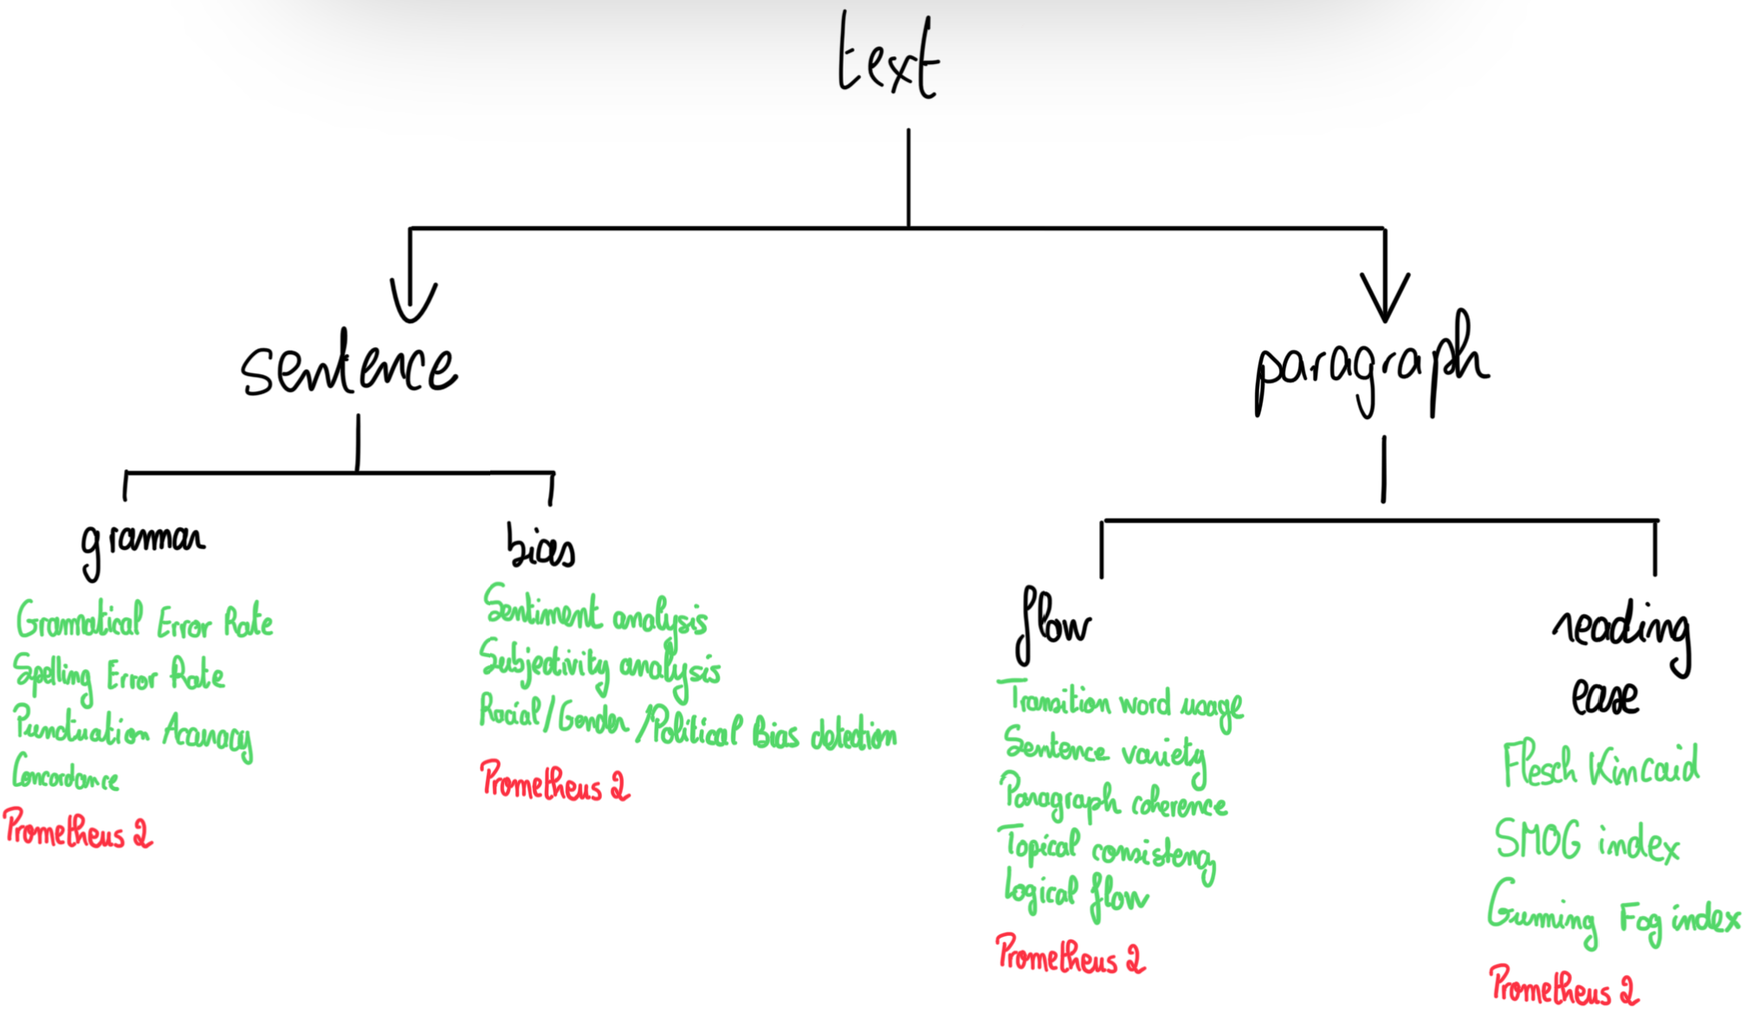
Evaluation
Quantitative
Noé Flandre
Enhancing Simulations Outcomes for Decision-Making
21

Slide 23
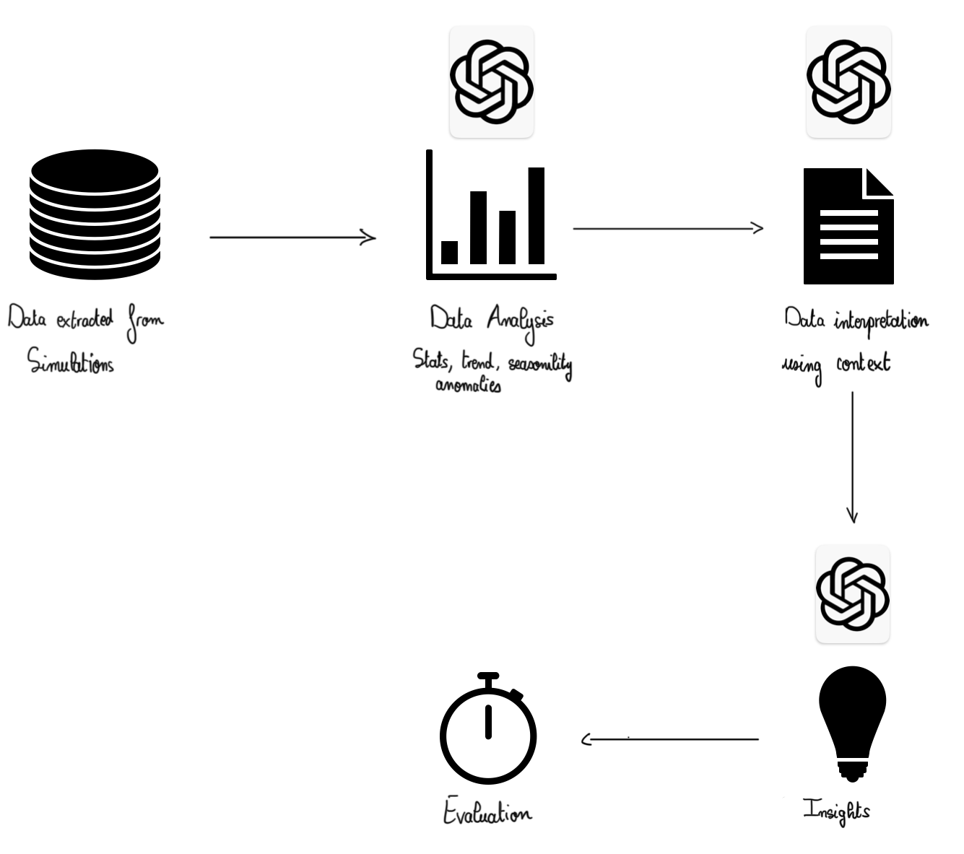
Evaluation
Quantitative
Noé Flandre
Enhancing Simulations Outcomes for Decision-Making
22

Slide 24
Thank you for listening!
Noé Flandre
Enhancing Simulations Outcomes for Decision-Making
23

