Slide 1
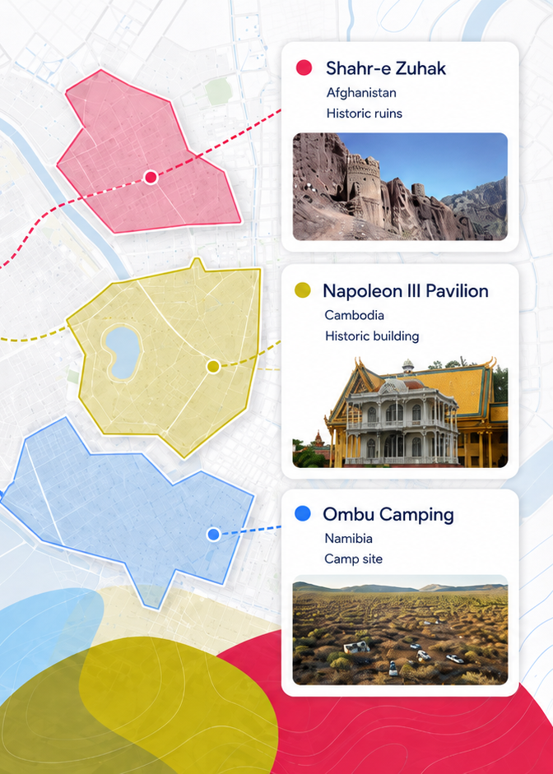
RESEARCH DATASET · OSM + GEOSPATIAL MEDIA
OSM polygons
with image references
A reproducible GeoParquet dataset of OpenStreetMap polygons carrying image references. Image bytes are not downloaded; each asset row keeps the source value, resolved URLs when available, and lookup status.
Noé Flandre · August 2026
Notes:
[Sources]
Project overview: https://github.com/NoeFlandre/osm-polygon-image-tag
Project asset: src/osm_polygon_image_tag/_data/hero.png
Visual conventions consulted read-only: https://github.com/NoeFlandre/slides-colloquium/blob/main/slides/talk.md

Slide 2
THE RESEARCH QUESTION
The dataset keeps the place with its image references
An image tag is useful only when its OSM object, source value, and lookup result remain visible.
333,733
1.91M
95.1%
Current snapshot
Snapshot: 8 Aug 2026, 07:23 CEST. Counts grow as finalized shards are published.
polygon observations
image-reference rows
asset rows with direct URLs
The place stays attached
The lookup result stays visible
Every asset row joins back to an OSM way or relation and its source PBF.
Direct image, page-only, and failure statuses are recorded instead of guessed away.
OSM POLYGON IMAGE TAG · RESEARCH OVERVIEW
2/8
Notes:
[Sources]
Current local snapshot: /Volumes/Seagate M3/projects/osm-polygon-image-tag/statistics/dataset-statistics.json (observed 2026-08-08 07:23 CEST).
Project README: https://github.com/NoeFlandre/osm-polygon-image-tag/blob/main/README.md
Data contract: https://github.com/NoeFlandre/osm-polygon-image-tag/blob/main/docs/data-contract.md

Slide 3
THE DESIGN CHOICE
Preserve raw OSM context.
Resolve references separately.
That separation keeps extraction, resolution, and publication auditable.
Notes:
[Sources]
Narrative structure follows the one-idea-per-slide and section-break conventions in the read-only reference repository: https://github.com/NoeFlandre/slides-colloquium/blob/main/slides/talk.md
Project architecture: https://github.com/NoeFlandre/osm-polygon-image-tag/blob/main/docs/architecture.md

Slide 4
EXTRACTION
We only keep polygonal OSM objects with image tags
The source PBFs are read-only; each finalized source file becomes one deterministic GeoParquet shard.
01
02
03
04
Read-only PBFs
Filter geometry
Select tags
Write shards
Geofabrik
source tree
closed ways +
relations
image, Commons,
Mapillary, Panoramax…
GeoParquet +
manifest
Selected reference families
image · wikimedia_commons · mapillary · panoramax · kartaview · flickr · bubbleid (Bing Streetside)
OSM POLYGON IMAGE TAG · RESEARCH OVERVIEW
4/8
Notes:
[Sources]
Data contract: https://github.com/NoeFlandre/osm-polygon-image-tag/blob/main/docs/data-contract.md
The source PBF tree is read-only; extraction and tag selection are implemented under ingest/.

Slide 5
DATA MODEL
The two tables answer different questions
One describes the OSM object. The other describes each image reference found on it.
polygons
image_assets
geometry
Polygon or MultiPolygon
source_tag_key/value
exact value + provider
tags
every original OSM tag
page_url / image_url
thumbnail when available
area_m2
geodesic area + bbox_*
status + reason
outcome recorded per row
source_pbf
stable input provenance
join key
OSM identity + source PBF
join
OSM POLYGON IMAGE TAG · RESEARCH OVERVIEW
5/8
Notes:
[Sources]
Data contract: https://github.com/NoeFlandre/osm-polygon-image-tag/blob/main/docs/data-contract.md
The polygon and asset configurations are published as separate GeoParquet datasets and joined on OSM identity plus source_pbf.

Slide 6
RESOLUTION AND OPERATIONS
A failed lookup is recorded, not hidden
A direct URL is a result, not an assumption; credentials and temporary failures remain visible in the data.
direct image
page only
explicit failure
resolved
resolved_page_only
status + reason
Resume without starting over
Publish verified artifacts
Stable rows are reused; temporary failures and expiring or credential-improvable URLs are revisited.
Verified shards, metadata, map, and hero asset are uploaded; a local receipt records the commit.
OSM POLYGON IMAGE TAG · RESEARCH OVERVIEW
6/8
Notes:
[Sources]
Data contract: https://github.com/NoeFlandre/osm-polygon-image-tag/blob/main/docs/data-contract.md
Operations: https://github.com/NoeFlandre/osm-polygon-image-tag/blob/main/docs/operations.md
Architecture: https://github.com/NoeFlandre/osm-polygon-image-tag/blob/main/docs/architecture.md

Slide 7
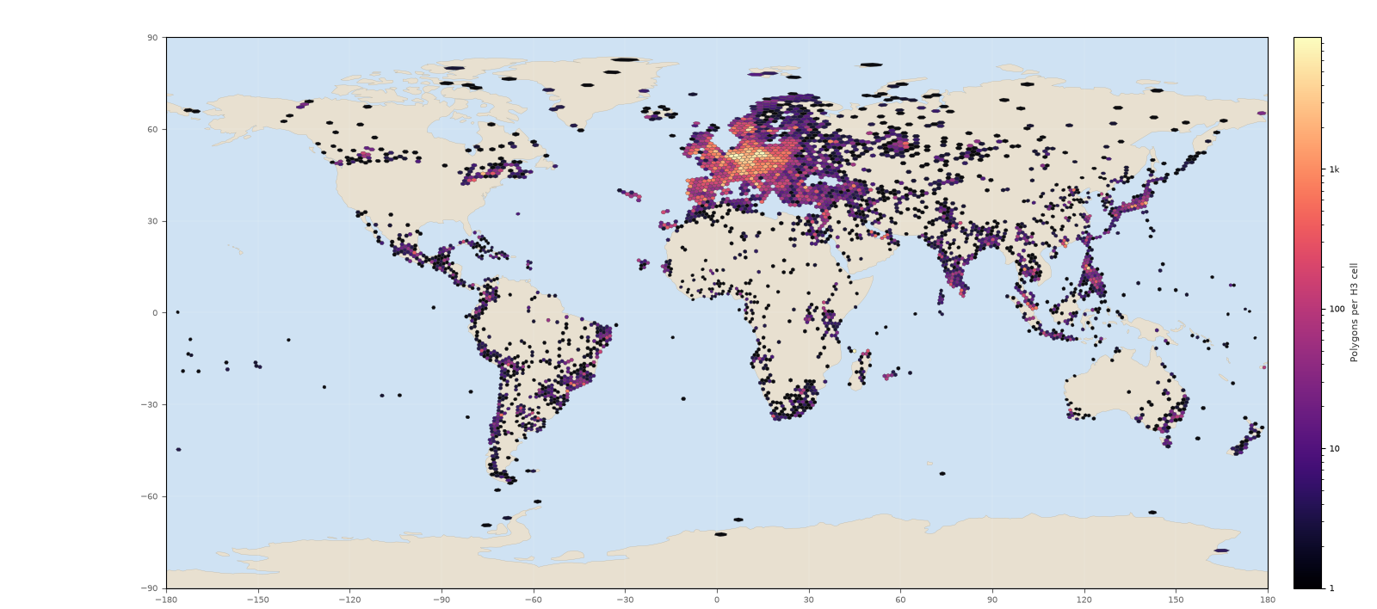
GEOGRAPHIC COVERAGE
Where are these polygons?
The dataset card renders a deterministic H3 density map from finalized polygon shards only.
3,352
H3 cells
with observations
Resolution 3 · logarithmic magma scale · each polygon row counted once by geometry centroid
OSM POLYGON IMAGE TAG · RESEARCH OVERVIEW
7/8
Notes:
[Sources]
Map artifact: /Volumes/Seagate M3/projects/osm-polygon-image-tag/assets/geographic_polygon_density.png (read-only snapshot observed 2026-08-08 07:23 CEST).
Geography contract: https://github.com/NoeFlandre/osm-polygon-image-tag/blob/main/docs/data-contract.md#geographic-coverage-map
The map is generated from finalized polygon GeoParquet shards; image_assets rows are not separately counted.

Slide 8
TAKEAWAY
What the dataset gives you
Versioned contracts, finalized manifests, checkpoints, and deterministic statistics make rebuilds repeatable; Hugging Face distributes verified artifacts.
01
Context
Closed OSM ways and relations stay linked to full tags, geometry, area, and source provenance.
02
Resolution
Provider-specific identifiers become direct or page URLs when the provider gives enough evidence.
03
Reproducibility
Versioned shards, checkpoints, deterministic statistics, and Hugging Face publication make the build repeatable.
OpenStreetMap data © contributors · ODbL 1.0 · github.com/NoeFlandre/osm-polygon-image-tag · HF dataset
OSM POLYGON IMAGE TAG · RESEARCH OVERVIEW
8/8
Notes:
[Sources]
Project README: https://github.com/NoeFlandre/osm-polygon-image-tag/blob/main/README.md
Dataset: https://huggingface.co/datasets/NoeFlandre/osm-polygon-image-tag

