Slide 1

STABL with nonlinear models

Slide 2
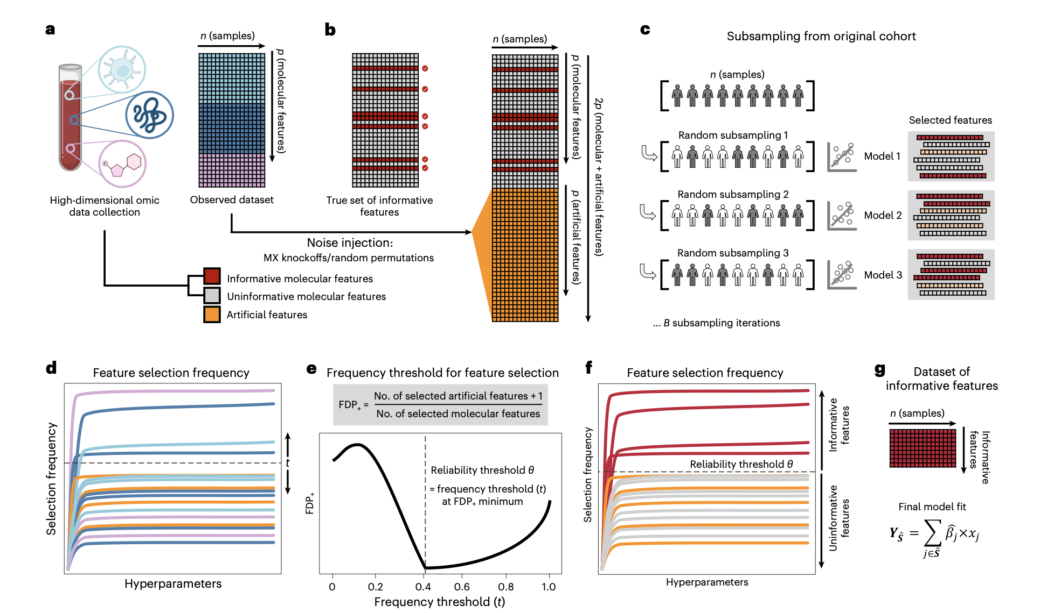
STABL’s current pipeline
Presence of linear models
The feature selection :
For each hyperparameter setting of the linear base models (Lasso, Elastic Net, ALasso), STABL selects a small, stable subset of features (via bootstraps + artificial features, FDR control).
The use of linear models with L1 gives a very sparse set of features but adapted to linear datasets.
The fitting part :
After selection, we refit a linear or logistic regression on the selected features.
This is effective on linear problems… but what if the data are non-linear or interaction-driven?

Slide 3
STABL’s feature selection
Linear models in STABL
dataset
N bootstraps with 50% of the samples

Slide 4
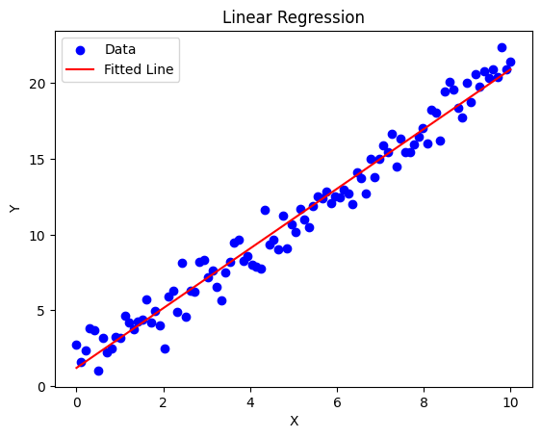
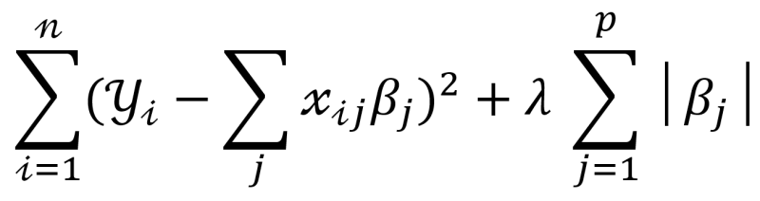
STABL’s feature selection
Linear models in STABL
dataset
N bootstraps with 50% of the samples
Fitting a linear model for each bootstrap

Slide 5
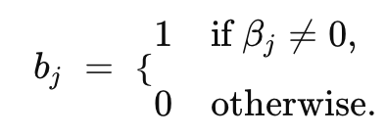
STABL’s feature selection
Linear models in STABL
dataset
N bootstraps with 50% of the samples
Fitting a linear model for each bootstrap
Binarizing the linear coefficients

Slide 6
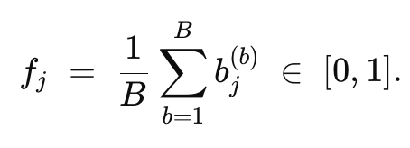
STABL’s feature selection
Linear models in STABL
dataset
N bootstraps with 50% of the samples
Fitting a linear model for each bootstrap
Binarizing the linear coefficients
Frequency of the features across N bootstraps

Slide 7
STABL’s feature selection
Linear models in STABL
dataset
N bootstraps with 50% of the samples
Fitting a linear model for each bootstrap
Binarizing the linear coefficients
Frequency of the features across N bootstraps
Plotting FDR and Stability path graphs

Slide 8
STABL’s feature selection
Linear models in STABL
dataset
N bootstraps with 50% of the samples
Fitting a linear model for each bootstrap
Binarizing the linear coefficients
Frequency of the features across N bootstraps
Plotting FDR and Stability path graphs
Tree models in STABL
dataset
N bootstraps with 50% of the samples

Slide 9
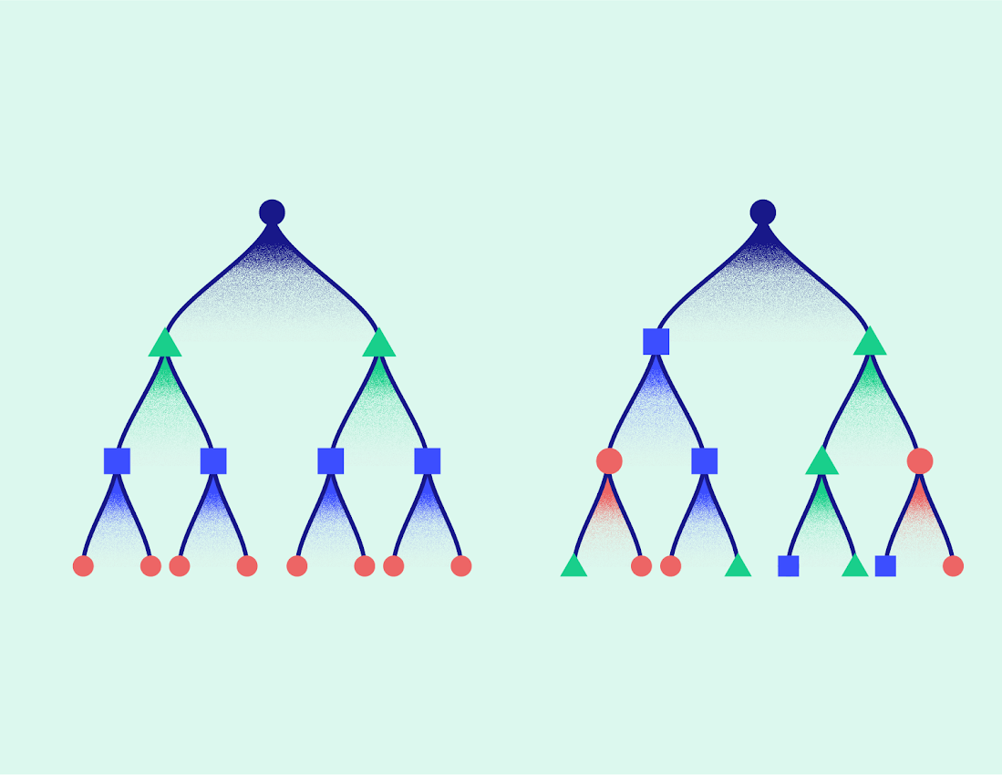
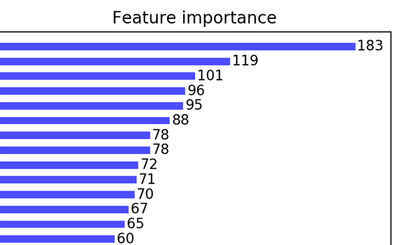
STABL’s feature selection
Linear models in STABL
dataset
N bootstraps with 50% of the samples
Fitting a linear model for each bootstrap
Binarizing the linear coefficients
Frequency of the features across N bootstraps
Plotting FDR and Stability path graphs
Tree models in STABL
dataset
N bootstraps with 50% of the samples
Fitting a tree model for each bootstrap and recover feature importance

Slide 10
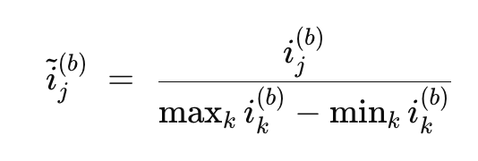
STABL’s feature selection
Linear models in STABL
dataset
N bootstraps with 50% of the samples
Fitting a linear model for each bootstrap
Binarizing the linear coefficients
Frequency of the features across N bootstraps
Plotting FDR and Stability path graphs
Tree models in STABL
dataset
N bootstraps with 50% of the samples
Fitting a tree model for each bootstrap and recover feature importance
Normalizing the feature importance (instead of binarizing it)

Slide 11
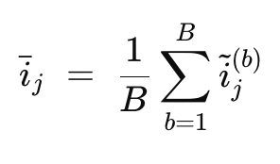
STABL’s feature selection
Linear models in STABL
dataset
N bootstraps with 50% of the samples
Fitting a linear model for each bootstrap
Binarizing the linear coefficients
Frequency of the features across N bootstraps
Plotting FDR and Stability path graphs
Tree models in STABL
dataset
N bootstraps with 50% of the samples
Fitting a tree model for each bootstrap and recover feature importance
Normalizing the feature importance (instead of binarizing it)
Average of the feature importance across N bootstraps

Slide 12
STABL’s feature selection
Linear models in STABL
dataset
N bootstraps with 50% of the samples
Fitting a linear model for each bootstrap
Binarizing the linear coefficients
Frequency of the features across N bootstraps
Plotting FDR and Stability path graphs
Tree models in STABL
dataset
N bootstraps with 50% of the samples
Fitting a tree model for each bootstrap and recover feature importance
Normalizing the feature importance (instead of binarizing it)
Average of the feature importance across N bootstraps
Plotting FDR and Stability path graphs
d₁
d₁
d₁
d₂
d₃
d₂
d₃
d₂
d₃
Reg = 0
Reg = 0.5
Reg = 1

Slide 13
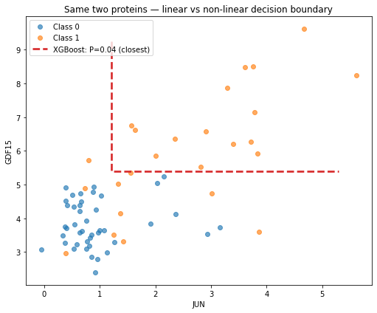
STABL XGBoost
Why STABL XGBoost
Linear STABL = stable & sparse, great if signal is linear/monotonic.
Many problems show thresholds, saturations, interactions (X₁×X₂). Linear models are not complex enough.
XGBoost as base model ⇒ captures non-linearities within STABL.

Slide 14
STABL XGBoost
Why STABL XGBoost
XGBoost’s feature importance
Linear STABL = stable & sparse, great if signal is linear/monotonic.
Many problems show thresholds, saturations, interactions (X₁×X₂). Linear models are not complex enough.
XGBoost as base model ⇒ captures non-linearities within STABL.
Importance method | Nb of features
Cover (fluctuate with split coverage) | 18
Gain (fast, stable across bootstraps) | 8
Shap (longer but often the most relevant) | 8
Total_cover (fluctuate with depth) | 9
Total_gain (adds little beyond gain) | 6
Weight (fluctuate with split counts) | 10

Slide 15

STABL XGBoost
Why STABL XGBoost
XGBoost’s feature importance
Linear STABL = stable & sparse, great if signal is linear/monotonic.
Many problems show thresholds, saturations, interactions (X₁×X₂). Linear models are not complex enough.
XGBoost as base model ⇒ captures non-linearities within STABL.
Importance method | Nb of features
Cover (fluctuate with split coverage) | 18
Gain (fast, stable across bootstraps) | 8
Shap (longer but often the most relevant) | 8
Total_cover (fluctuate with depth) | 9
Total_gain (adds little beyond gain) | 6
Weight (fluctuate with split counts) | 10
The normalisation (arbitrary)
Importance magnitudes vary across bootstraps/feature importance metric.
Per-bootstrap normalisation :
$$\frac{feat_imp}{\max\left(feat imp\right)−min⁡(feat imp)}$$
STABL picks t* with FDR

Slide 16
STABL XGBoost
Why STABL XGBoost
XGBoost’s feature importance
Linear STABL = stable & sparse, great if signal is linear/monotonic.
Many problems show thresholds, saturations, interactions (X₁×X₂). Linear models are not complex enough.
XGBoost as base model ⇒ captures non-linearities within STABL.
Importance method | Nb of features
Cover (fluctuate with split coverage) | 18
Gain (fast, stable across bootstraps) | 8
Shap (longer but often the most relevant) | 8
Total_cover (fluctuate with depth) | 9
Total_gain (adds little beyond gain) | 6
Weight (fluctuate with split counts) | 10
The normalisation (arbitrary)
STABL XGBoost: hyperparameters and fitting
Importance magnitudes vary across bootstraps/feature importance metric.
Per-bootstrap normalisation :
$$\frac{feat_imp}{\max\left(feat imp\right)−min⁡(feat imp)}$$
STABL picks t* with FDR
Importance for selection: all 6 of them (in parallel).
STABL bootstraps: B =1000
Base estimator : XGB (selection grid): max_depth ∈ {3, 6, 9}, reg_alpha ∈ {0, 0.5, 1, 2, 5} (L1 sparsity/stability), seed=42.
Final refit on selected features: XGBClassifier (typically n_estimators 200–800, learning_rate 0.01–0.1, subsample ≈0.6, colsample_bytree ≈0.5, seed=42).

Slide 17
Performances

Slide 18
Performances on Onset of Labor CyTOF + Proteomics (Regression dataset)
Feature selection part
STABL Models | Nb of features (median across 100 folds) [25%, 75%] | Number of unique features across the 100 folds
STABL Lasso | 17 [13, 23.25] | 176
STABL ALasso | 19 [13, 22.25] | 186
STABL ElasticNet | 48 [34.75, 84.5] | 499
Previous performances (with Linear Regression for the fitting part)
STABL Models | R² (average) | RMSE (average) | MAE (average)
STABL Lasso + Linereg | 0.735 | 16.544 | 12.001
STABL Alasso + Linereg | 0.726 | 16.826 | 12.031
STABL ElasticNet + Linereg | 0.679 | 18.209 | 13.347

Slide 19
Performances on Onset of Labor CyTOF + Proteomics (Regression dataset)
Feature selection part
Results with basic XGBoost for the fitting part
Best STABL Linear :
STABL ElasticNet
STABL Models | Nb of features (median across 100 folds) [25%, 75%] | Number of unique features across the 100 folds
STABL Lasso | 17 [13, 23.25] | 176
STABL ALasso | 19 [13, 22.25] | 186
STABL ElasticNet | 48 [34.75, 84.5] | 499
Previous performances (with Linear Regression for the fitting part)
STABL Models | R² (average) | RMSE (average) | MAE (average)
STABL Lasso + Linereg | 0.735 | 16.544 | 12.001
STABL Alasso + Linereg | 0.726 | 16.826 | 12.031
STABL ElasticNet + Linereg | 0.679 | 18.209 | 13.347

Slide 20
Performances on Onset of Labor CyTOF + Proteomics (Regression dataset)
Feature selection part
Results with basic XGBoost for the fitting part
Best STABL Linear :
STABL ElasticNet
STABL XGBoost
STABL Models | Nb of features (median across 100 folds) [25%, 75%] | Number of unique features across the 100 folds
STABL Lasso | 17 [13, 23.25] | 176
STABL ALasso | 19 [13, 22.25] | 186
STABL ElasticNet | 48 [34.75, 84.5] | 499
STABL XGBoost | 8 [7, 9] | 25
Previous performances (with Linear Regression for the fitting part)
STABL Models | R² (average) | RMSE (average) | MAE (average)
STABL Lasso + Linereg | 0.735 | 16.544 | 12.001
STABL Alasso + Linereg | 0.726 | 16.826 | 12.031
STABL ElasticNet + Linereg | 0.679 | 18.209 | 13.347

Slide 21
Performances on COVID-19 (Classification dataset) (training cohort for now)
Feature selection part
STABL Models | Nb of features (median across 100 folds) [25%, 75%] | Number of unique features across the 100 folds
STABL Lasso | 9 [4, 17] | 25
STABL ALasso | 6 [3, 11] | 31
Previous performances (with Logistic Regression for the fitting part)
STABL Models | AUROC (average) | Precision (average)
STABL Lasso + Logit | 0.85 | 0.80
STABL Alasso + Logit | 0.76 | 0.72

Slide 22
Performances on COVID-19 (Classification dataset) (training cohort for now)
Feature selection part
Results with basic XGBoost for the fitting part
Best STABL Linear :
STABL Lasso
STABL Models | Nb of features (median across 100 folds) [25%, 75%] | Number of unique features across the 100 folds
STABL Lasso | 9 [4, 17] | 25
STABL ALasso | 6 [3, 11] | 31
AUROC = 0.830 [0.712, 0.929]
AUPRC = 0.74 [0.54, 0.90]
Previous performances (with Logistic Regression for the fitting part)
STABL Models | AUROC (average) | Precision (average)
STABL Lasso + Logit | 0.85 | 0.80
STABL Alasso + Logit | 0.76 | 0.72

Slide 23
Performances on COVID-19 (Classification dataset) (training cohort for now)
Feature selection part
Results with basic XGBoost for the fitting part
Best STABL Linear :
STABL Lasso
STABL XGBoost
STABL Models | Nb of features (median across 100 folds) [25%, 75%] | Number of unique features across the 100 folds
STABL Lasso | 9 [4, 17] | 25
STABL ALasso | 6 [3, 11] | 31
STABL XGBoost | 2 [2, 3] | 5
AUROC = 0.830 [0.712, 0.929]
AUPRC = 0.74 [0.54, 0.90]
Previous performances (with Logistic Regression for the fitting part)
STABL Models | AUROC (average) | Precision (average)
STABL Lasso + Logit | 0.85 | 0.80
STABL Alasso + Logit | 0.76 | 0.72
AUROC = 0.891 [0.808, 0.958]
AUPRC = 0.82 [0.65, 0.95]

Slide 24
Performances on CFRNA (Classification dataset)
Feature selection part
STABL Models | Nb of features (median across 100 folds) [25%, 75%] | Number of unique features across the 100 folds
STABL Lasso | 12 [8, 16] | 80
STABL ALasso | 6 [4, 11] | 161
Previous performances (with Linear Regression for the fitting part)
STABL Models | AUROC (average) | Precision (average)
STABL Lasso + Logit | 0.83 | 0.87
STABL Alasso + Logit | 0.80 | 0.82
STABL ElasticNet + Logit | 0.82 | 0.86

Slide 25
Performances on CFRNA (Classification dataset)
Feature selection part
Results with basic XGBoost for the fitting part
Best STABL Linear :
STABL Lasso
STABL Models | Nb of features (median across 100 folds) [25%, 75%] | Number of unique features across the 100 folds
STABL Lasso | 12 [8, 16] | 80
STABL ALasso | 6 [4, 11] | 161
AUROC = 0.847 [0.787, 0.898]
AUPRC = 0.90 [0.85, 0.94]
Previous performances (with Linear Regression for the fitting part)
STABL Models | AUROC (average) | Precision (average)
STABL Lasso + Logit | 0.83 | 0.87
STABL Alasso + Logit | 0.80 | 0.82
STABL ElasticNet + Logit | 0.82 | 0.86

Slide 26
Performances on CFRNA (Classification dataset)
Feature selection part
Results with basic XGBoost for the fitting part
Best STABL Linear :
STABL Lasso
STABL XGBoost
STABL Models | Nb of features (median across 100 folds) [25%, 75%] | Number of unique features across the 100 folds
STABL Lasso | 12 [8, 16] | 80
STABL ALasso | 6 [4, 11] | 161
STABL XGBoost | 7 [6, 8] | 30
AUROC = 0.847 [0.787, 0.898]
AUPRC = 0.90 [0.85, 0.94]
Previous performances (with Linear Regression for the fitting part)
STABL Models | AUROC (average) | Precision (average)
STABL Lasso + Logit | 0.83 | 0.87
STABL Alasso + Logit | 0.80 | 0.82
STABL ElasticNet + Logit | 0.82 | 0.86
AUROC = 0.871 [0.818, 0.922]
AUPRC = 0.92 [0.88, 0.95]

Slide 27
Performances on BioBank SSI (Classification dataset)
Feature selection part
STABL Models | Nb of features (median across 100 folds) [25%, 75%] | Number of unique features across the 100 folds
STABL Lasso | 37 [28, 46] | 296
STABL ALasso | 39 [30, 49] | 314
STABL ElasticNet | 150 [81, 262] | 1208
Previous performances (with Linear Regression for the fitting part)
STABL Models | AUROC (average) | Precision (average)
STABL Lasso + Logit | 0.82 | 0.51
STABL Alasso + Logit | 0.80 | 0.47
STABL ElasticNet + Logit | 0.78 | 0.43

Slide 28
Performances on BioBank SSI (Classification dataset)
Feature selection part
Results with basic XGBoost for the fitting part
Best STABL Linear :
STABL Lasso
STABL Models | Nb of features (median across 100 folds) [25%, 75%] | Number of unique features across the 100 folds
STABL Lasso | 37 [28, 46] | 296
STABL ALasso | 39 [30, 49] | 314
STABL ElasticNet | 150 [81, 262] | 1208
AUROC = 0.806 [0.680, 0.896]
AUPRC = 0.46 [0.24, 0.70]
Previous performances (with Linear Regression for the fitting part)
STABL Models | AUROC (average) | Precision (average)
STABL Lasso + Logit | 0.82 | 0.51
STABL Alasso + Logit | 0.80 | 0.47
STABL ElasticNet + Logit | 0.78 | 0.43

Slide 29
Performances on BioBank SSI (Classification dataset)
Feature selection part
Results with basic XGBoost for the fitting part
Best STABL Linear :
STABL Lasso
STABL XGBoost
STABL Models | Nb of features (median across 100 folds) [25%, 75%] | Number of unique features across the 100 folds
STABL Lasso | 37 [28, 46] | 296
STABL ALasso | 39 [30, 49] | 314
STABL ElasticNet | 150 [81, 262] | 1208
STABL XGBoost | 9 [7, 11] | 112
AUROC = 0.806 [0.680, 0.896]
AUPRC = 0.46 [0.24, 0.70]
Previous performances (with Linear Regression for the fitting part)
STABL Models | AUROC (average) | Precision (average)
STABL Lasso + Logit | 0.82 | 0.51
STABL Alasso + Logit | 0.80 | 0.47
STABL ElasticNet + Logit | 0.78 | 0.43
AUROC = 0.828 [0.715, 0.917]
AUPRC = 0.51 [0.26, 0.73]

Slide 30
Relevance of features selected

Slide 31
Comparing feature sets selected by STABL XGB and STABL ALasso
Onset of Labor
STABL XGBoost
STABL ALasso
Feature | Folds_XGB (25 folds) | folds_Alasso (25 folds)
Feature | Folds_XGB (25 folds) | folds_Alasso (25 folds)
Feature | Folds_XGB (25 folds) | folds_Alasso (25 folds)
mDCs_STAT1_IFNa | 19 | 0
pDCs_STAT1_IFNa | 17 | 0
CD4posTnaive_STAT3_unstim | 14 | 0
Cystatin.C | 12 | 1
Siglec.6 | 25 | 25
IL.1.R4 | 24 | 24
NK_STAT1_IFNa | 23 | 24
Activin.A | 21 | 25
Angiopoietin.2 | 0 | 25
Granulocytes | 0 | 22
CD69negCD56loCD16negNK_STAT1_IFNa | 1 | 24
SLPI | 0 | 21

Slide 32
Appendix

Slide 33
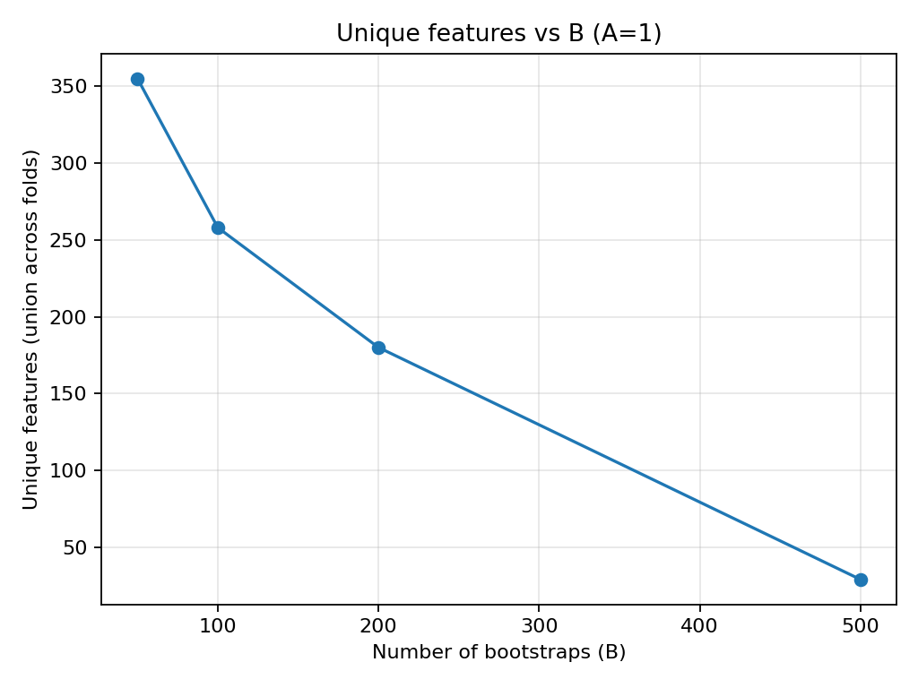
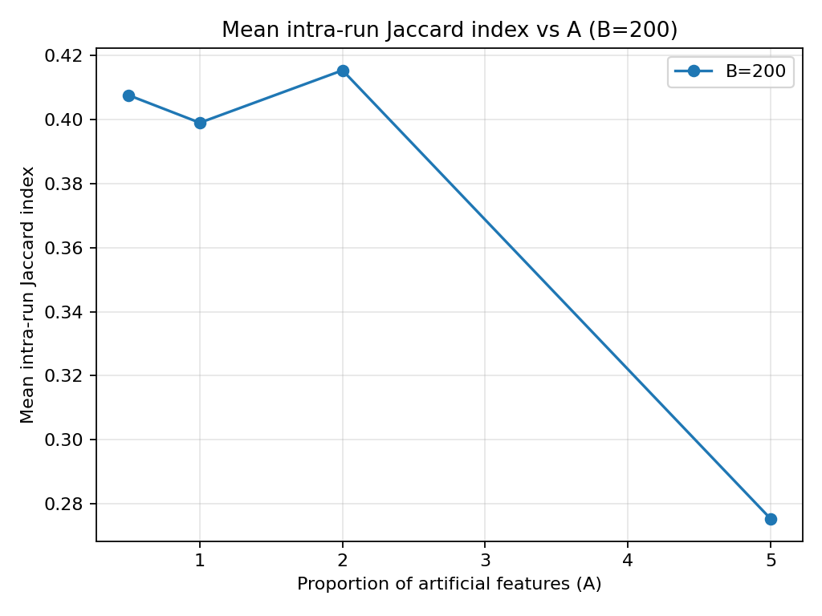
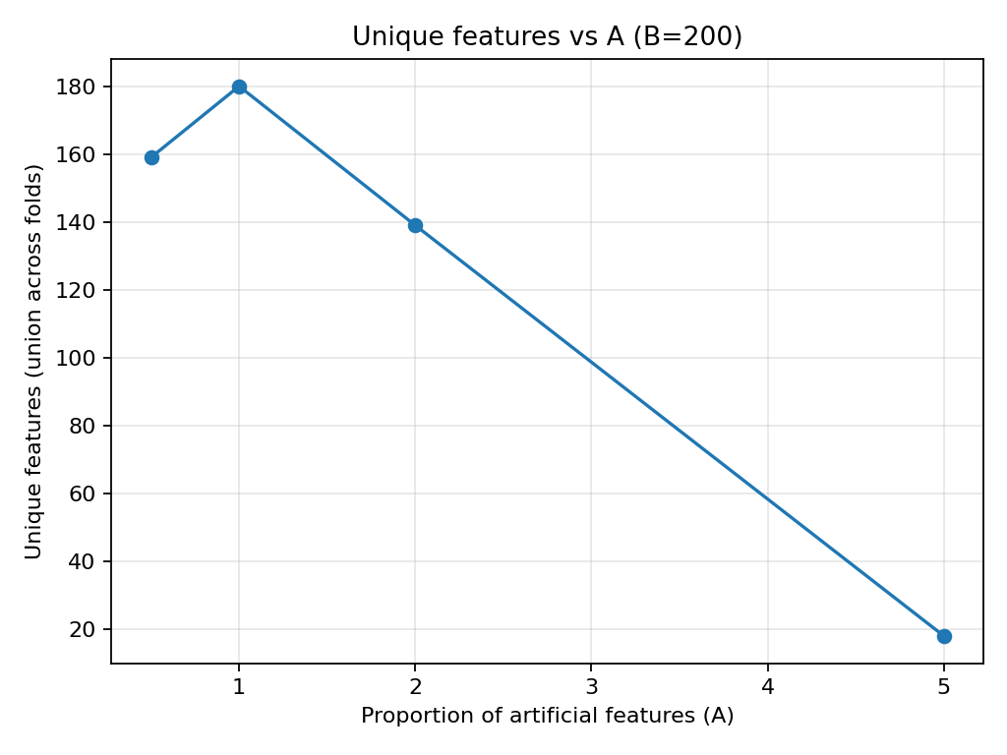
Impact of number of bootstraps, artificial features proportion, FDR threshold (OOL)
Impact of the number of bootstraps
Jaccard Index across the different experiments
Impact of the artificial features proportion
Performances for FDR Threshold starts at 0.1 vs 0.01
STABL Models | Metrics for FDR : 0.1 | Metrics for FDR : 0.01
STABL XGBoost | Features : 8 [7, 9] Unique features : 25 R² : 0.779 | Features : 8 [7,9] Unique features : 29 R² : 0.778

Slide 34
Impact of normalization on STABL Linear: OOL
Feature selection (normalization)
Results comparison (normalization /binarization)
Best STABL Linear
(binarization) :
STABL ElasticNet
Best STABL Linear
(normalization) :
STABL ElasticNet
STABL Models | Nb of features (median across 100 folds) [25%, 75%] | Number of unique features across the 100 folds | R²
STABL Lasso | 14 [11, 16] | 74 | 0.799
STABL ALasso | 14 [11, 16.25] | 81 | 0.794
STABL ElasticNet | 12 [8, 18.25] | 155 | 0.802
STABL XGBoost | 8 [8, 9] | 25 | 0.779
Previous feature selection (with binarization)
STABL Models | Nb of features (median across 100 folds) [25%, 75%] | Number of unique features across the 100 folds | R²
STABL Lasso | 17 [13, 23.25] | 176 | 0.781
STABL ALasso | 19 [13, 22.25] | 186 | 0.785
STABL ElasticNet | 48 [34.75, 84.5] | 499 | 0.787

Slide 35
Impact of normalization on STABL Linear: COVID (validation cohort)
Feature selection (normalization)
Results comparison (normalization /binarization)
STABL Models | Nb of features | Number of unique features | AUROC | AUPRC
STABL Lasso (0.01 FDR) | 9 [6, 17] | 80 | 0.802 | 0.949
STABL Alasso (0.01 FDR) | 10 [6, 16] | 65 | 0.818 | 0.951
STABL Lasso (0.1 FDR) | 3 [3, 4] | 22 | 0.745 | 0.926
STABL Alasso (0.1 FDR) | 3 [2, 4] | 25 | 0.771 | 0.931
STABL XGBoost | 2 [2, 3] | 5 | 0.751 | 0.923
Best STABL normalized:
STABL ALasso
Best STABL Binarized:
STABL ALasso
AUROC = 0.818 [0.775, 0.859]
AUPRC = 0.951 [0.931, 0.968]
Previous feature selection (with binarization)
STABL Models | Nb of features (median across 100 folds) [25%, 75%] | Number of unique features across the 100 folds | AUROC | AUPRC
STABL Lasso | 9 [4, 17] | 25 | 0.749 | 0.932
STABL ALasso | 6 [3, 11] | 31 | 0.758 | NA
STABL ElasticNet | 16.5 [6, 63] | NA | 0.734 | NA
AUROC = 0.749 [0.706, 0.789]
AUPRC = 0.932

Slide 36
Impact of normalization on STABL Linear: BioBank SSI
Feature selection (normalization)
Results comparison (normalization /binarization)
Best STABL normalized:
STABL ElasticNet
Best STABL Binarized:
STABL Lasso
STABL Models | Nb of features | Number of unique features | AUROC | AUPRC
STABL Lasso | 5.5 [4, 7] | 40 | 0.833 | 0.60
STABL ALasso | 5 [3, 6] | 44 | 0.818 | 0.54
STABL ElasticNet | 5 [4, 9] | 104 | 0.845 | 0.62
STABL XGBoost | 9 [7, 11] | 112 | 0.828 | 0.51
AUROC = 0.845 [0.732, 0.921]
AUPRC = 0.62 [0.48, 0.72]
Previous feature selection (with binarization)
STABL Models | Nb of features (median across 100 folds) [25%, 75%] | Number of unique features across the 100 folds | AUROC | AUPRC
STABL Lasso | 28.5 [20,36] | 236 | 0.818 | NA
STABL ALasso | 24 [19, 30] | 274 | 0.804 | NA
STABL ElasticNet | 30.5 [21.75, 48] | 544 | 0.779 | NA
AUROC = 0.818 [0.713, 0.903]
AUPRC = NA

Slide 37
Impact of normalization on STABL Linear: CFRNA
Feature selection (normalization)
Results comparison (normalization /binarization)
STABL Models | Nb of features | Unique features | AUROC (average) | Precision (average)
STABL Lasso (FDR 0.01) | 7 [5, 9] | 85 | 0.835 | 0.896
STABL Alasso (FDR 0.01) | 6 [4, 8] | 303 | 0.797 | 0.869
STABL ElasticNet (FDR 0.01) | 19.5 [11, 31] | 306 | 0.862 | 0.912
STABL XGBoost | 7 [6, 8] | 30 | 0.871 | 0.92
Best STABL normalized :
STABL XGBoost
Best STABL binarized :
STABL ElasticNet
AUROC = 0.871 [0.827, 0.938]
AUPRC = 0.922 [0.882, 0.952]
Previous feature selection (with binarization)
STABL Models | Nb of features (median across 100 folds) | Number of unique features across the 100 folds | AUROC (average) | Precision (average)
STABL Lasso | 11 [8, 17] | 80 | 0.828 | 0.85
STABL Alasso | 7 [5, 11] | 161 | 0.799 | NA
STABL ElasticNet | 26 [15.5, 38] | NA | 0.859 | NA
AUROC = 0.859 [0.780, 0.927]
AUPRC = NA

Slide 38
XGBoost’s importance methods
Importance Methods
Importance Methods
Weight (“frequency”) :
Definition: The number of splits (across all trees in the model) where the feature is used for splitting.
How it’s calculated: For every split, if the feature is selected as the split variable, it gets +1. This count is summed over all trees. Interpretation: Measures how often a feature is used, not how much it improves the model.
Gain :
Definition: The average loss reduction brought by the feature, averaged over all splits where the feature appears.
How it’s calculated: For each split, XGBoost computes the improvement in the objective function (including regularization) when the split is made. This improvement is called the “gain” of that split. The gain metric for the feature is the mean of these gains across all splits where the feature was used.
Interpretation: Answers the question: “On average, how much does this feature improve the model when it’s used?”
Total_gain
Definition: The sum of the gains, instead of the average.
How it’s calculated: Adds up the gain values from all splits where the feature appears.
Interpretation: Answers the question: “Overall, how much total improvement has this feature contributed to the model?”
Cover
Definition: The average coverage of the splits where the feature is used.
How it’s calculated: For every split where the feature is chosen, XGBoost computes the coverage of that node (sum of the Hessians of the samples passing through it). The cover metric for the feature is the average of these coverage values over all its splits.
Interpretation: Measures how many (weighted) samples a feature splits when it’s used.
Total_cover
Definition: The sum of coverage values instead of the average.
How it’s calculated: Adds up the coverage from all splits where the feature appears.
Interpretation: Measures the overall weighted sample mass that the feature has split across the entire model.
SHAP (TreeSHAP)
Definition: Local attributions per sample; for global importance. Meaning: “How much does this feature contribute, in absolute value, to the prediction for a given instance?”
How it’s calculated: TreeSHAP uses the structure of the decision trees to compute exact Shapley values for each feature on each sample. The global importance is the mean of the absolute SHAP values across all samples.
Interpretation: Captures both magnitude and direction of a feature’s influence at the instance level, then summarizes it globally.

Slide 39
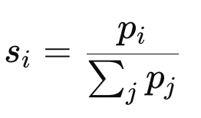
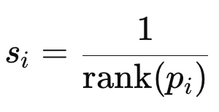
Normalization techniques tried
Proportionnal normlization
Quantile Normlization
Idea: Convert per-bootstrap importances p_{i}​ into shares that sum to 1
Pros:
Invariant to a common scale factor (c⋅p → same s).
Fits in [0,1] and sums to 1 (easy to visualize within a bootstrap).
Cons (in STABL):
Loses absolute magnitude: a “confident” bootstrap and a “noisy” one both sum to 1 → FDR curves become less informative.
Dilutes signal when many features have small mass: each share shrinks with the number of nonzero features.
Not comparable across bootstraps/λ: depends on how many features are active in that draw.
Unstable when ∑pj≈0.
Why didn’t I keep it ?
It compresses scale and makes cross-bootstrap aggregation (selection frequency, FDR thresholding) unreliable and overly sensitive.
Idea: Replace importances by ranks per bootstrap (1 = largest), then score as 1/rank (ties → average rank).
Pros:
Invariant to any monotone transform of p (scale/log).
Creates a crisp top-k hierarchy.
Cons (in STABL):
Destroys margins: adjacent values get scores 1 vs 1/2 regardless of true gaps; tail ranks can differ a lot for near-equal values.
Group correlation dilution: correlated features rotate in/out of the top; frequencies spread across the group.
Depends on d (number of features) and ties → poor comparability across omics / datasets.
Misaligned with FDR-by-threshold: ranks don’t reflect loss/gain; FDR curves become less meaningful.
Why didn’t I keep it?
Good for within-bootstrap ordering, but it biases frequency aggregation and weakens FDR control in practice.

Slide 40
Performances on INA’s data (Regression dataset) : OUT
Feature selection part
Results with basic XGBoost for the fitting part
Best STABL Linear :
STABL Lasso
STABL XGBoost
STABL Models | Nb of features (median across 100 folds) [25%, 75%] | Number of unique features across the 100 folds
STABL Lasso | 20 [19, 23.25] | 169
STABL ALasso | 20 [18.75, 22] | 175
STABL ElasticNet | 37 [30.75, 45.25] | 229
STABL XGBoost | 28 [26, 33] | 141
Previous performances (with Linear Regression for the fitting part)
STABL Models | R² (average) | RMSE (average) | MAE (average)
STABL Lasso + Linereg | 0.047 | 30.792 | 20.589
STABL Alasso + Linereg | 0.144 | 28.233 | 19.297
STABL ElasticNet + Linereg | -0.203 | 34.718 | 21.086

