Slide 1
Recap for Practice

Slide 2
Decision Tree Induction: An Example
Training data set: Buys_computer
The data set follows an example of Quinlan’s ID3 (Playing Tennis)
Resulting tree:
age?
<=30
overcast
>40
31..40
student?
yes
credit rating?
no
yes
excellent
fair
no
yes
no
yes

Slide 3
Algorithm for Decision Tree Induction
Basic algorithm (a greedy algorithm)
Tree is constructed in a top-down recursive divide-and-conquer manner
At start, all the training examples are at the root
Attributes are categorical (if continuous-valued, they are discretized in advance)
Examples are partitioned recursively based on selected attributes
Test attributes are selected on the basis of a heuristic or statistical measure (e.g., information gain)
Conditions for stopping partitioning
All samples for a given node belong to the same class
There are no remaining attributes for further partitioning – majority voting is employed for classifying the leaf
There are no samples left

Slide 4
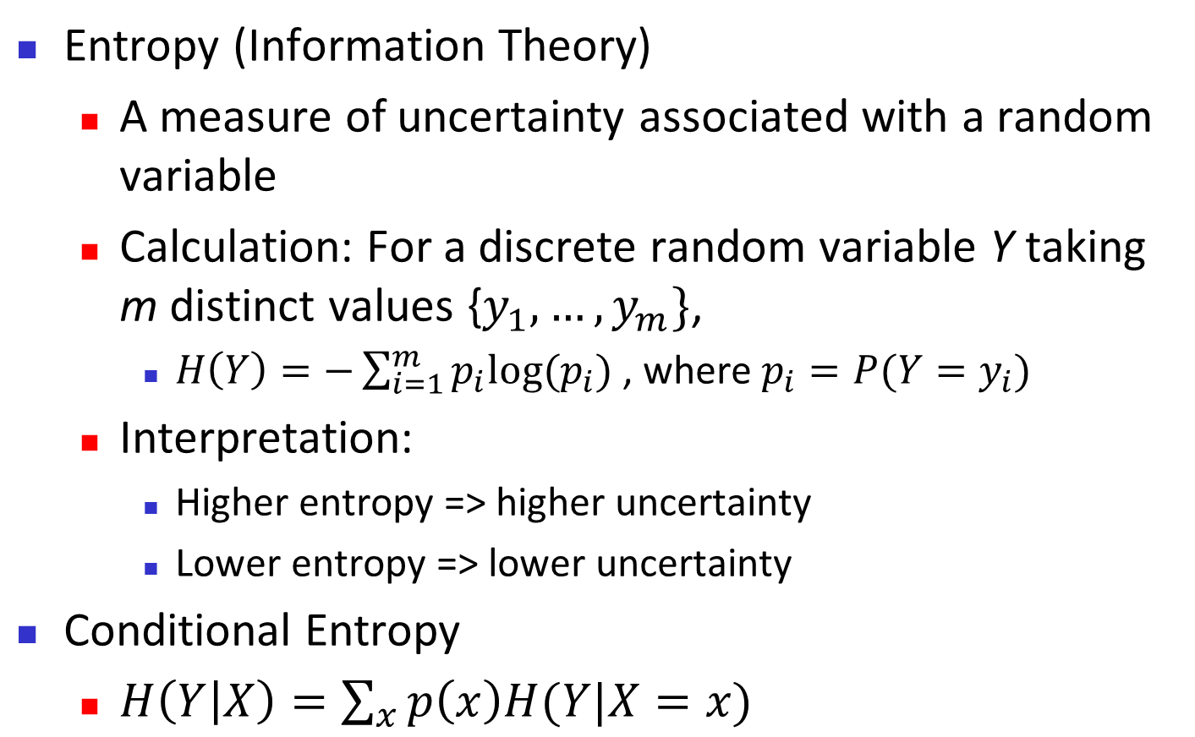
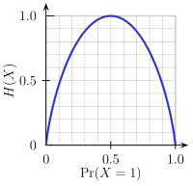
Brief Review of Entropy
m = 2
Notes:
Log2 because information is represented in bit
pi is the non zero probability that a tuple in D belong to the class Ci

Slide 5
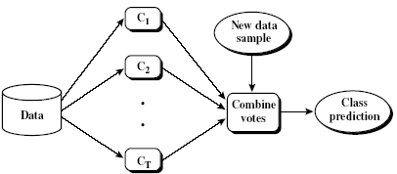
Ensemble Methods: Increasing the Accuracy
Ensemble methods
Use a combination of models to increase accuracy
Combine a series of k learned models, M₁, M₂, …, M_{k}, with the aim of creating an improved model M*
Popular ensemble methods
Bagging: averaging the prediction over a collection of classifiers
Boosting: weighted vote with a collection of classifiers
Ensemble: combining a set of heterogeneous classifiers
5

Slide 6
Bagging: Boostrap Aggregation
Analogy: Diagnosis based on multiple doctors’ majority vote
Training
Given a set D of d tuples, at each iteration i, a training set D_{i} of d tuples is sampled with replacement from D (i.e., bootstrap)
A classifier model M_{i} is learned for each training set D_{i}
Classification: classify an unknown sample X
Each classifier M_{i} returns its class prediction
The bagged classifier M* counts the votes and assigns the class with the most votes to X
Prediction: can be applied to the prediction of continuous values by taking the average value of each prediction for a given test tuple
Accuracy
Often significantly better than a single classifier derived from D
For noise data: not considerably worse, more robust
Proved improved accuracy in prediction
6

Slide 7
Boosting
Analogy: Consult several doctors, based on a combination of weighted diagnoses—weight assigned based on the previous diagnosis accuracy
How boosting works?
Weights are assigned to each training tuple
A series of k classifiers is iteratively learned
After a classifier M_{i} is learned, the weights are updated to allow the subsequent classifier, M_{i+1}, to pay more attention to the training tuples that were misclassified by M_{i}
The final M* combines the votes of each individual classifier, where the weight of each classifier's vote is a function of its accuracy
Boosting algorithm can be extended for numeric prediction
Comparing with bagging: Boosting tends to have greater accuracy, but it also risks overfitting the model to misclassified data
7
Notes:
bagging stands for bootstrap aggregation
The increased accuracy occurs because the composite model reduces the variance of the individual classiﬁers.

Slide 8
Adaboost (Freund and Schapire, 1997)
Given a set of d class-labeled tuples, (X₁, y₁), …, (X_{d}, y_{d})
Initially, all the weights of tuples are set the same (1/d)
Generate k classifiers in k rounds. At round i,
Tuples from D are sampled (with replacement) to form a training set D_{i} of the same size
Each tuple’s chance of being selected is based on its weight
A classification model M_{i} is derived from D_{i}
Its error rate is calculated using D_{i} as a test set
If a tuple is misclassified, its weight is increased, o.w. it is decreased
Error rate: err(X_{j}) is the misclassification error of tuple X_{j}. Classifier M_{i} error rate is the sum of the weights of the misclassified tuples:
The weight of classifier M_{i}’s vote is
Notes:
After a classiﬁer, M i, is learned, the weights are updated to allow the subsequent classiﬁer, M i + 1 , to “pay more attention” to the training tuples that were misclassiﬁed by M i.
. A tuple’s weight reﬂects how difﬁcult it is to classifythe higher the weight, the more often it has been misclassiﬁed

Slide 9
Random Forest (Breiman 2001)
Random Forest:
Each classifier in the ensemble is a decision tree classifier and is generated using a random selection of attributes at each node to determine the split
During classification, each tree votes and the most popular class is returned
Two Methods to construct Random Forest:
Forest-RI (random input selection): Randomly select, at each node, F attributes as candidates for the split at the node. The CART methodology is used to grow the trees to maximum size
Forest-RC (random linear combinations): Creates new attributes (or features) that are a linear combination of the existing attributes (reduces the correlation between individual classifiers)
Comparable in accuracy to Adaboost, but more robust to errors and outliers
Insensitive to the number of attributes selected for consideration at each split, and faster than bagging or boosting
9

Slide 10
Partitioning Algorithms: Basic Concept
Partitioning method: Partitioning a database D of n objects into a set of k clusters, such that the sum of squared distances is minimized (where c_{i} is the centroid or medoid of cluster C_{i})
Given k, find a partition of k clusters that optimizes the chosen partitioning criterion
Global optimal: exhaustively enumerate all partitions
Heuristic methods: k-means and k-medoids algorithms
k-means (MacQueen’67, Lloyd’57/’82): Each cluster is represented by the center of the cluster
k-medoids or PAM (Partition around medoids) (Kaufman & Rousseeuw’87): Each cluster is represented by one of the objects in the cluster

Slide 11
The K-Means Clustering Method
Given k, the k-means algorithm is implemented in four steps:
Partition objects into k nonempty subsets
Compute seed points as the centroids of the clusters of the current partitioning (the centroid is the center, i.e., mean point, of the cluster)
Assign each object to the cluster with the nearest seed point
Go back to Step 2, stop when the assignment does not change

Slide 12
Hierarchical Clustering
Use distance matrix as clustering criteria. This method does not require the number of clusters k as an input, but needs a termination condition
Step 0
Step 1
Step 2
Step 3
Step 4
agglomerative
(AGNES)
a
a b
b
a b c d e
c
c d e
d
d e
e
divisive
(DIANA)
Step 4
Step 3
Step 2
Step 1
Step 0

Slide 13
Dendrogram: Shows How Clusters are Merged
Decompose data objects into a several levels of nested partitioning (tree of clusters), called a dendrogram
A clustering of the data objects is obtained by cutting the dendrogram at the desired level, then each connected component forms a cluster

Slide 14
Distance between Clusters
X
X
Single link: smallest distance between an element in one cluster and an element in the other, i.e., dist(K_{i}, K_{j}) = min(t_{ip}, t_{jq})
Complete link: largest distance between an element in one cluster and an element in the other, i.e., dist(K_{i}, K_{j}) = max(t_{ip}, t_{jq})
Average: avg distance between an element in one cluster and an element in the other, i.e., dist(K_{i}, K_{j}) = avg(t_{ip}, t_{jq})
Centroid: distance between the centroids of two clusters, i.e., dist(K_{i}, K_{j}) = dist(C_{i}, C_{j})
Medoid: distance between the medoids of two clusters, i.e., dist(K_{i}, K_{j}) = dist(M_{i}, M_{j})
Medoid: a chosen, centrally located object in the cluster
14
Notes:
14

Slide 15
Density-Based Clustering: Basic Concepts
Two parameters:
Eps: Maximum radius of the neighbourhood
MinPts: Minimum number of points in an Eps-neighbourhood of that point
N_{Eps}(p): {q belongs to D | dist(p,q) ≤ Eps}
Directly density-reachable: A point p is directly density-reachable from a point q w.r.t. Eps, MinPts if
p belongs to N_{Eps}(q)
core point condition:
|N_{Eps} (q)| ≥ MinPts
p
MinPts = 5
Eps = 1 cm
q

Slide 16
Density-Reachable and Density-Connected
Density-reachable:
A point p is density-reachable from a point q w.r.t. Eps, MinPts if there is a chain of points p₁, …, p_{n}, p₁ = q, p_{n} = p such that p_{i+1} is directly density-reachable from p_{i}
Density-connected
A point p is density-connected to a point q w.r.t. Eps, MinPts if there is a point o such that both, p and q are density-reachable from o w.r.t. Eps and MinPts
p
p₁
q
p
q
o

Slide 17
DBSCAN: Density-Based Spatial Clustering of Applications with Noise
Relies on a density-based notion of cluster: A cluster is defined as a maximal set of density-connected points
Discovers clusters of arbitrary shape in spatial databases with noise
Outlier
Border
Eps = 1cm
MinPts = 5
Core

Slide 18
DBSCAN: The Algorithm
Arbitrary select a point p
Retrieve all points density-reachable from p w.r.t. Eps and MinPts
If p is a core point, a cluster is formed
If p is a border point, no points are density-reachable from p and DBSCAN visits the next point of the database
Continue the process until all of the points have been processed

Slide 19

Parametric Methods II: Detection of Multivariate Outliers
Multivariate data: A data set involving two or more attributes or variables
Transform the multivariate outlier detection task into a univariate outlier detection problem
Method 1. Compute Mahalaobis distance
Let ō be the mean vector for a multivariate data set. Mahalaobis distance for an object o to ō is MDist(o, ō) = (o – ō )^{T} S ^{–1}(o – ō) where S is the covariance matrix
Use the Grubb's test on this measure to detect outliers
Method 2. Use χ² –statistic:
where E_{i} is the mean of the i-dimension among all objects, and n is the dimensionality
If χ² –statistic is large, then object o_{i} is an outlier
19

