Slide 1


Multi-Cloud Architecture & IaC
Building Secure, Scalable, and Fault-Tolerant Systems
Noel Mathews

Slide 2






Solution Pillars
Security
Availability
Fault Tolerance
Scalability
Zero-trust posture with private endpoints & firewalls.
Multi-zone redundancy for zero-downtime operations.
Graceful degradation through isolated domains.
Dynamic provisioning for elastic enterprise workloads.

Slide 3
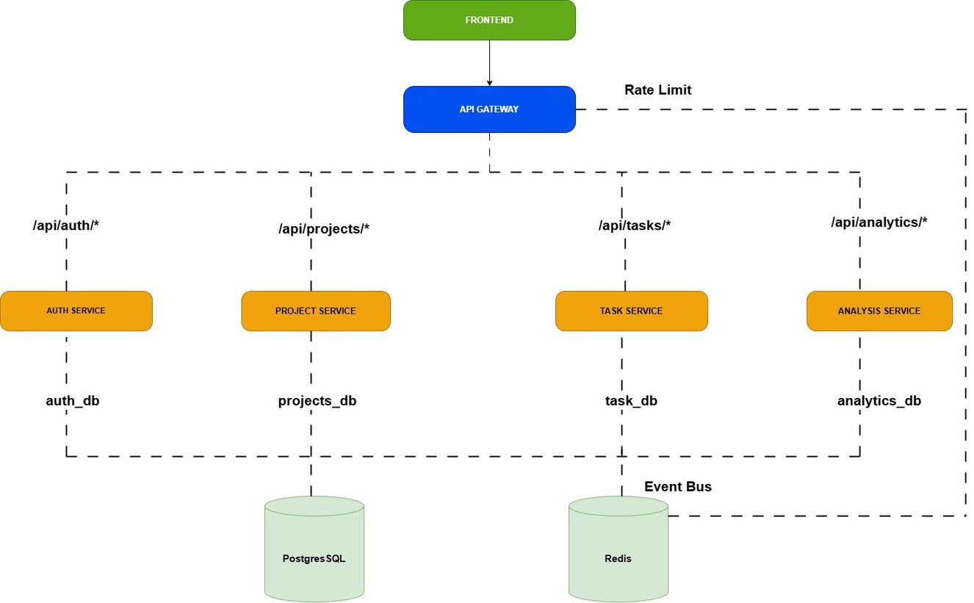
Application Architecture

Slide 4
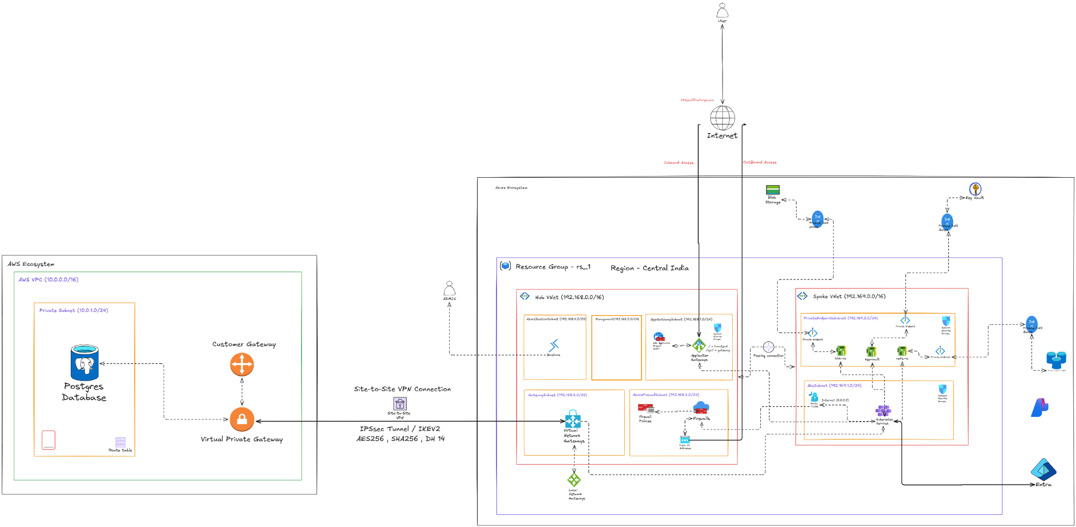
Cloud Architecture

Slide 5
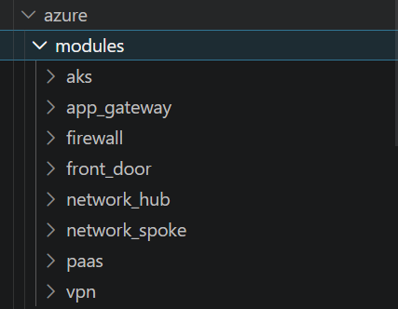

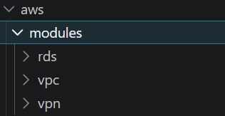
Terraform: Modularity
Code Modularity
Custom Modules: Standardized, reusable components for compute/network.
DRY Logic: Centralized resource definitions to minimize duplication.
Provider Isolation: Separate directories for Azure and AWS resources.

Slide 6
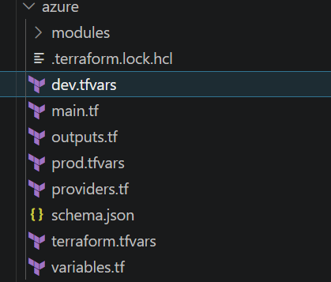
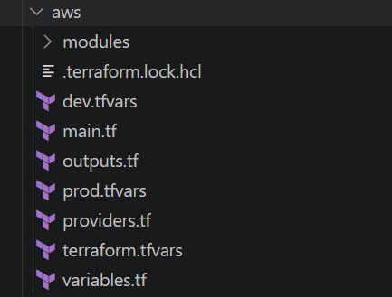
Dynamic Environments
Variable Injection: Use of dev.tfvars and prod.tfvars for environment-specific values.
One Codebase: Deploy the same HCL code to different tiers without modification.
Scaling Controls: Vary instance sizes and node counts per environment dynamically.

Slide 7

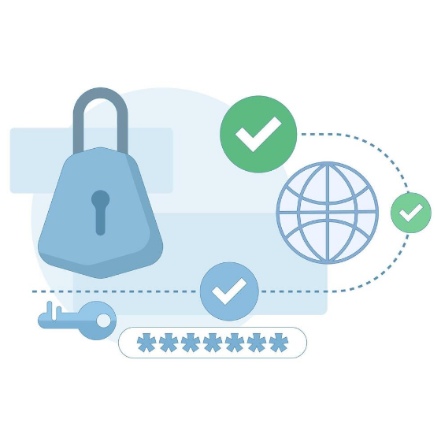

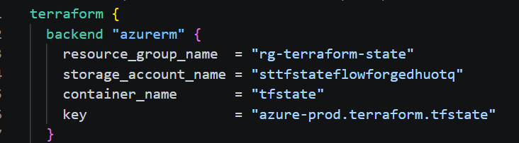
State Management
Remote Backend
Azure Blob Storage: Centralized storage for .tfstate files.
State Locking: Lease mechanism prevents concurrent state modification.
Corruption Prevention: Avoids race conditions during team deployments.
Security: State encrypted at rest with managed identities.

Slide 8

Thankyou !

