Slide 1
FlowForge
A Cloud-Native Microservices based Task Management Platform with a Production-Ready DevSecOps Pipeline
Noel Mathews

Slide 2
Objective
FlowForge is a cloud-native project and task management platform built on 6 microservices — API Gateway, Auth, Project, Task, Analysis, and a Next.js Frontend — backed by PostgreSQL and Redis.
The Problem: Before DevOps, software delivery was entirely manual. Engineers SSH-ed into servers, copied files by hand, had no monitoring, no automated testing, and no reliable rollback. As applications moved to the cloud and microservices became the standard, this approach completely broke down — you cannot manually manage 6 services, a database, a cache, load balancers, and storage across distributed nodes.
Our Goal: Deploy FlowForge on a production-grade, self-managed Kubernetes cluster on AWS — with thrreeworker nodes, persistent NFS-backed storage, a centralized load balancer, and full namespace isolation between dev and production environments. On top of that infrastructure, build a DevSecOps pipeline that automates every step from code push to cluster deployment — with security scanning, controlled release strategies, deployment governance, and full observability — so the platform runs reliably, safely, and at scale.

Slide 3
Application Stack
•Frontend: Next.js Framework
•Backend Services: Python FastAPI
•Internal Communication: HTTP REST API calls over ClusterIP with NetworkPolicy
•Data Layer: PostgreSQL and Redis isolated via PVCs
Backend MicroServices:
Gateway - Acts as the single entry point for the application, routing incoming client requests to the appropriate backend microservices also handles rate limiting and JWT Validation
Auth-service - Handles user registration, authentication, authorization.
Project-service - Manages the complete lifecycle, metadata, and configuration of projects created within the system.
Task-service - Handles creation, assignment, status tracking, and management of individual tasks within projects.
Analysis-service - Processes application data to generate metrics, insights, and analytical reports regarding projects and tasks.

Slide 4
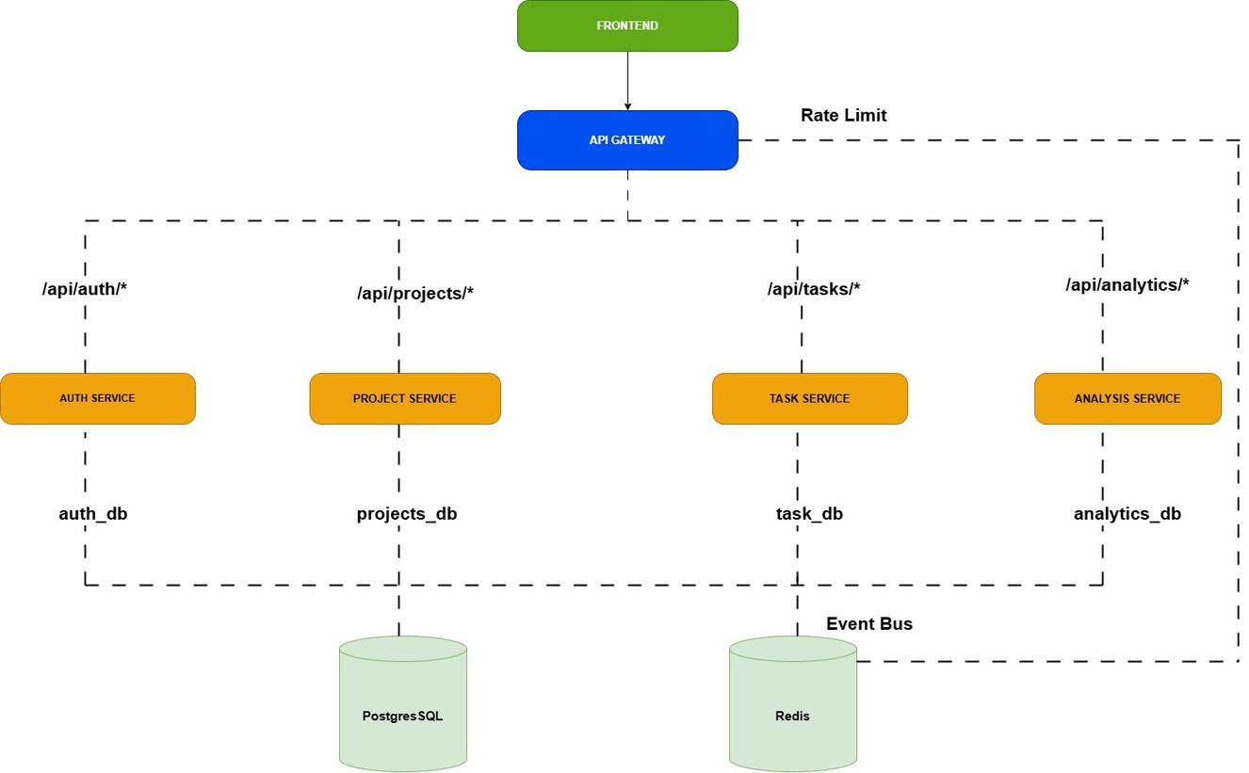
Application Architecture

Slide 5
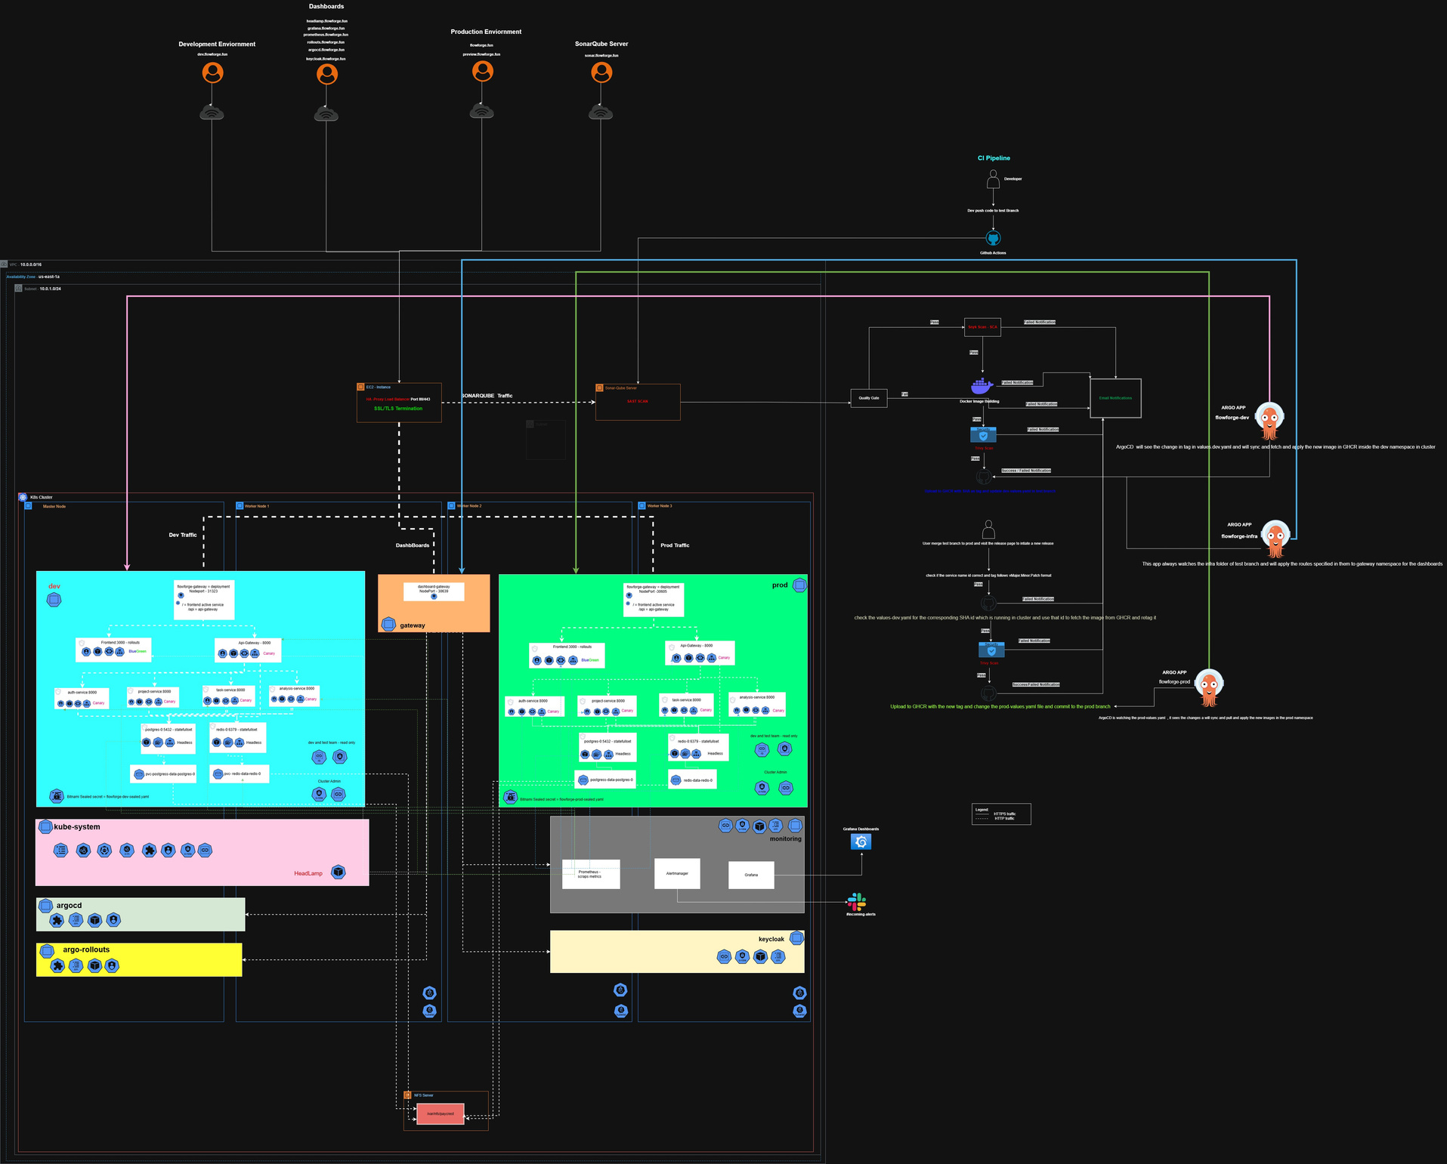
Devops Architecture with CI CD Pipeline

Slide 6
Services and Ports
Frontend | 3000
Gateway | 8000
Auth-Service | 8001
Project-Service | 8002
Task-Service | 8003
Analysis-Service | 8004

Slide 7
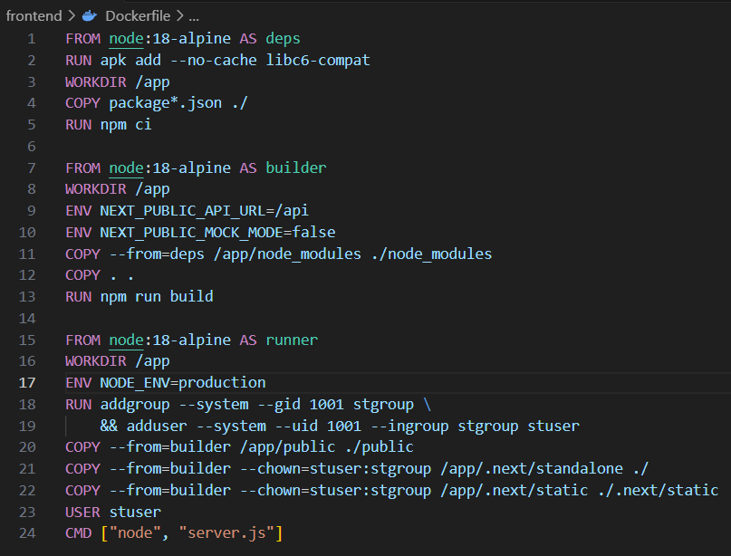
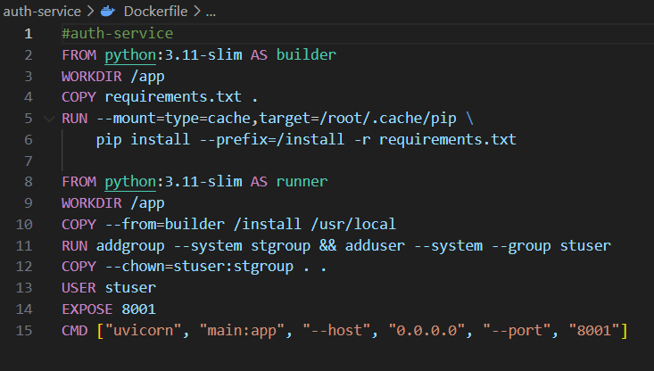
DockerFiles

Slide 8
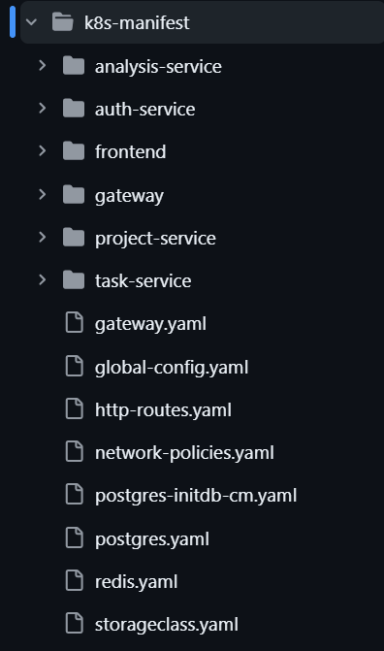
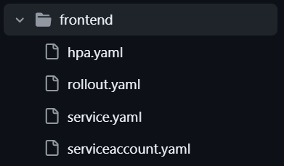
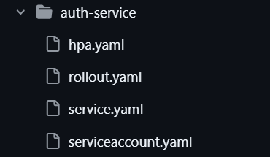
Kubernetes Manifest Files

Slide 9
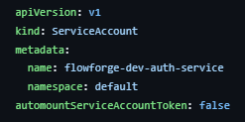
Security Aspects
Service Accounts - Instead of default SA we have created a SA for each microservice and disabled injecting the token that can be used to communicate with the API Server , and we have given that the containers should run as nonroot only
NetworkPolicy - we have implemented network policies inorder to restrict unauthorized communication in between the components in our namespace and across from other namespaces
Kyverno Cluster Policy - we have implemented cluster policy using kyverno to disallow any new resource creation using latest tag , specified tag should be given .

Slide 10
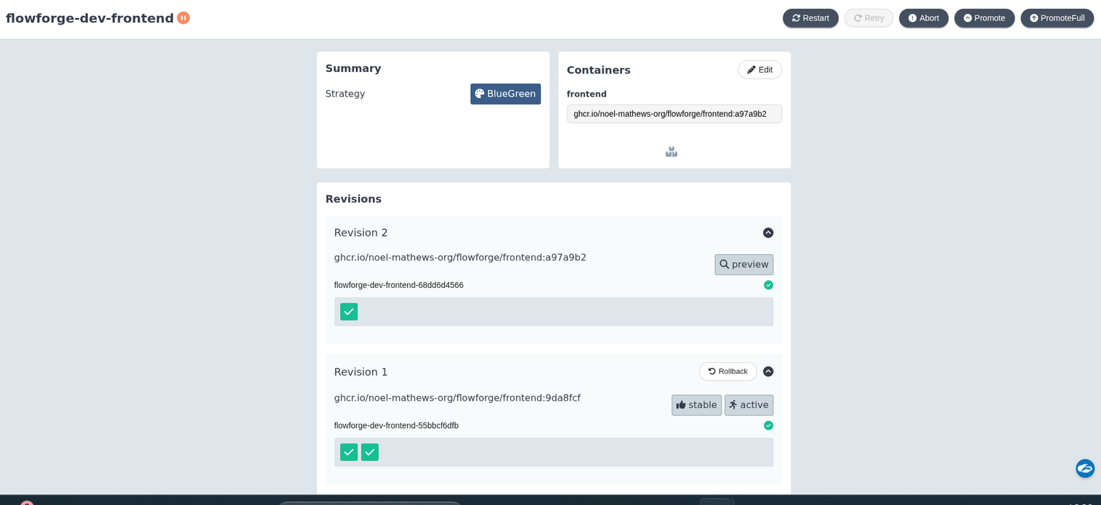
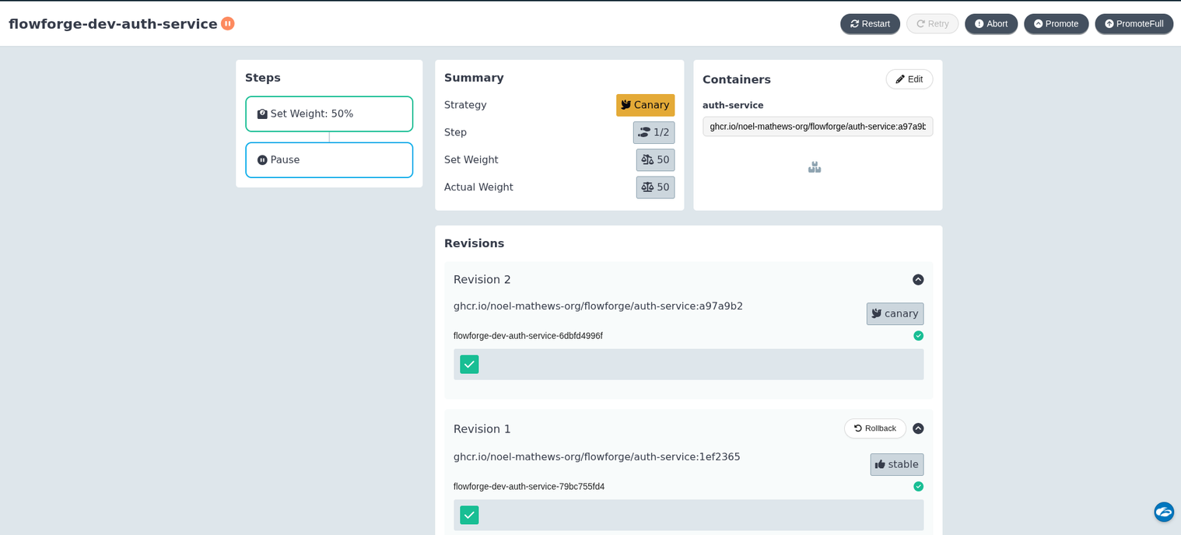
Deployment Strategies
BlueGreen - Frontend
Microservices - Canary

Slide 11
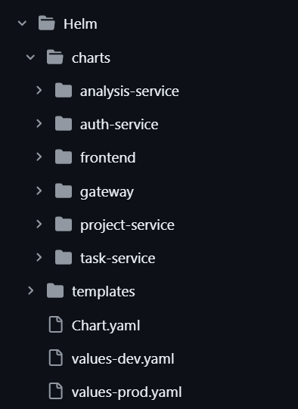
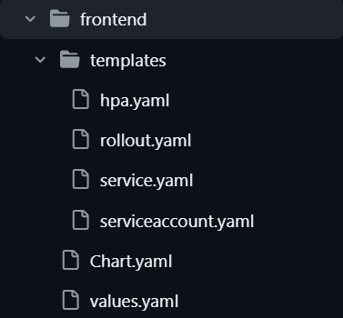
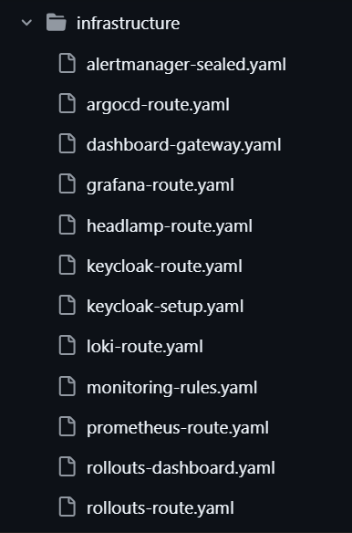
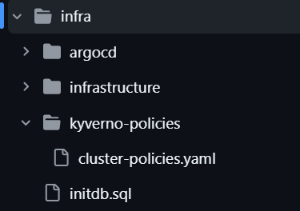
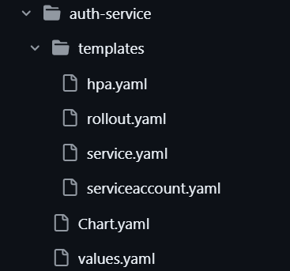
Helm Charts - GitOps

Slide 12
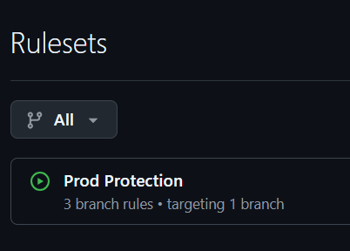
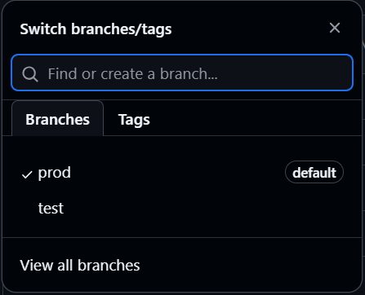
Branching Strategy
Trunk Based
Branch Protection
•No direct pushes to prod branch
•Pull request required before merge
•At least one approval required
•Status checks must pass before merge

Slide 13
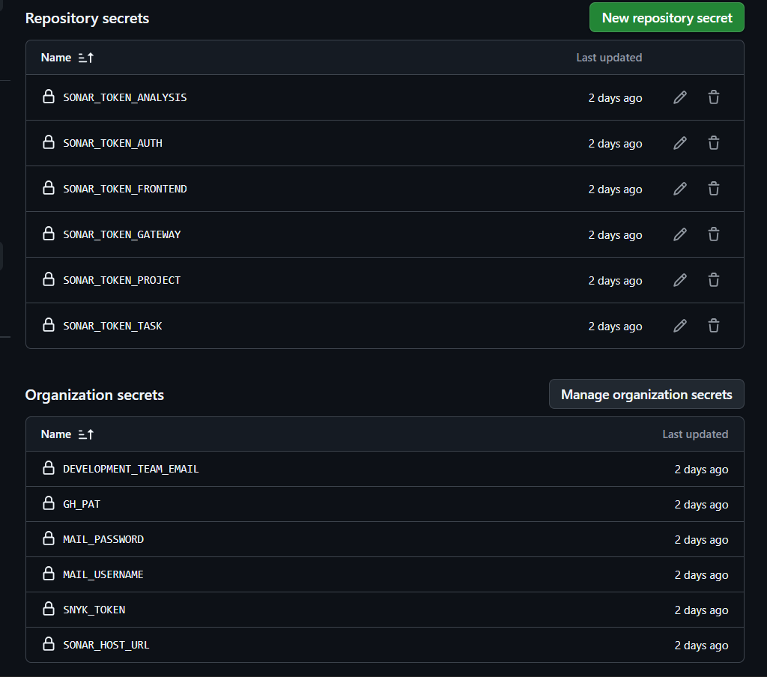
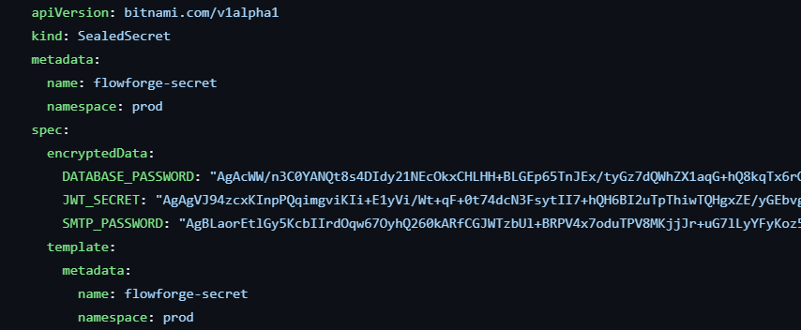
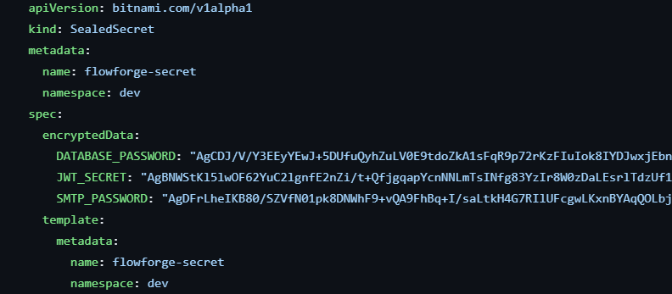
Secret Management

Slide 14
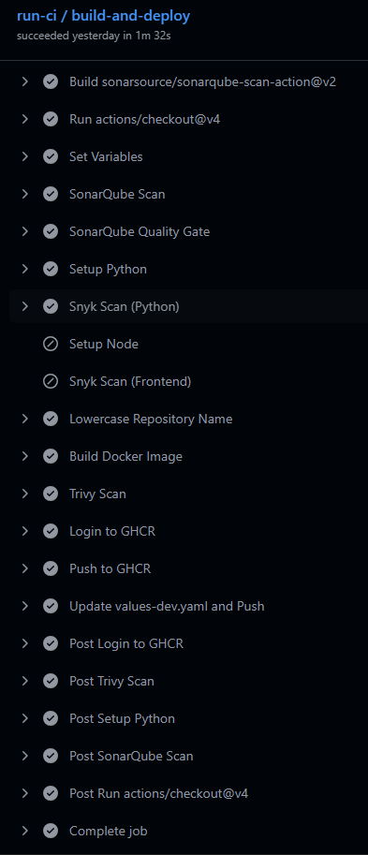
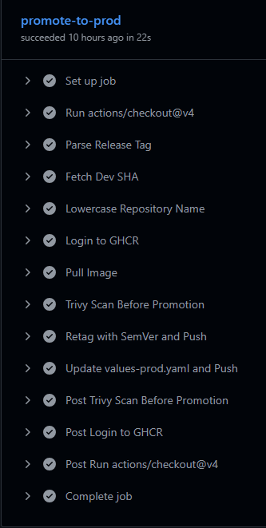
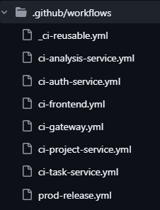
CI-CD Pipeline
Shift Left Security - Securing Left side before moving to right side
Reuseable Workflows - We dont need to create seperate pipeline for each microservice , we can use workflow call to call this reuseable workflow by path based triggers
Deployment Governance - we use 7 letters of the commit SHA of the developer to track which image is created and is responsible by whom
Immutable Promotion - we do not rebuild the image that wa salready tested and is ready for production , we just retag it and deploy to production which helps us to maintain the integrity of the image

Slide 15
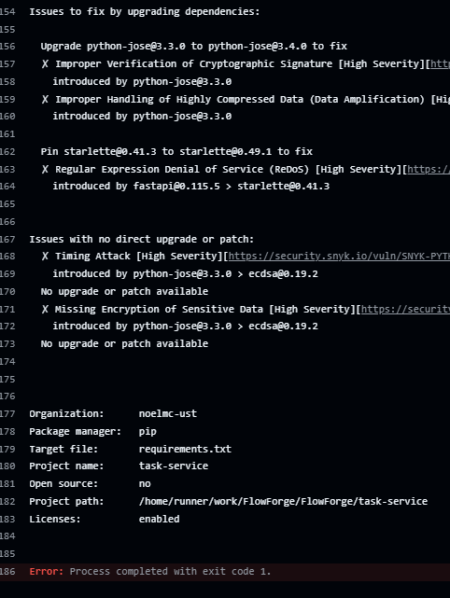
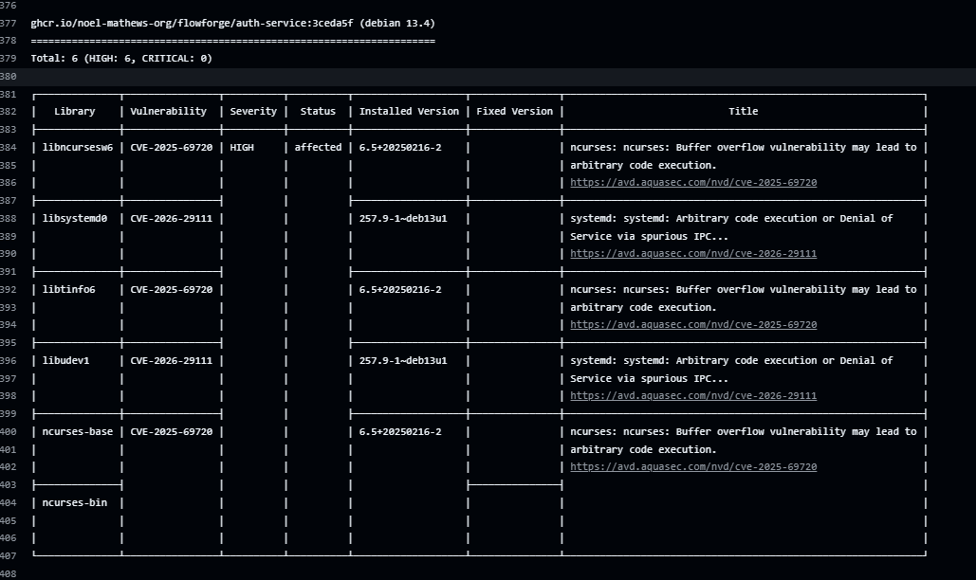
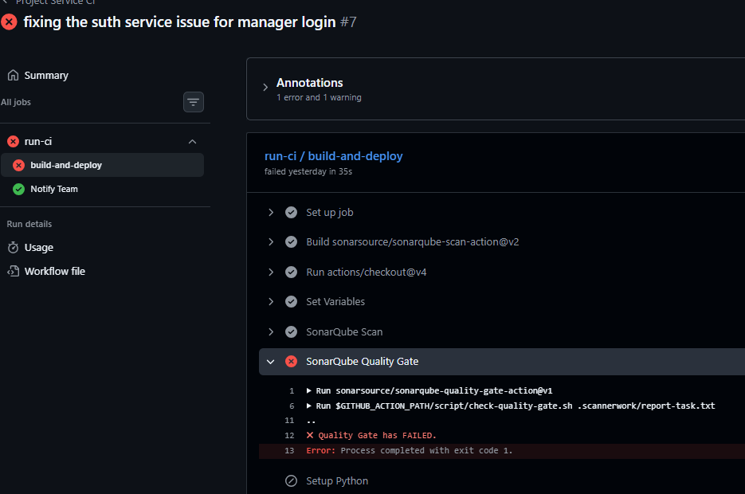
Shift Left Security

Slide 16
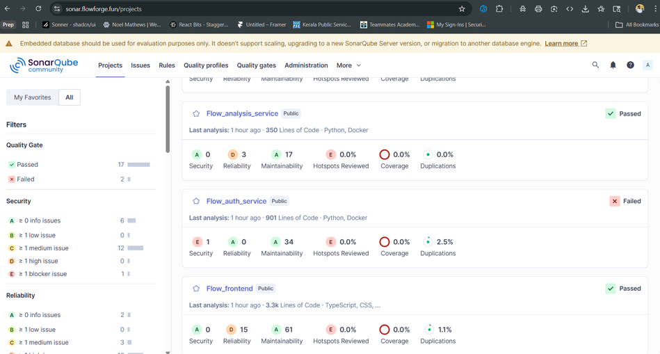
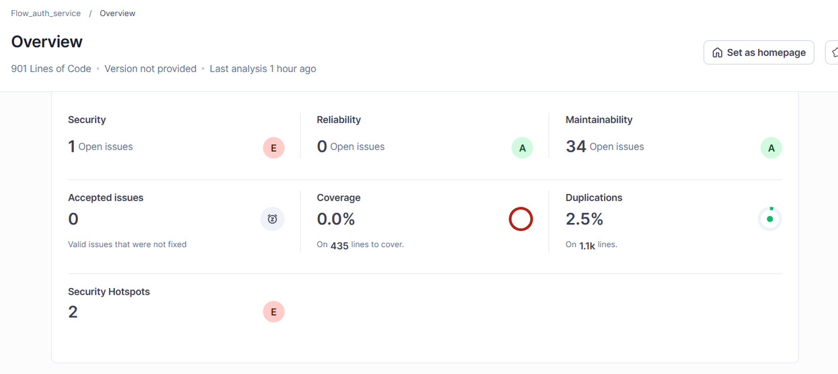
SonarQube Quality Gate - Help us to make sure our code maintains a certain level of benchmark for Reliability , Securty and Maintainability

Slide 17
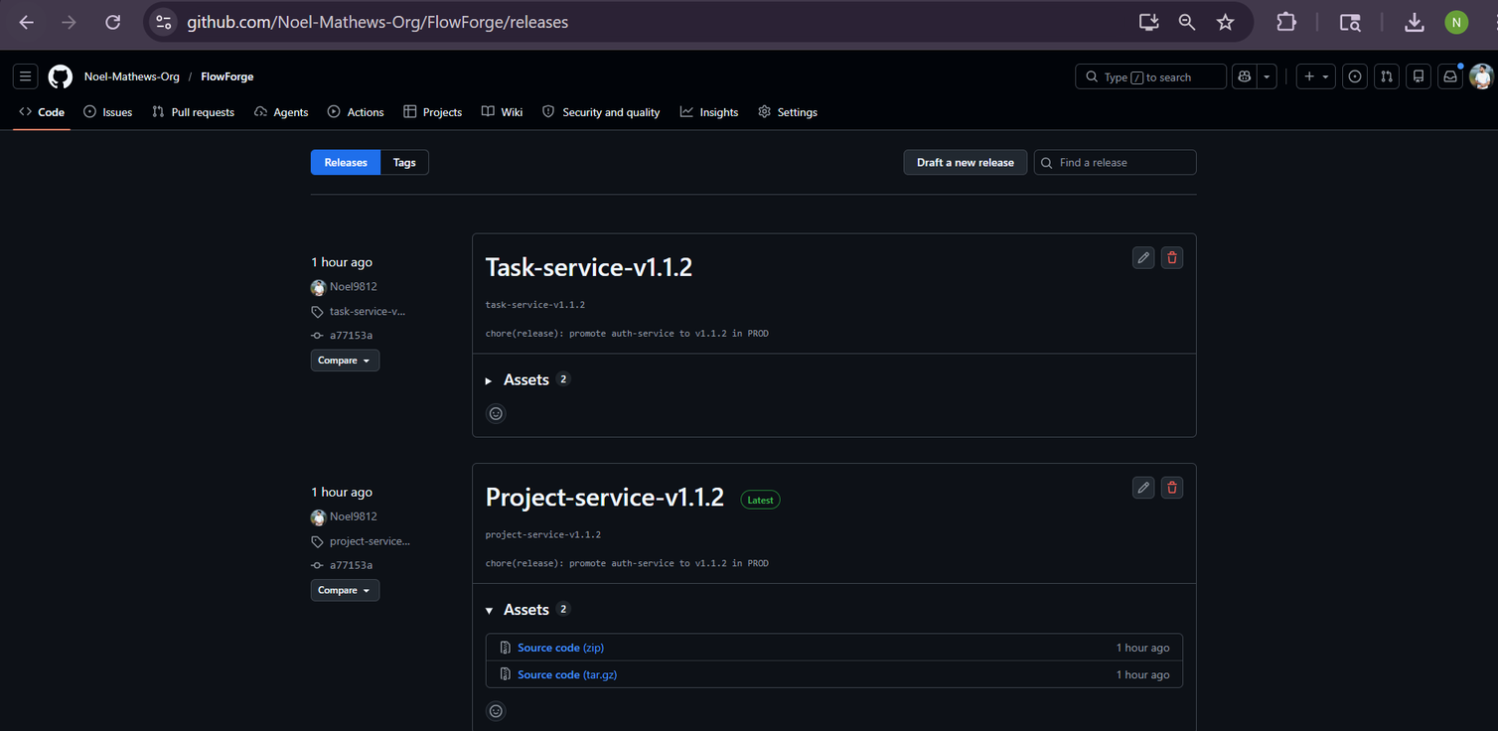
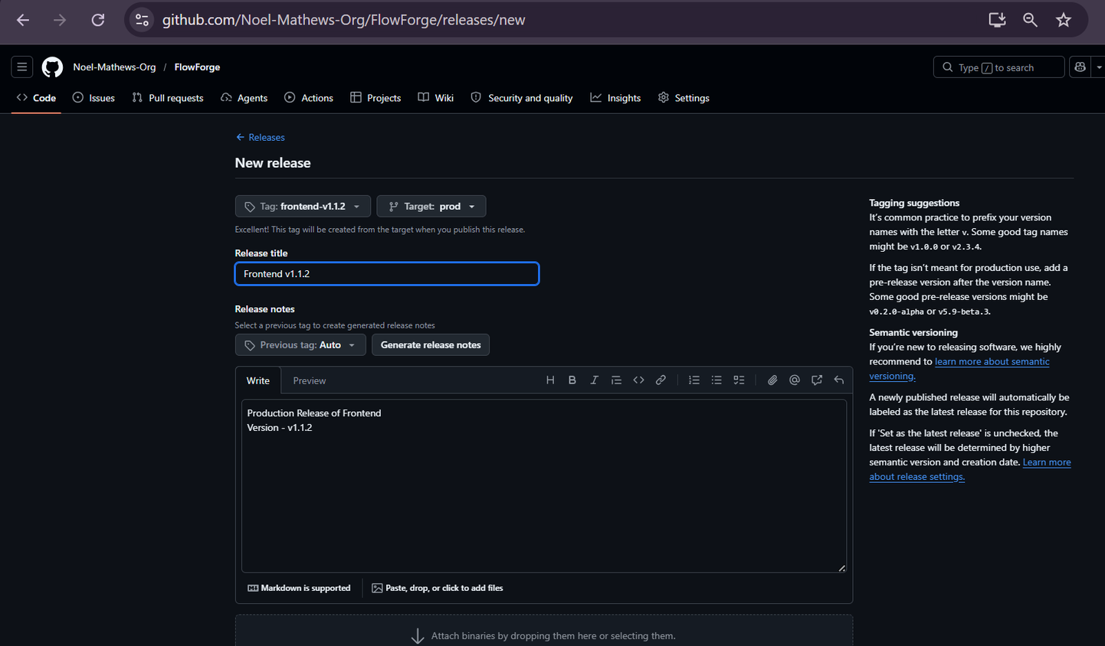
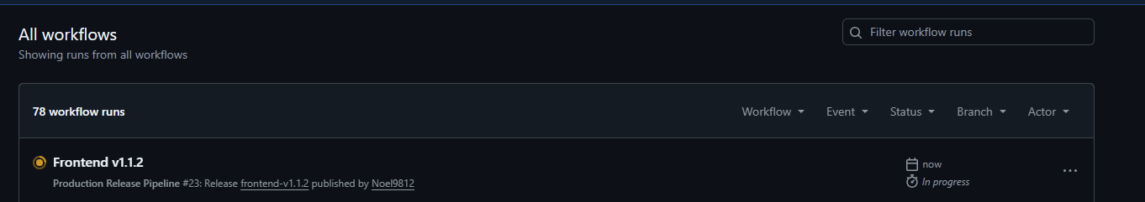
Manual Gates

Slide 18
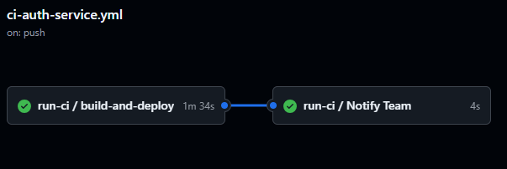
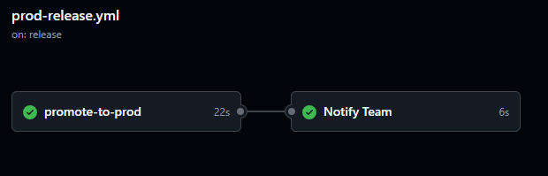
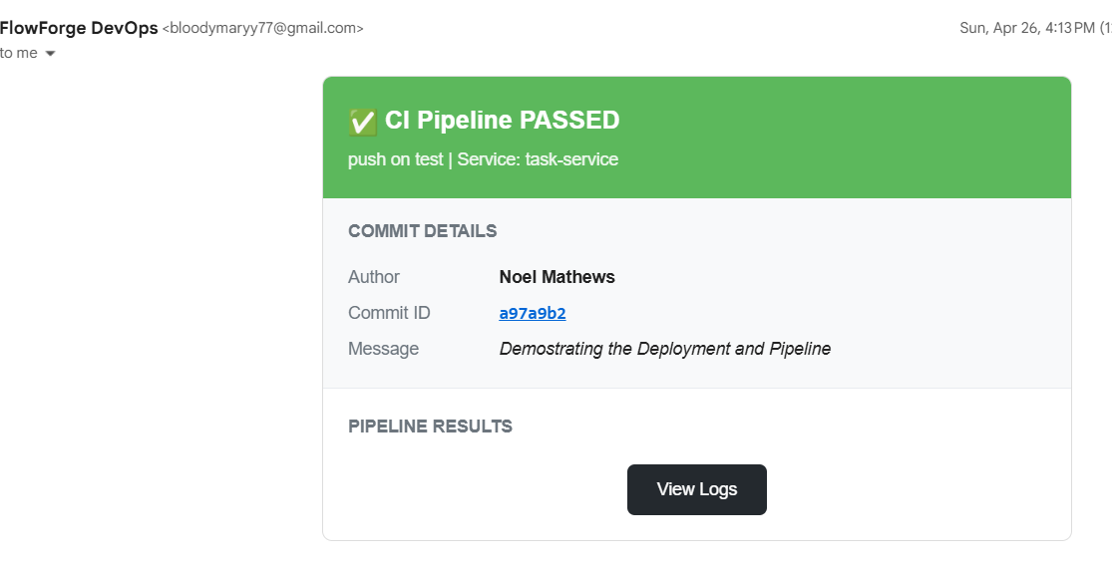
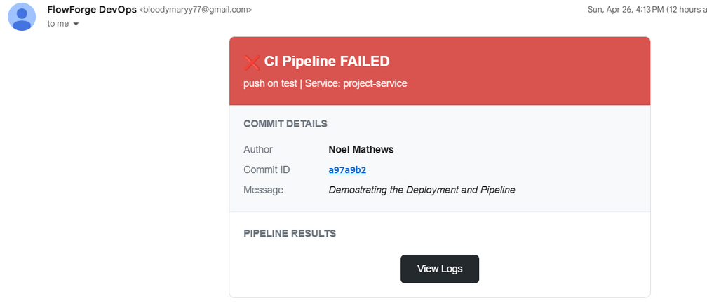
Jobs and Notifications

Slide 19
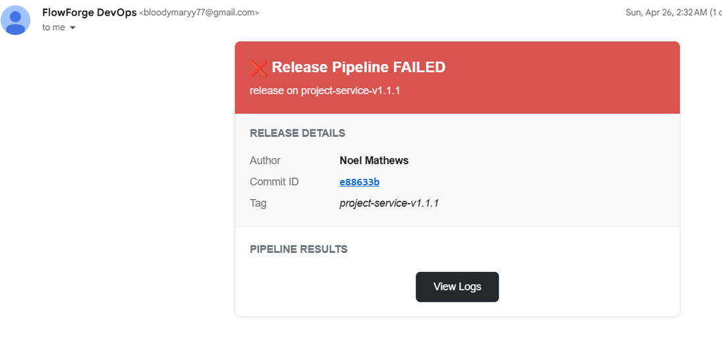
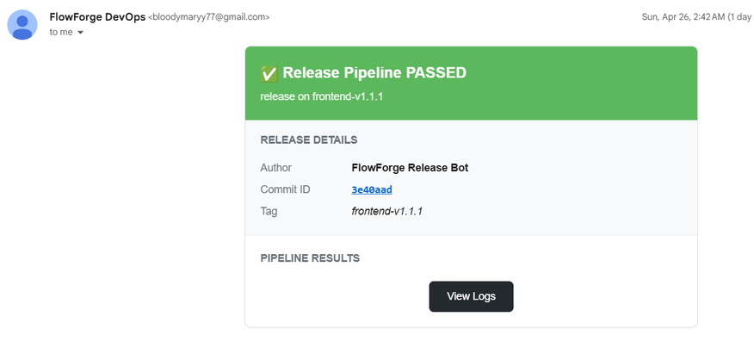

Slide 20
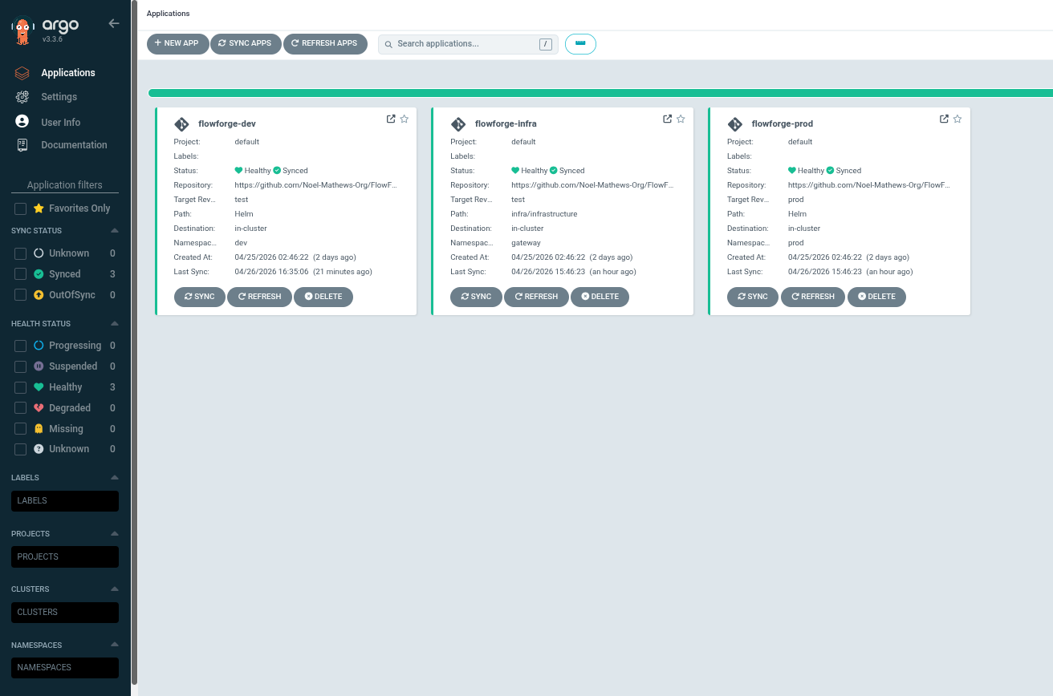
ArgoCD Dashbioard

Slide 21
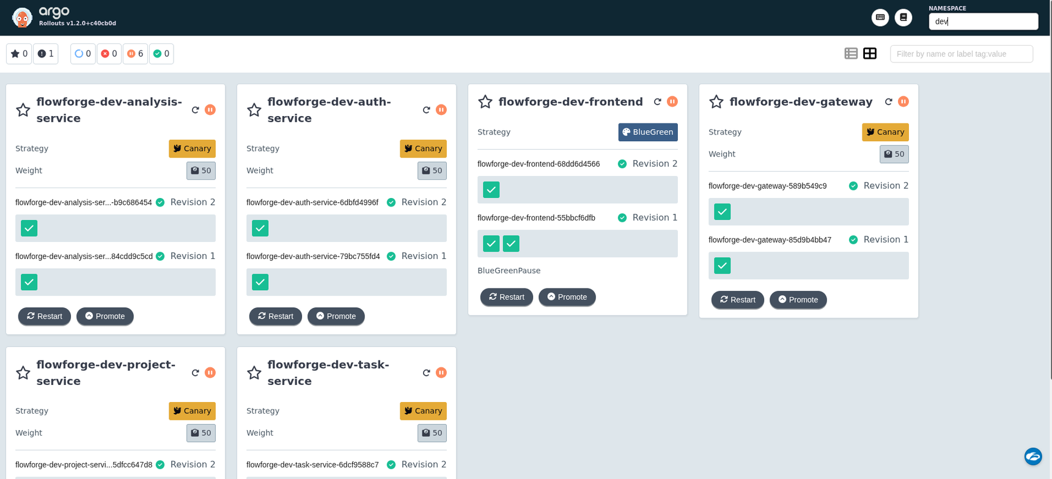
Argo Rollouts Dashbioard

Slide 22
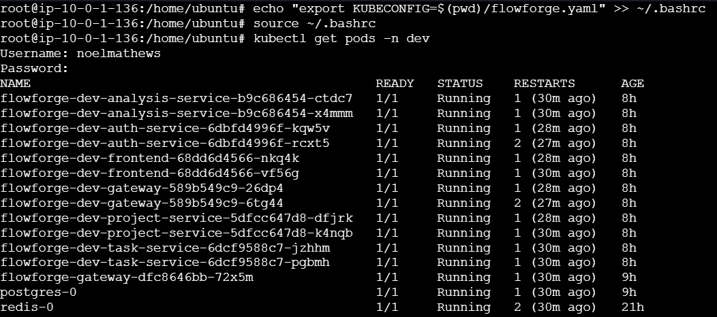
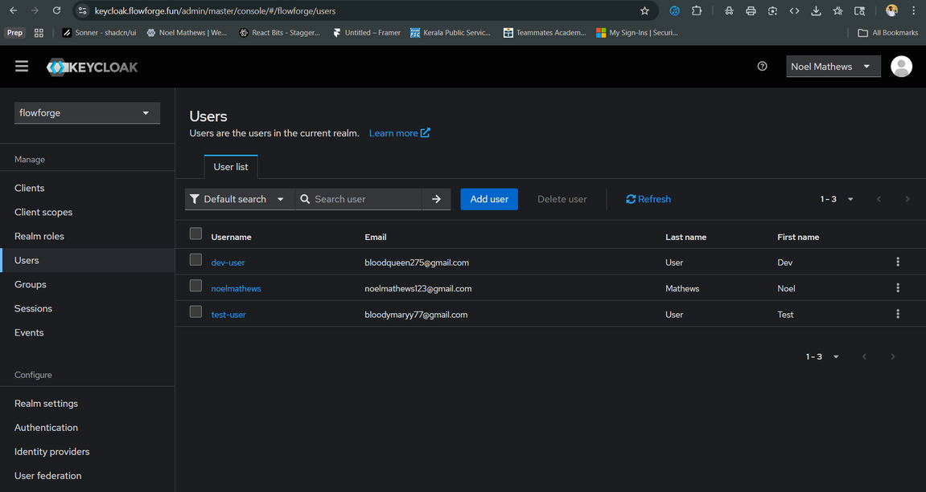
Access Control and Team Governance
Keycloak

Slide 23
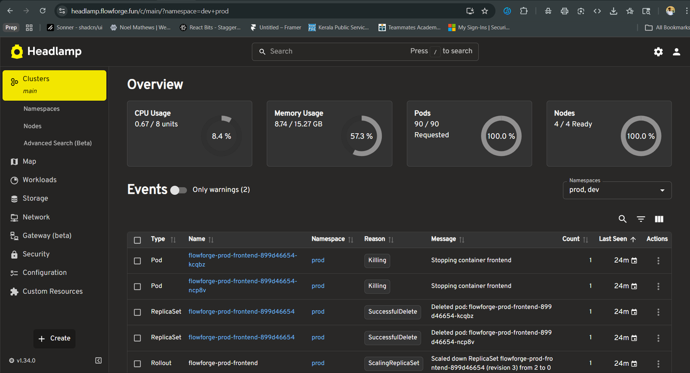
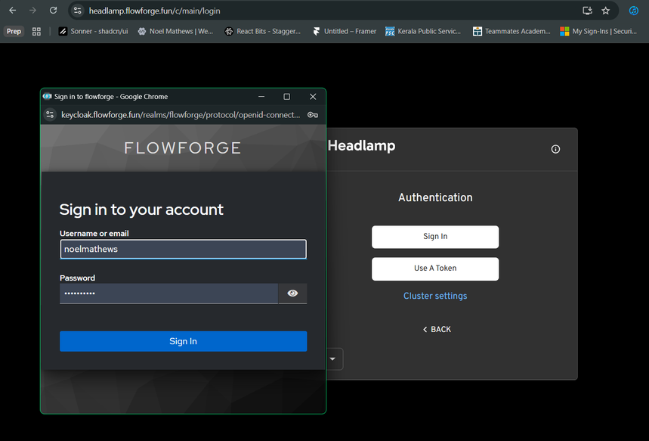
HeadLamp - we used keycloak as a sigin provider for our team memebers to access the cluster via headlamp

Slide 24
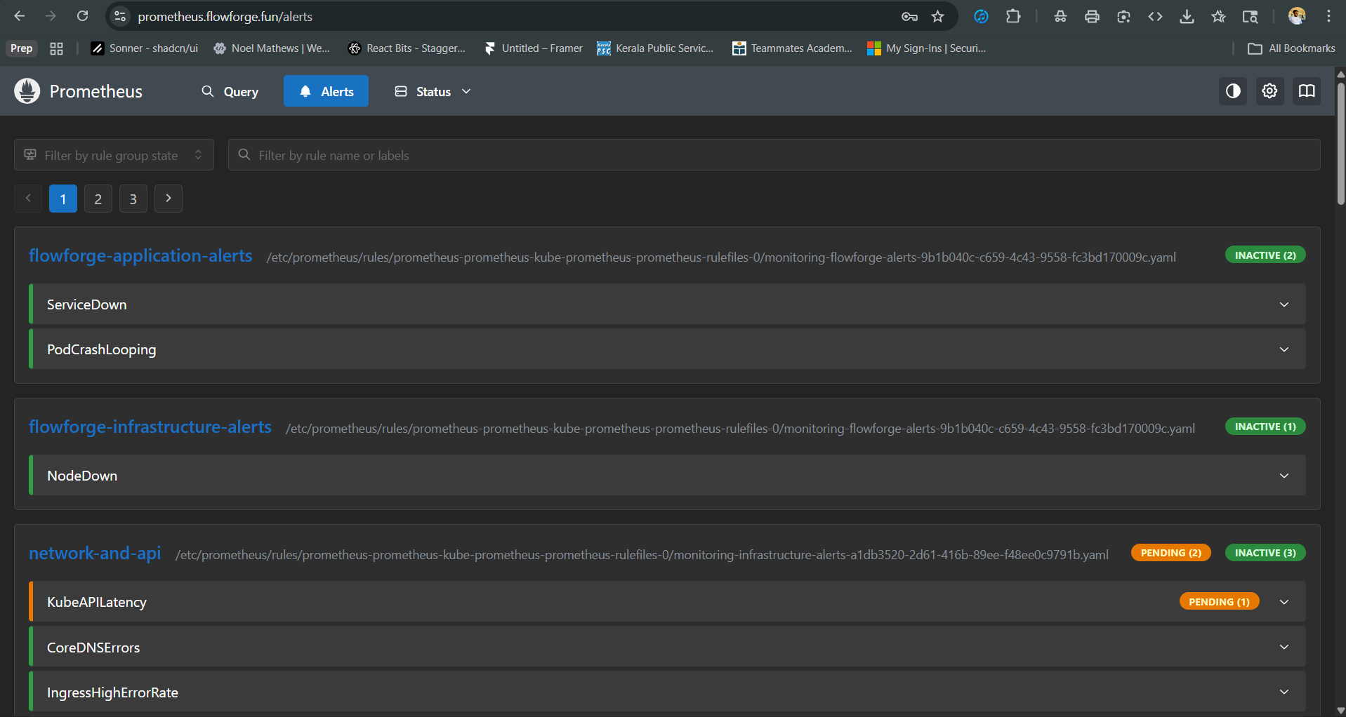
Prometheus and Alert Manager
Alerts we setup for our project

Slide 25
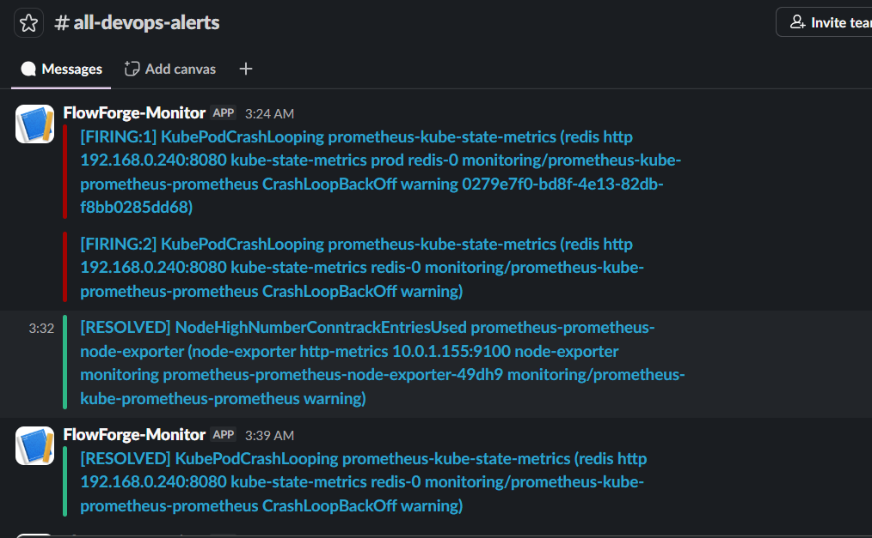
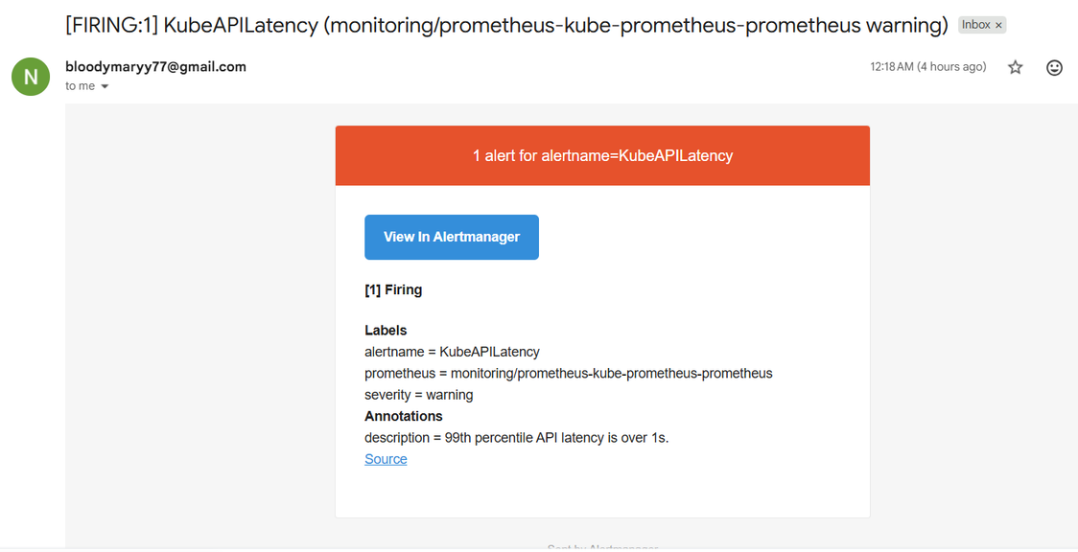

Slide 26
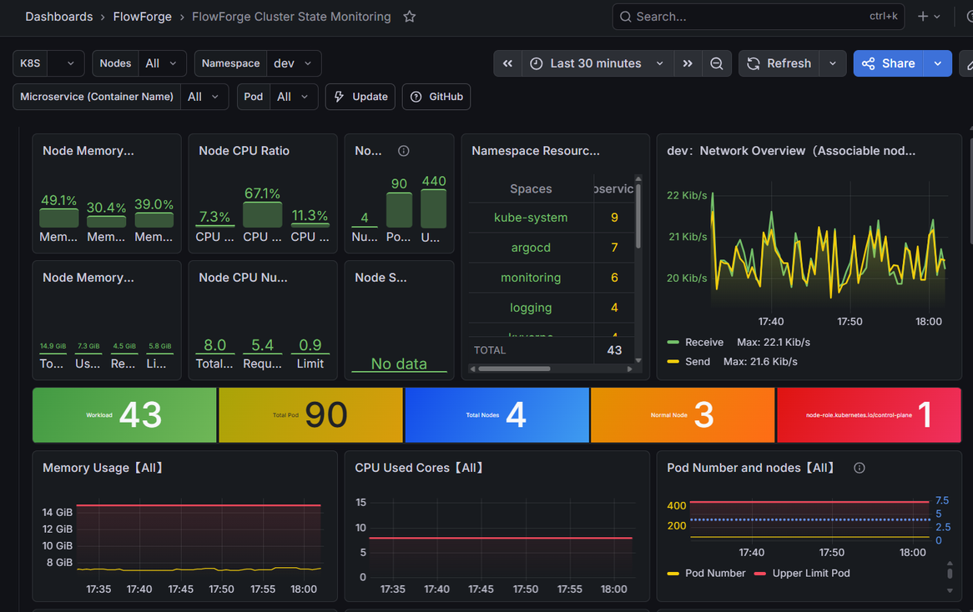
Monitoring

Slide 27
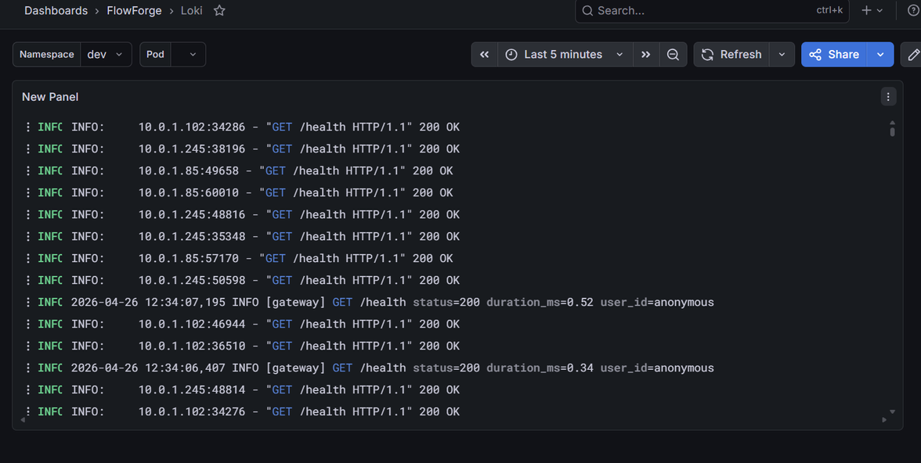
Observability
Loki and Promtail

Slide 28
flowforge.fun | Production
dev.flowforge.fun | Testing
preview.flowforge.fun | Preview before going to production
sonar.flowforge.fun | SonarQube Server
argocd.flowforge.fun | ArgoCD Dashboard
rollouts.flowforge.fun | Argo Rollouts Dashboard
headlamp.flowforge.fun | Headlamp
keycloak.flowforge.fun | Keycloak -OIDC
prometheus.flowforge.fun | Aert manager and Pormetheus
grafana.flowforge.fun | Grafana Dashboard
Domain and Subdomains
For all the domains and subdomains SSL/TLS termination i done at HAProxy , all the cerificates generated are using certbot

Slide 29
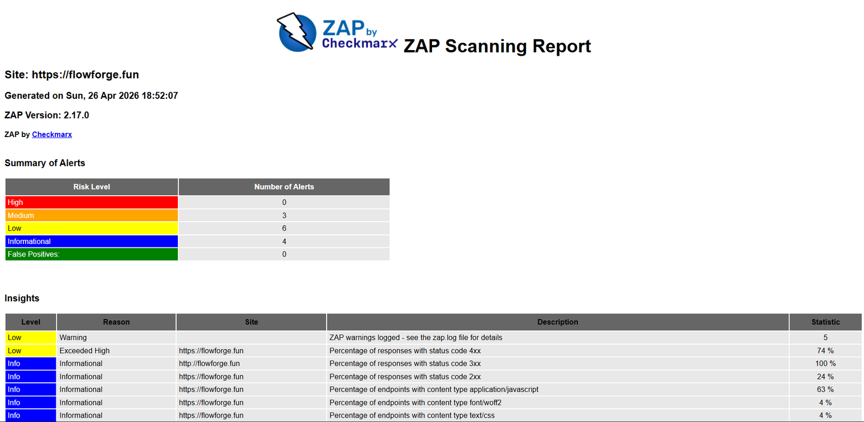
DAST

Slide 30
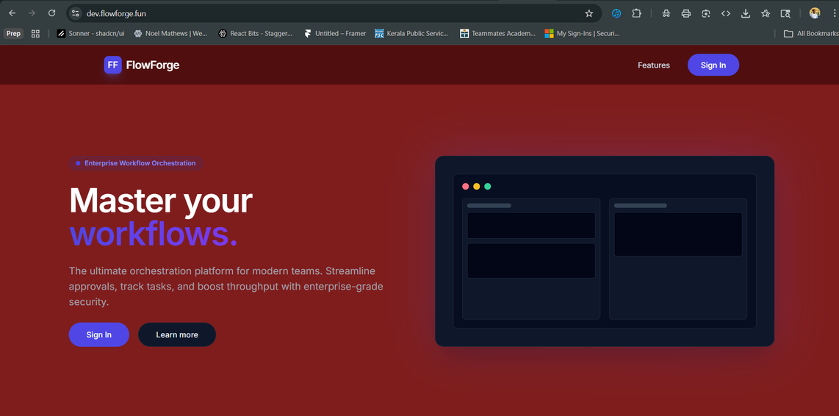

Dev vs Prod

Slide 31

Verification
kubectl get all -n prod

Slide 32



Slide 33
Conclusion
This project demonstrates a complete, enterprise-ready DevOps platform — from identity management and network segmentation to automated CI/CD pipelines and GitOps-driven deployments. The architecture is secure by default, observable by design, and scalable through pattern-driven configuration. It represents a production-grade implementation of modern cloud-native DevOps principles.

