Slide 1

GUARDIA WOMEN'S SAFETY APP

Slide 2
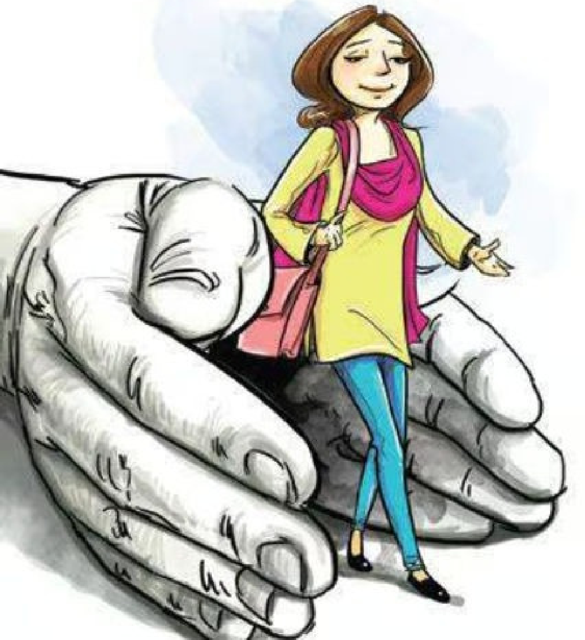
What is Guardia?
Guardia is a mobile application that acts as a personal safety companion. It provides users with features such as emergency alerts,real-time location sharing, community support, and incident documentation. With Guardia,women can feel more secure in their everyday lives.

Slide 3
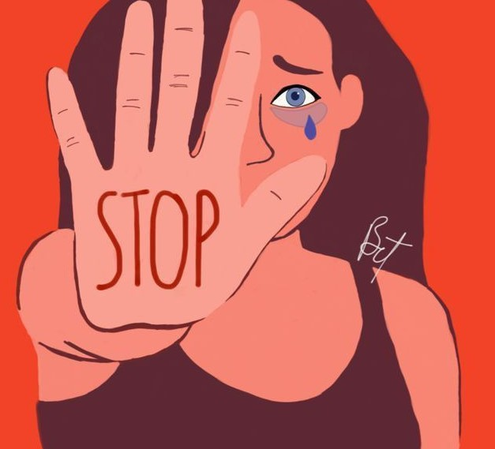
The Need for Safety
In today's world, women's safety remains a critical concern. Statistics reveal that 1 in 3 women experience some form of violence. The need for a reliable tool like Guardia is more crucial than ever to ensure protection and peace of mind.

Slide 4





Real-time location sharing with Geo-fencing.
KEY
Panic gesture activation Incident documentation mode
Ofﬂine emergency mode Threat detection
Video evidence generation Map and emergency services

Slide 5
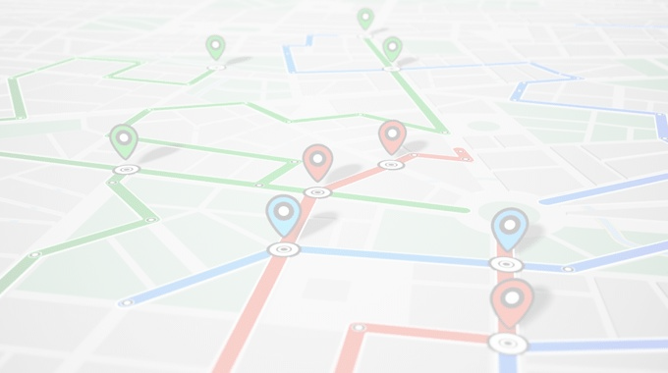

1. Real-time location sharing with Geo-fencing
Users can share their real-time location with trusted contacts.
Geo-fencing alerts are triggered when a user enters or exits predefined dangerous areas.

Slide 6

2. Panic Gesture Activation
Users can trigger emergency alerts by performing discreet gestures, such as shaking the phone or pressing a specific button sequence.
The app provides vibration feedback to confirm that the alert was sent.

Slide 7

3. Incident Documentation Mode
Users can document incidents in real-time by capturing photos, videos, voice memos, and time- stamped notes, which are securely stored in the cloud.
Provides valuable evidence for legal purposes and helps victims articulate their experiences later.

Slide 8

4. Offline Emergency Mode
Users can trigger alerts and record audio/video evidence even without an active internet connection.
Data is synced to the cloud when connectivity is restored.
Ensures that users can seek help in areas with poor network coverage.

Slide 9

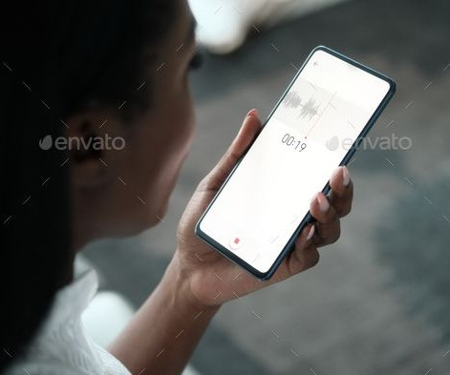
5. Threat Detection
The app uses TensorFlow Lite for on- device machine learning to detect threatening situations based on voice feeds.
The Bhashini API allows language conversion in 19 regional languages.

Slide 10
6. Video Evidence Generation
The app captures a 30-second video recursively when an alert is triggered to provide evidence for incidents.

Slide 11
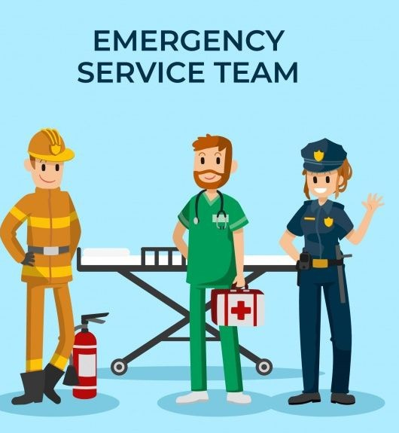
7. Map and Emergency Services Information
The app displays
maps of nearby
emergency services, helping users locate safe places quickly.

Slide 12


User-Friendly Design
The app’s user-friendly interface ensures that women can easily navigate its features.With a focus on accessibility and intuitive design, Guardia empowers users to act swiftly in emergencies,making safety a priority.

Slide 13

TECH STACK
Firebase
Google Maps API Socket.io TensorFlow Lite TLS/HTTPS
APIs : Bhashini API
Voice control integration with Google Assistant or Siri
Flutter Framework SQLite

Slide 14
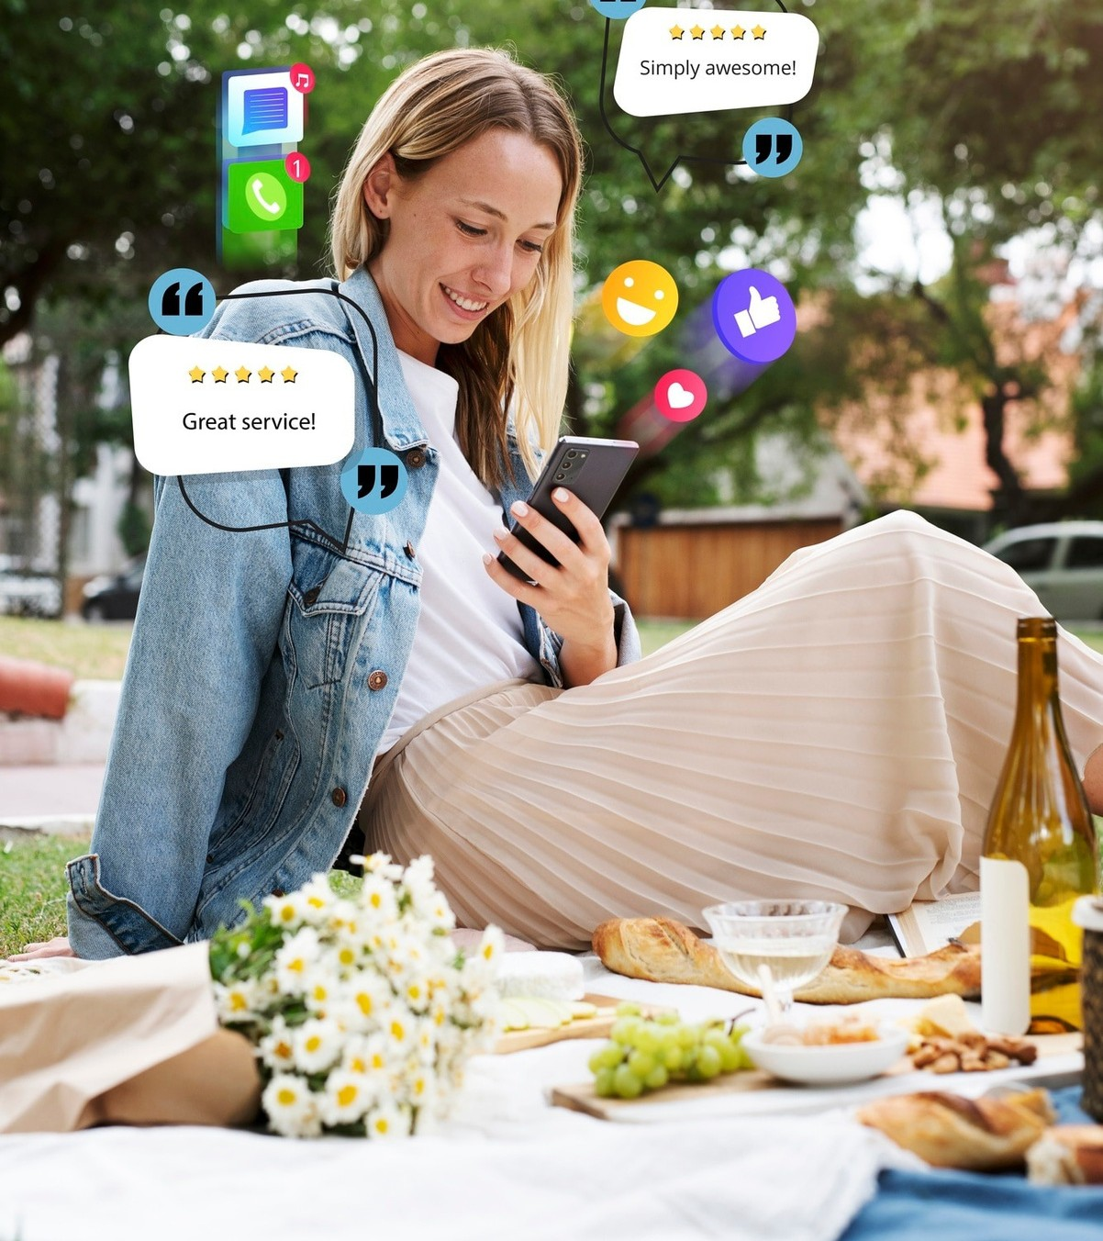
Real-Life Impact
Since its launch,Guardia has made a significant impact on women safety.Users report feeling more secure and confident when going out,thanks to the app’s supportive features and community it fosters.

Slide 15

Safety Education
Guardia also focuses on safety education.The app provides resources on self-defense,situational awarenes and emergency preparedness empowering women to take proactive steps in protecting themselves.

Slide 16
Conclusion
Conclusion
In conclusion,Guardia is more than just an app;it is a lifeline foe women seeking safety and support.By harnessing technology and community,we can empower women to reclaim their freedom and confidence.
In conclusion,Guardia is more just an app;it is a lifeline for women seeking safety and support.By harnessing technology and community,we can empower women to reclaim their freedom and confidence.

Slide 17

Thanks!..

