Slide 1
Book1
File created on: 01-07-2022 15:17:24

Slide 2
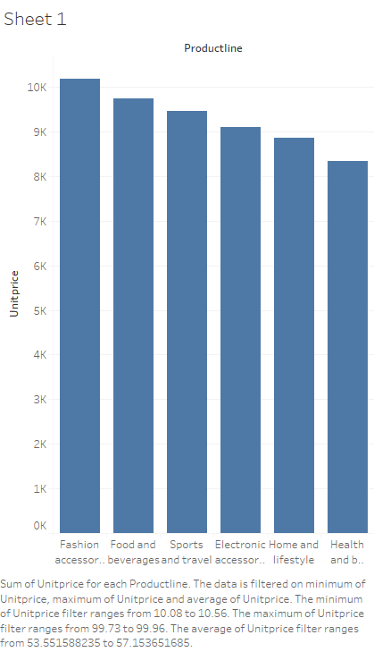

Slide 3
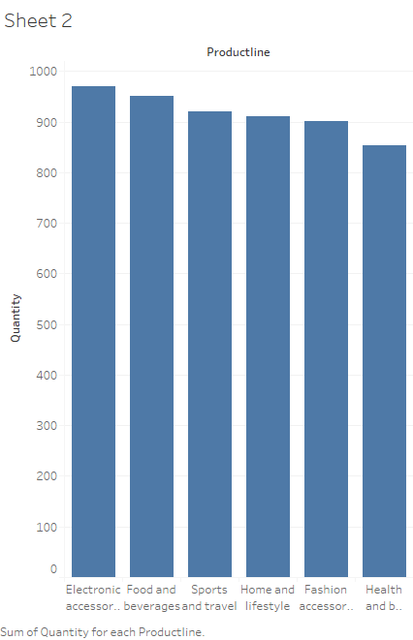

Slide 4


Slide 5
