Slide 1

IDSOL 2026 · INTERNATIONAL DATA SCIENCE OLYMPIAD
Empowering SMEs and startups to foster resilience to global supply chain disruptions with AI.
Agentic supply-chain decision support combining LLM/NLP, RAG, knowledge graphs, a digital twin, simulation, optimization, and governance.
Team: University of Toronto · Ka Woon Ho, Ke Xin Cao, Gary Leng, Mo Xia, Andrew Li
Focus: SMEs · startups · semiconductor and electronics supply networks
Notes:
Chainsilience AI — supply chain resilience. We're a UofT team: four CS students build the AI, and I lead product and go-to-market from Rotman. In the next ~10 minutes I'll show how our platform turns a flood of global disruption news into a specific, costed action plan for one company.

Slide 2
THE DECISION GAP
Disruption signals arrive before operational context
Taiwan earthquake
Manual workflow breaks at four points
US export restrictions
High-volume reporting hides enterprise-relevant events.
Rare-earth shortages
1
Relevant events are detected too late
2
Unsupported reports create costly false alarms
Shipping & port delays
3
Dependencies remain scattered across enterprise systems
New tariffs
4
News rarely produces a feasible operational response
Chainsilience AI
IDSOL 2026 · The Decision Gap
Notes:
A single disruption — an earthquake, an export ban, a port closure — can be devastating for a company that depends on one region. Today the bottleneck is human: someone has to read everything and manually connect a headline to their own suppliers. Small companies simply don't have that capacity, and even large ones react too late.

Slide 3
WHY IT MATTERS
A small timing gap can become a stoppage
60%
12 days
21 days
Day 13
qualified wafer volume from one supplier
usable inventory coverage
illustrative recovery range
projected baseline shortage
Illustrative Orion Controls scenario: concentrated supply, short inventory coverage, and slow recovery create a time-critical enterprise decision.
Chainsilience AI
IDSOL 2026 · Why it matters
Notes:
These figures come straight from our worked semiconductor scenario. The point: the gap between an event and a production stoppage is often measured in days, and the revenue at stake is in the millions. The companies least able to absorb that are precisely our target users.

Slide 4
CHAINSILIENCE AI
From external signal to governed decision
Every transition stores confidence, provenance, timestamp, and version.
1
2
3
4
Detect & Verify
Map Exposure
Quantify Impact
Plan & Approve
Normalize permitted sources and cross-check disruption claims
Link events to enterprise parts, routes, products, and orders
Deterministic metrics and Monte Carlo scenario analysis
RAG-grounded options, feasibility checks, and human authorization
Chainsilience AI
IDSOL 2026 · Chainsilience AI
Notes:
Four pillars. We monitor and verify the outside world, we model the inside of your business as a digital twin, we predict the impact where those two meet, and then we help you act — with scenarios and drafted communications. The key differentiator is the middle: mapping events to your specific operations.

Slide 5
END-TO-END WORKFLOW
One evidence-preserving intelligence loop
›
›
›
›
›
1
2
2
3
4
5
6
Collect
Filter
Verify
Map
Simulate
Plan
Normalize permitted external signals
LLM relevance to enterprise entities
Cross-source claims and provenance
Knowledge graph to digital twin snapshot
DOC, shortage, cost, mitigation scenarios
RAG-grounded options and approval-gated actions
New confirmations, inventory changes, shipment data, and production results update the versioned twin while preserving before-and-after evidence.
Chainsilience AI
IDSOL 2026 · End-to-End Workflow
Notes:
Six stages, running continuously. Note stage two — verification — before anything is trusted. And the whole thing is a loop: once a company acts, we compare predicted vs. actual outcomes and feed that back, so the system learns each customer's real lead times and supplier behavior.

Slide 6
AI AGENT ARCHITECTURE
Bounded agents turn news into governed action
1
Non-AI Scout
5
Analyst
scrapes permitted news, advisories, and feeds
calls deterministic and Monte Carlo engines
2
Extractor
6
Planner
filters enterprise relevance · structures event
retrieves constraints · proposes mitigation options
3
Verifier
7
Communicator
cross-checks sources · filters out unsupported claims
drafts supplier and customer emails
4
Mapper
RAG and controlled tools preserve evidence; supplier and customer emails remain drafts until human approval.
links disruption to graph path then to entity twins
Chainsilience AI
IDSOL 2026 · Agent Architecture
Notes:
This is the live demo we'll run. An earthquake is detected and verified, we trace it through the digital twin to a specific 42%-dependency on wafers, calculate 12 days of cover and 71% stoppage risk, compare three responses, recommend shifting 25% of orders, and draft the emails — all before the dashboard finishes updating. The takeaway line: this connects an external event to YOUR data and produces a real operational decision.

Slide 7
RAG & VERIFICATION
Evidence enters the LLM before an answer
RAG retrieves authorized records; verification filters out unreliable, contradictory, or unsupported claims.
1
External evidence
2
Enterprise context
Government advisories, feeds, trade notices, disclosures, trusted media, and cited passages
Approved suppliers, substitutes, contracts, policies, capacities, routes, and prior responses
Chainsilience AI
IDSOL 2026 · RAG & Verification
Notes:
This is where the team's second idea folds in. Before we let a story drive a $180K decision, we verify it: dedupe across sources, score credibility, and — importantly in 2026 — run a deepfake detector on any video or audio evidence. It combines visual, audio, sync, and metadata signals into a manipulation-risk score. Crucially it's framed as evidence for a human, not a verdict.

Slide 8
THE DIGITAL TWIN
Knowledge graph turns relevance into exposure
Edge
Authorized enterprise data becomes a versioned graph plus time-indexed operational state.
Illustrative affected graph path
Taiwan earthquake
↓ affects
Suppliers
Sites
Inventory
Routes
Supplier A site
↓ supplies
Products
Components
Orders
Customers
Controller chip
↓ required by
State includes inventory, demand, capacity, lead time, routes, orders, priorities, source, and effective time.
3 product SKUs
↓ fulfills
7 customer orders
↓ owned by
Enterprise teams
Node
Chainsilience AI
IDSOL 2026 · The Digital Twin
Notes:
This is the heart of the product. We don't just tag a news article 'semiconductor' — we know Supplier A gives you 42% of your wafers, those wafers go into Product X, and Product X has three big customer orders behind it. That chain is what lets us translate a distant event into your revenue at risk.

Slide 9
HYBRID DSAI STACK
Each component performs one accountable job
Language understanding, structured context, quantitative analysis, and authorization remain separate.
LLM + NLP
Relevance, extraction, explanation
87/100
RAG
Authorized evidence and constraints
Digital twin
Critical Risk
Versioned replica of enterprise entities
Knowledge graph
Affected supply chain paths
Deterministic services calculate. The LLM interprets and explains score reasoning. Enterprise policy and authorized roles decide.
Simulation + optimization
Impact, feasibility, trade-offs
Policy + human approval
Authorization and accountability
Chainsilience AI
IDSOL 2026 · Hybrid DSAI Stack
Notes:
Judges will ask 'is this a black box?' No. The score is a transparent product of six factors, each traceable to a number in the digital twin. So instead of just showing '87', we show WHY it's 87 — which is what makes a procurement manager actually trust and act on it. We map the knowledge graph to the digital twin to show affected supply chain dependency paths.

Slide 10
IMPACT ENGINE
Operational impact becomes reproducible
Illustrative Orion Controls outputs from one frozen enterprise snapshot.
13
12
71%
projected shortage day
days of inventory coverage
Production stoppage probability
$180K
3 weeks
7
mitigation cost estimate
illustrative recovery range
customer orders on affected path
Method: deterministic inventory and cost calculations plus Monte Carlo simulation. The LLM explains outputs and reasoning behind the numbers; the LLM does not perform the calculations.
Chainsilience AI
IDSOL 2026 · Impact Engine
Notes:
This is the 'so what'. A CFO doesn't care that there was an earthquake — they care that $1.2M of revenue and 14 orders are exposed, with a 71% chance of a stoppage. We deliberately use a hybrid rules-plus-forecasting approach so it's buildable for a prototype and still defensible.

Slide 11
MITIGATION PLANNING
Candidate mitigation actions are grounded, checked, and compared
RAG provides tailored mitigation options and constraints; deterministic services validate options numerically.
Illustrative scenario simulation comparison
B · Switch 25% to Supplier B
$180K estimate · 5-day changeover · qualification checked
C · Use qualified air freight
$300K estimate · carrier · customs · capacity · cost checked
D · Delay low-priority orders
$0 estimate · Priority · contract · service commitments checked
Chainsilience AI
IDSOL 2026 · Mitigation Planning
Notes:
This is the payoff of the digital twin. Doing nothing leaves a 71% stoppage risk. Switching a quarter of orders drops it to 34% for $180K. Air freight gets you to 18% but costs more. We lay the trade-offs side by side so a human can choose based on their priorities — cost, speed, or protecting key customers.

Slide 12
ACTION GOVERNANCE
AI recommendations remain reviewable drafts
One reviewable recommendation package
AI-drafted supplier request email
“Please confirm facility status, available capacity, revised lead time, allocation policy, and next update time for Purchase Order 1042.”
Evidence
Verified sources · cited passages · affected graph path
AI-recommended mitigation strategies
Supplier/customer/executive drafts remain editable and approval-gated.
Proposed actions · projected impact · cost · recovery time · financial impact
Policy gateway: Consequential actions require named authorization. MCP may expose typed tools, but authentication, validation, and approval remain enterprise responsibilities.
Human review and decision
Named approver · edits · approval status · deadline · audit history
Chainsilience AI
IDSOL 2026 · Action Governance
Notes:
Recommendations are grouped by urgency, each with an expected benefit, cost, owner and deadline. We also draft the outbound comms — to suppliers, customers, and executives. But nothing is automated end-to-end: a human always reviews and approves. That's both safer and what real procurement teams require.

Slide 13
DECISION DASHBOARD
Evidence, exposure, impact, and action share one view
Top enterprise exposures
EVENT
AFFECTED PATH
TRIAGE
IMPACT
Taiwan earthquake
Supplier A → chip → 7 orders
$600K revenue at risk
Critical
Port congestion
Shanghai–LA route
6-day delay
High
Export restriction
Rare-earth supplier
+18% cost
High
Each alert separates the no-action baseline, projected mitigated outcome, and realized outcome—and links every figure to evidence and the twin snapshot.
Chainsilience AI
IDSOL 2026 · Decision Dashboard
Notes:
The dashboard shows a clear overview, not raw news. At a glance: how many critical vs. low risks, the top exposures ranked by impact, a global risk map, inventory countdowns, and a news feed filtered to only company-relevant events. It turns the platform from passive monitoring into an operational tool.

Slide 14
ILLUSTRATIVE REPLAY
Case Study: Taiwan earthquake’s evidence to decision flow
1
Dated event collected
5
Options grounded by RAG
M7.4 source record retained
Switching 25% to supplier B from Vietnam, Air Freight, etc.
2
Relevance + verification
6
Trade-offs validated
claims cross-checked and cited
recovery time = 1 week · cost = $180K · risk reduced = 64%
3
Affected path mapped
7
Decision recorded
event → site → supplier → chip → orders
human approval and drafts email to the Vietnam supplier and USA customers
4
Digital Twin snapshot simulated
Design-test inputs are illustrative; earthquake evidence is historical and source-linked.
12 DOC · baseline shortage day 13
Chainsilience AI
IDSOL 2026 · Illustrative Replay
Notes:
This is the live demo we'll run. An earthquake is detected and verified, we trace it through the digital twin to a specific 42%-dependency on wafers, calculate 12 days of cover and 71% stoppage risk, compare three responses, recommend shifting 25% of orders, and draft the emails — all before the dashboard finishes updating. The takeaway line: this connects an external event to YOUR data and produces a real operational decision.

Slide 15
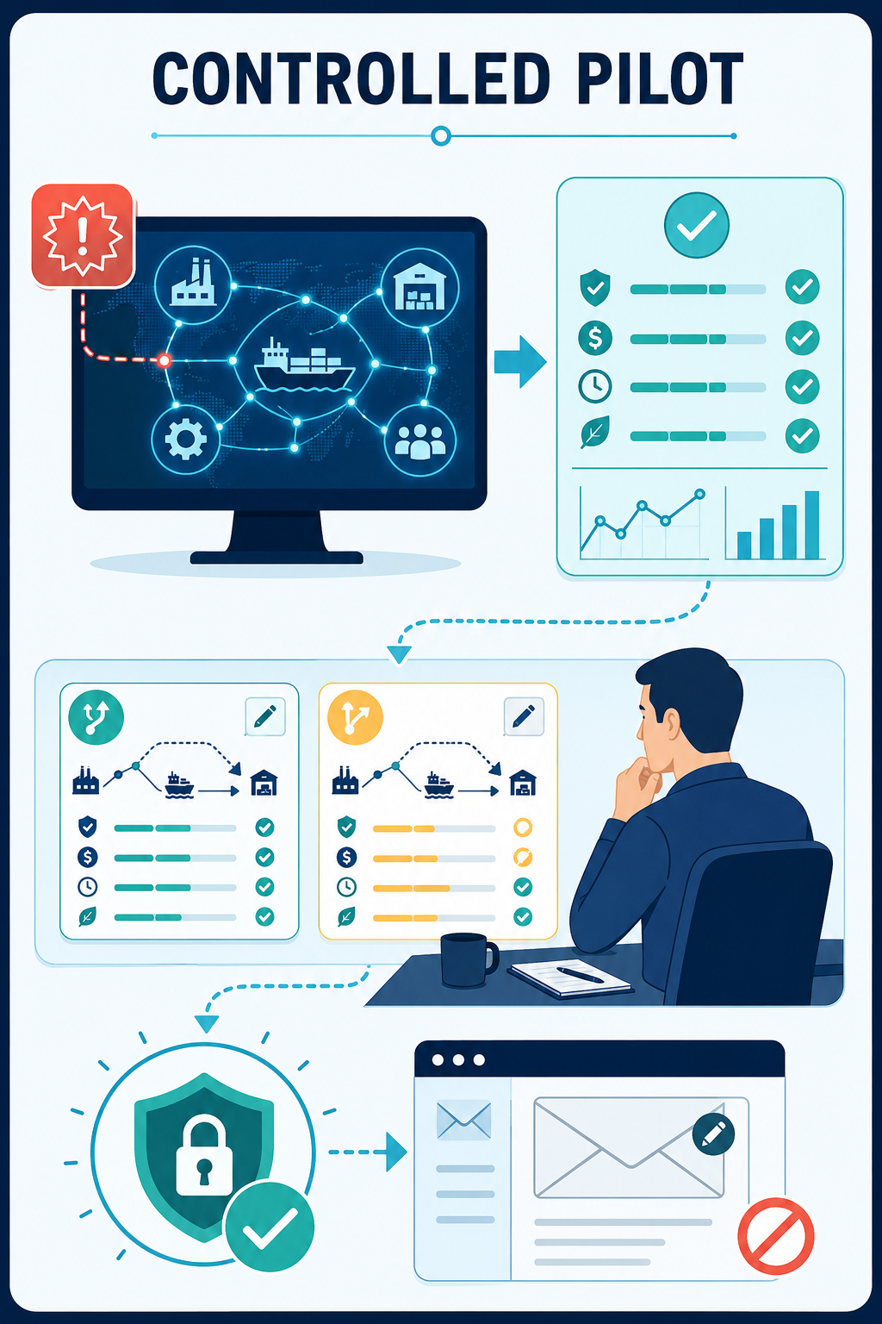
PILOT & VALUE
Claims are designed to be tested
Pilot acceptance criteria
Detection: ≥ 85% of disruptions within 24 hours
Verification: <2% unsupported claims
Mapping: ≥ 80% correct affected supply chain paths connected to disruption
Action: ≥ 90% feasible recommendations
Workflow: 50% faster alert-to-decision time
Chainsilience AI
IDSOL 2026 · Pilot & Value
Notes:
Two messages here. First, our moat isn't the news feed — anyone can scrape news. It's the mapping to a company-specific digital twin plus explainability and action. Second, for the competition we're deliberately narrow: one industry, one full workflow, end to end. Depth over breadth is what makes a convincing prototype.

Slide 16

Verified disruption evidence. Enterprise-specific impacts and tailored mitigations. Human-approved action.
Start counteracting supply chain disruptions today.
4 × Computer Science
1 × Rotman Commerce
Ka Woon Ho, Ke Xin Cao, Mo Xia, Andrew Li
Gary Leng
University of Toronto · Focus: SMEs, startups, and semiconductor supply networks · Functional prototype ready for demonstration.
Notes:
To close: Chainsilience turns global disruption into an action your business can take. Our CS team builds the models; I own product and go-to-market. We're ready to run the full workflow live for you now. Thank you — happy to take questions.

