Slide 1

Food Truck Management System
A full-stack POS application for modern food truck operations
Designed to simulate real-world business workflow
Noemi Delgadillo Roldan
Per Scholas | Accenture / PeopleShores | April 2026

Slide 2


Problem & Solution
BEFORE
AFTER
Paper-based order management — errors during peak hours
No real-time visibility on product availability
Manual expense tracking — time-consuming and error-prone
No sales data or business insights
Digital POS — orders created and tracked in real time
Instant availability toggle for menu items
Automated expense tracking with categories and reports
Analytics dashboard with charts and business insights
->

Slide 3
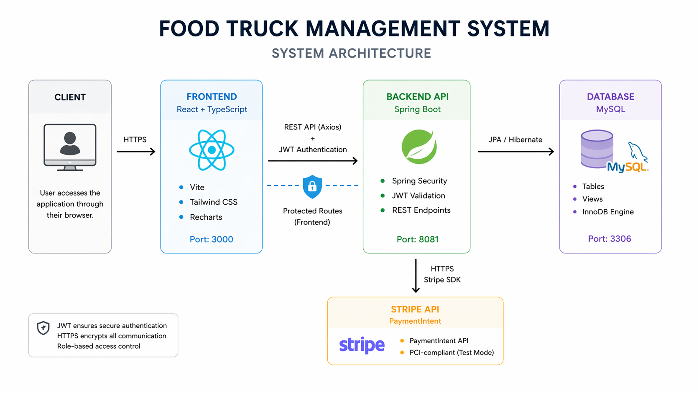




System Architecture Overview
Frontend Layer
Backend Layer
Database Layer
Payments Layer
React 18 + TypeScript
Vite · Tailwind · Recharts
Spring Boot 4
Spring Security · JWT
MySQL 8.0
6 tables + 3 views
Stripe API
PaymentIntent flow
PCI-compliant payment handling (test environment)

Slide 4
Live Demo
Application running locally
Full-stack integration (frontend, backend, database, payments)
Backend: Spring Boot | Port 8081 Frontend: React | Port 3000

Slide 5






Live Demo — Key Features
Dashboard
New Order
Orders
Real-time stats for admin
(orders, revenue, expenses)
Cart with notes per item
Cash & Stripe payment
Status tracking & updates
Kitchen modal for staff
Menu Management
Expenses
Reports
Toggle availability
Product CRUD (admin)
Track costs by category
(admin only)
Sales charts & trends
Popular items analysis

Slide 6

Technical Deep Dive
useReducer for Cart State
4 actions: ADD_ITEM, REMOVE_ITEM, UPDATE_QUANTITY, CLEAR_CART · All cart logic centralized in cartReducer.ts — predictable & testable · Notes per item tracked in cart state · No Redux needed — built-in React hook
MySQL Views for Reporting
3 database views: daily_sales, monthly_expenses, popular_items · Aggregation in DB — faster than computing in Java or JavaScript · Mapped as @Immutable JPA entities with composite keys (@IdClass) · Feeds Reports page charts (BarChart, PieChart, LineChart)
Stripe PaymentIntent Flow
Backend creates PaymentIntent — card data never touches our server · clientSecret returned to frontend securely · Stripe.js CardElement handles PCI-compliant card input · PCI-DSS compliant by design — test mode for demo

Slide 7


Security & Local Setup
JWT Authentication Flow
Role-Based Access Control
1. POST /api/auth/login with credentials
2. Backend validates & generates JWT token
3. JWT stored securely in localStorage (frontend)
4. Bearer token sent on every API request
5. Spring Security validates on each request
6. 401 Unauthorized → frontend redirects to login
Feature | ADMIN | EMPLOYEE
Products — CRUD | Yes | View only
Toggle Availability | Yes | Yes
Orders — Create & Update | Yes | Yes
Expenses & Reports | Yes | No
User Management | Yes | No

Slide 8
Lessons Learned
01
02
03
JPA Validation Errors
Secrets in Source Control
Backend First Development Approach
Transaction failures taught me to align frontend and backend validation constraints from the start — seed data must also respect all entity constraints.
Accidentally committing a Stripe secret key — GitHub's push protection blocked it. Learned to use environment variables and .gitignore from day one.
Building and testing the API before the frontend saved significant rework. TypeScript interfaces kept frontend-backend contracts aligned throughout.

Slide 9
?
Questions?
Thank you for your attention!
Noemi Delgadillo Roldan
Per Scholas | Accenture / PeopleShores | April 2026
Food Truck Management System

