Slide 1
the main sequence of star forming galaxies
Laboratory of data analysis
GROUP 2
Noemi Mezzanzanica
Federico Ravelli
Simone Restuccia
Leonardo Toti

Slide 2
questions
What are the physical processes that determine the presence of two regions? What is the relation between the sSFR and the mass of the galaxy on the star formation main sequence?

Slide 3


materials & methods
Sloan Digital Sky Survey (SDSS)
Catalog containing 300000 multi-band photometric observations of galaxies
Code Investigating GALaxy Emission (CIGALE)
Python tool to derive physical properties from galaxy photometric observations

Slide 4
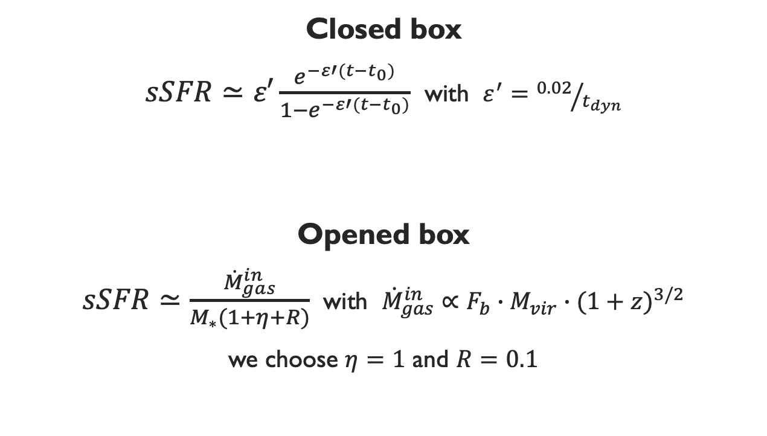
models
Closed box
$sSFR≃ε′\frac{e^{−ε′(t−t_{0})}}{1−e^{−ε′(t−t_{0})}}$ with $ε^{′}={0.02}/{t_{dyn}}$
Opened box
$sSFR≃\frac{{\dot{M}}_{gas}^{in}}{M_{∗}(1+η+R)}$ with ${\dot{M}}_{gas}^{in}∝F_{b}∙M_{vir}∙{(1+z)}^{3/2}$
we choose $η=1$ and $R=0.1$

Slide 5
Results

Slide 6
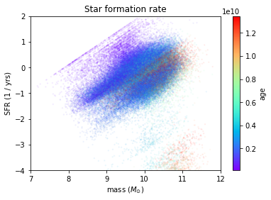
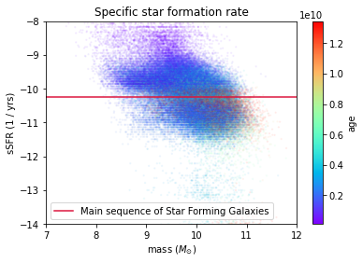
sdss dataset

Slide 7
discussion

Slide 8
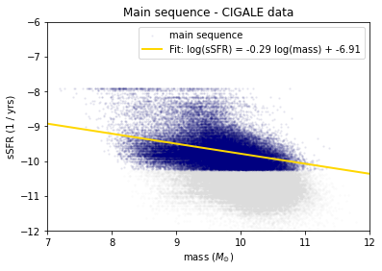
FIt of the main sequence

Slide 9
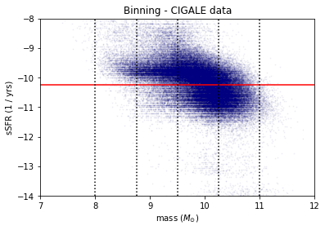
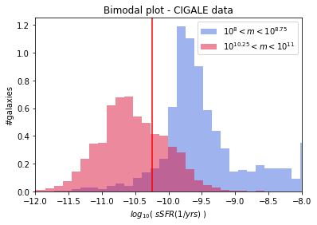
Bimodal plot

Slide 10
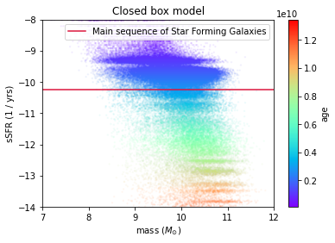
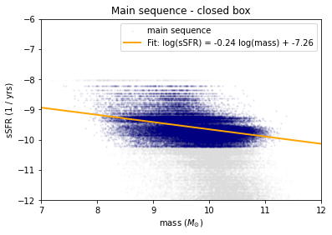
closed box model

Slide 11
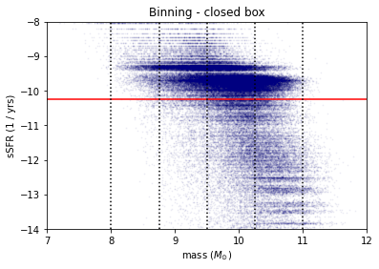
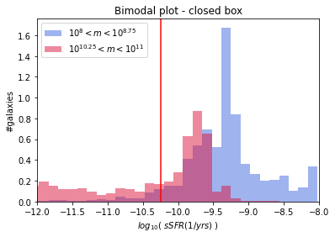
closed box model

Slide 12
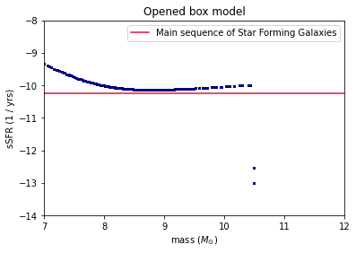
opened box model

Slide 13
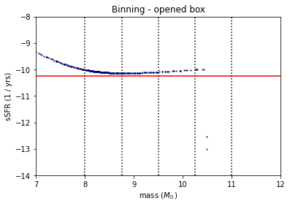
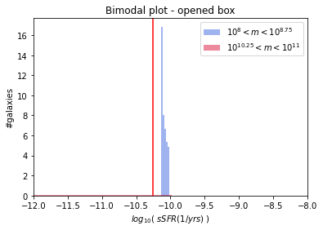
opened box model

Slide 14
summary
Closed box model VS SDSS data
The closed box is not an equilibrium model
The two fits of the Main Sequence of star forming galaxies aren’t compatible
The bimodality is not reproduced by this model
Opened box model
We cannot perform the same analysis since we’re not able to reproduce the spread of the galaxies in the sSFR plot → age of the galaxies
The code doesn’t produce galaxies in the passive region → sSFR drop

Slide 15
Thanks for your attention!

