Slide 1
the main sequence of star forming galaxies
Laboratory of data analysis
GROUP 2
Noemi Mezzanzanica
Federico Ravelli
Simone Restuccia
Leonardo Toti

Slide 2
questions
What are the physical processes that determine the presence of two regions? What is the relation between the ssfr and the mass of the galaxy on the star formation main sequence?

Slide 3
materials & methods
SSDS
Cigale

Slide 4
models
Closed box
Opened box

Slide 5
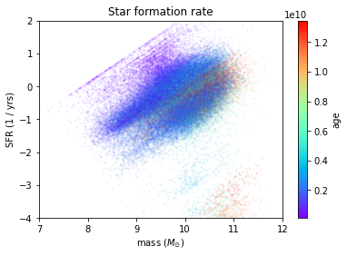
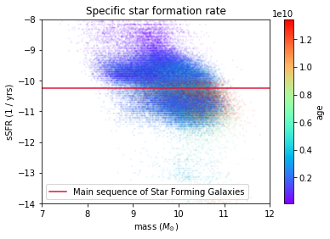
sdss dataset
2 graph

Slide 6
Results

Slide 7
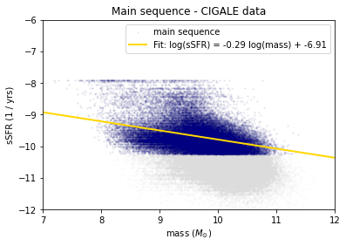
FIt of the main sequence
SSDS
(sistema titoli grafici)

Slide 8
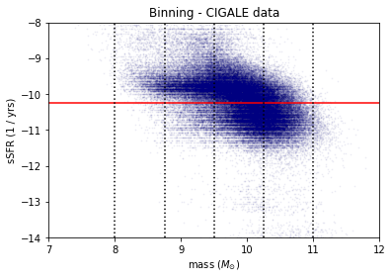
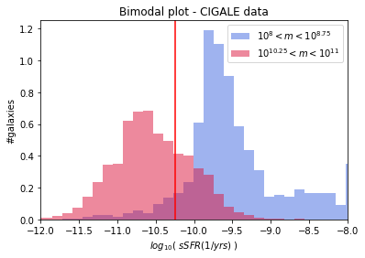
Bimodal plot
2 graph SDSS
bins
histogram

Slide 9
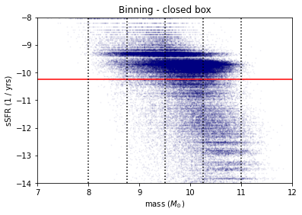
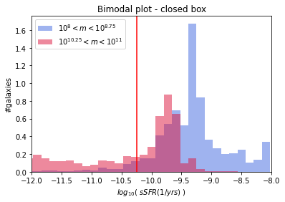
opened box
2 graph closed
bins
histogram

Slide 10
discussion

Slide 11
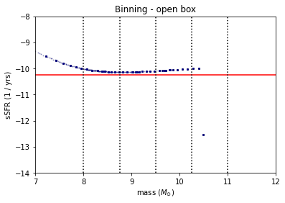
Bimodal plot
2 graph opened
bins

Slide 12
summary
ssds vs closed
no equilibrio
fit non compatibile
bimodalità non riprodotta
opened
non possiamo fare la stessa analisi → no spread perchè ~stessa age

Slide 13
Grazie per l’attenzione

