Slide 1
How to create a beautiful blog
COUTABLE Guillaume, MENORET Clément,
RULLIER Noémie, WOLLENBURGER Antoine

Slide 2
Contents
Introduction
Sign up on overblog
Create an article
Pimp your blog !
Sharing it
Conclusion

Slide 3

Introduction
Many tools
Novice to Professional
Overblog

Slide 4
Sign up on overblog
Go on overblog website
Sign up
Valid your email address
Ready to enrich your blog

Slide 5
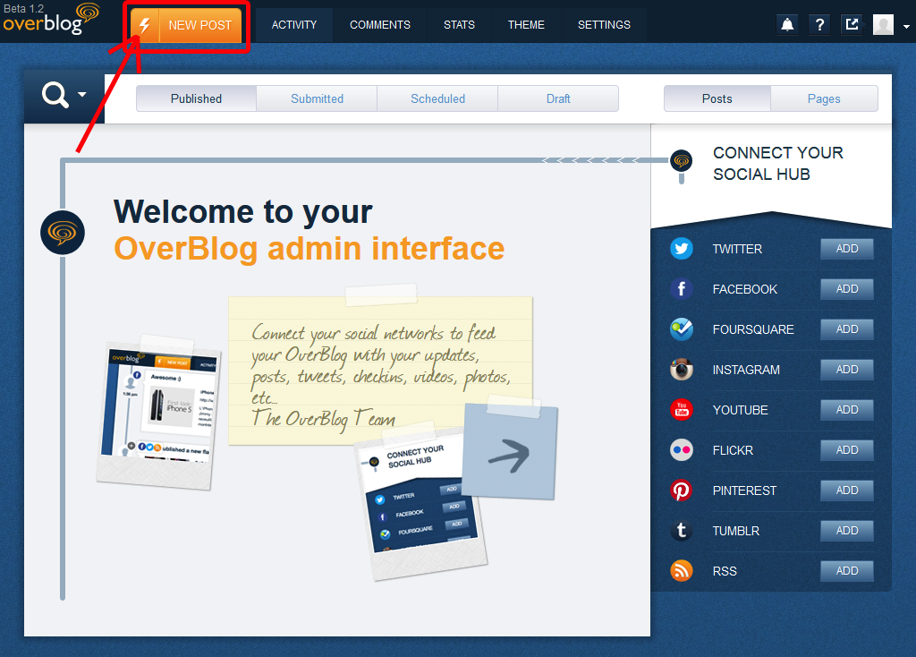
Create an article
A quick post

Slide 6
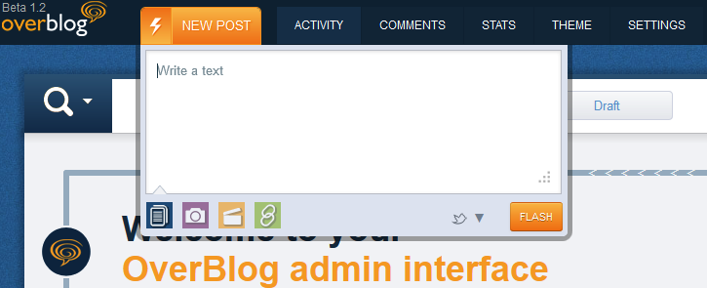
Create an article
Writing a basic post

Slide 7

Create an article
A real article

Slide 8
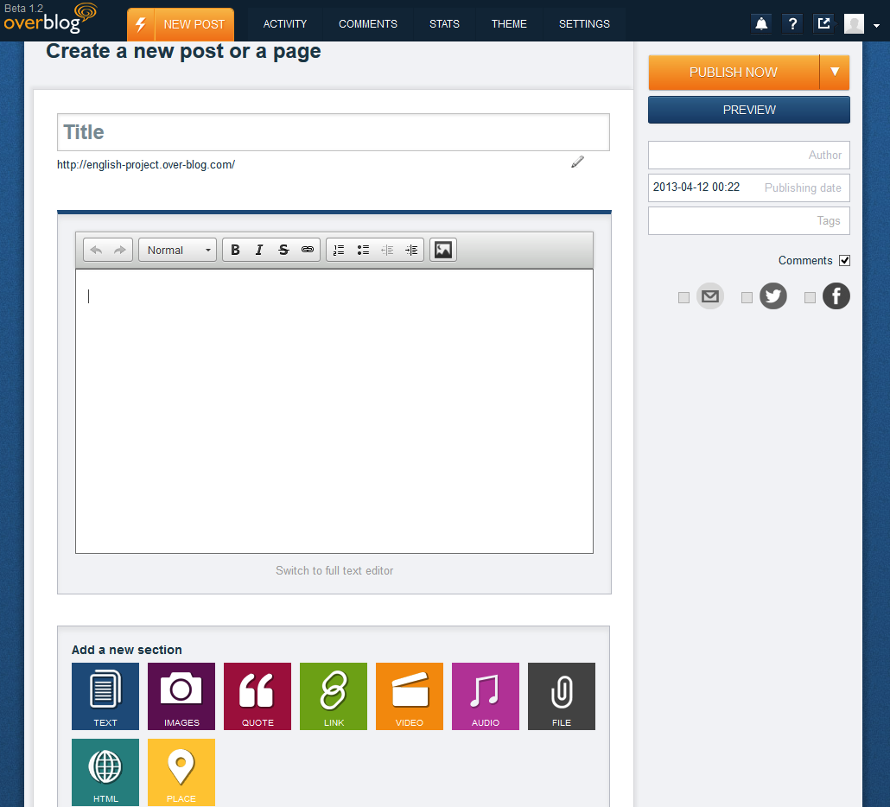
Create an article
Building an article

Slide 9
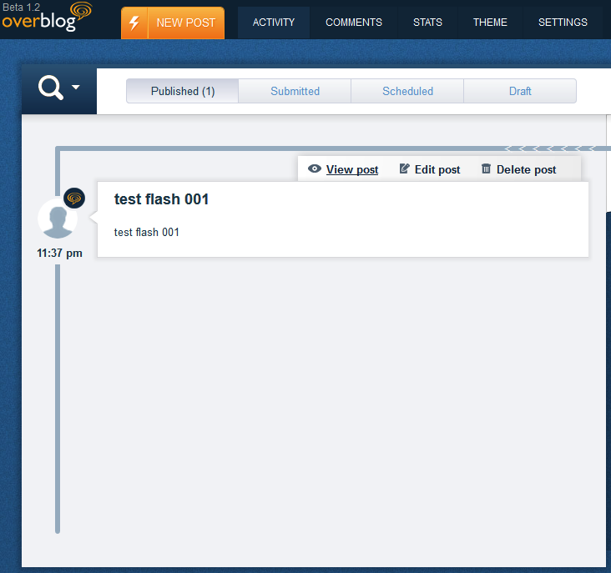
Create an article
Manage the articles

Slide 10
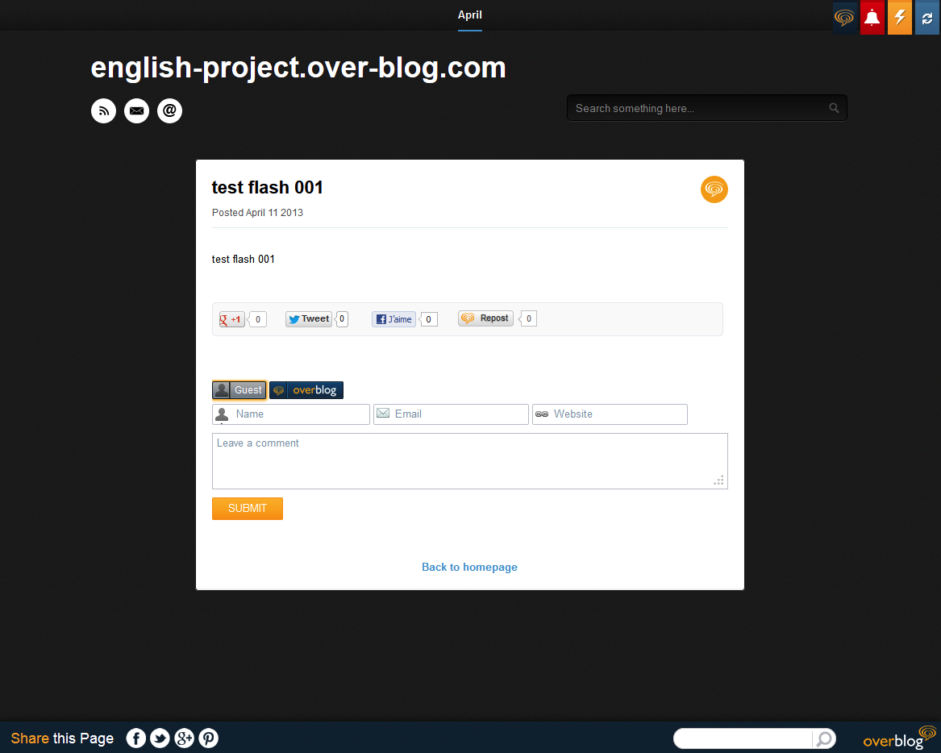
Create an article
View your article in context

Slide 11
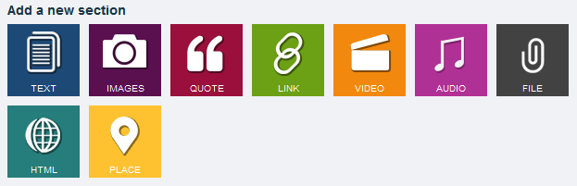
Create an article
Multimedia support

Slide 12
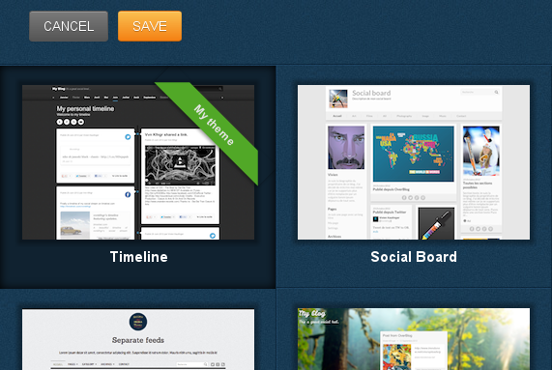
Pimp your blog !
Choose your theme
Modify it

Slide 13
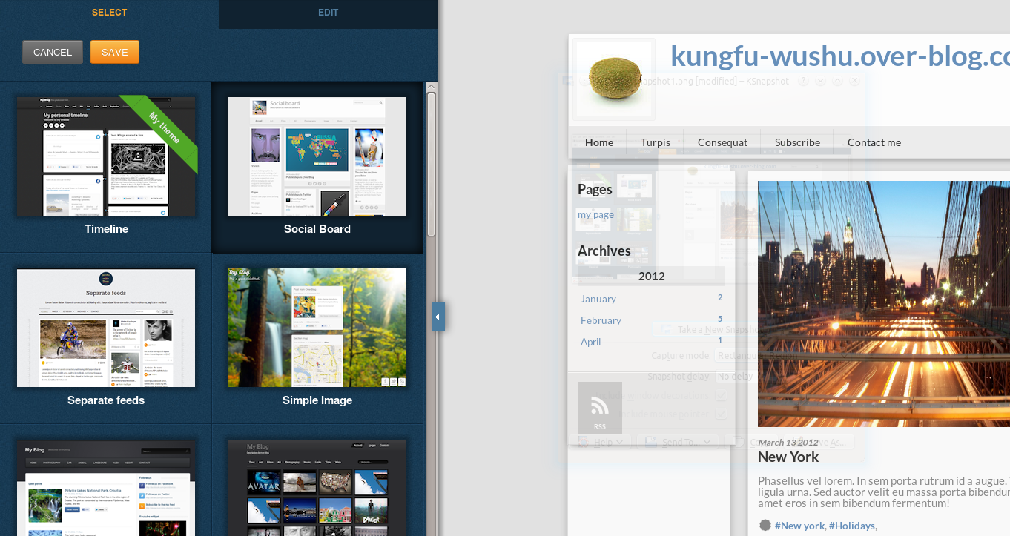
Pimp your blog !
Preview it
Apply it

Slide 14

Share it to let it know !
It’s beautiful to make a blog.
But without reader, is it joyous ?
Share it !
Like it !

Slide 15
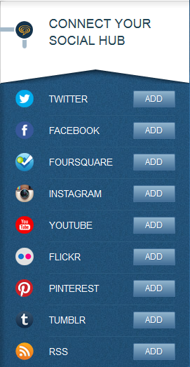
Feed it !
Write a lot of articles bored you ?
You can automatically use your facebook publications.
So let all this people know your personal life.
Just click on the deadly button and take care of your boss.

Slide 16
Conclusion

