Slide 1
How to create a beautiful blog
COUTABLE Guillaume, MENORET Clément,
RULLIER Noémie, WOLLENBURGER Antoine

Slide 2
Contents
Introduction
Sign up on overblog
Create an article
Sharing it
Conclusion

Slide 3

Introduction
Many tools
Novice to Professional
Overblog

Slide 4
Sign up on overblog
Go on overblog website
Sign up
Valid your email address
Ready to enrich your blog

Slide 5

Share it to let it know !
It’s beautiful to make a blog.
But without reader, is it joyous ?
Share it !
Like it !

Slide 6
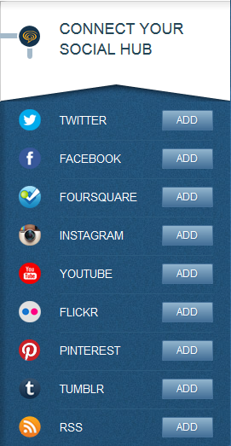
Feed it !
Write a lot of articles bored you ?
You can automatically use your facebook publications.
So let all this people know your personal life.
Just click on the deadly button and take care of your boss.

Slide 7
Conclusion

