Slide 1

WELCOME EVERYONE Presentation of the work I did during my six-week internship …
TOUITOU NOEMIE
STAGIAIRE EN DEVELOPPEMENT

Slide 2






THE OBJECTIVE OF MY WORK
Using the GIE’s PowerPoint
Translation to .json files
Reading the XML file on EXCEL
Redrawing on DRAWIO
Tasks dependencies
CONTROL M’s dags
Sending to AIRFLOW

Slide 3
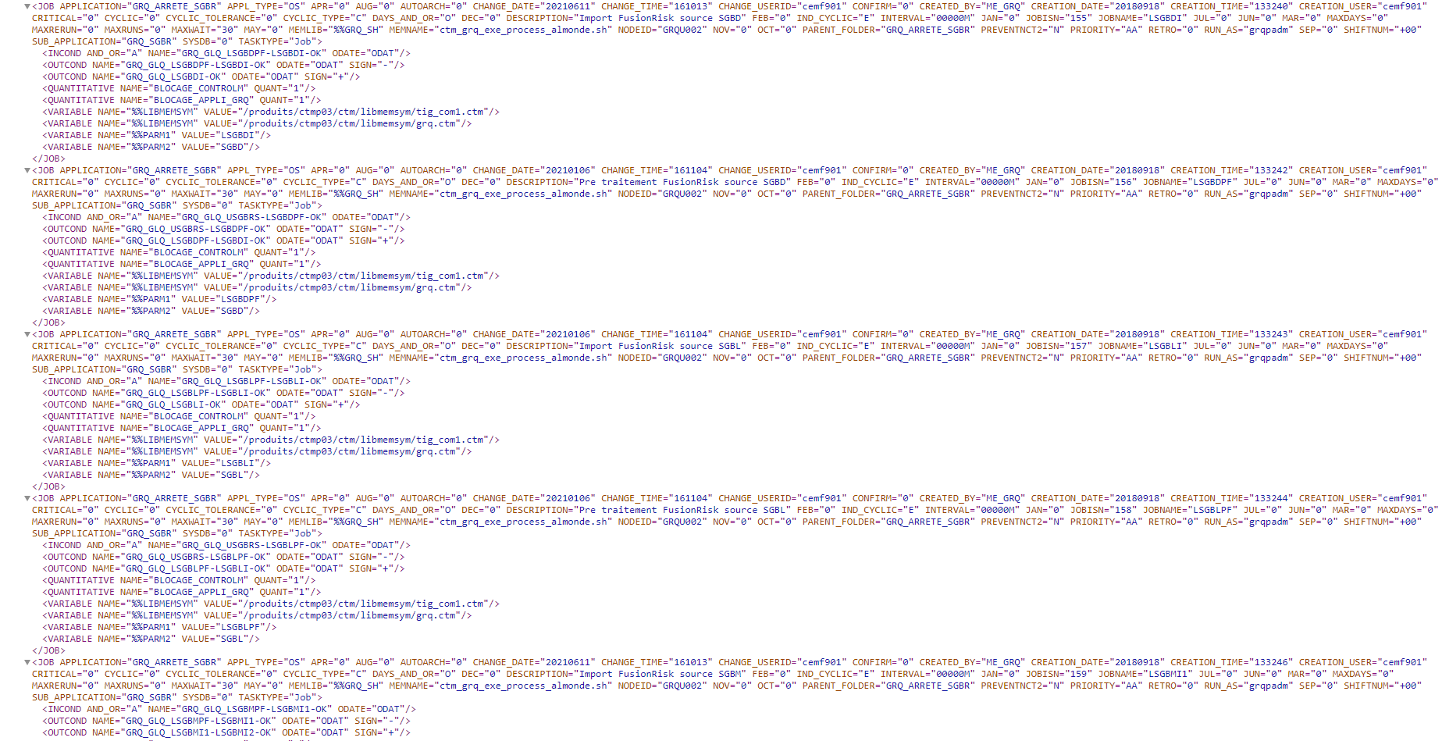
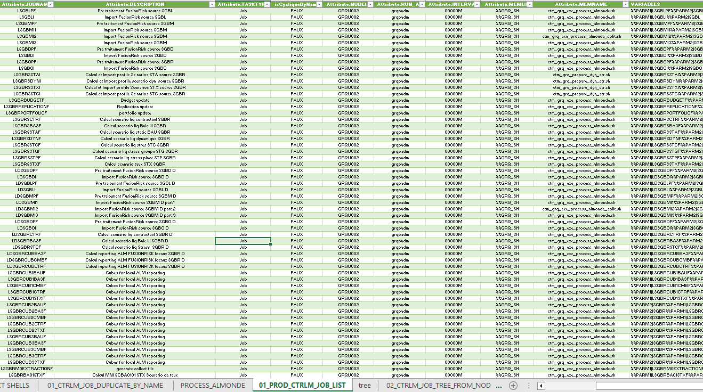
The main dag I worked on :
GIE_GRQ_ARRETE_SGBR
PART 1 : SGBR MONTHLY → A PART ON CONTROL M AND ANOTHER ALREADY ON AIRFLOW
PART 2 : SGBR DAILY
XML
EXCEL
POWER QUERY

Slide 4
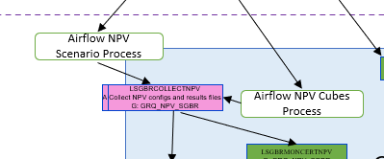
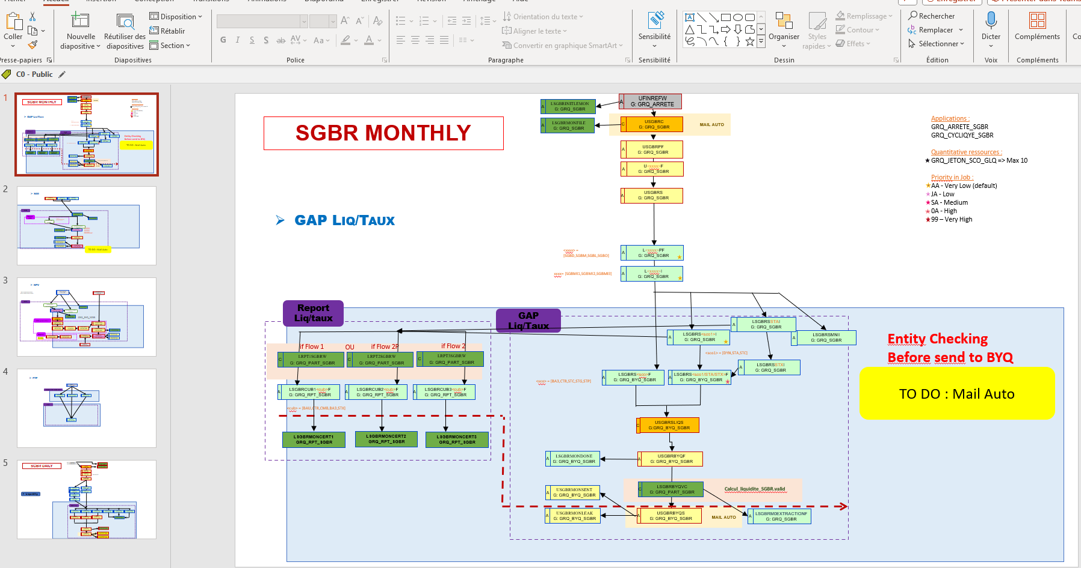
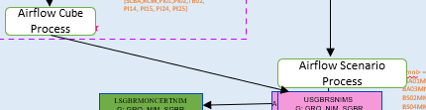
FROM GIE’s POWERPOINT TO DRAWIO
MONTHLY
= part on Airflow
DAILY

Slide 5
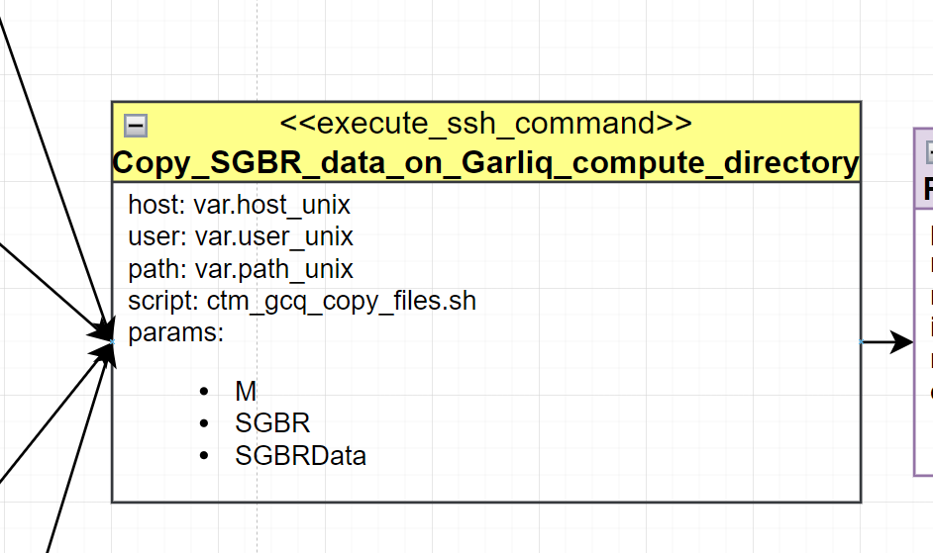
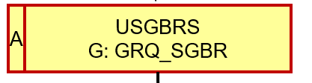
FROM GIE’s POWERPOINT TO DRAWIO
FROM EXCEL to DRAWIO
FROM POWERPOINT TO EXCEL

Slide 6
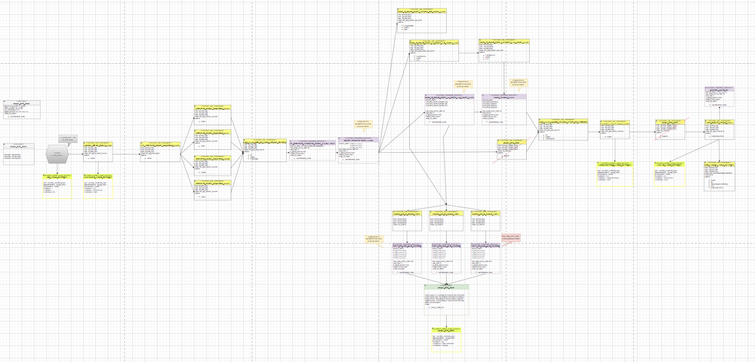
FROM GIE’s POWERPOINT TO DRAWIO
A PART OF SGBR MONTHLY

Slide 7
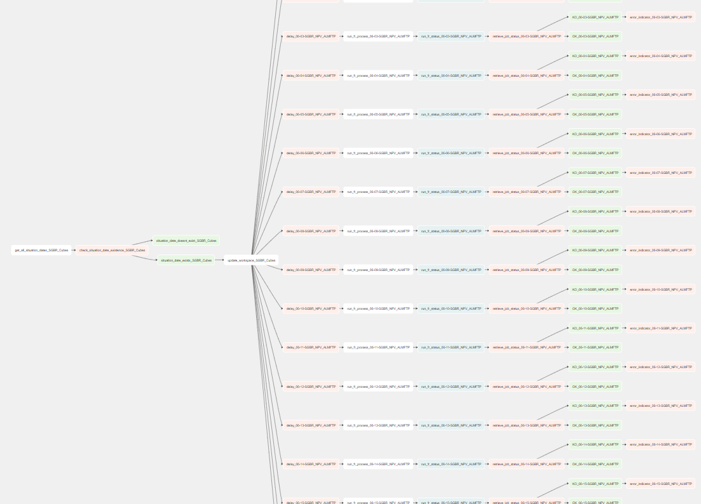

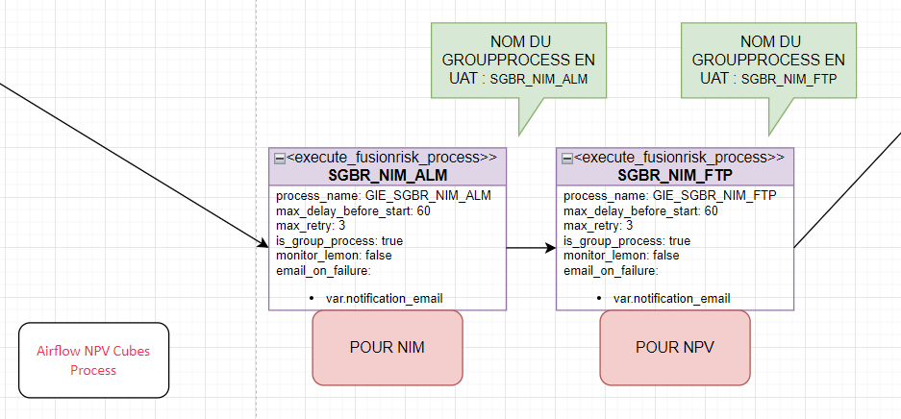
FROM GIE’s POWERPOINT TO DRAWIO
AND WHAT’S ABOUT THE PART THAT ALREADY WAS ON AIRFLOW ?
AIRFLOW
I also transalated it to have it on DRAWIO
DRAWIO

Slide 8
WHAT I DID ?
WHAT’S NEXT ?
XL
S
M
S
S
S
S
GRQ_ARRETE_SGBR
XL
XS
M
L
S
XL
GRQ_ARRETE_SGBT
GRQ_ARRETE_GLBA
GRQ_ARRETE_SECU
GRQ_ARRETE_GP
GRQ_ARRETE_TRES
GRQ_ARRETE_CGIF
GRQ_ARRETE_SGSS
GRQ_ARRETE_ALD
GRQ_ARRETE_PBSU
GRQ_ARRETE_BRS
GRQ_ARRETE_SGMA
GRQ_ARRETE_GEFA

Slide 9
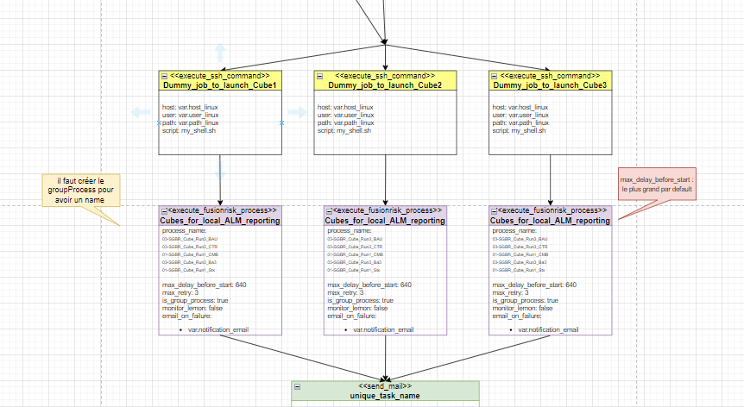
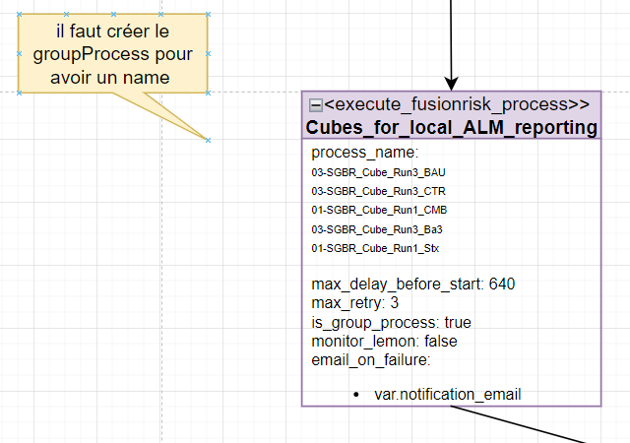
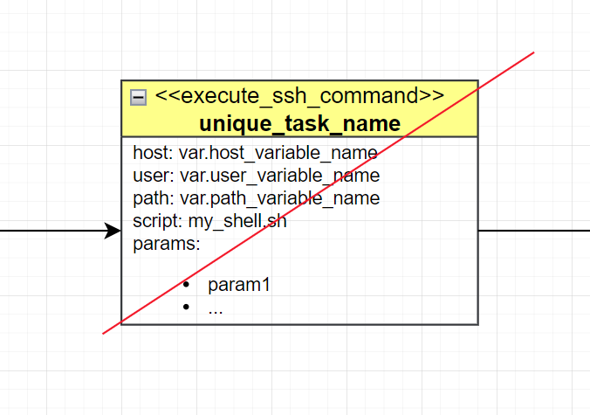
Sequence
GROUP PROCESSES MISSING
ERRORS I NOTICED
COMPONENTS TO CREATE
GAP BETWEEN POWERPOINT AND REALITY (xml)

Slide 10
It was a pleasure to work with you.
THANK YOU ALL
for your attention.

