Slide 1
JAMES WILD
A life remembered
Funeral Memorial • 2026

Slide 2
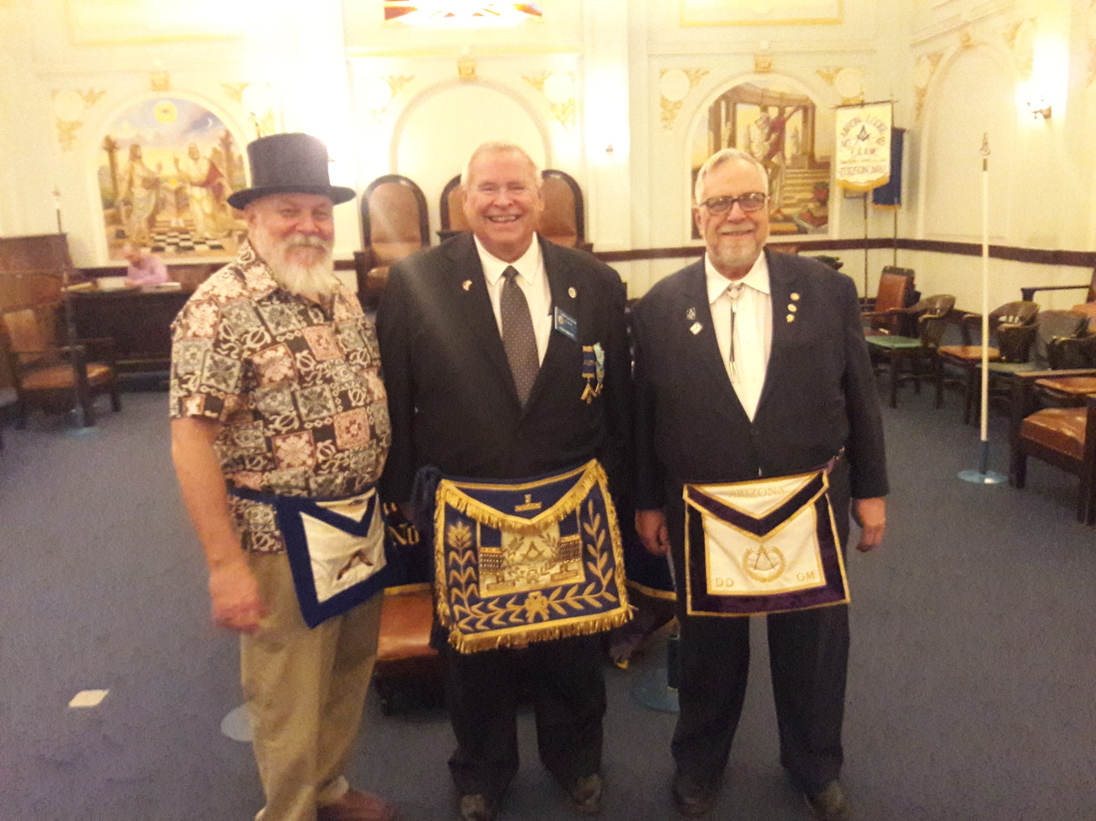
01 • JAMES WILD

Slide 3
01 • JAMES WILD • MEMORY

Slide 4
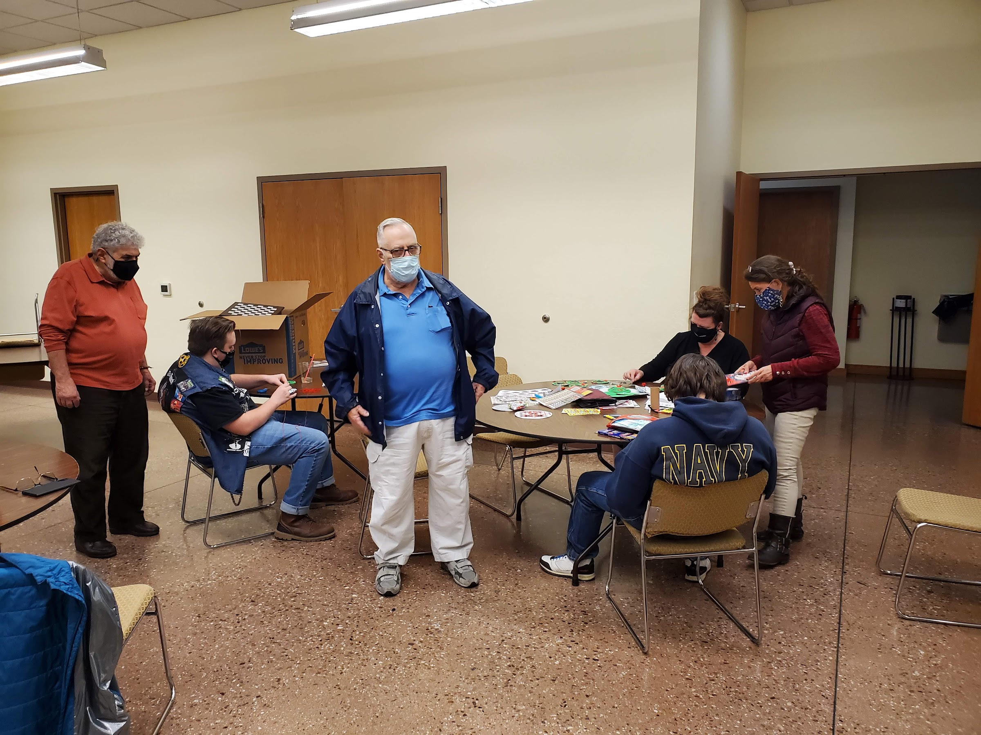
02 • JAMES WILD

Slide 5
02 • JAMES WILD • MEMORY

Slide 6
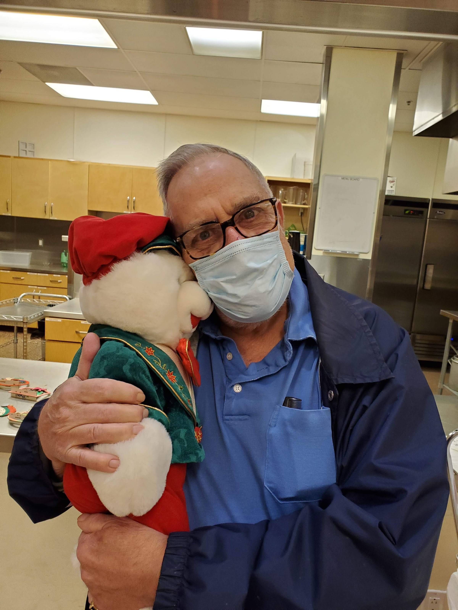
03 • JAMES WILD

Slide 7
03 • JAMES WILD • MEMORY

Slide 8
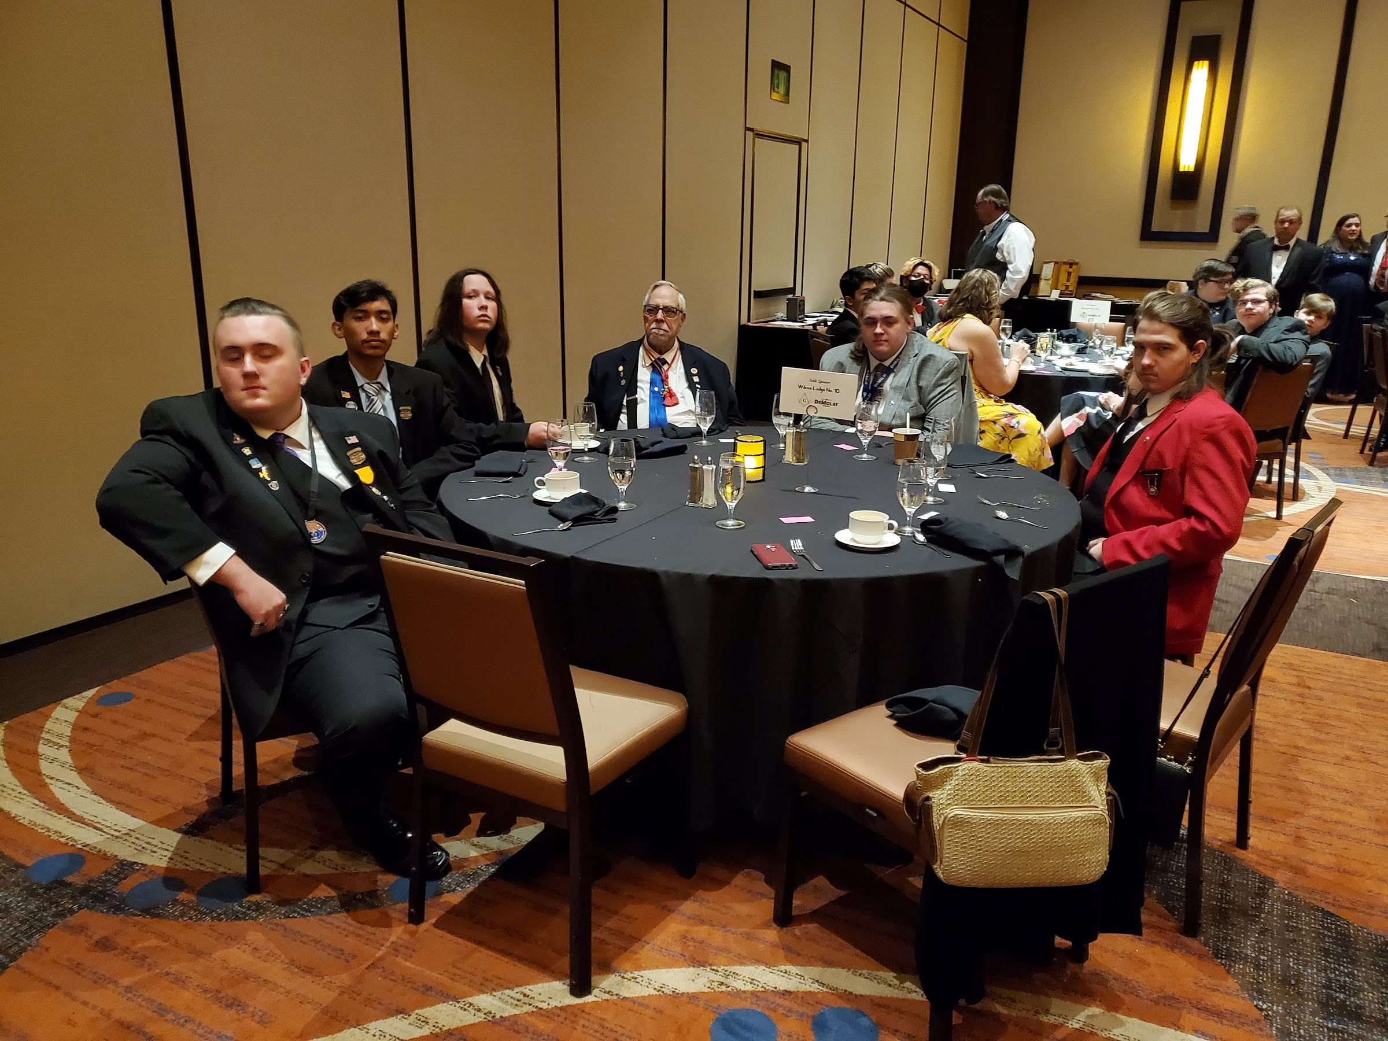
04 • JAMES WILD

Slide 9
04 • JAMES WILD • MEMORY

Slide 10
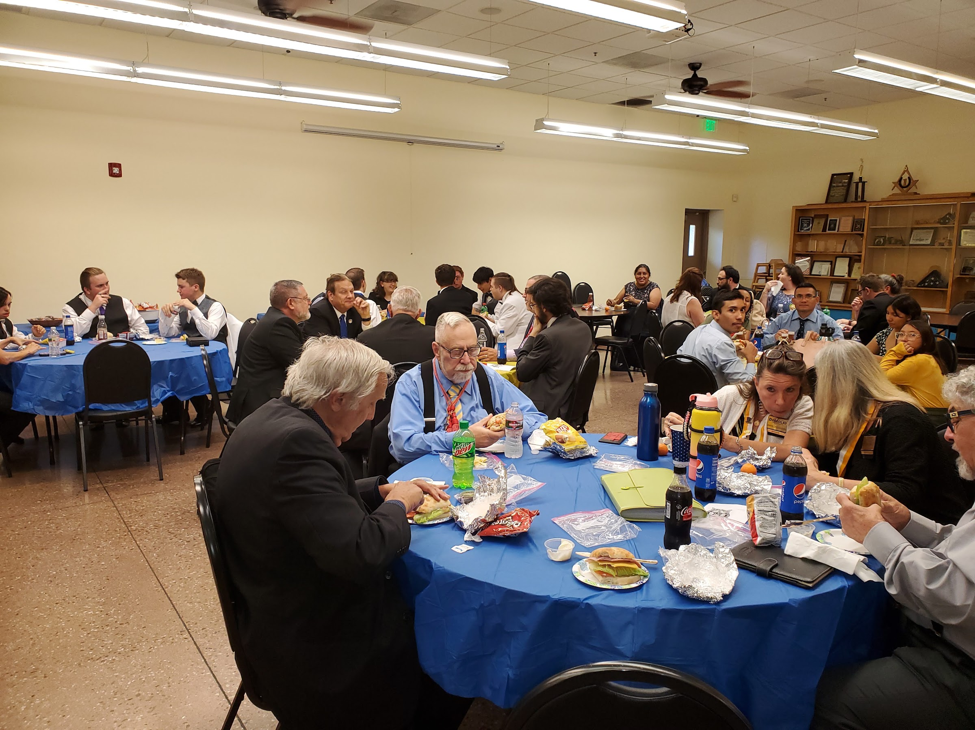
05 • JAMES WILD

Slide 11
05 • JAMES WILD • MEMORY

Slide 12
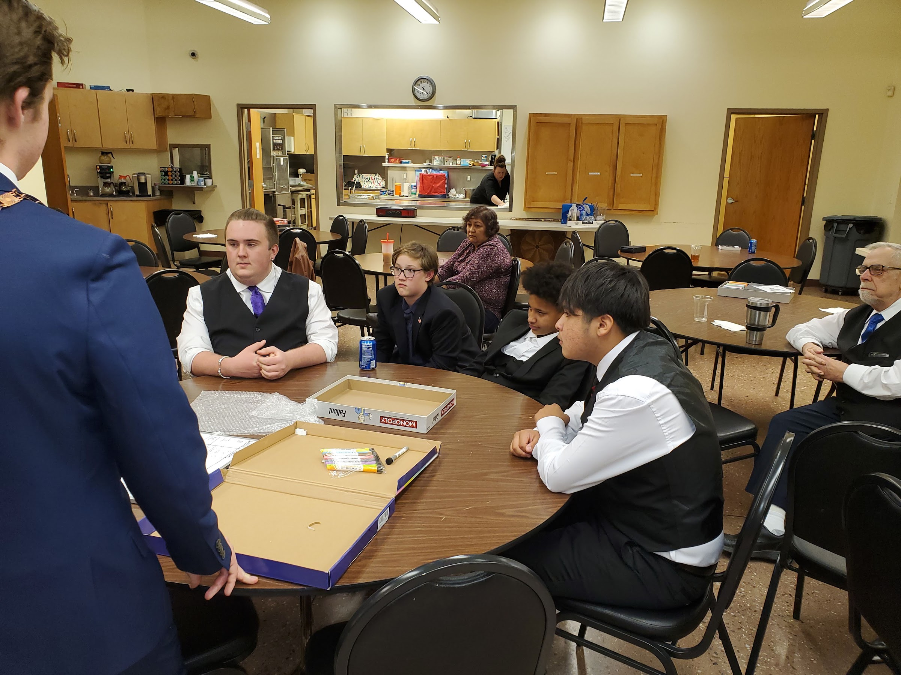
06 • JAMES WILD

Slide 13
06 • JAMES WILD • MEMORY

Slide 14
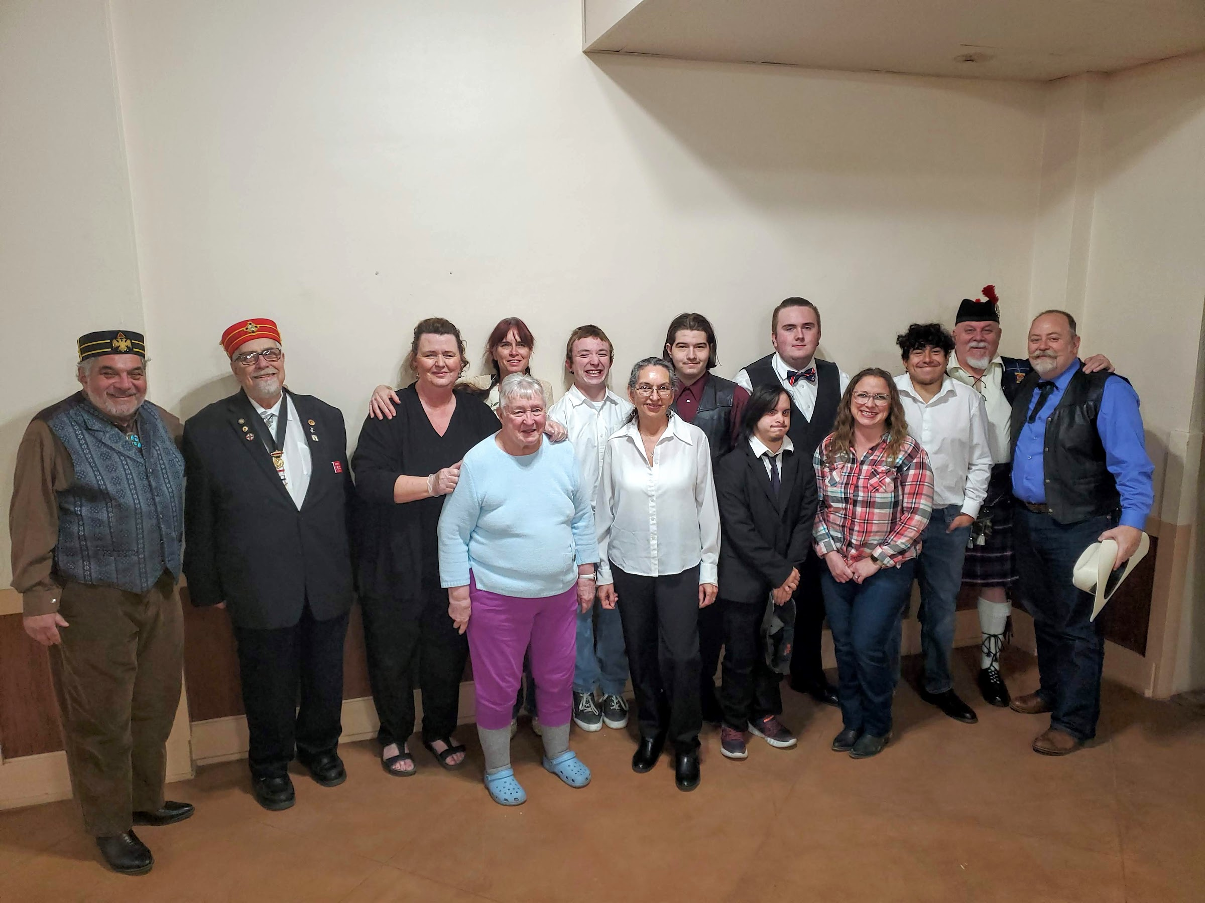
07 • JAMES WILD

Slide 15
07 • JAMES WILD • MEMORY

Slide 16
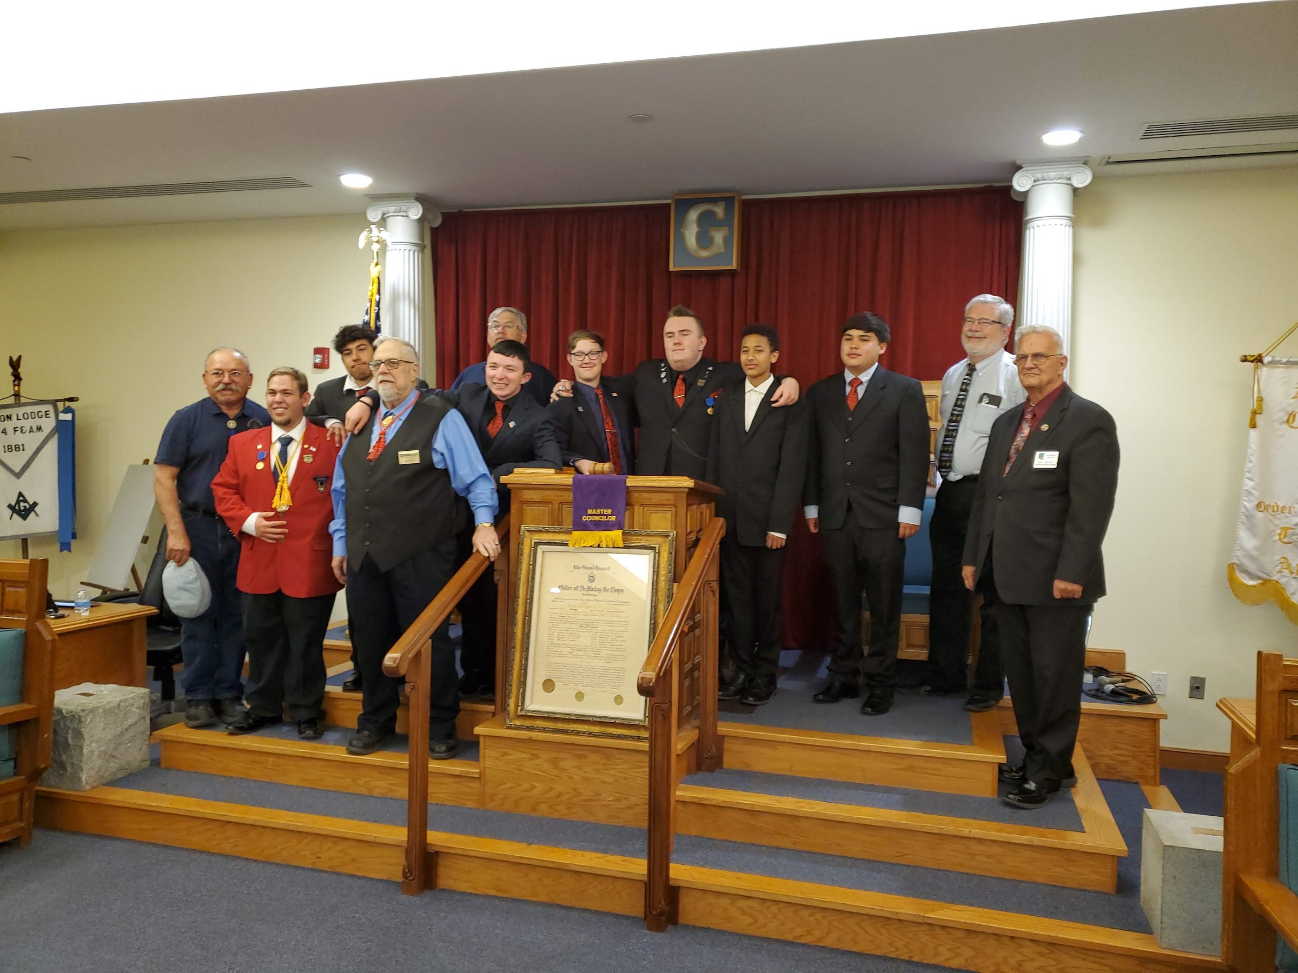
08 • JAMES WILD

Slide 17
08 • JAMES WILD • MEMORY

Slide 18
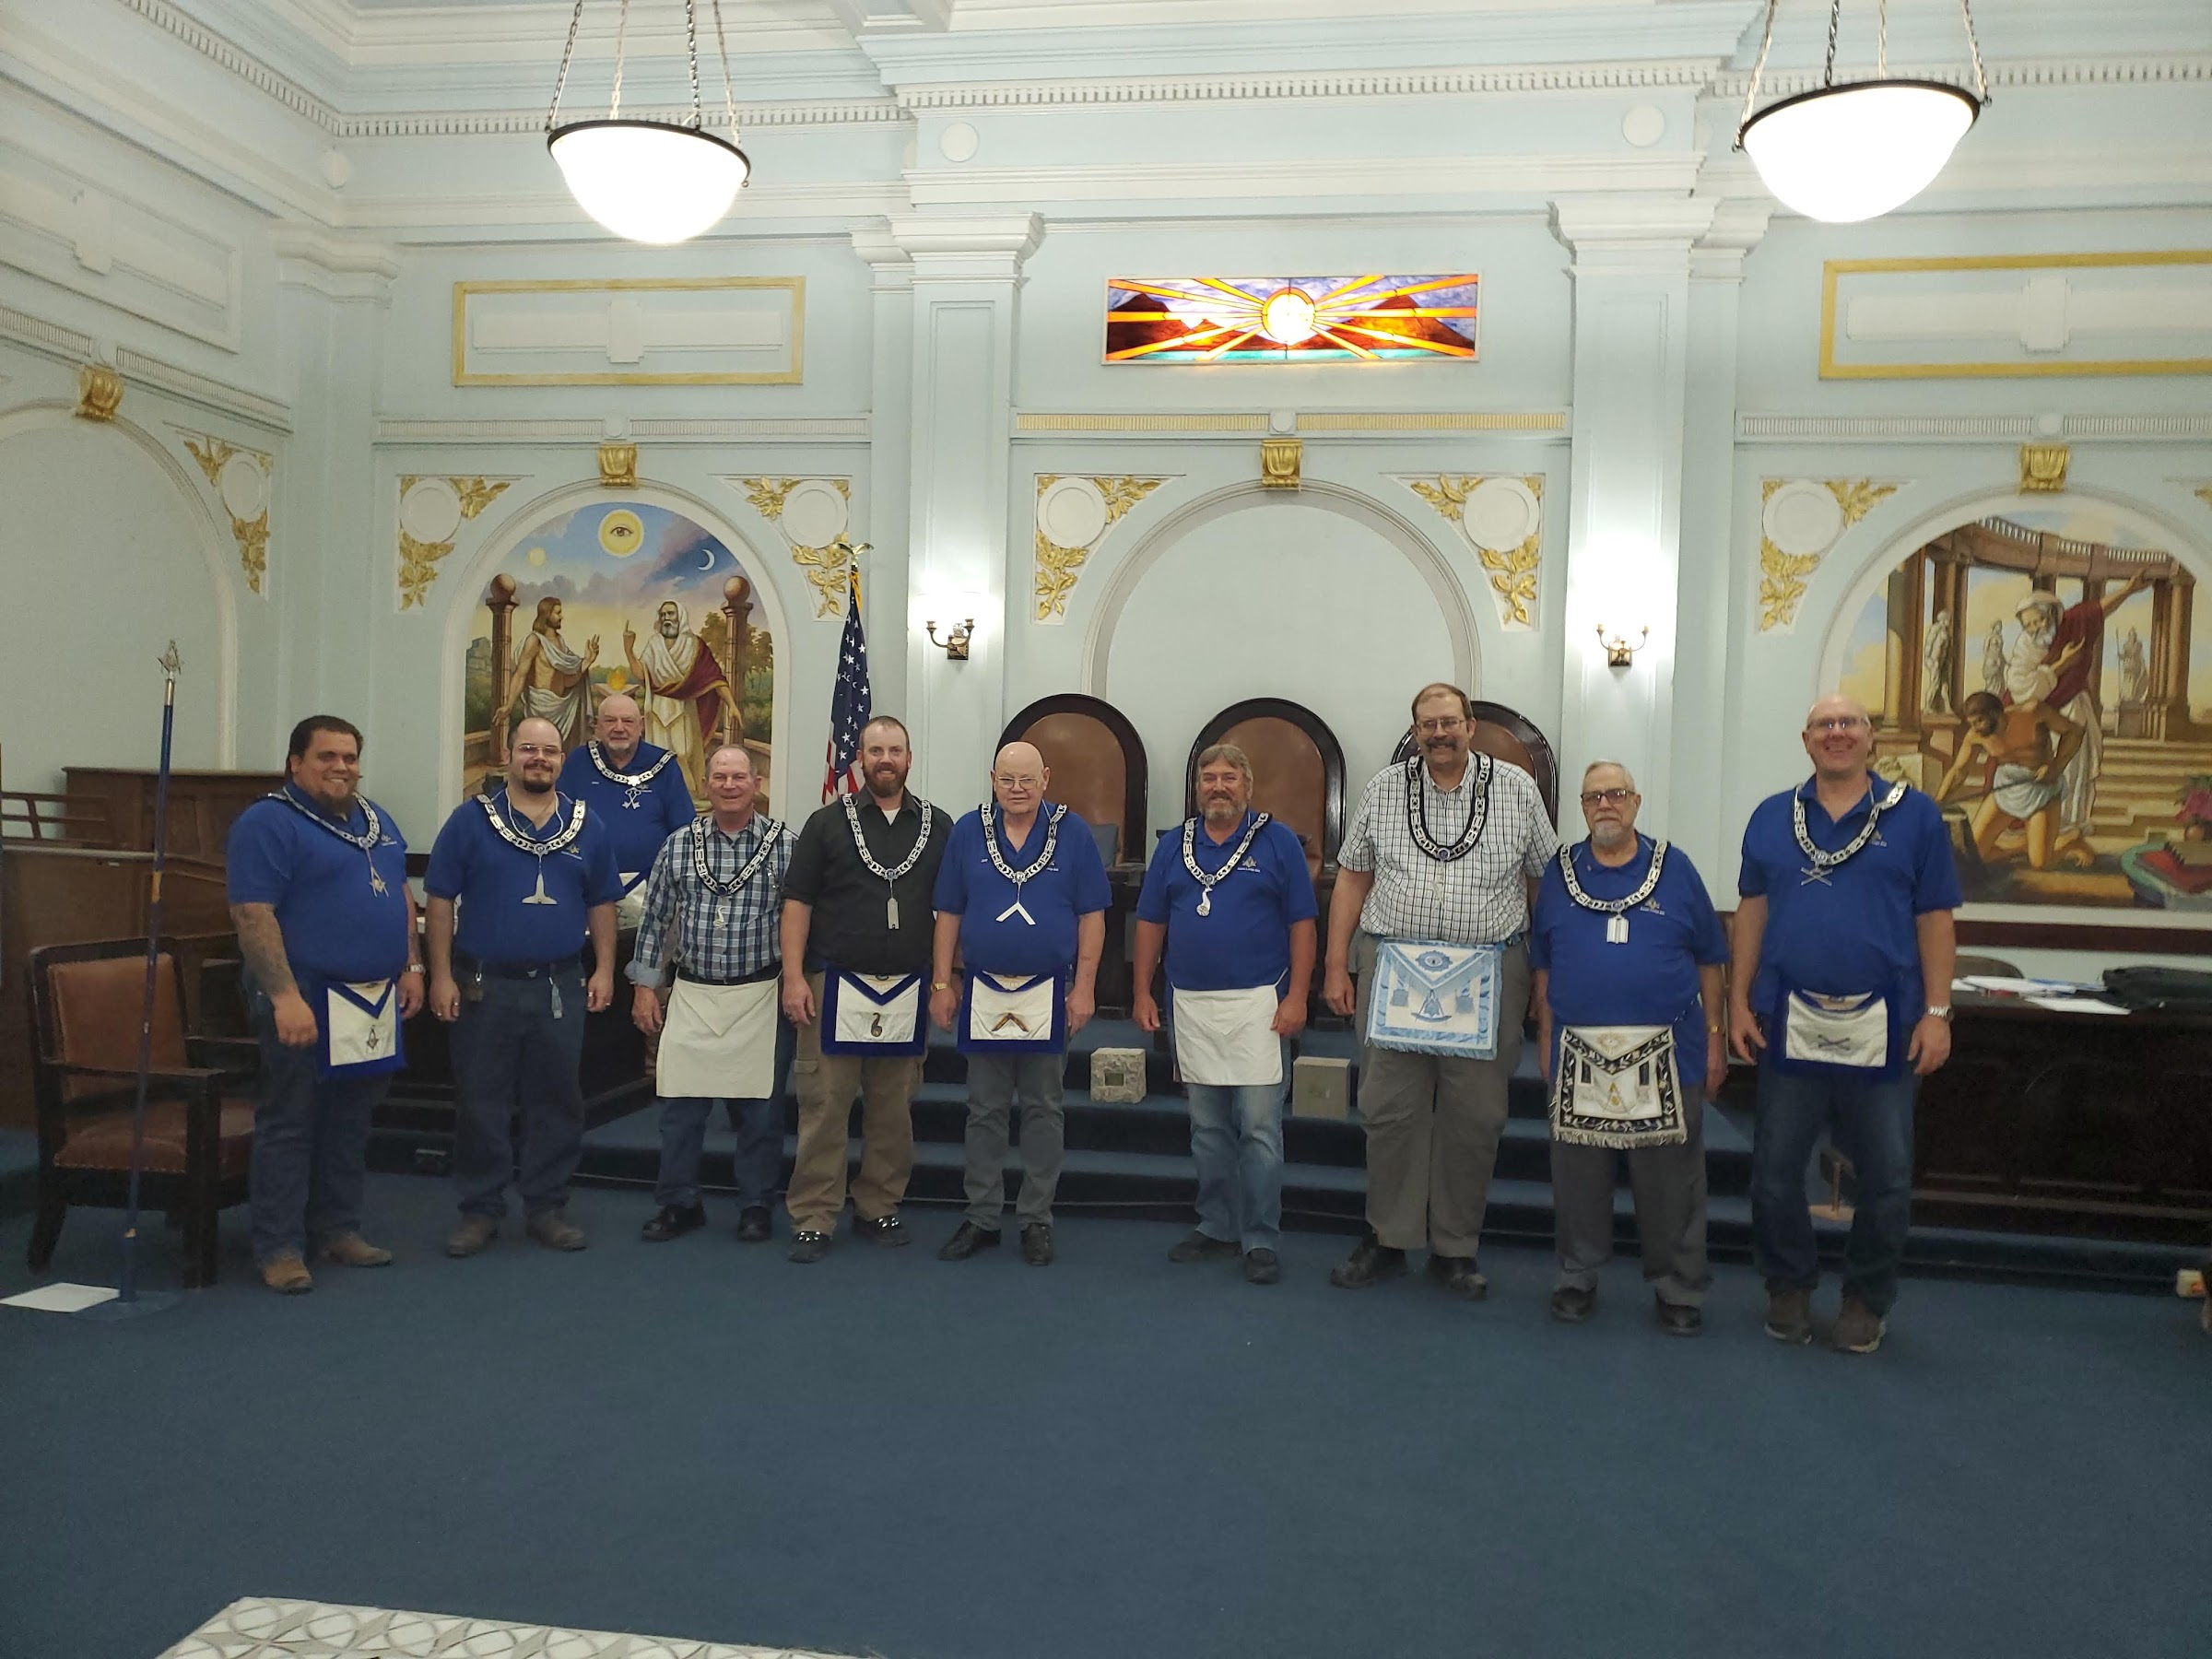
09 • JAMES WILD

Slide 19
09 • JAMES WILD • MEMORY

Slide 20
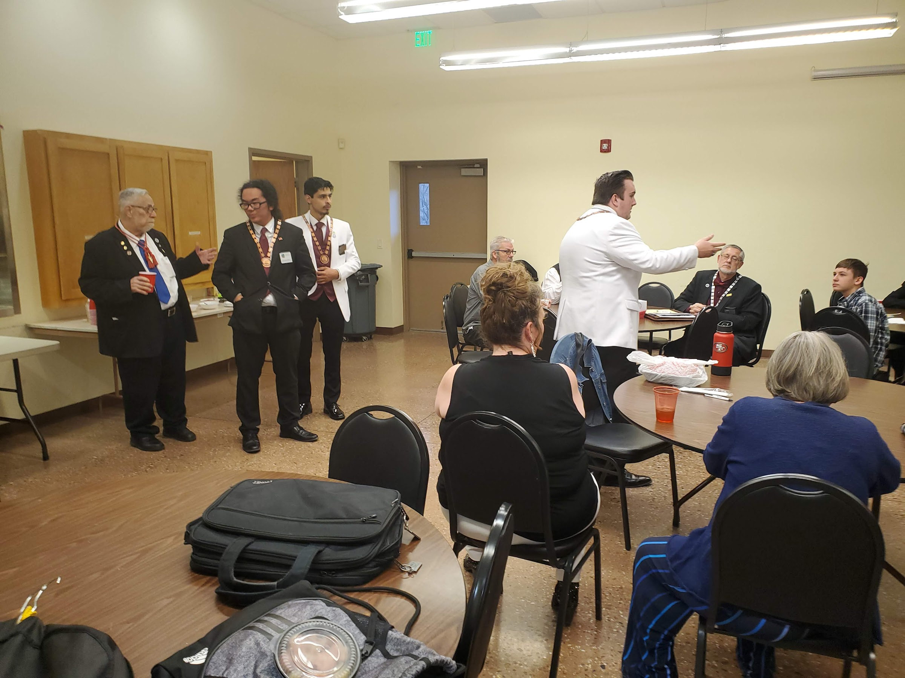
10 • JAMES WILD

Slide 21
10 • JAMES WILD • MEMORY

Slide 22
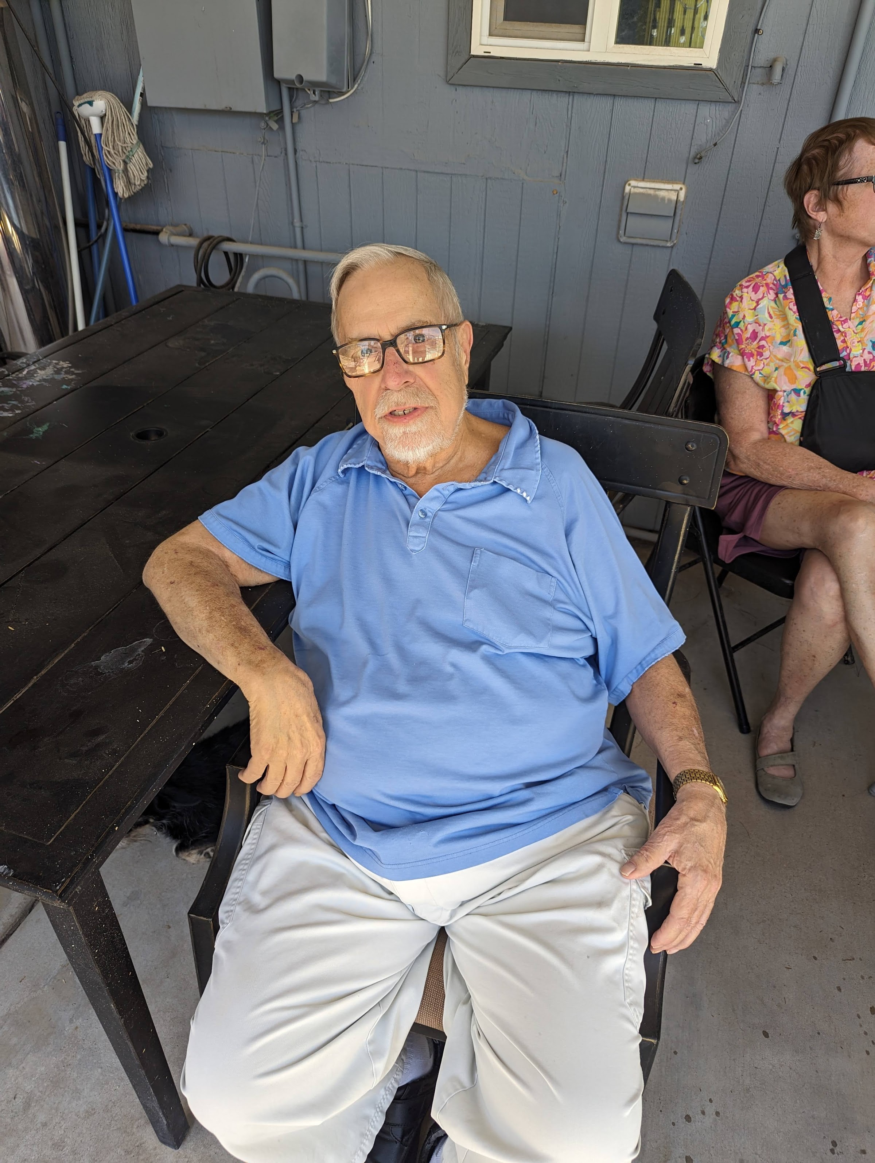
11 • JAMES WILD

Slide 23
11 • JAMES WILD • MEMORY

Slide 24
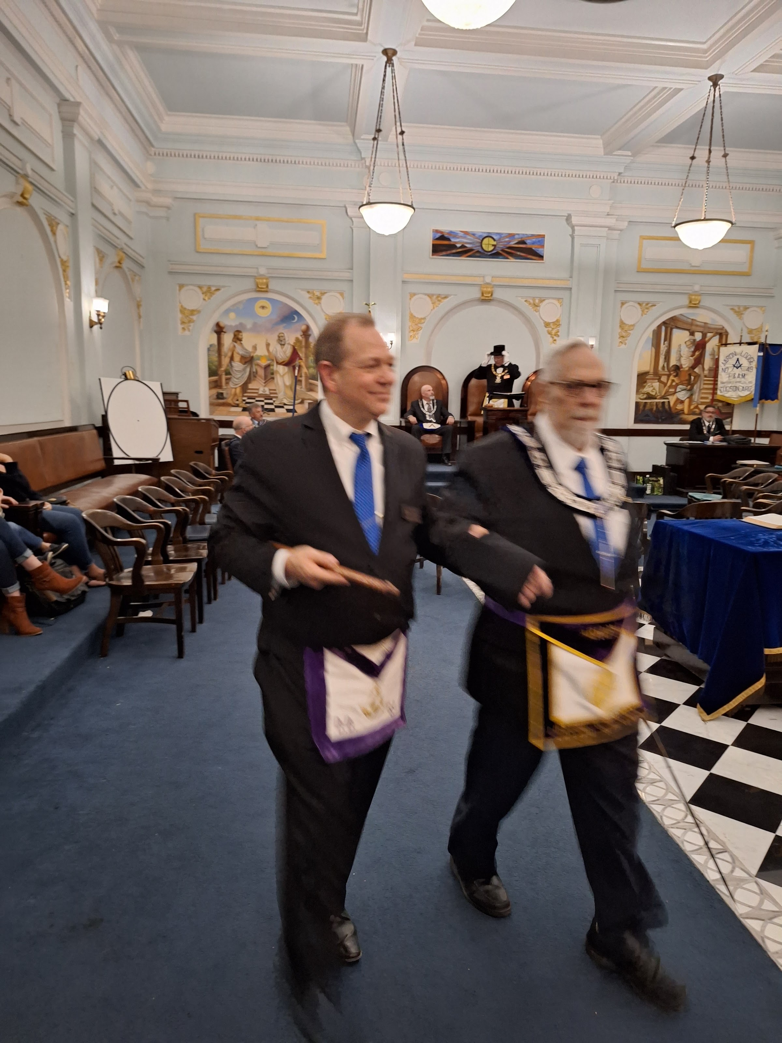
12 • JAMES WILD

Slide 25
12 • JAMES WILD • MEMORY

Slide 26
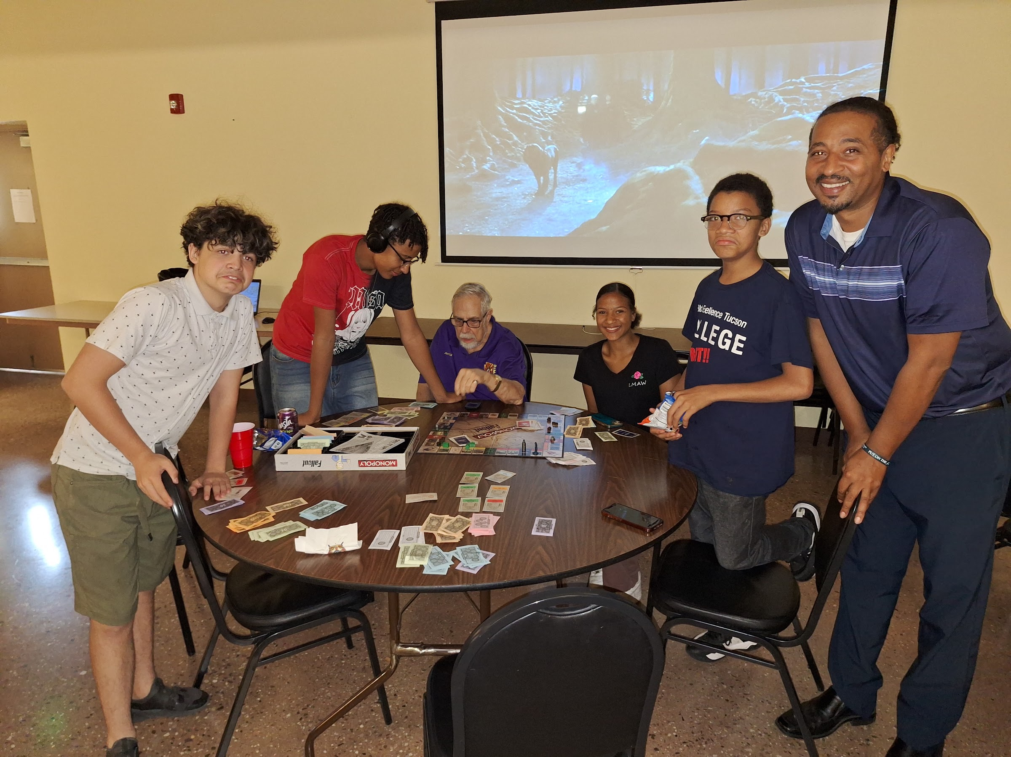
13 • JAMES WILD

Slide 27
13 • JAMES WILD • MEMORY

Slide 28
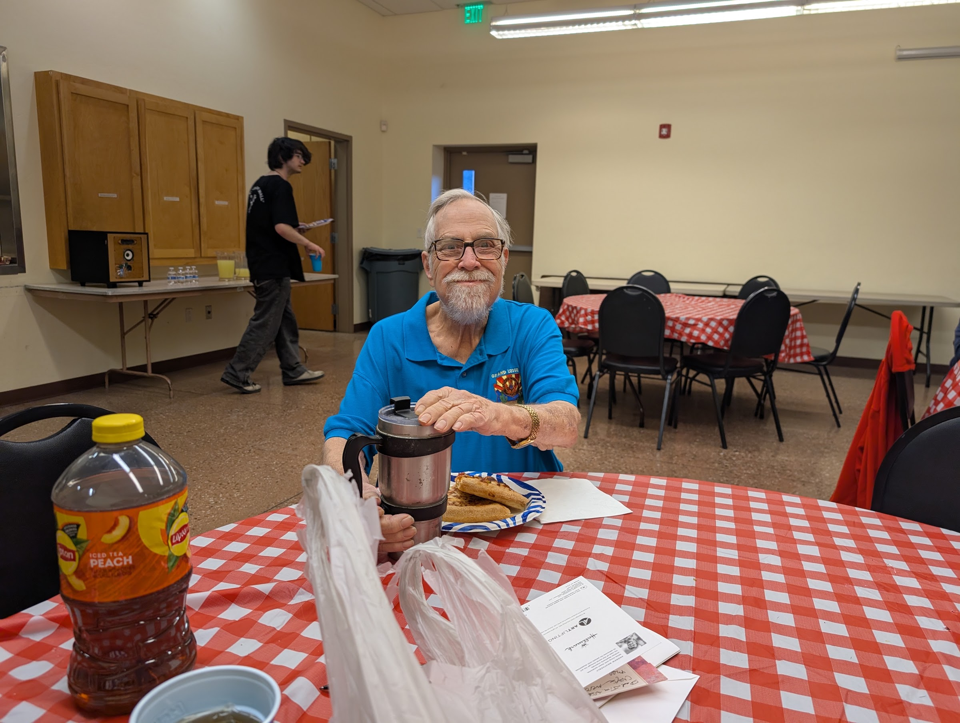
14 • JAMES WILD

Slide 29
14 • JAMES WILD • MEMORY

Slide 30
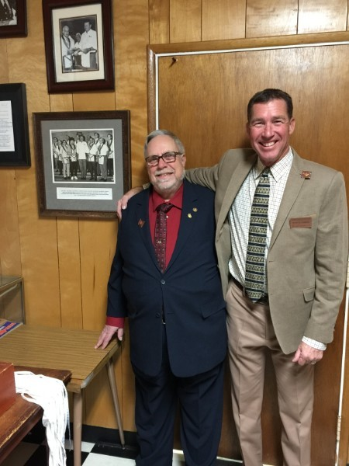
15 • JAMES WILD

Slide 31
15 • JAMES WILD • MEMORY

Slide 32
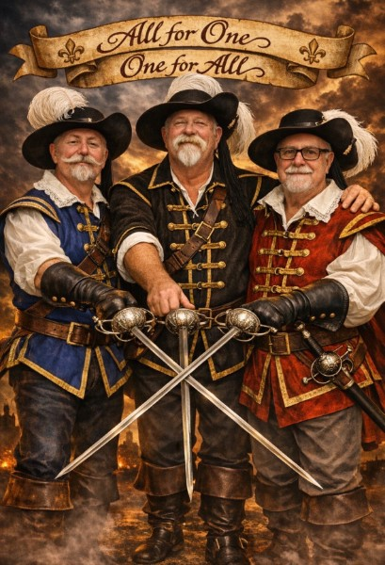
16 • JAMES WILD

Slide 33
16 • JAMES WILD • MEMORY

Slide 34
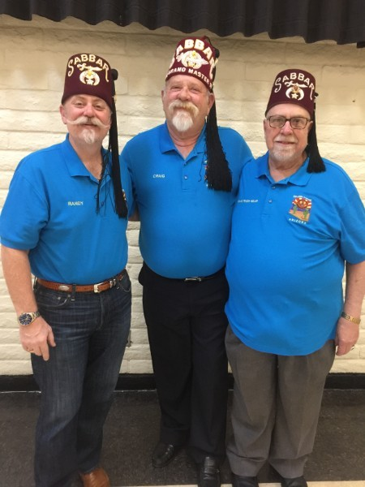
17 • JAMES WILD

Slide 35
17 • JAMES WILD • MEMORY

Slide 36
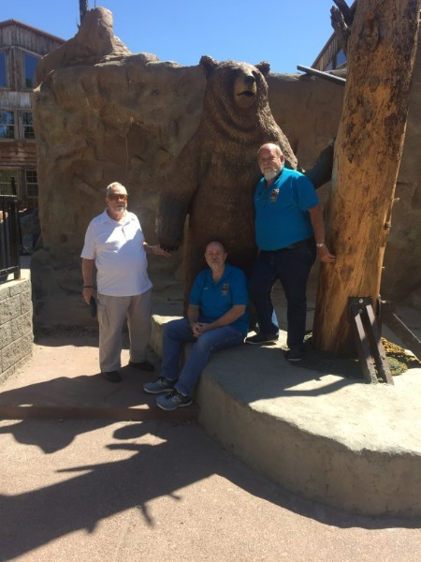
18 • JAMES WILD

Slide 37
18 • JAMES WILD • MEMORY

Slide 38
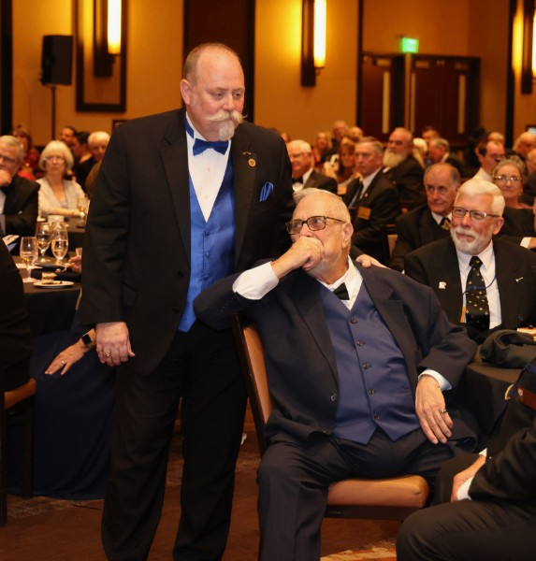
19 • JAMES WILD

Slide 39
19 • JAMES WILD • MEMORY

Slide 40
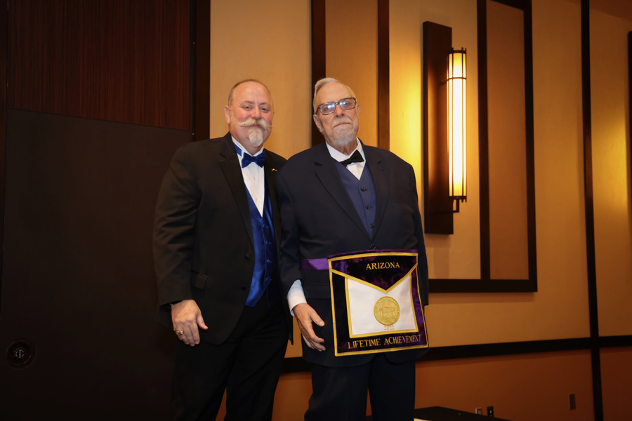
20 • JAMES WILD

Slide 41
20 • JAMES WILD • MEMORY

Slide 42
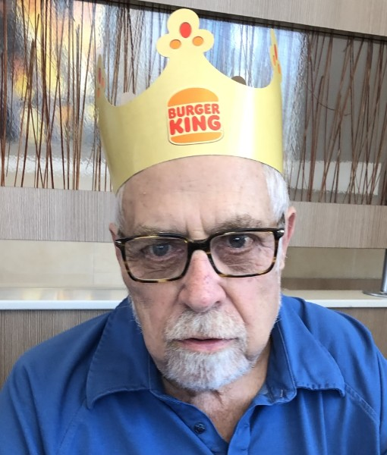
21 • JAMES WILD

Slide 43
21 • JAMES WILD • MEMORY

Slide 44
MUSIC FOR THE SERVICE
Audio files included with this presentation
1
the old rugged cross
2
amazing grace
3
nearer my god to thee
4
how great thou art
5
youll never walk alone
Use the audio files from the accompanying audio folder as the service soundtrack.

