Slide 1
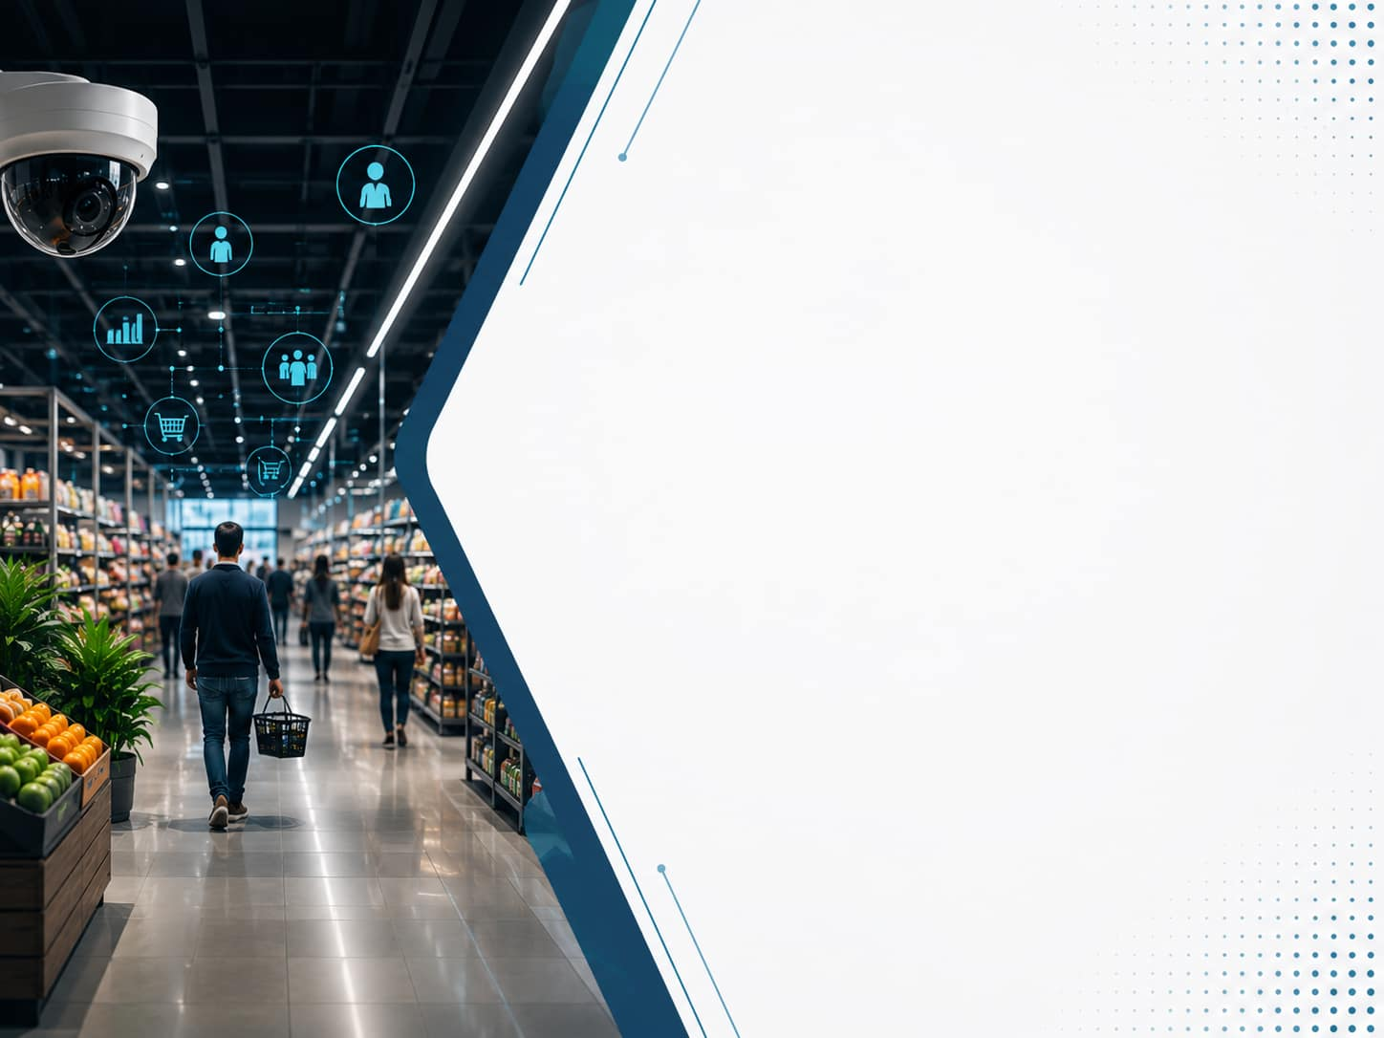
RetailVisionAI
Real-Time Intelligent Video Analytics for Retail
Transforming CCTV Footage into Actionable Business Intelligence
------------------------------------------------------------------------------------------------------ Presented by Internship Organization Naveen Gundyagol TANSAM B.Tech CSE (AI & ML) Tamil Nadu Smart and Joy University Advanced Manufacturing Centre

Slide 2
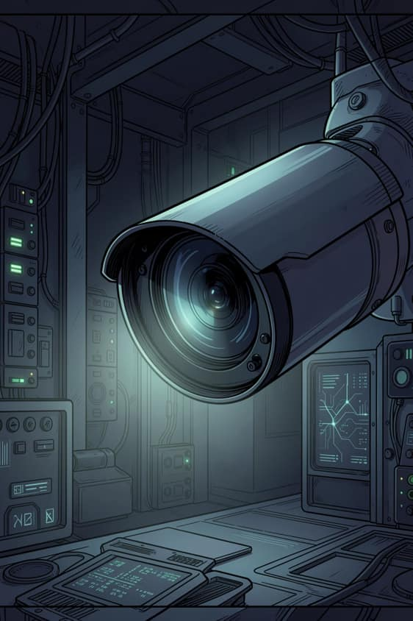
Challenges in Retail Surveillance
Traditional retail surveillance systems primarily serve security purposes, leaving valuable customer behavior and operational insights largely unexplored. Manual video analysis is time-consuming and does not provide meaningful business intelligence.
📹 CCTV footage is primarily used for security monitoring.
👥 Customer behavior is hidden.
⏱ Manual video analysis is time-consuming and inefficient.
📊 Limited insights for improving store layout and operations.
💡
Opportunity: Convert surveillance footage into actionable business insights using AI-powered customer detection, tracking, and analytics.

Slide 3
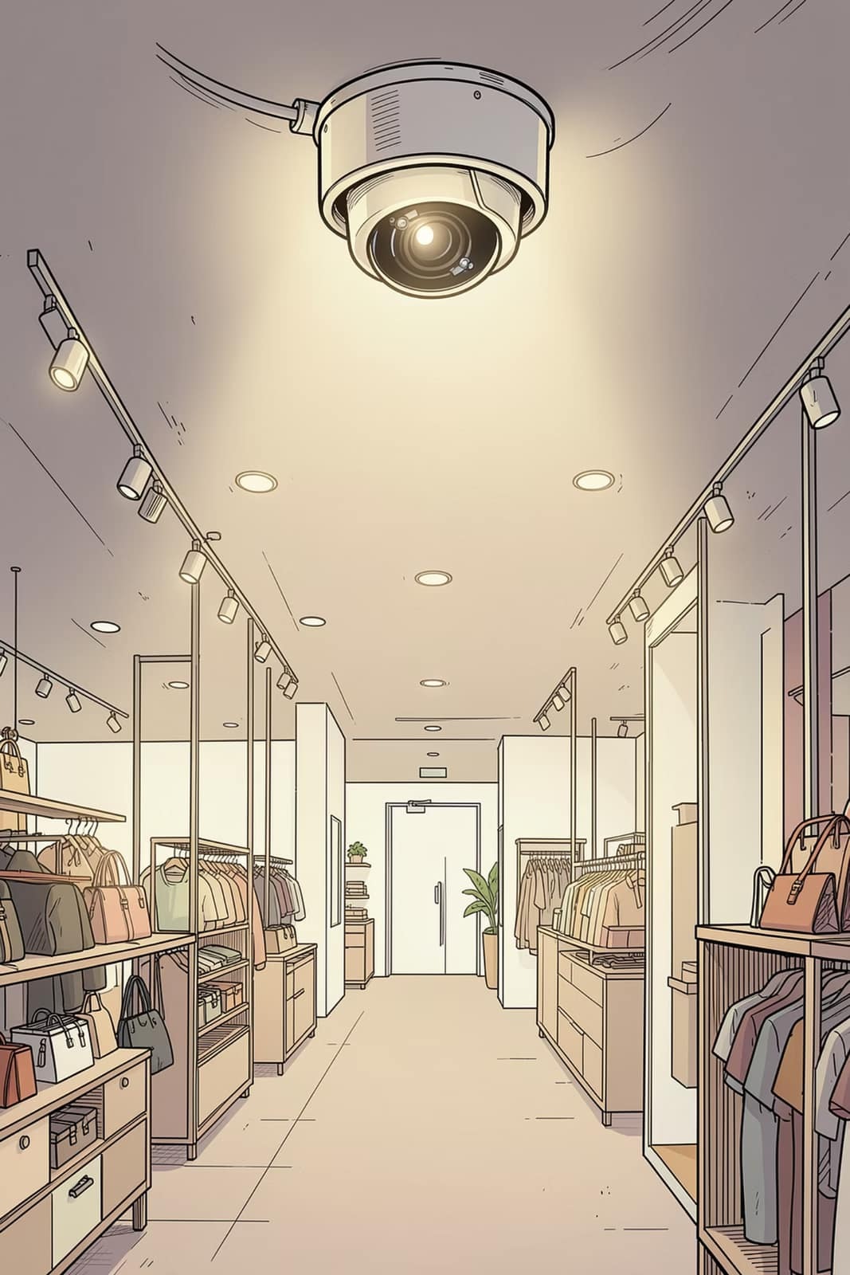
Project Objectives
Customer Detection :
Detect customers in retail surveillance using YOLOv8.
Multi-Object Tracking :
Track customer across video frames using DeepSORT.
Retail Analytics :
Generate customer counts, dwell time and heatmaps.
Interactive Dashboard :
Visualize insights using Streamlit dashboard.

Slide 4
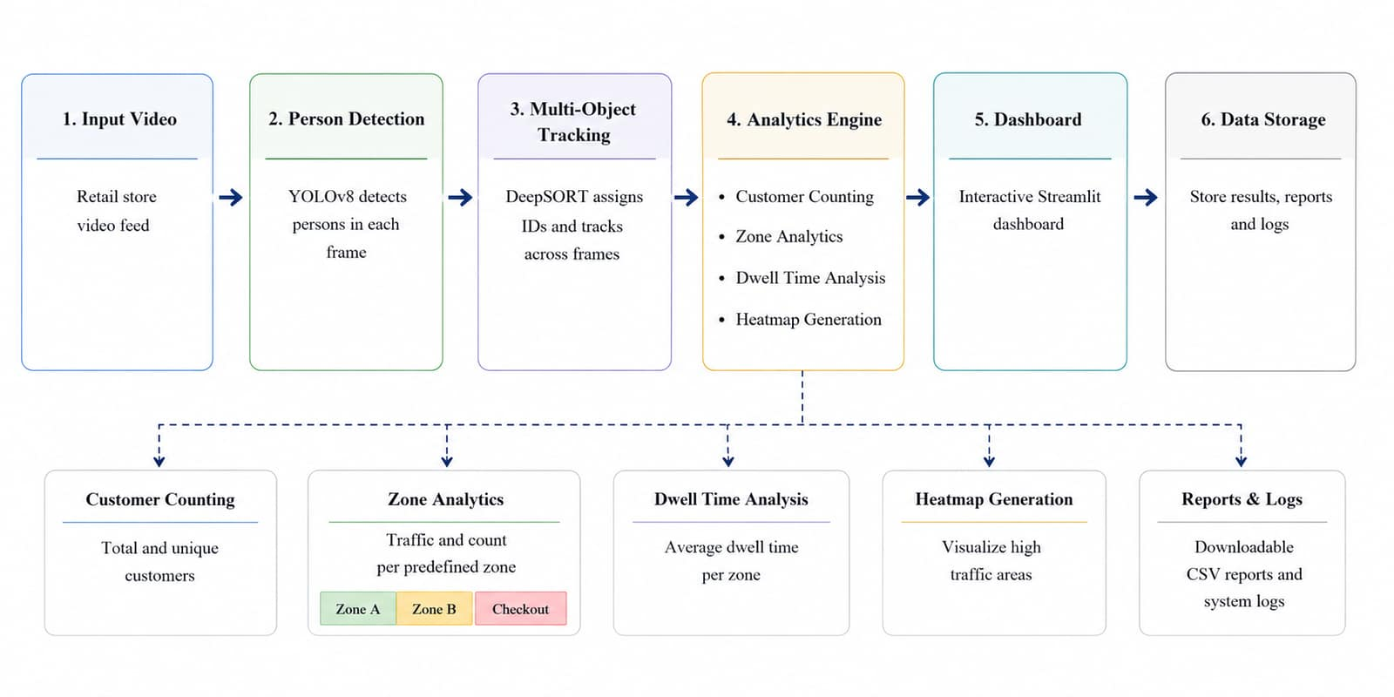
System Architecture

Slide 5
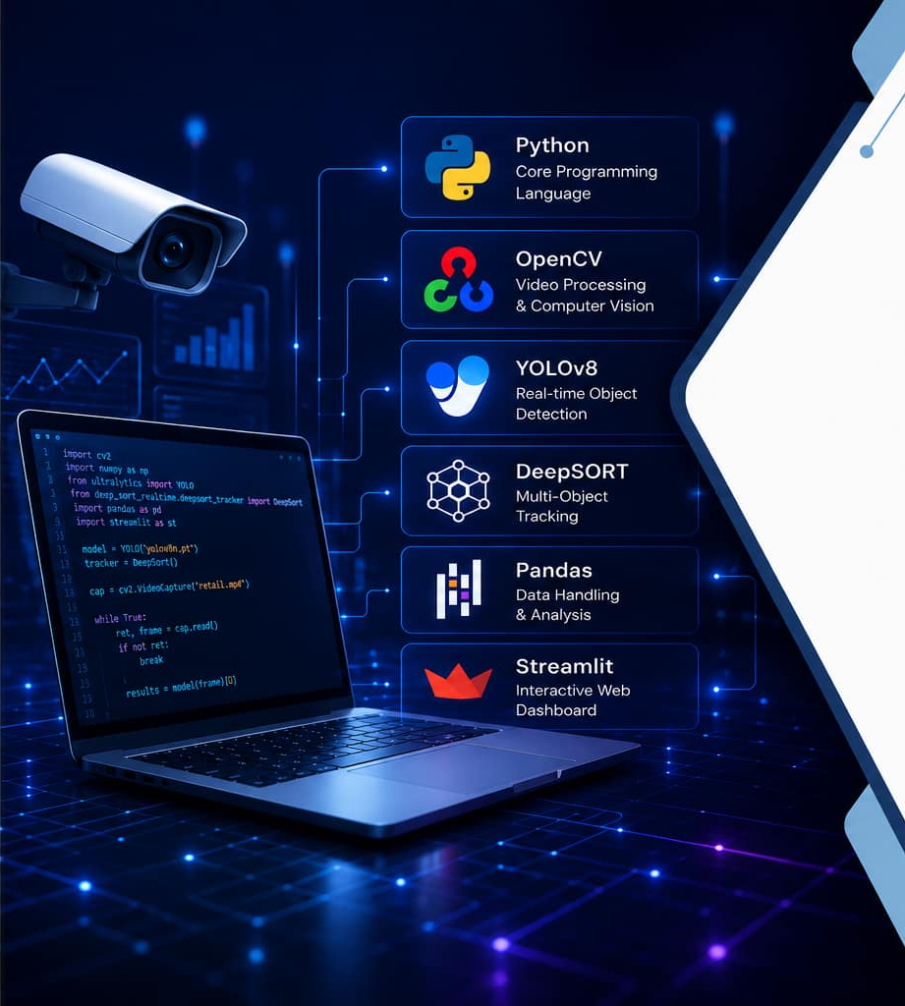
Technology Stack
Python
Core Programming Language.
Pandas (Analytics and CSV Reports)
OpenCV
Video Processing.
YOLOv8
DeepSORT
Person Detection
Multi-Object Tracking.
Streamlit
Interactive Dashboard

Slide 6
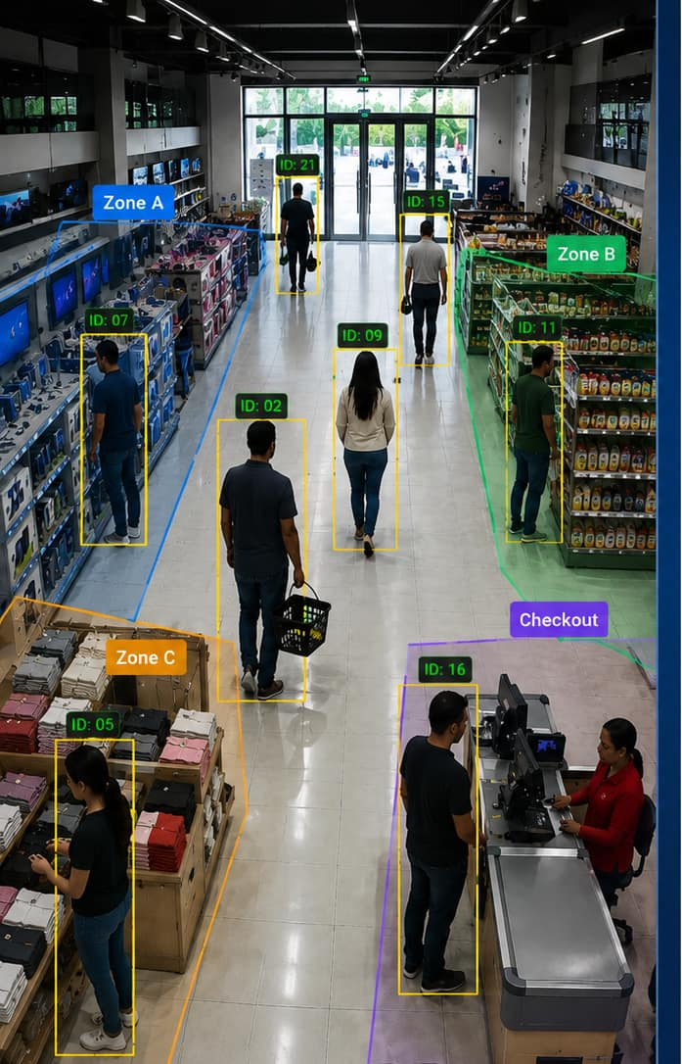
Project Demonstration
RetailVisionAI processes retail surveillance footage to detect customers, monitor their movement, and generate actionable retail analytics in real time.
👥 Customer Detection
📍 Zone-Based Analytics
Customers are detected using YOLOv8 and assigned unique IDs with DeepSORT to ensure continuous tracking throughout the video.
The system monitors customer movement across predefined store zones to calculate customer count, zone visits, and dwell time.
📊 Analytics & Visualization
Tracking data is transformed into heatmaps, CSV reports and
an interactive Streamlit dashboard for retail analysis.

Slide 7
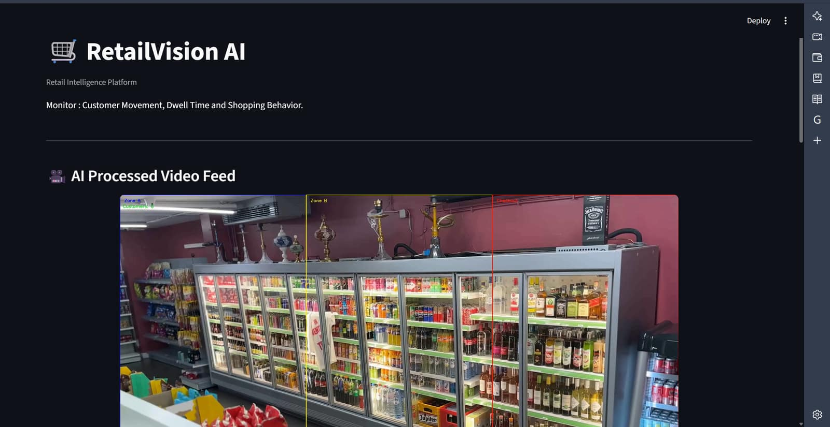
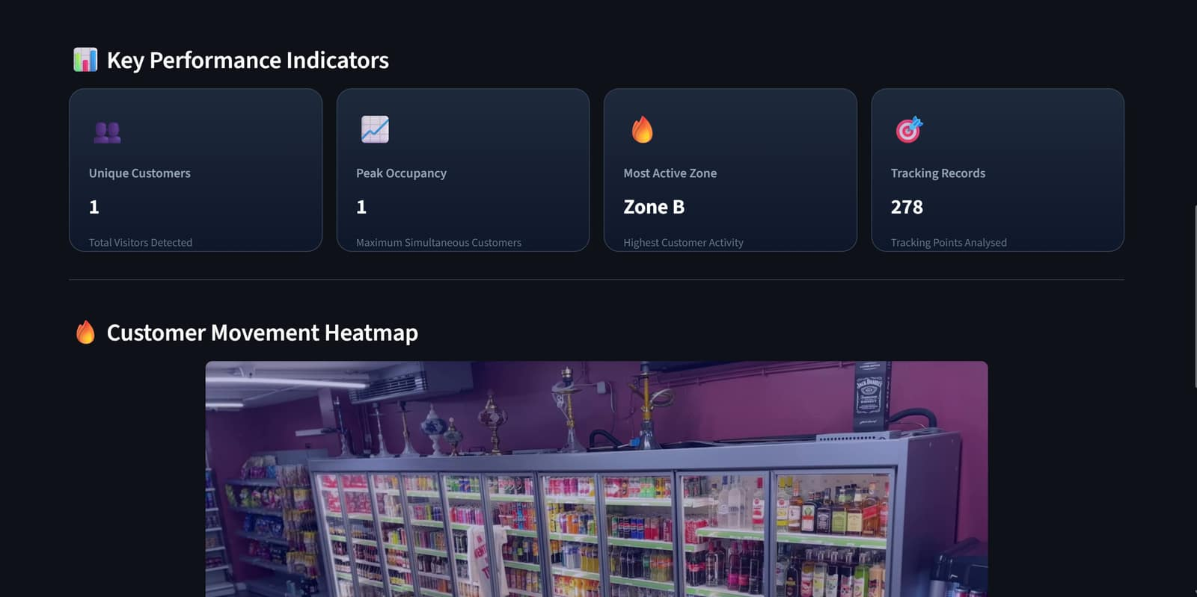
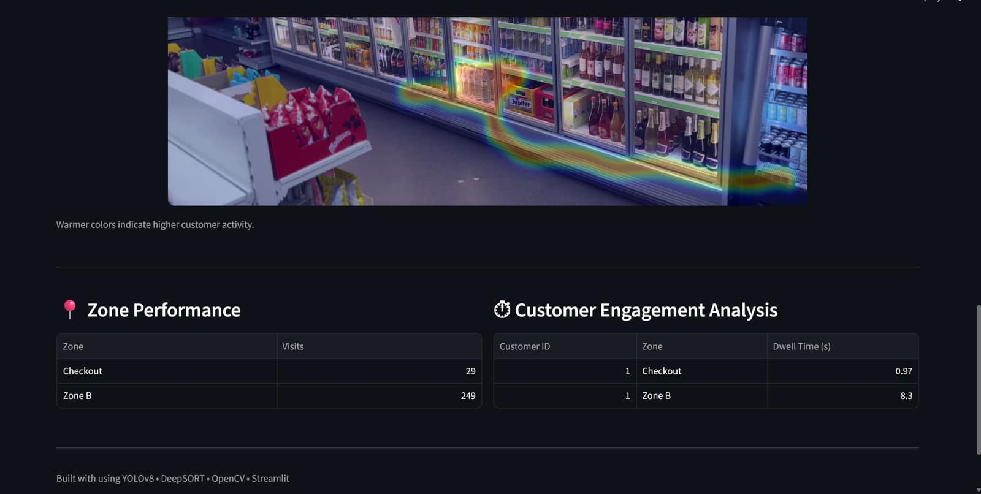
Interactive Dashboard
RetailVisionAI presents analytics through an interactive Streamlit dashboard enabling easy monitoring of customer activity and store performance.
RetailVisionAI presents analytics through an interactive Streamlit dashboard enabling easy monitoring of customer activity and store performance.

Slide 8
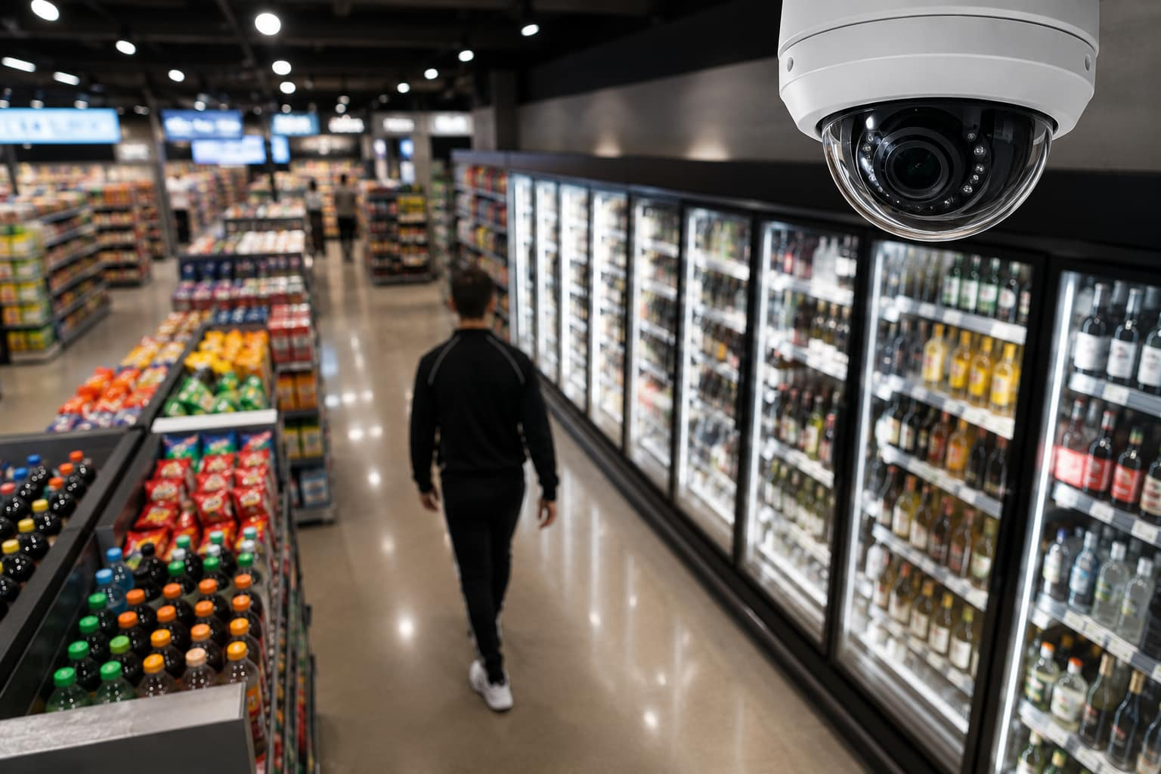

Conclusion
RetailVisionAI demonstrates how computer vision can transform conventional retail surveillance into a valuable analytics tool. By integrating customer detection, object tracking, and zone-based analysis, the system provides meaningful insights into customer behavior through an interactive dashboard.
Key Achievements :
✅ Real-time customer detection using YOLOv8
✅ Multi-object tracking using DeepSORT
✅ Zone-based customer analytics and dwell time
✅ Heatmap generation and CSV reports
✅ Interactive Streamlit dashboard
Provides a scalable foundation for AI-driven retail analytics, enabling data-informed decisions for store management and customer experience optimization.

Slide 9
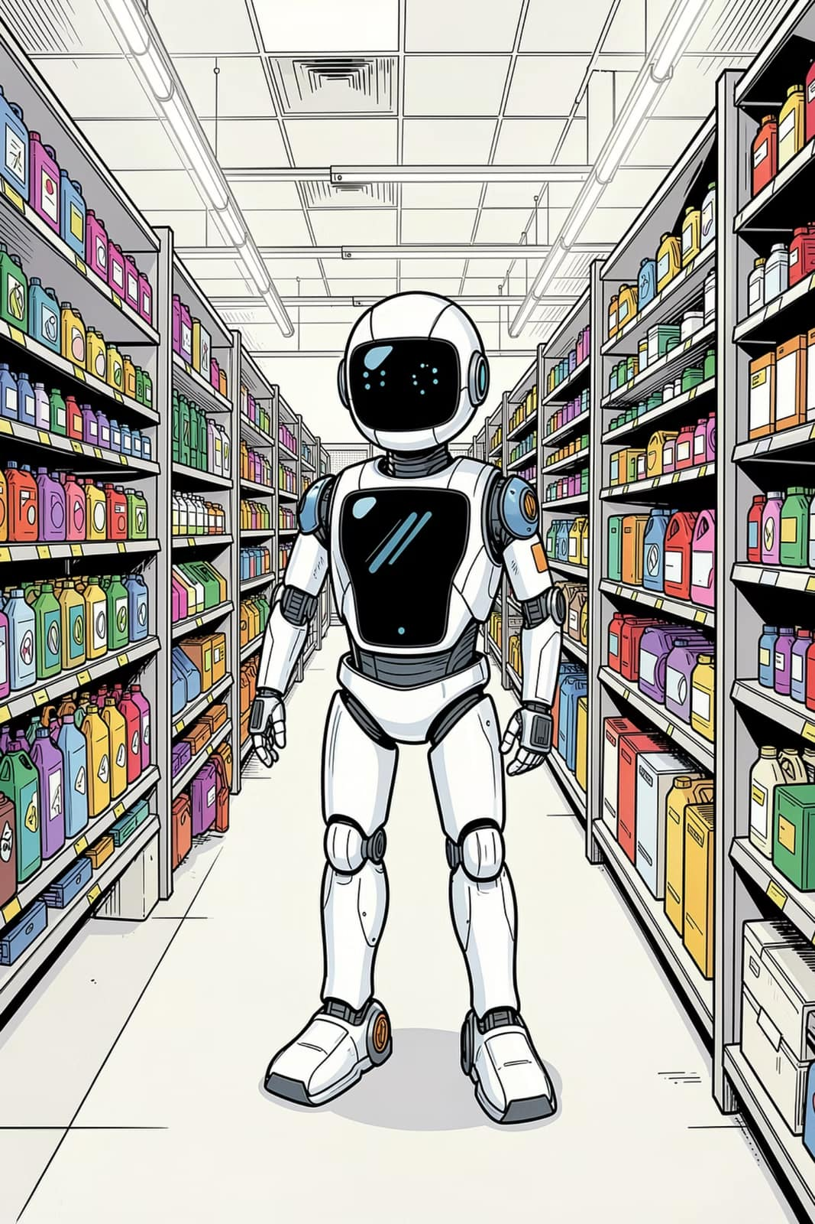
Future Scope
AI-Based Customer Behavior Analysis
Leverage AI to analyze shopping patterns, customer engagement and purchasing behavior for deeper retail insights.
Predictive Analytics
Forecast customer traffic, peak shopping hours and store occupancy using historical analytics data.
Multi-Camera Integration
Connect multiple surveillance cameras to provide seamless customer tracking across the entire retail store.
Enhanced Privacy and Security
F Implement privacy-preserving analytics, secure data storage and role-based access for retail surveillance systems.

Slide 10

Thank You!
RETAILVISIONAI

